Slide 1
Welcome
To My English Class

Slide 2
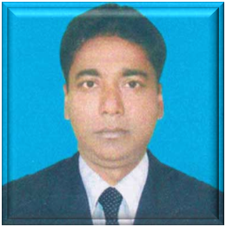
Identity
Azimnagor Com.K.
School & Coll.(voc)
English for Today
Class-Ten
Time- 45 mins
Md. Monirul Islam
Assistant Teacher
E-mail-monir19077@gmail.com
01761714820

Slide 3
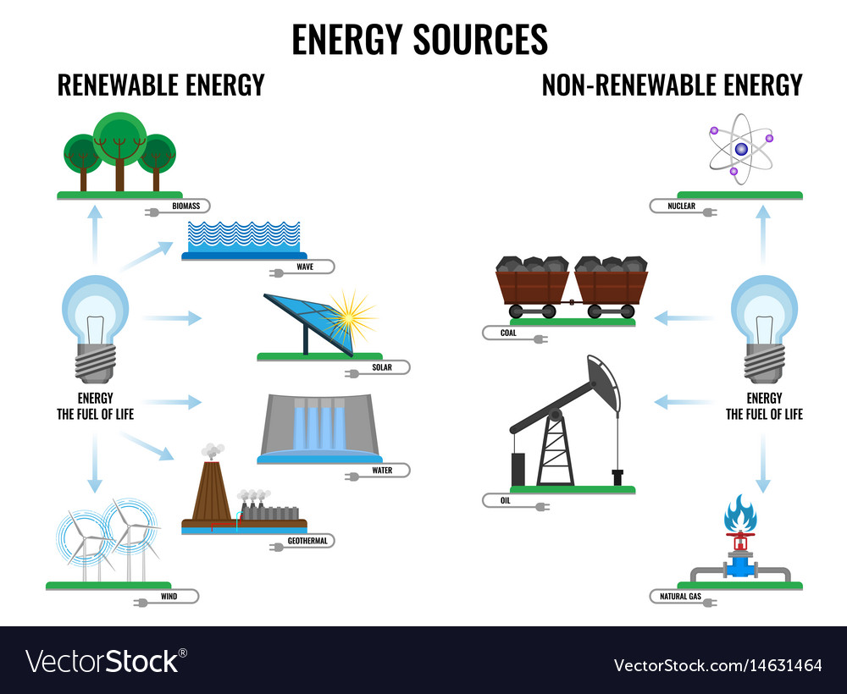
Look and think about these pictures.
What do you see in these pictures?

Slide 4
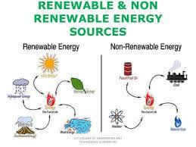
Look and think about some another pictures.
What do you see in these pictures?

Slide 5
Renewable energy sources-3
Unit No-Eleven.
Lesson –Three.`
Today’s Topic is...

Slide 6
Learning outcomes:
After we have studied the lesson we will be able to-
infer the word meaning from the text ;
ask and answer questions ;
read intensively and extensively;
write incidents .

Slide 7
My dear students, now , we will share our ideas about some difficult vocabulary to understand the lesson clearly.

Slide 8
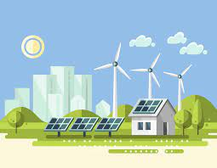
Renewable
Capable of being renewed.
Global
Relating to the whole world.

Slide 9
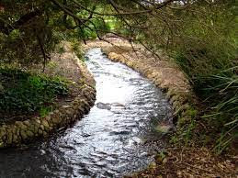
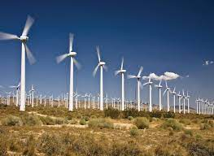
Stream
A continuous flow of liquid
Turbine
An engine that has a part with blades that are caused to spin by pressure from water, steam or air.

Slide 10
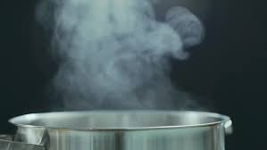
Vapour
A liquid substance diffused in the air.

Slide 11
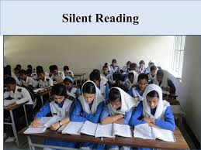
Dear students,
Now read the story carefully.
Unit No- Eleven
Lesson No- Three
Renewable energy
sources-3

Slide 12
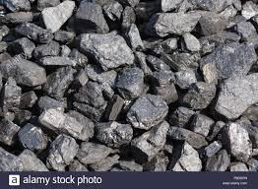
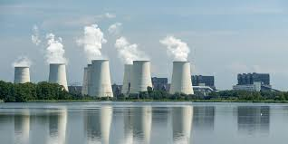
Non renewable Energy.
Hydro –carbon or fossil fuels are non renewable sources of energy.
Oil
Coal
Gas
Nuclear
Reliance on them poses real big problems.

Slide 13
Advantages and disadvantages of non renewable energy.
Advantages | Disadvantages
Ready-made fuel. It is relatively cheap to mine to convert and to extract into energy. A small amount of radio active material produces a lot of energy. Can last quite a long time. Doesn’t give off atmospheric pollutants. | Fossil fuels are finite energy resources and the world eventually will run out of them. They will become too expensive in the coming decades and too damaging for the environment . Fossil fuels have direct polluting impact on earth’s environment causing global warming.

Slide 14
SOURCES.

Slide 15
Advantages of renewable energy.
Most renewable energy comes either directly or indirectly from the sun.
Renewable energy sources which are constantly and naturally replenished and never run out.
Renewable energy sources are infinite.
Renewable energy sources provide us with energy which doesn’t harm environment during its production or consumption. There’s no burning no smoke, no emission of gases.

Slide 16
Individual work
What is solar energy ?
What do you mean by renewable energy sources ?

Slide 17
Pair work
What are the major differences between renewable and non-renewable energy sources ?

Slide 18
Evaluation
What is wind energy ?
What’s hydroelectricity ?
Why is it called green energy ?

Slide 19
Grammar Focus.
Adjective এর শেষে ly যোগ করে পদ্ধতিসূচক Adverb তৈরি করা যায় , যেমন:
Adjective | Adverb
Clear | Clearly
Soft | Softly
Polite | politely
আবার কিছু গুরুত্বপুর্ন Adverb যেমন: very , so, fast, too ইত্যাদি adverb সমুহ Adjective বা অন্য কোন Adverb এমনকি কখনও কখনও verb কেও qualify করে, যেমন-
He si very honest.
He touched me softly.

Slide 20
Your Knowledge
Rely অর্থ নির্ভর করা, এটি Verb, এর Noun হচ্ছে Reliance যার অর্থ নির্ভরশীলতা.
Run out অর্থ ফুরিয়ে যাওয়া. এটি Phrase.
‘Depth’ অর্থ গভীরতা, এটি noun , এর Adjective হচ্ছে Deep, যার অর্থ গভীর

Slide 21
Home work
Write a summary about renewable energy sources.

Slide 22
N
A
K
S
H
ALLAH HAFEZ
T

