Slide 1
WELCOME
TO
Multimedia Class

Slide 2
IDENTITY
Faiz Ahmed
Lecturer in English
Bakila Fazil Degree Madrasha
Hajiganj, Chandpur.
Class : XI
Sub : English
Chapter :Unit5,Lesson2

Slide 3
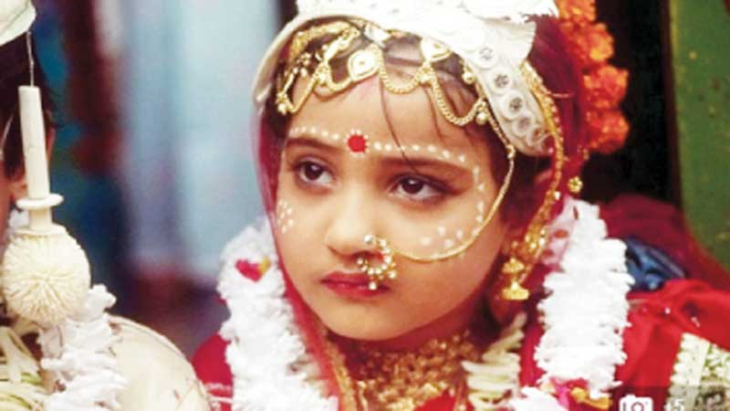
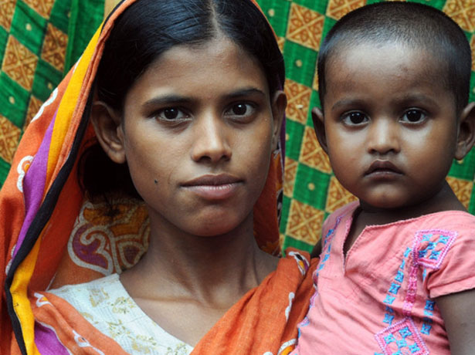
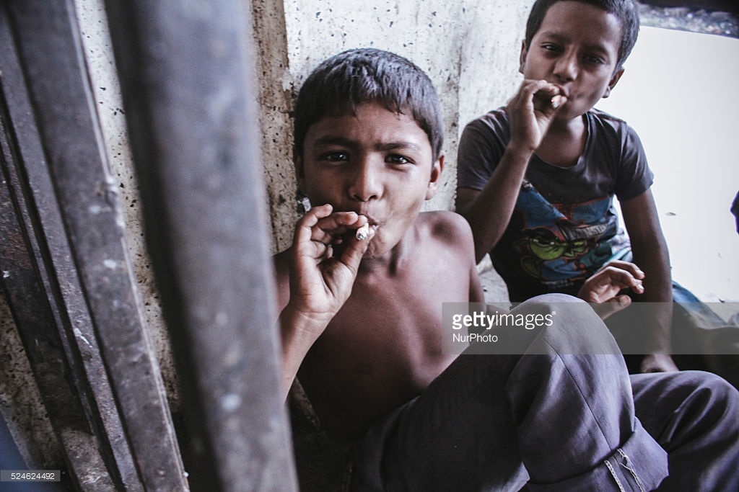
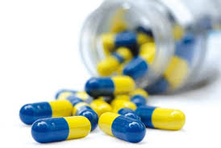

Slide 4
What does each of these photographs show?
B.Why should all of us say ‘No’ to habit-forming drugs of every kind?

Slide 5
Adolescence and Some (Related) Problems in Bangladesh

Slide 6
Learning Outcome
After completing this session Students will....
Learn New words and there meaning;
Easily identify the bad effects of early marriage;
Explain the bad effects of drugs on society;
Know the legal age of marriage.

Slide 7
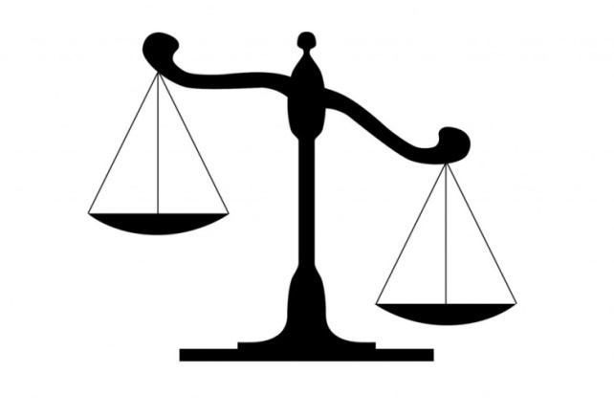
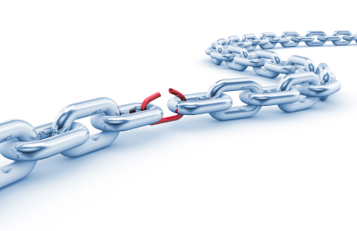
Vocabulary
Unparallel,
Lack of balance, Injustice
Inequality
Vulnerable
Unsafe
Barbarity,
Brutality
Violence

Slide 8
Adolescents constitute a nations core resource for national renewal and growth. Adolescence is a period in life when transition from childhood to adulthood takes place and behaviors and life styles are shaped. According to the World Health Organization (WHO), adolescence is the period which shapes the future of girls and boys lives. There are 28 million adolescents in Bangladesh; 13.7 million of them are girls and 14.3 million boys.

Slide 9
Individual Task
1.What is adolescence?
2.How many adolescents are in Bangladesh?
13.7 million
28 million
14.3 million

Slide 10
In Bangladesh, the legal age of marriage is 18 for girls and 21 for boys. However, 33 percent of adolescent girls are married before the age of 15 and 60 percent become mothers by the age of 19. Research finds that adolescents with higher level of education and from more affluent families tend to marry at a later age. When adolescent girls are pulled out of school, either for marriage or work, they often lose their mobility, their friends and social status.
While the situation for adolescent boys is somewhat better, many are vulnerable and lack the power to make decisions about their own lives. Many boys who are unable to go to school, or are unemployed, remain unaware of social or health issues. They are at considerable risk of being drawn into criminal activities. They are also more likely to get exposed to drugs and alcohol.

Slide 11
Group Work
What is the bad effects of early marriage?
Who have the considerable risk in taking drugs? why?

Slide 12
Evaluation
What is the meaning of VIOLENCE?
Is early marriage safe ?
Tell me three bad effects of taking drugs.
What is the legal age of marriage in Bangladesh?

Slide 13
Home Work
Write a paragraph on The bad effects of early marriage .

Slide 14
Thank
you
all

