Slide 1
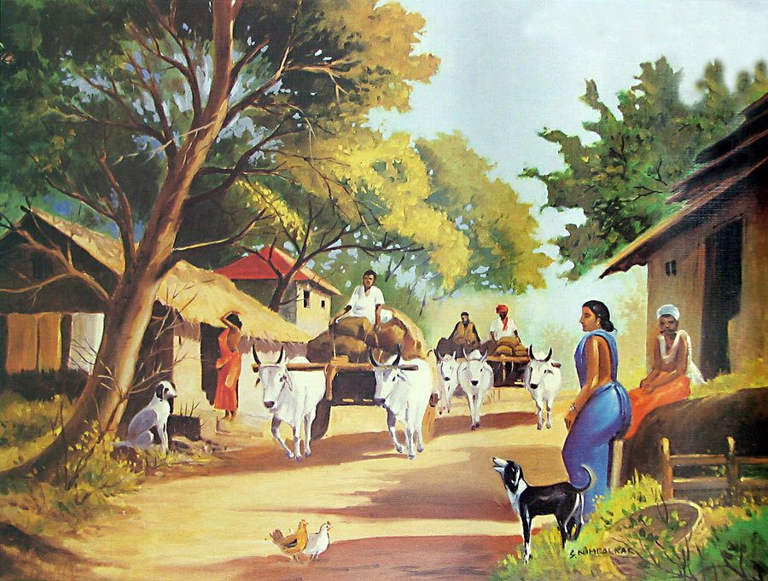
WELCOME TO MY ENGLISH CLASS

Slide 2
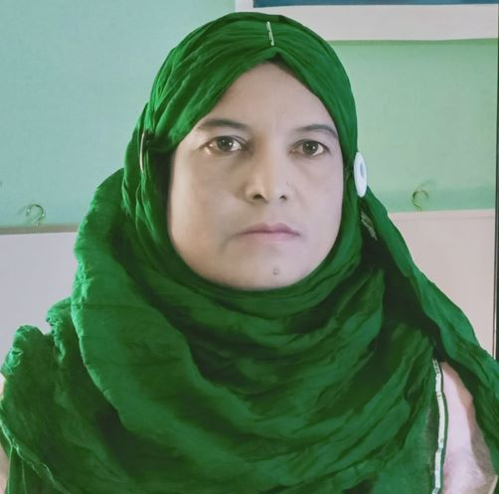
Mst. Hosneara Parvin
Head Teacher
Sholotaka Gps
Gangni, Meherpur.
Class: One
Sub: English
Time: 40 min.

Slide 3
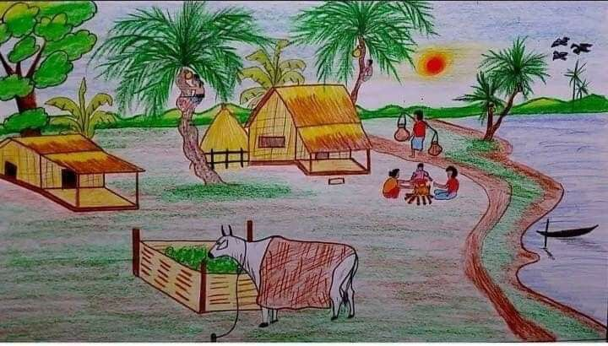
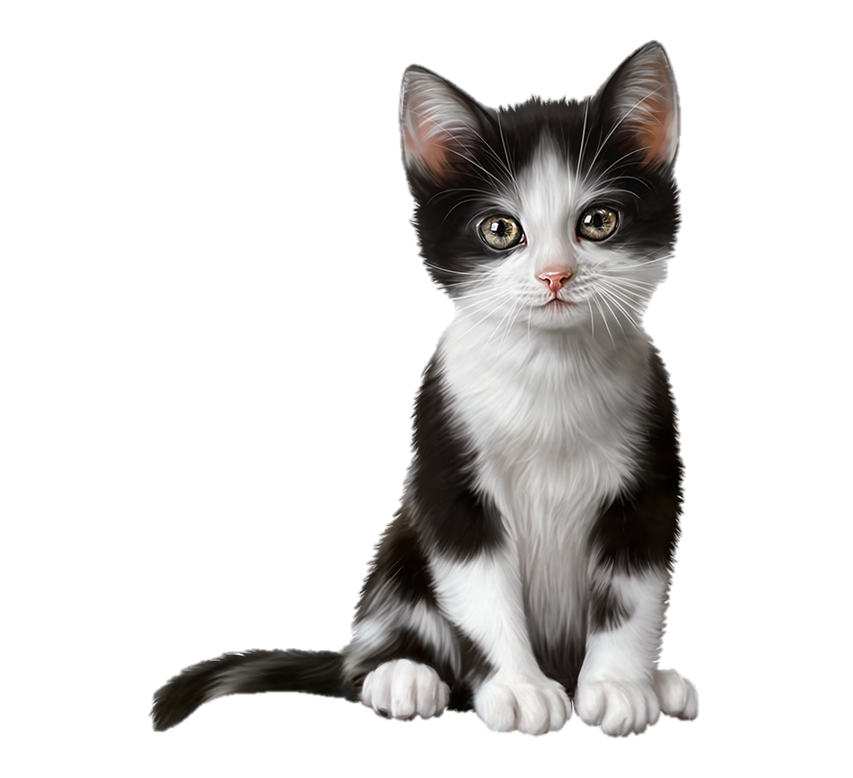
What can you understand by this picture?
A village

Slide 4
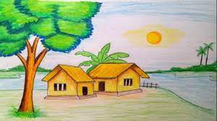
Today’s Lesson
In the village

Slide 5
Learning outcomes: Students will be able to
Listening:
1.1.1 become familiar with English sounds by listening to common English words.
Speaking:
1.1.1 repeat after the teacher simple words and phrases.

Slide 6
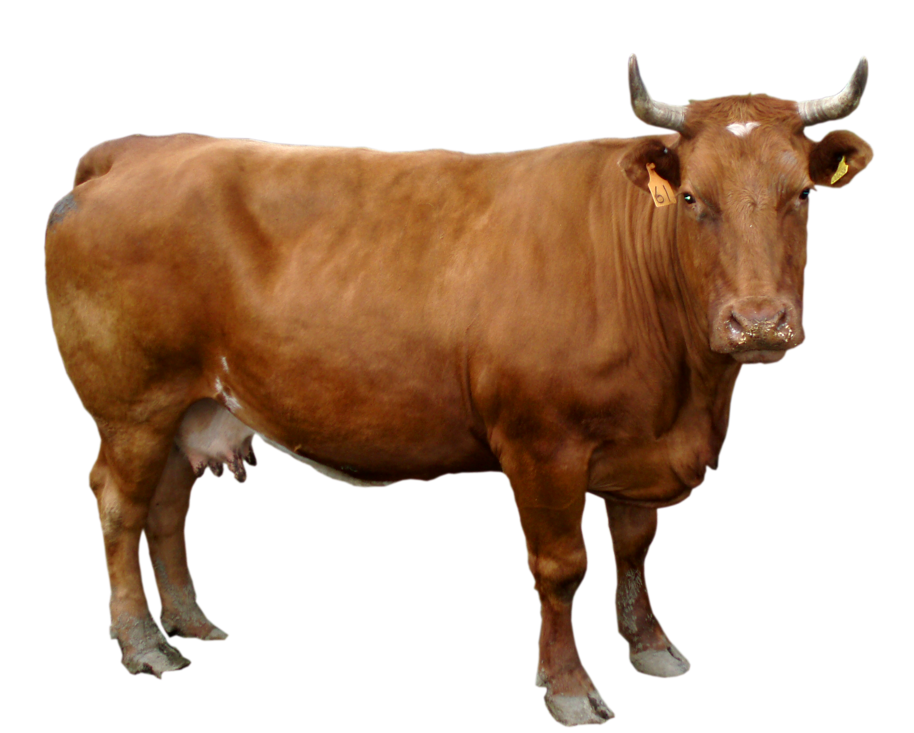
What is this?
গরু
Cow

Slide 7
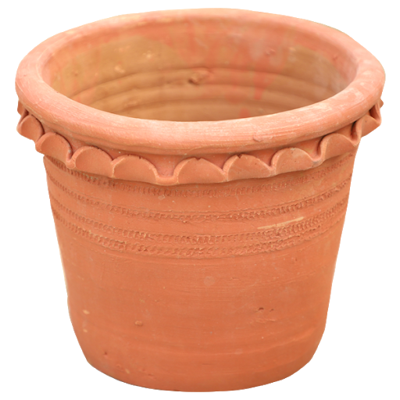
What is this?
টব / বালতি বিশেষ
Tub

Slide 8
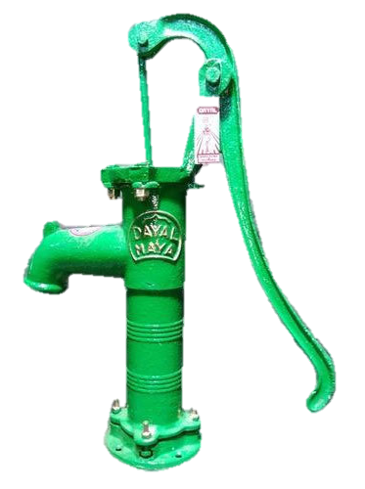
What is this?
নলকূপ
Tubewell

Slide 9
What is this?
বিড়ালছানা
Kitten

Slide 10
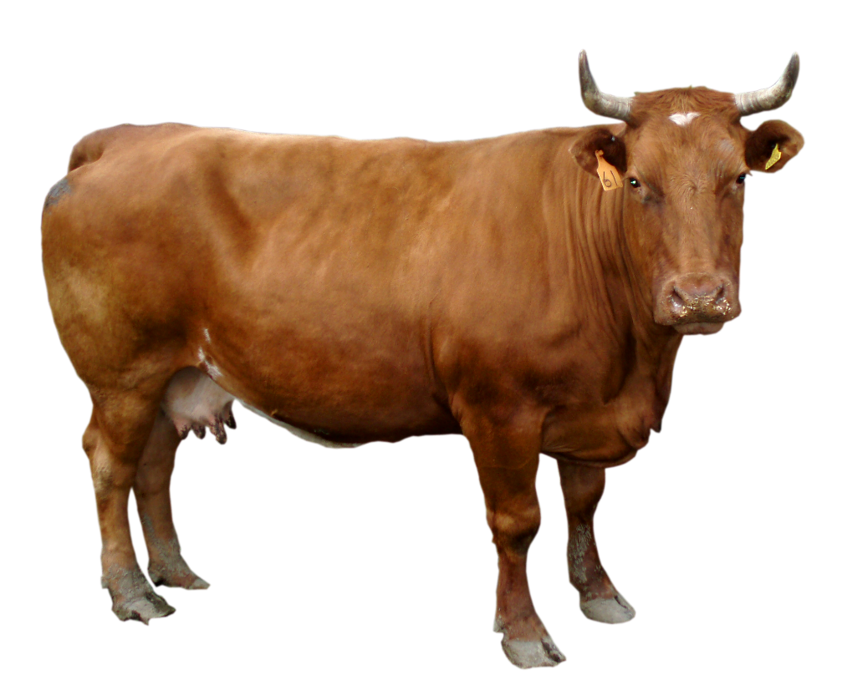
Let’s see the pictures at a glance.
Cow
Tub
Tubewell
Kitten

Slide 11
Teacher’s Reading

Slide 12
Indiviual work
Watch the pictures and say the words.
cow
tub
tubewell
kitten

Slide 13
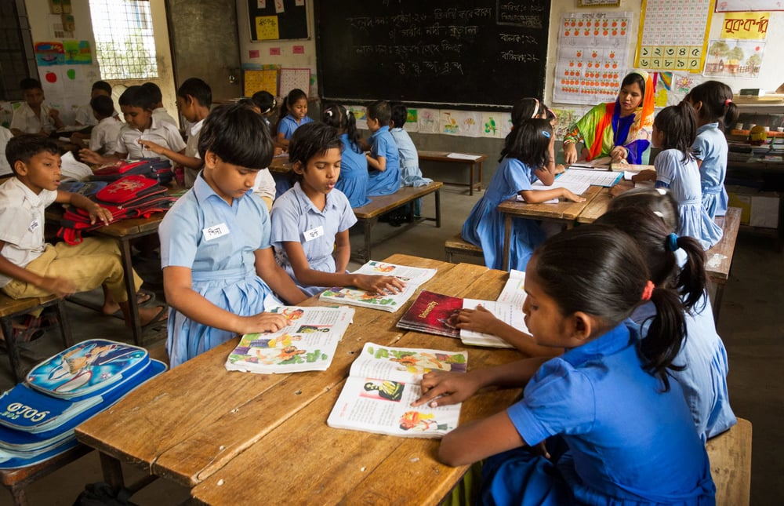
Student’s Reading

Slide 14
Pairwork
tub
Cow

Slide 15
Pairwork
tubewell
kitten

Slide 16
Match the words to the correct pictures.
Evaluation
tubewell
kitten
cow
tub

Slide 17
Homework
Name all the things in your house.

Slide 18
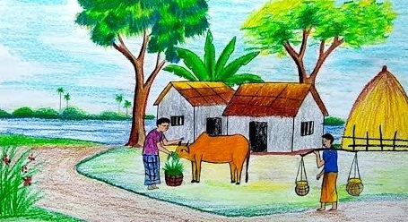
See you!

