Slide 2
Presented by
Md. Alamgir Hossain
(ICT Teacher)
Rahimapur Fazil Madrasah, Patnitala, Naogaon.
Cell : 01723-626108
E-mail : alamgirchz@gmail.com
Date – 05/04/2021

Slide 3
1. There is an angry bird on the table.
2.The angry bird is under the table.

Slide 4
Lesson Identity
PREPOSITION
Class – Seven, Eight, Nine, Ten.

Slide 5
Learning outcomes
After we have studied this lesson, we will be able to
1. What is Preposition ?
2. know the rules of Preposition .
3. Know the Types of Preposition ?

Slide 6
Preposition
(পদান্বয়ী অব্যয়)
যে সকল শব্দ সাধারণত noun বা pronoun এর সামনে বসে noun বা pronoun এর সাথে sentence এর অন্যানো শব্দের সম্পর্ক প্রকাশ করে তাদেরকে preposition বলা হয়।
The book is on the table.
We sat under the tree.

Slide 7
Classification/Types of Prepositions:
Simple Preposition
Preposition of place
Compound Preposition
Preposition of direction
Phrase Preposition
Preposition for an agent
Participle Preposition
Preposition used for Tools, Mechanism or Gadget
Double Preposition
Preposition of time

Slide 8
Simple Preposition:
সাধারণত sentence এ ব্যবহৃত একক preposition গুলোকে simple preposition বলে ।
On,
in,
to,
at,
from,
with,
of,
off,
over,
under
etc.

Slide 9
She is living this room.
in
I am going the varsity.
to
He was looking me.
at

Slide 10
In
The tree is the water

Slide 11
Compound Preposition:
যে preposition গুলো দুটো noun, pronoun অথবা phrase কে যুক্ত করতে ব্যবহৃত হয় তাদেরকে
compound preposition বলে।
Between,
before,
around,
about,
along,
above
etc.

Slide 12
I will complete the work he comes.
before
She was asking this matter.
about
The river is running the town.
across

Slide 13
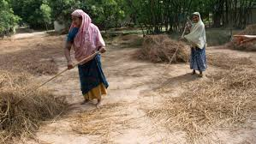
ACROSS

Slide 14
Phrase Preposition:
যে preposition গুলো দলবদ্ধ শব্দ এবং sentence এর বিভিন্ন অংশের মধ্যে সম্পর্ক বোঝায় তাদেরকে phrase preposition বলে ।
In spite of,
in front of,
in order to,
due to,
on account of,
for the sake of,
etc.

Slide 15
She came here meet me.
in order to
We were standing the college.
in front of
She could not come here her illness.
due to

Slide 16
THE FLAG IS A LITTLE GIRL
IN FRONT OF

Slide 17
Double Preposition:
দুটো preposition যুক্ত হয়ে একটি নতুন preposition গঠণ করলে তাকে double preposition বলে ।
because of,
from behind,
within,
out of,
outside of,
etc.

Slide 18
He could not come to the meeting his illness.
because of
I have to do this work today.
within
I have to answer three questions all.
out of

Slide 19
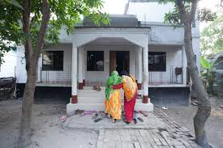
OUT

Slide 20
Preposition of time:
যে preposition কোনো কাজের সময় বা একটি sentence এর noun গুলোর মধ্যে সময়ের সম্পর্ক নির্দেশ করে তাকে preposition of time বলে ।
I will try to come at 6:30 pm.
This program will be held in January.
Try to come on Monday.

Slide 21
in
New leaves grow on trees after trees Spring.

Slide 22
Preposition of place:
যে preposition গুলো কোনোকিছুর অবস্থান নির্দেশ করে তাকে preposition of place বলে।
behind,
under,
on,
in,
at,
between,
over,
etc.
The boy was standing the tree.
behind
in
She lives in Dhanmondi Dhaka.

Slide 23
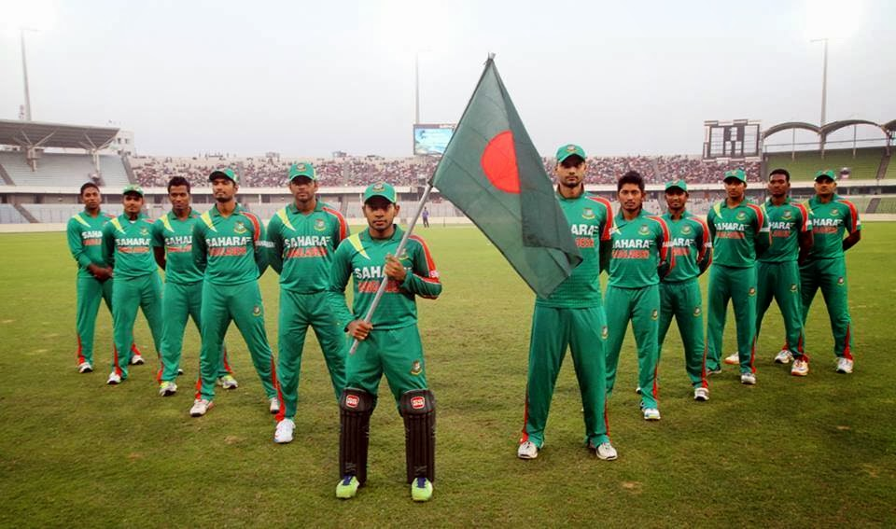
The cricketers are the flag.
behind

Slide 24
Preposition of direction:
যে preposition কোনোকিছুর বা কারো দিকে নির্দেশ করে তাকে preposition of direction বলে ।
in,
on,
under,
over,
left,
right,
etc.

Slide 25
The school is situated the right side of the town.
on
The jeep is now going the bridge.
over
The bird is sitting the roof.
on

Slide 26
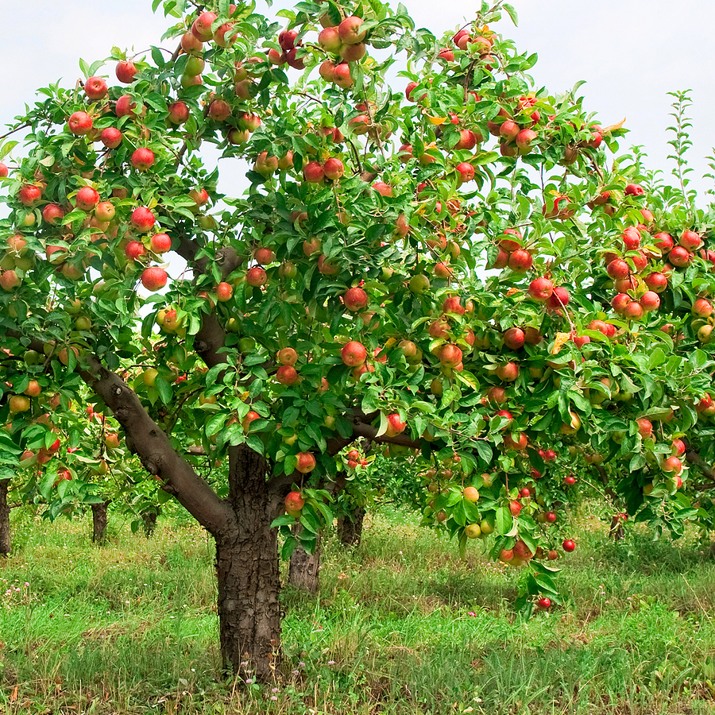
Under the tree

Slide 27
Preposition for an agent:
যে preposition কোনো কাজ ও কাজ সম্পাদনকারীর মধ্যে সম্পর্ক নির্দেশ করে তাকে preposition for agent বলে ।
with,
By,

Slide 28
I like to go there you.
with
She likes to read the books written Tagore.
by

Slide 29
By the tree

Slide 30
Preposition used for Tools, Mechanism or Gadget:
এই preposition গুলো বিভিন্ন noun কে ( যন্ত্র, বাদ্যযন্ত্র , মেশিন প্রভৃতি ) sentence এর অন্যান্য শব্দের সাথে যুক্ত করে ।
with the help of,
By,
On.

Slide 31
I opened the bottle an opener.
with the help of
He likes to go long drives his car.
by
She came here foot.
on

Slide 32
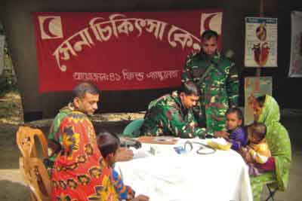
by
The poor are helped Bangladesh Army

Slide 33
বিদায়

