Slide 1
HELLO
To Everyone

Slide 2
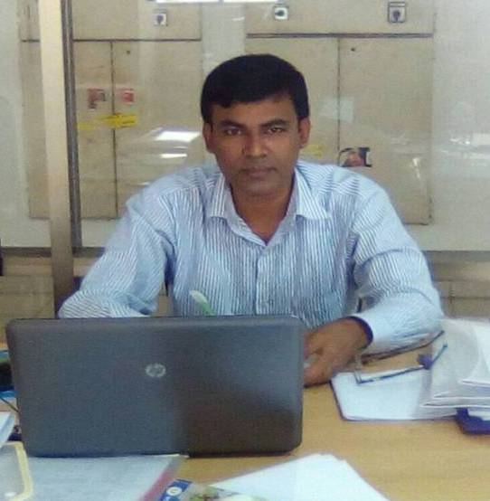
This is
Mohammad Faruk Ahmed Mazumder
Assistant Teacher
Malora Government Primary school
Shahrasti,Chandpur
Email:farukt1979@gmail.com

Slide 3
Lesson Introduce
Subject : English
Unit:01(Hello)
Lesson: 1(A. Sima: Hello!.......
……………..............too, Sima)
Time:40 minutes
Date:

Slide 4
Dear students,
Do you want to enjoy?
So, let’s see a video!

Slide 5
Dear students . look at the picture
What is this?
Yes.
‘This is our “English for Today’ textbook”

Slide 6
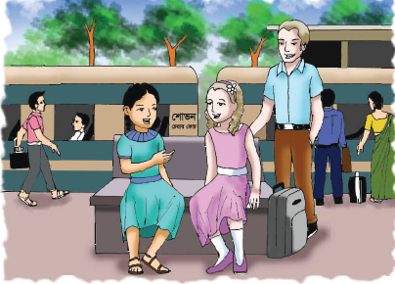
Dear students . look at the picture
What can you see in the picture ?

Slide 7
Today’s our lesson
H
E
L
L
O

Slide 8
Learning Outcomes
At the end of the lesson , students will be able to-
Listening:
3.2.1 understand questions about family and friends of students.
3.4.1 understand statements made by the teacher and students.
Speaking:
1.1.1 say words, phrases and sentences with proper sounds and stress.
8.1.1 take part in conversations on appropriate topics.
Reading:
1.5.1 read words, phrases and sentences in the text with proper pronunciation ,stress and intonation.

Slide 9
Hello!
May I introduce myself ?
I’m Sima.
Hi! I’m Jessica.

Slide 10
Where are you going , Jessica?
I’m going to Chattogram .
I’m on holiday with my father

Slide 11
Really? Where are you from?
I’m from the United Kingdom.
Are you from Dhaka?

Slide 12
No, I’m from Sylhet. That’s where we’re going. Our train is leaving in 10 minutes.
Have a good journey.

Slide 13
Thank you. Nice meeting you, Jessica.
Have fun in Chattogram.
Thanks. Nice meeting you, too, Sima .

Slide 14
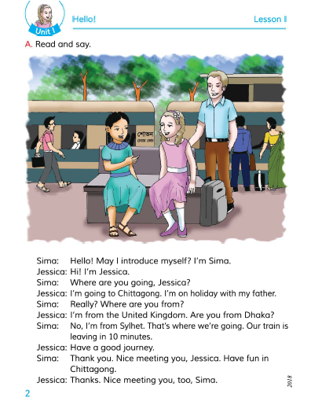
Everybody take your EFT book
and
open page at 02

Slide 15
New word in this lesson
Introduce
পরিচয় করানো
Formally known by name to another in person..
Really
সত্যি
in actual fact
Holiday
ছুটি
an extended period of leisure and recreation
Meeting
দেখা হওয়া
formal discussion
Leaving
ছেড়ে যাওয়া
go away from

Slide 16
Teacher’s model reading

Slide 17
Individual reading
Students read this dialogue individually.

Slide 18
Now dear students answer the following questions
a) Where is Jessica going?
b) Where is Sima from?
c) Where are Sima and Jessica?
d) Where is Sima going?

Slide 19
One day One word
Introduce
পরিচয় করানো
make (someone) known by name to another in person, especially formally.

Slide 20
Group work
Dear students, To make conversation to each other about your first meet.

Slide 21
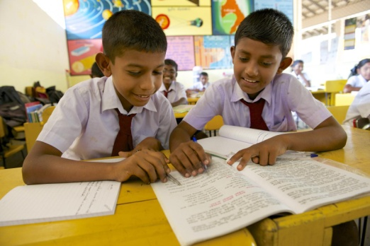
Pair work
Dear students, To make conversation to each other about your first meet.
I will look around the pair work and help them

Slide 22
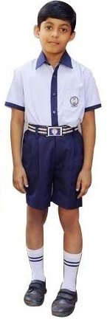
Evaluation
I will call two students to the front and ask them to create a conversation about themselves

Slide 23
Home task
Students will practice to create a conversation about Yourself

