Slide 2
Welcome

Slide 3
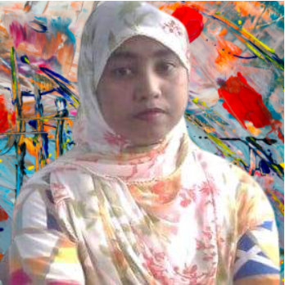
Introduction
Most.Sharmin Sultana
Assistant Teacher
Porahati Govt. Primary school
Harinakundu,Jhenaidah.
Email:sherminmithu@gmail.com

Slide 4
Lesson Introduction
Class:Five Subject: English
Lesson Title:Occupations
Lesson Unit :A long ……… didn’t mind.

Slide 5
Learning Outcomes
Students will be able to…….
1.5.1 read words ,phrases and sentences in the text with proper pronunciation , stress and intonation.
8.1.1 make sentences using words and phrases given in the text.

Slide 6
?
Try to guess
What can you see in the pictures ?
Occupations
What are they doing ?
(in pictures 1, 2,3,4)

Slide 7
Occupations

Slide 8
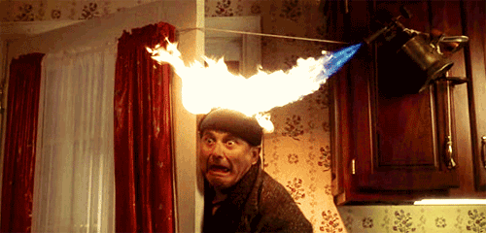
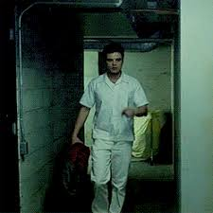
Vocabulary
Alarmed
Panicked
Quietly
Calmly

Slide 9
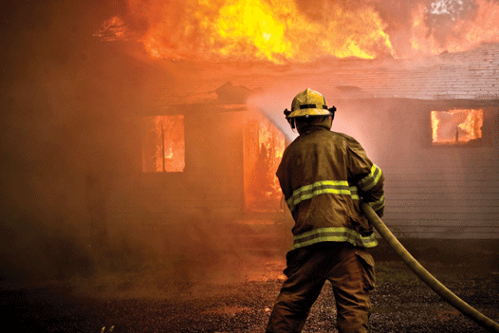
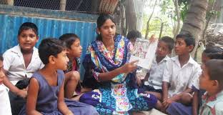
A person who puts out fire
Firefighter
A person who works without pay
Volunteer

Slide 10
Now pronunce with me
Pa nicked
Quite ly
Vo lun teer
Fire figh ter

Slide 11
Now spell
P
a
n
i
c
k
e
d
Q
u
i
e
t
l
y
F
i
r
e
f
i
g
h
t
e
r
V
o
l
n
t
e
e
r
u

Slide 12
Make sentences
Panicked
No one panicked.
Quitely
The students leave the building quietly .

Slide 13
Firefighter
Raju is a firefighter .
Volunteer
Raju joined a volunteer fire department .

Slide 14
There was a fire in Raju’s school.

Slide 15
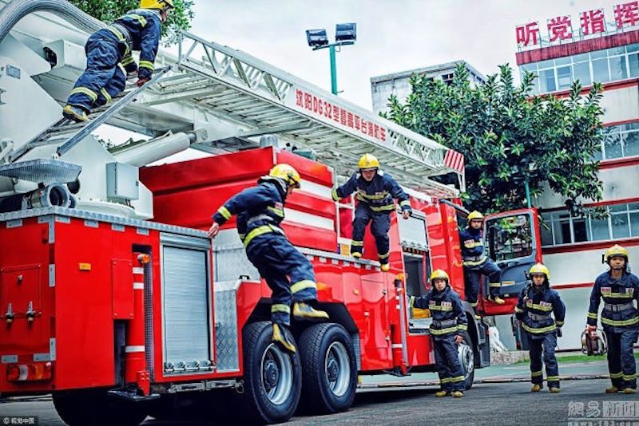
Soon the firefighters came

Slide 16
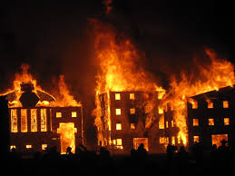
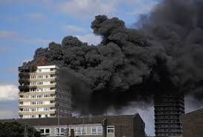
He thought about the fire and the firefightersfor a long time .

Slide 17
Group work
Group 1:What is a firefighter ?
Group 2:Make a list of the firefighters activities.

Slide 18
Game
Here are some words for you.You can take only 4 words from here and fill your drawing box like this.
School, Afraid, Safely, Mind, Building, Yard, , Department
1
2
3
4

Slide 19
Now I will tell words one after another and you will cross them
Out .who ‘ll fill first H/She will be the winner.
Let’s play the Game.
Volunteer
School
Department
Building

Slide 20
Evaluation
Write True/False , if false give the correct answer :
1.Raju was in class 6 ,there was a fire in his school.
2.The teachers helped the students to leave the building.
3.The firefighters came late.

Slide 21
Thanks to all

