Slide 1
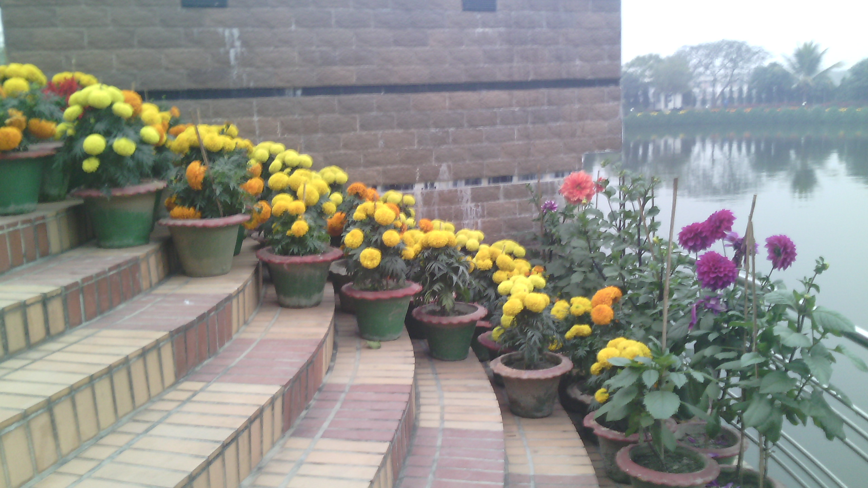
welcome

Slide 2
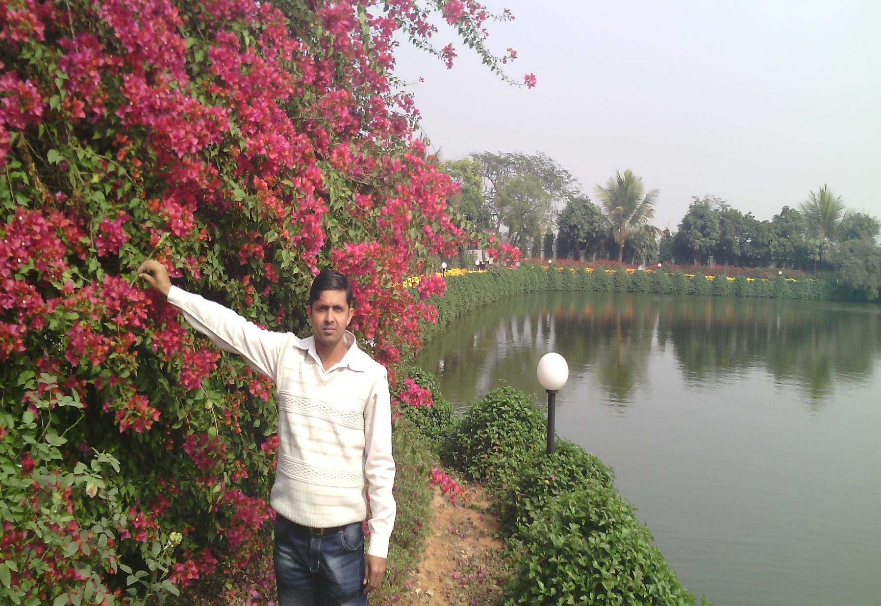
Ujjal Kumar Ghosh
Assistant Teacher(english)
Chuadanga Krishnanagor high school
Panjia, Keshabpur, Jassore
Class:Eight
English First paper

Slide 3
What is it?

Slide 5
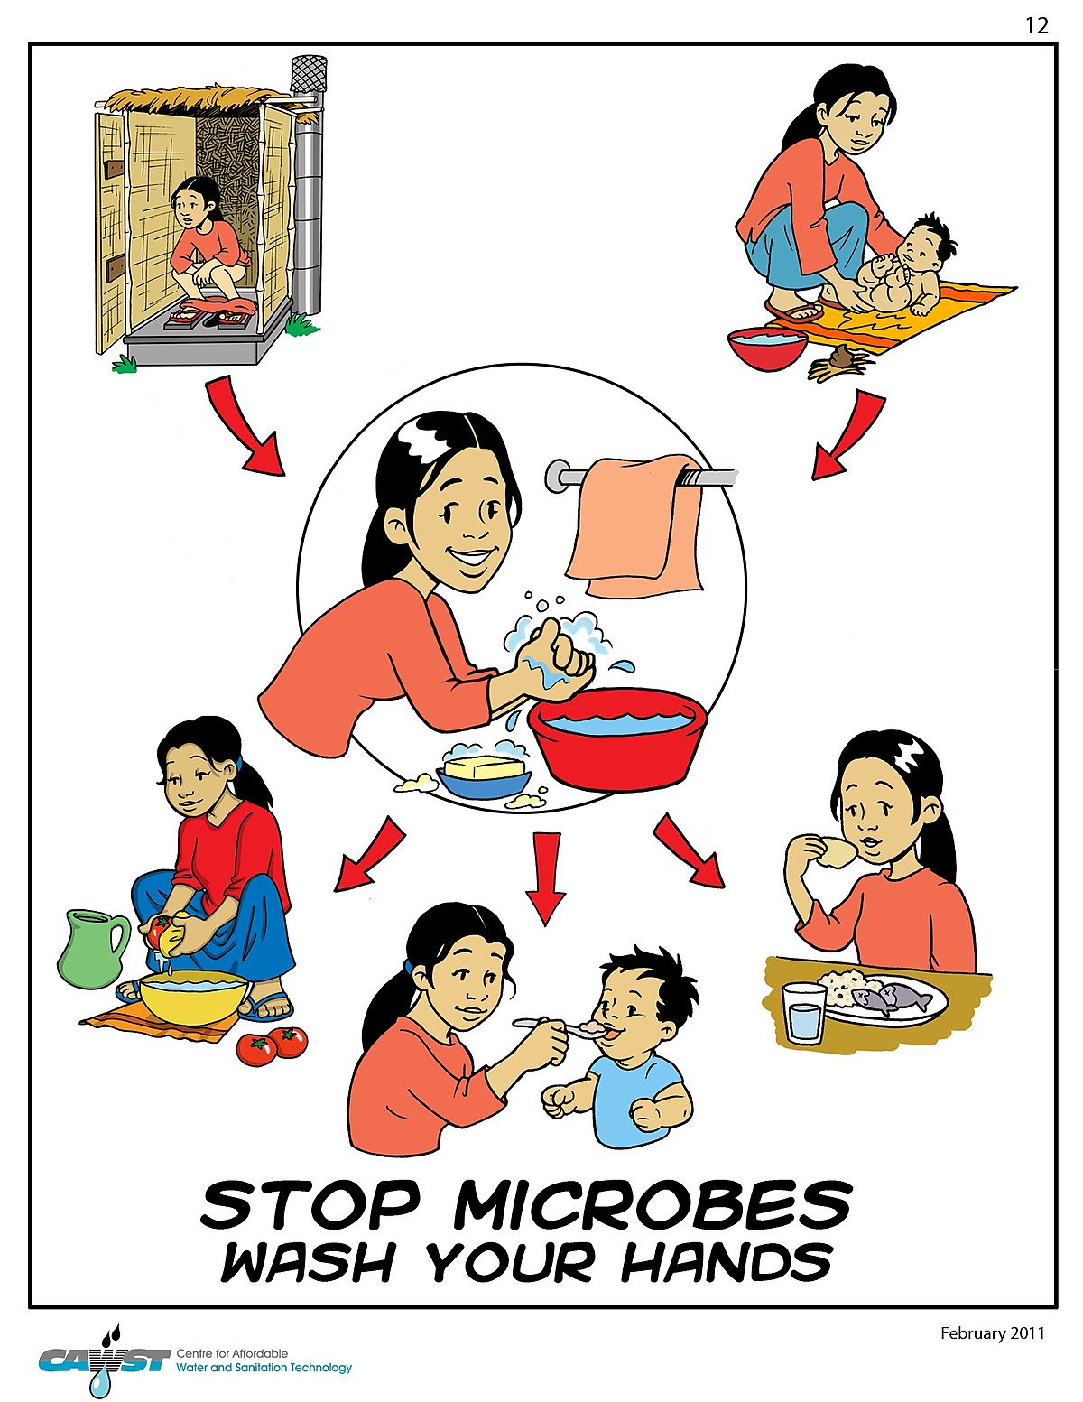
What are they doing?

Slide 6
Use good Hygiene
Today’s lesson is Hygiene
Unit-Three
Lesson-Three

Slide 7
Learning Outcome
By the end of the lesson learners will be able to:
talk about a picture
use new words: hygiene, godliness, achieve, spiritually, soul
True or false ? If false give the correct information.
Ask and answer question
Complete the following sentences
Write a dialogue

Slide 8
hygiene
Hygiene means cleanliness , purity, sterility
The word ‘hygiene’ means the practice of keeping ourselves clean.

Slide 9
godliness
Godliness means Piety, virtue
Hygiene is thought to be next to godliness.

Slide 10
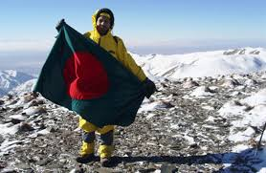
achieve
Achieve means earn, acquire, attain, gain,
we cannot achieve anything physically, mentally or spiritually if we are unclean in our body, mind and soul.

Slide 11
spiritually
Spiritually means Religiously, mystically, piously
They showed great strength, both morally and spiritually.

Slide 12
soul
Soul means spirit, psyche, genie, heart, self
The soul, in many religious, philosophical, and mythological traditions, is the incorporeal essence of a living being.

Slide 13
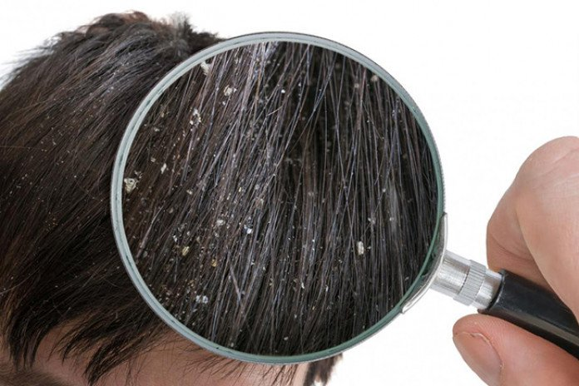
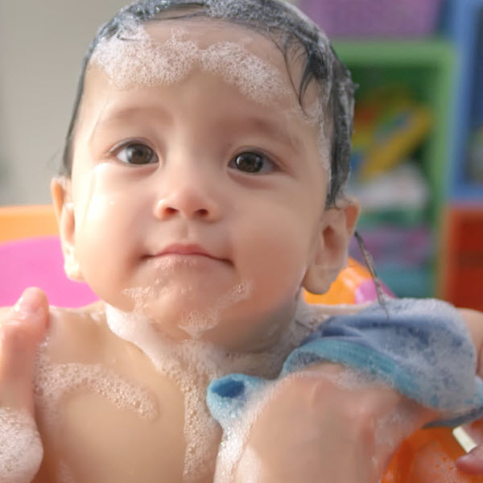
Reading test
First, we must keep our body clean. We should have a bath every day and wash our hair regularly. This will keep the body and hair free from dirt and bacteria.

Slide 14
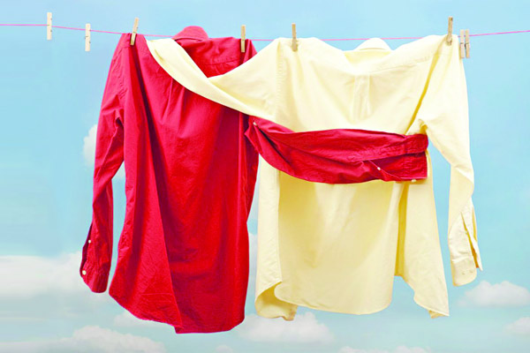
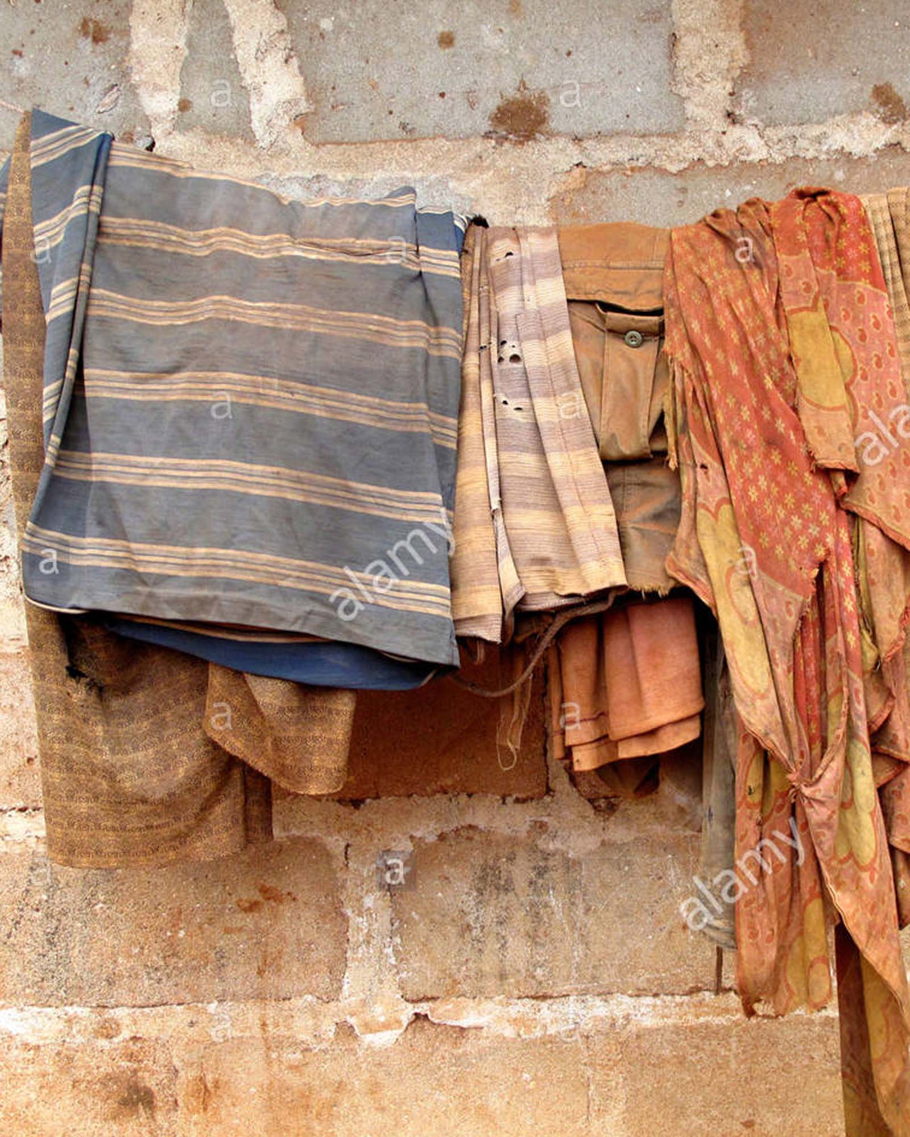
Secondly, we should wash our clothes regularly. Dirty clothes give off bad smell and invite germs.

Slide 15
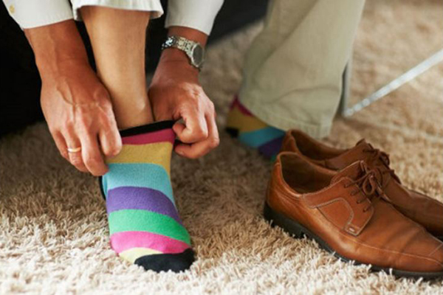
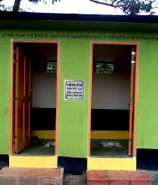
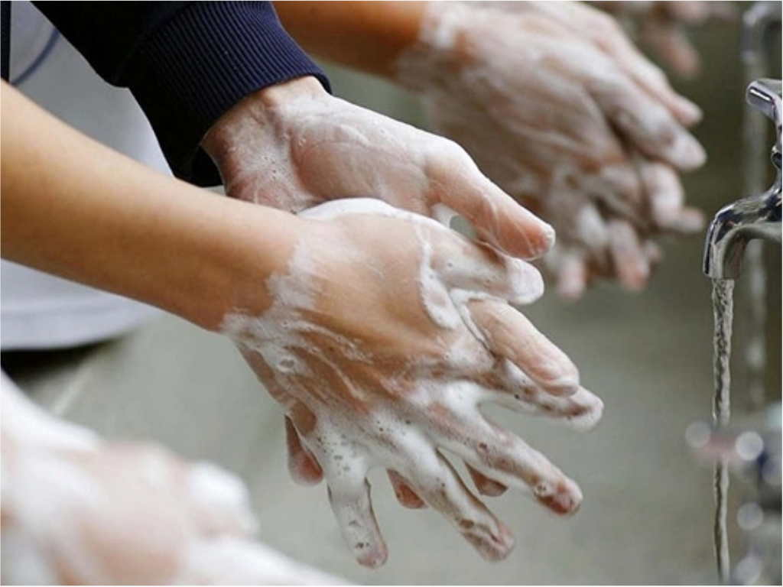
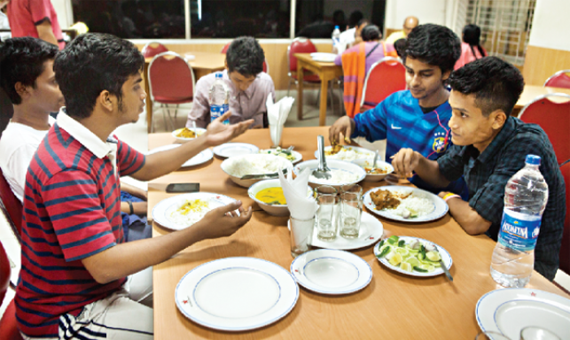
We should wear socks and shoes when we go out to protect our feet from dust and germs. It is also important to wash our hands before meals and after using the toilet.

Slide 16
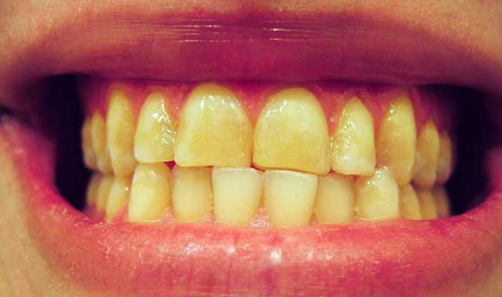
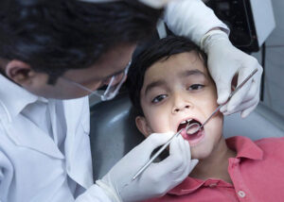
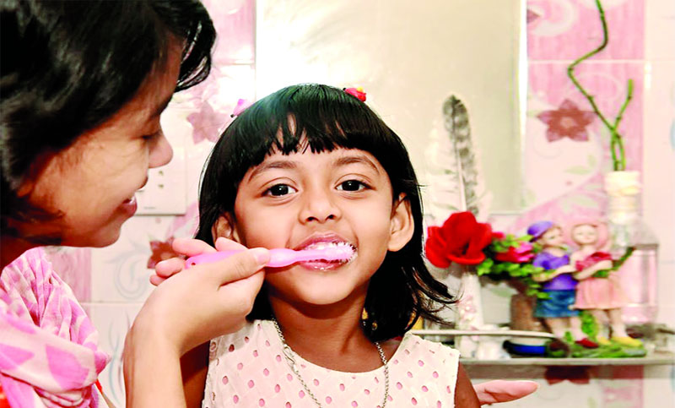
We should brush our teeth twice a day, after breakfast and supper.

Slide 17
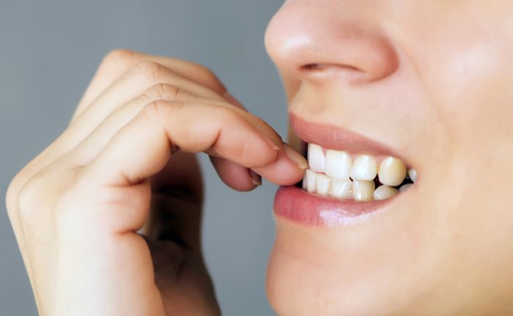
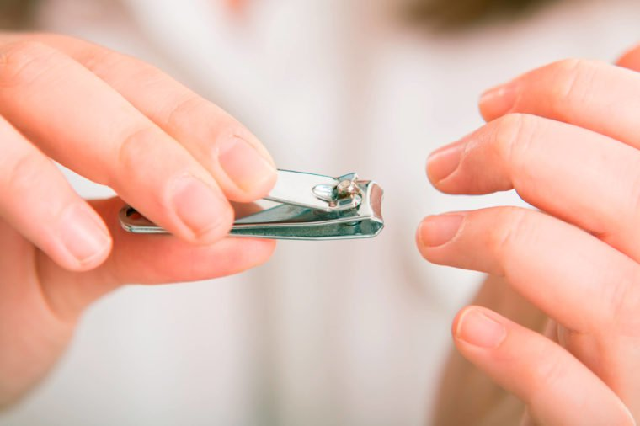
We must also cut our nails regularly.

Slide 18
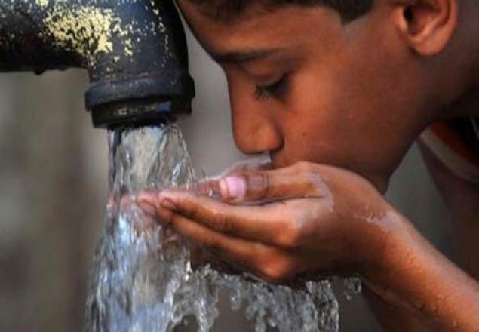
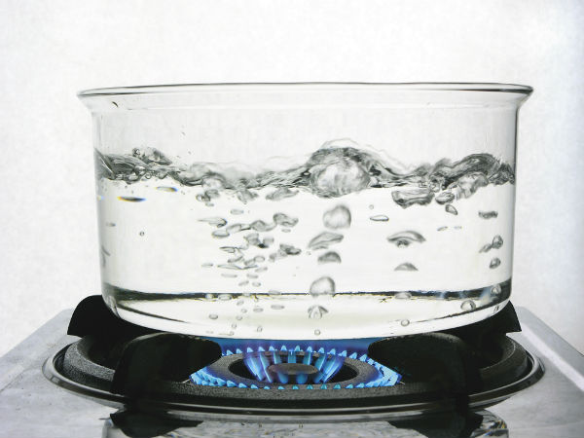
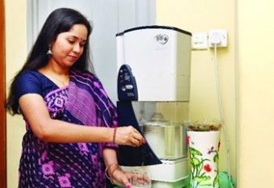
Our drinking water must be pure. We can get pure water by boiling and filtering.

Slide 19
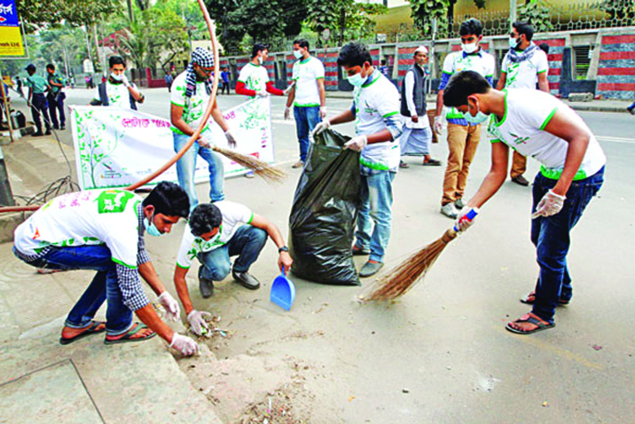
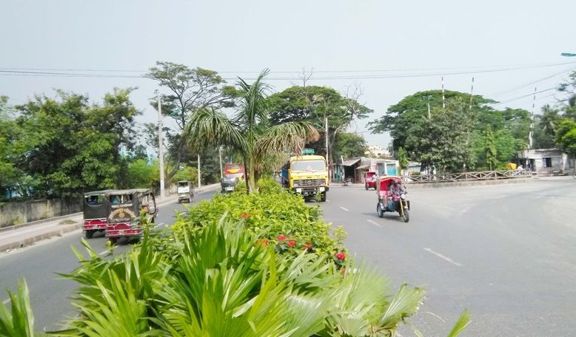
Finally, we should keep our surroundings and environment clean . If we do and follow all the above things properly, we will be able to lead a healthy and happy life.

Slide 20
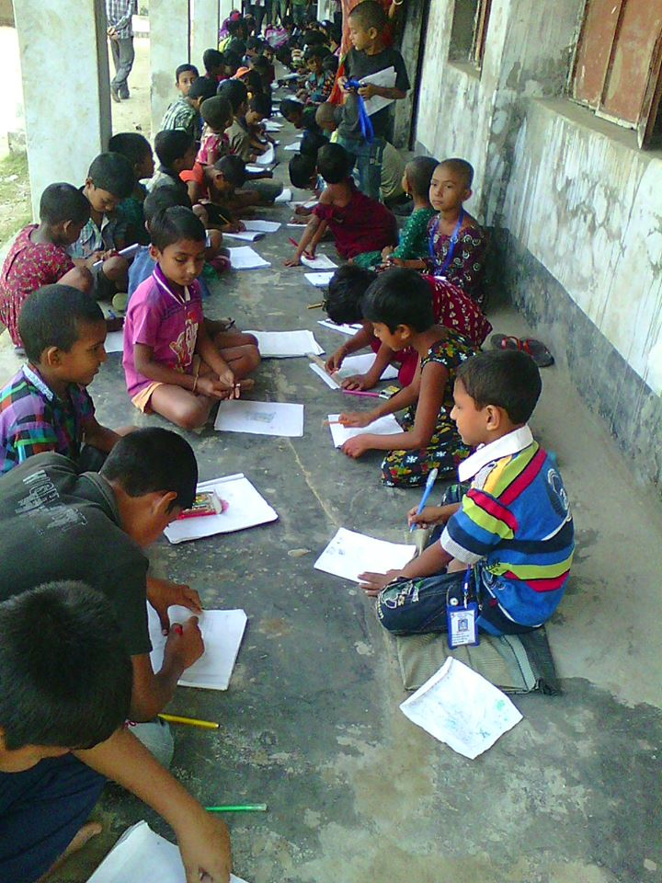
Writing test
Individual work
B True or false? If false, give the correct information.
1 Cleanliness is part of good health.
2 Cleanliness is very important for mental health.
3 We need to wear socks and shoes to look smart.
4 We need to brush our teeth before meals.
5 We must keep ourselves clean.
6 We can have pure drinking water from tube wells.

Slide 21
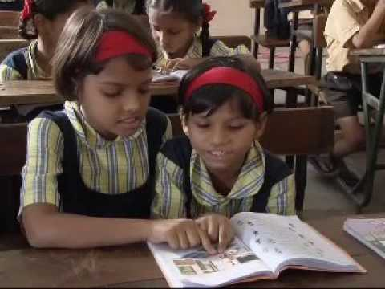
Pair work
C Complete the following sentences.
1 If we are healthy, we ----------------------------- .
2 We must be clean so that-------------------------- .
3 You must exercise to ------------------------------- .
4 Nobody likes an ----------------------------------- .
5 If we obey the laws of hygiene, we ----------------

Slide 22
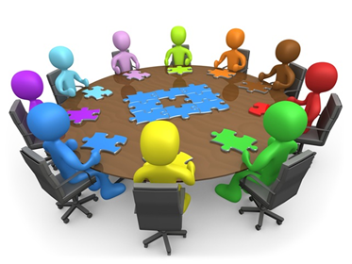
Group work
1 What can be a hotbed of germs?
2 How many times should we brush our teeth a day?
3 What kind of water should we drink?

Slide 23
Homework
Write a dialogue between two friends about hygiene

Slide 24
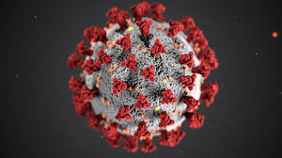
Good bye

