Slide 1
E
C
M
W
L
O
E

Slide 2
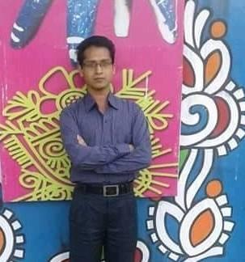
Teacher’s Identity
Gobinda Chandra Mondal
Assistant Teacher
Sreenagar No. 1 Model GPS
Sreenagar, Munshigonj.
E-mail: gobinda19mondal@gmail.com

Slide 3
Subject Identity
Class: Four
Subject: English
Unit: 18
Lesson: 3-4
Activity: A and B
Page: 37

Slide 4
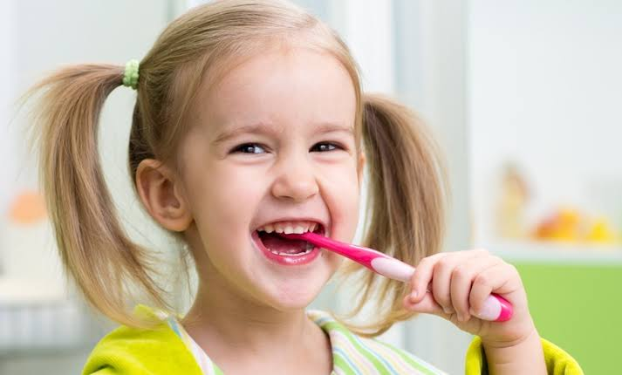
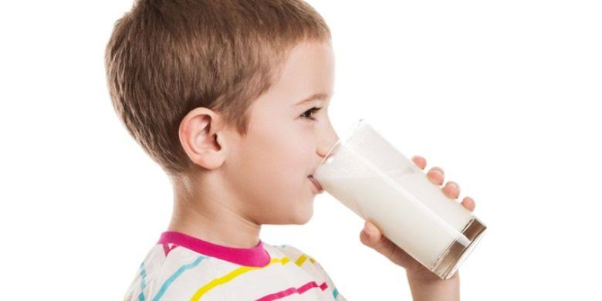
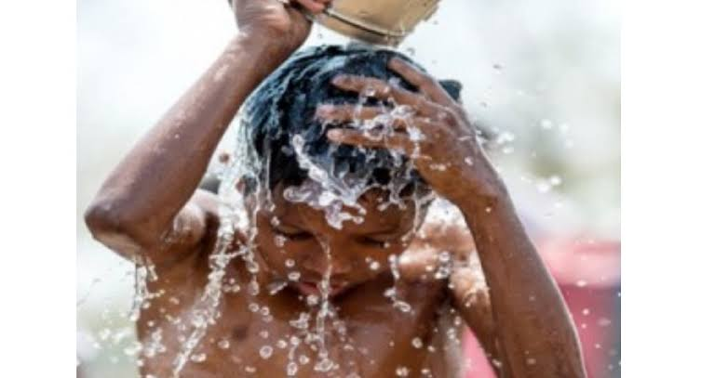
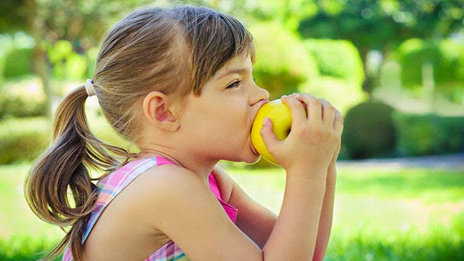
What kind of works are these?
What do you do for these good works?
Clap your hands.
Look at the picture.
Good works
What can you see?

Slide 5
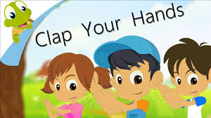
Our Today’s Lesson
Clap your hands

Slide 6
Learning Outcomes
Students will be able to-
Listening:
1.1.1 recognize sound differences in the context of words.
1.2.1 recognize which syllable in a word is stressed.
1.3.1 recognize which words in a sentence are stressed.
Speaking:
1.1.1 repeat after the teacher and say words, phrases and sentences with proper sounds, stress and intonation.
Reading:
1.4.1 read words, phrases and sentences in the text.
1.5.1 read words, phrases and sentences in the text with proper pronunciation, stress and intonation.

Slide 7
Let’s watch a video.

Slide 8
NEW WORDS
teeth
দাঁত
everyday
প্রতিদিন
brush
মাজা
drink
পান করা
bath
গোসল
fruit
ফল

Slide 9
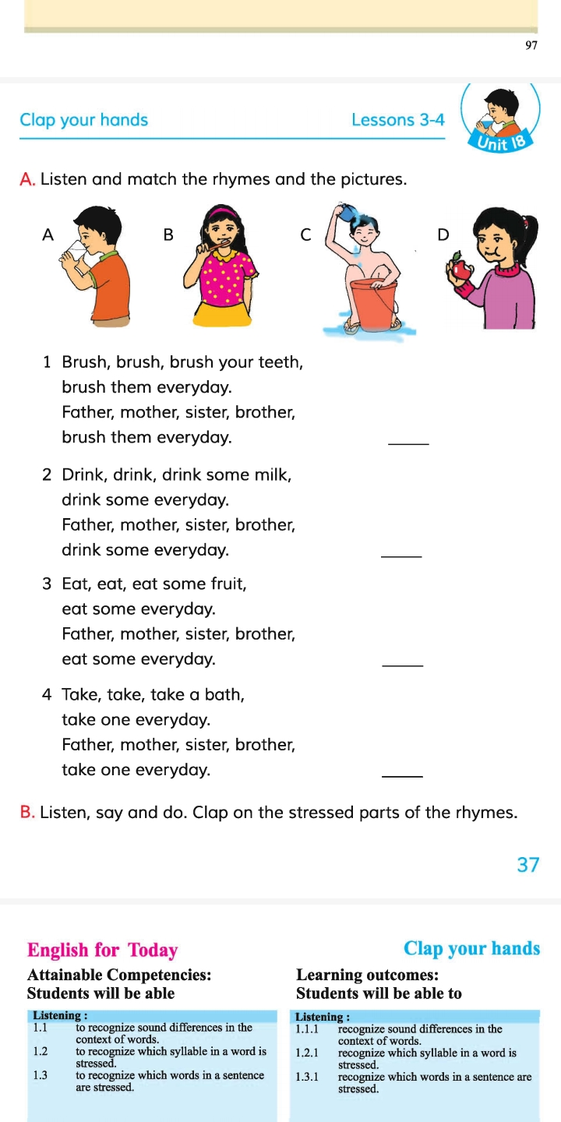
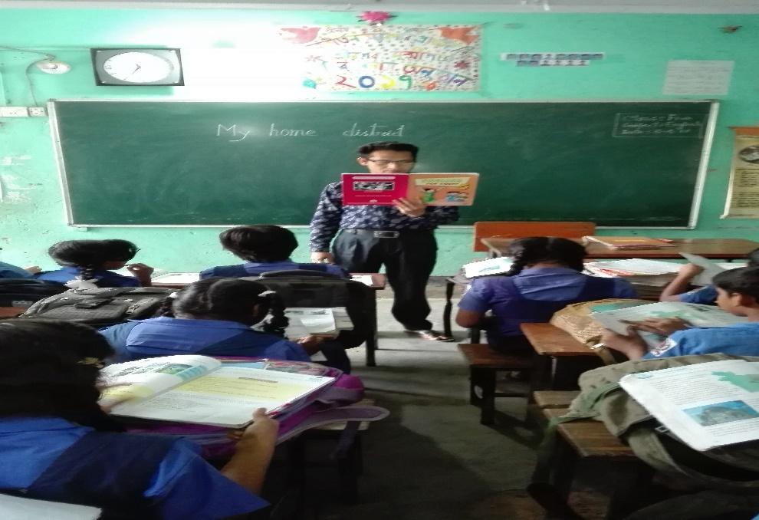
Teacher’s Reading
Open at page 37

Slide 10
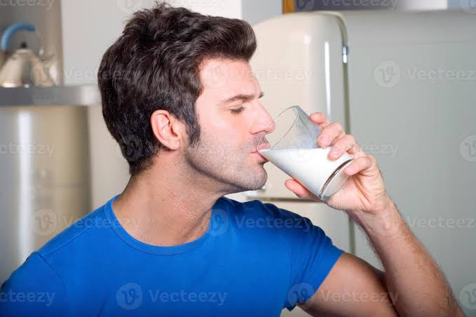
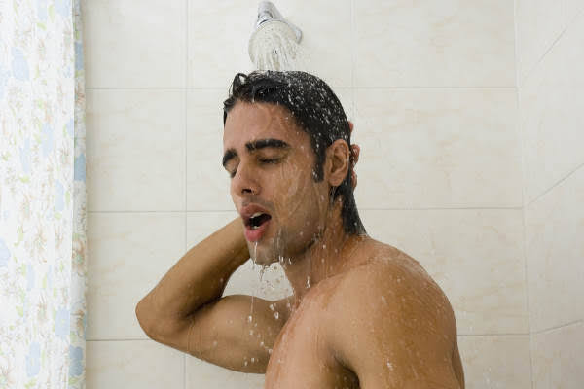
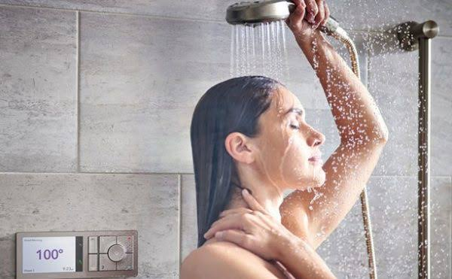
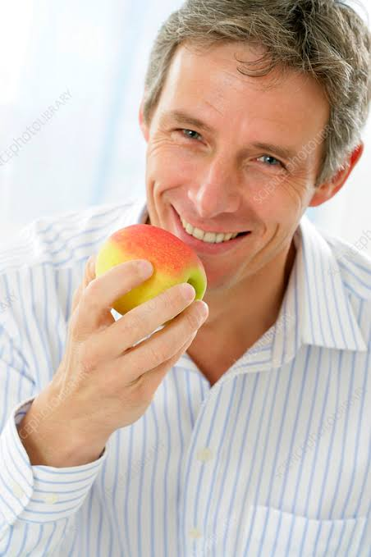
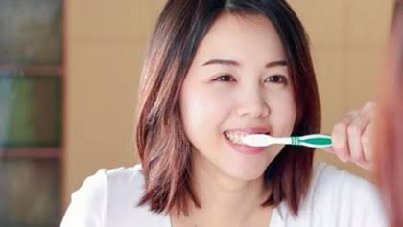
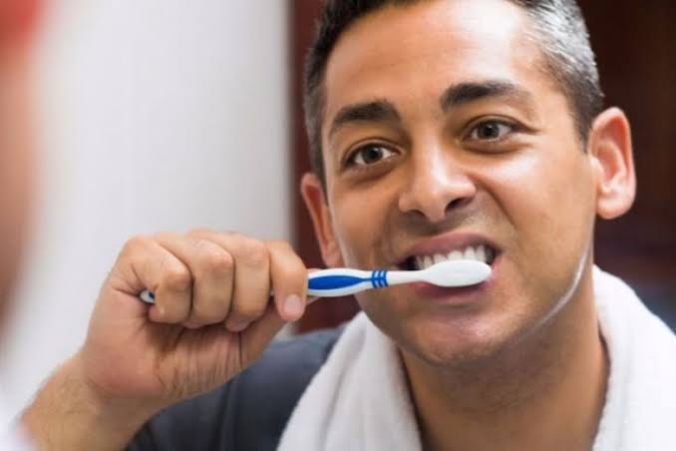
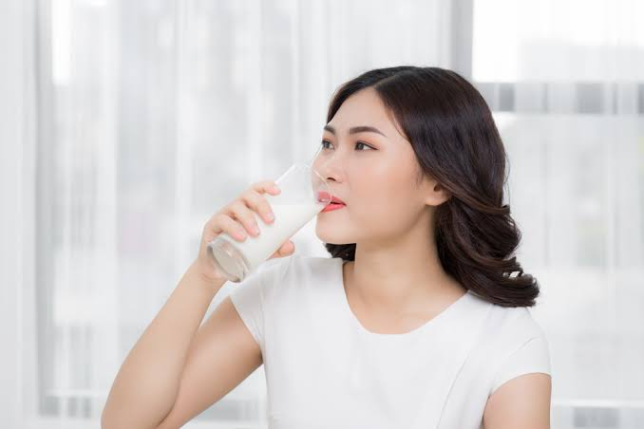
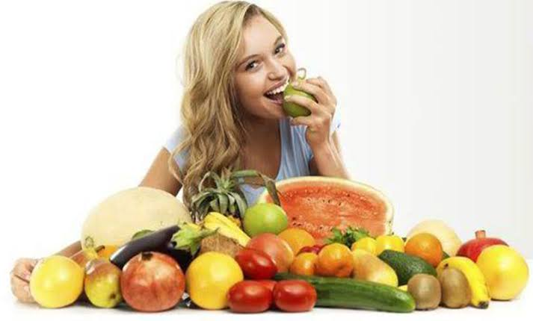
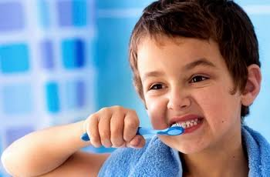
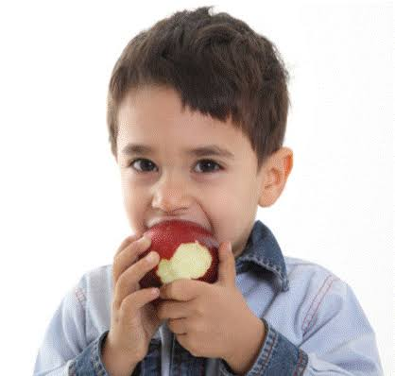
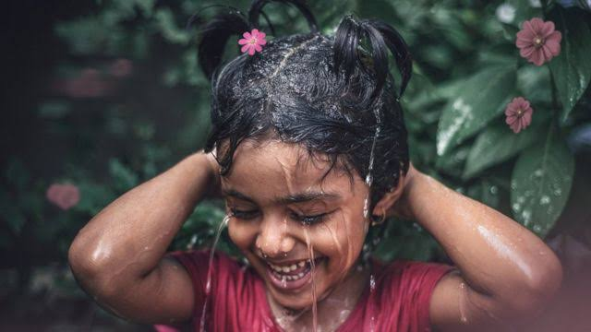
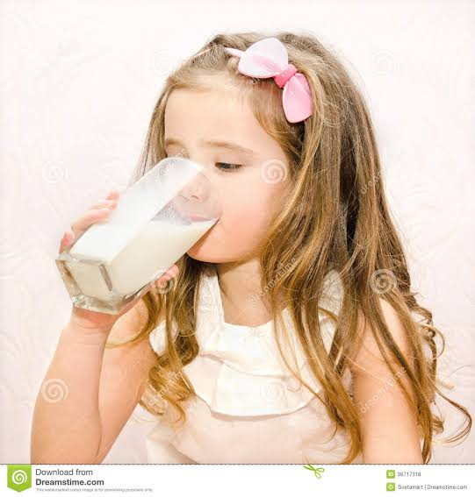
Look, listen and say. Read.
Drink, drink, drink some milk,
drink some everyday.
Father, mother, sister, brother,
drink some everyday.
Brush, brush, brush your teeth,
brush them everyday.
Father, mother, sister, brother,
brush them everyday.
Eat, eat, eat some fruit,
eat some everyday.
Father, mother, sister, brother,
eat some everyday.
Take, take, take a bath,
Take one everyday.
Father, mother, sister, brother,
Take one everyday.

Slide 11
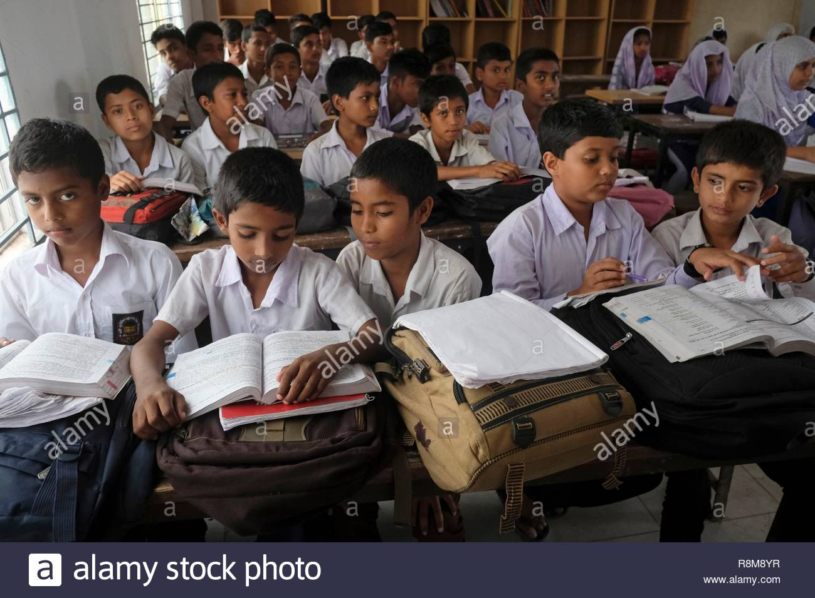
Student’s Reading

Slide 12
Pair work
Match the sentences with the pictures.
Brush them everyday.
Drink some everyday.
Eat some everyday.
Take one everyday.

Slide 13
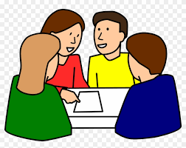
Group work
Group-1
Recite the rhyme (1st para)
Group-2
Recite the rhyme (2nd para)
Group-3
Recite the rhyme (3rd para)
Group-4
Recite the rhyme (4th para)

Slide 14
Evaluation
Look at the pictures and answer the following questions:
1. What is the boy doing?
Ans: The boy is brushing his teeth.
2. What is the girl doing?
Ans: The girl is drinking milk.
3. What is the man doing?
Ans: The man is taking his bath.
4. What is the woman doing?
Ans: The woman is eating fruit.

Slide 15
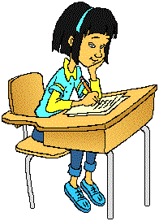
Homework
Write 5 sentences about everything
you do at home.

Slide 16
