Slide 1
Hi !Every body

Slide 2
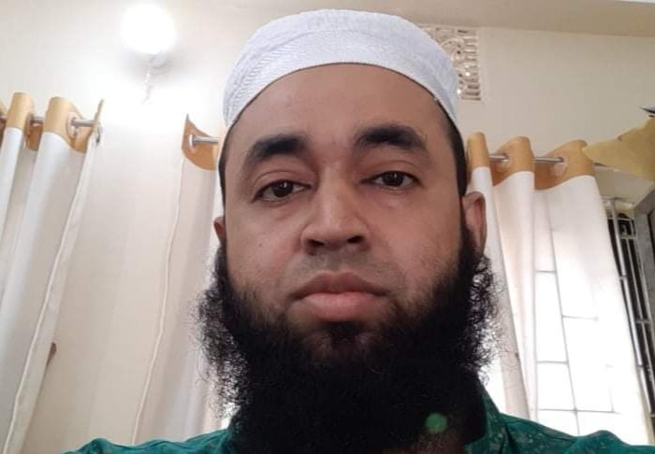
Teacher Introduction
Shahenur Alam shibly
Assistant teacher
Lal md sikdarpara govt primary school
Moheshkhali , Cox,bazar.
Class: Four.
Subject:English
Time:40 Minutes.
Introduction of lesson

Slide 3
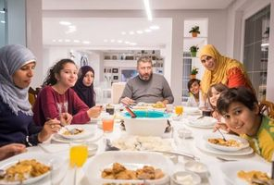
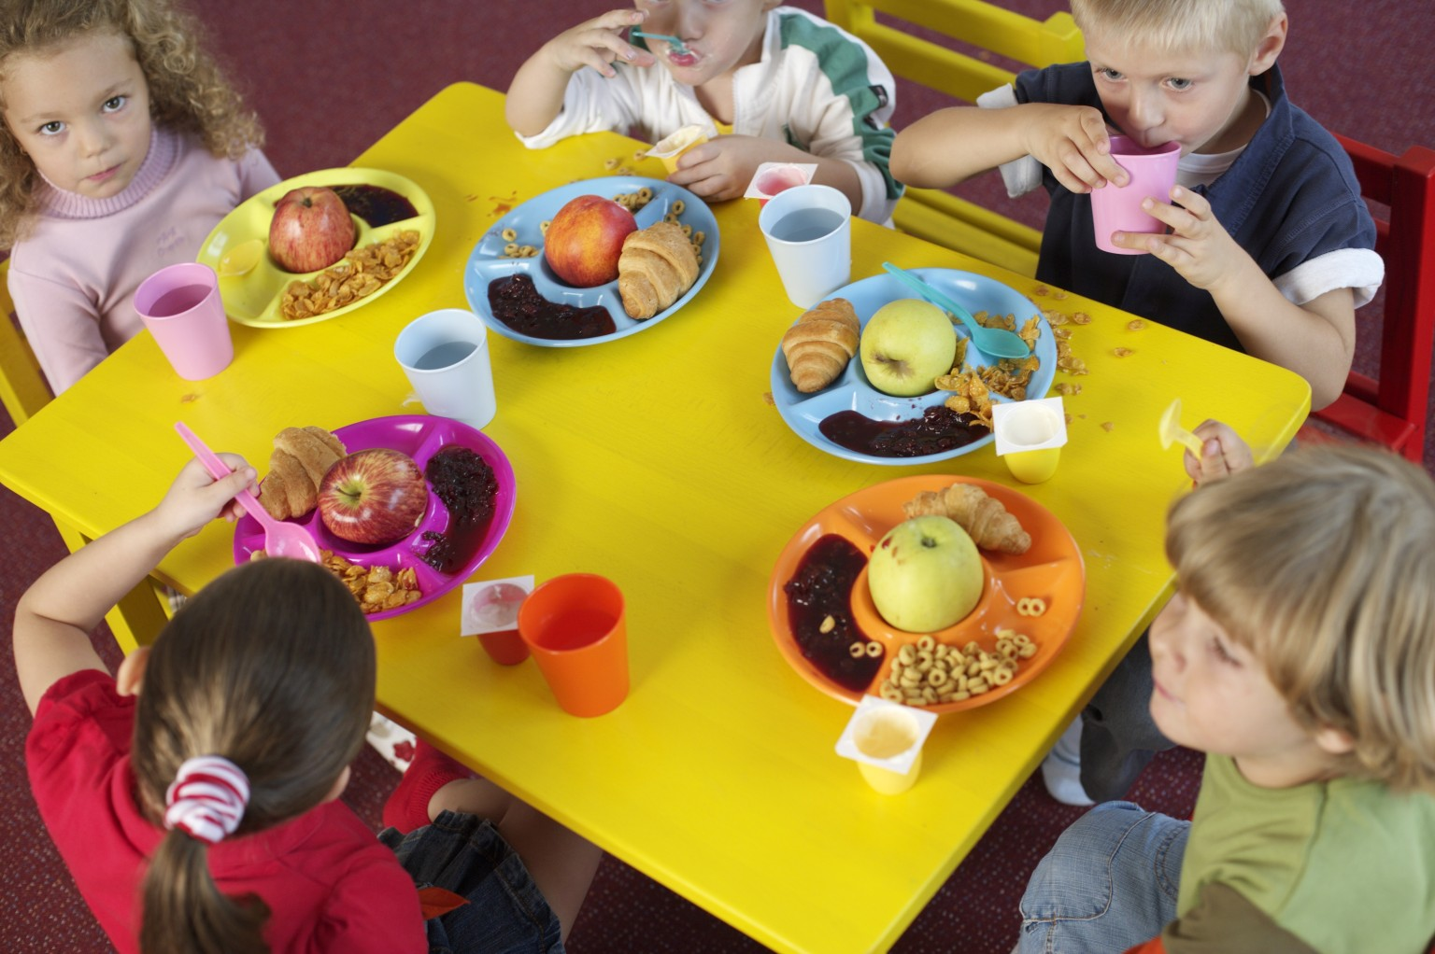
Look at the picture
They are eating food

Slide 4
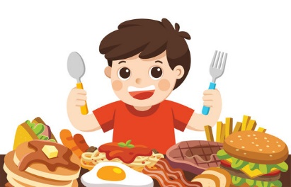
Todays Lesson
Food around the world
Unit : 21
Lessons 1-2
Page : 42

Slide 5
Learning Outcome
Student will be able to :
1.5.1To read words,phrases and sentences in the text with proper pronunciation.
8.1.1To make sentences using words.
1.7.1To write a short simple composition.

Slide 6
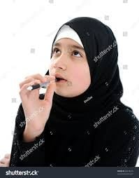
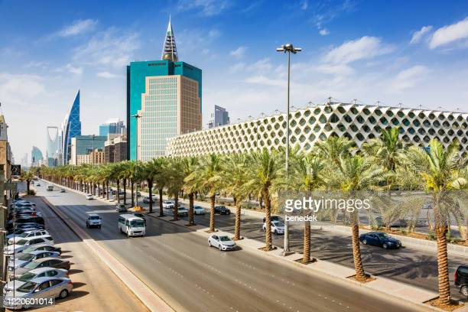
What we see ?
Heba
Saudi Arabia
This is Heba , She is from Saudi Arabia.

Slide 7
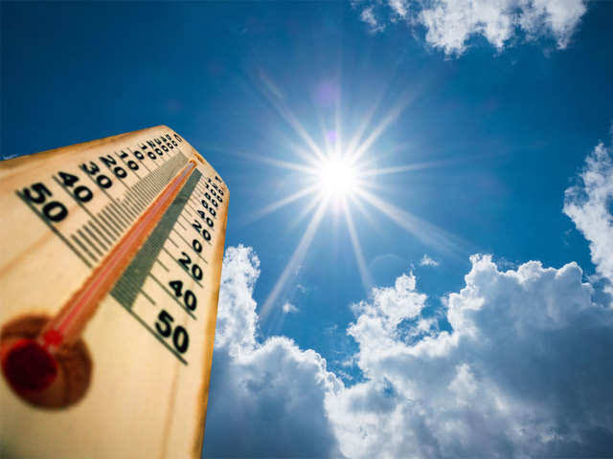
Look at the picture
Heba
Going school
Hot day
I start my day at 5 a.m and I have breakfast at 6 o’clock. It is bvery hot day , my school start at 7 a.m.

Slide 8
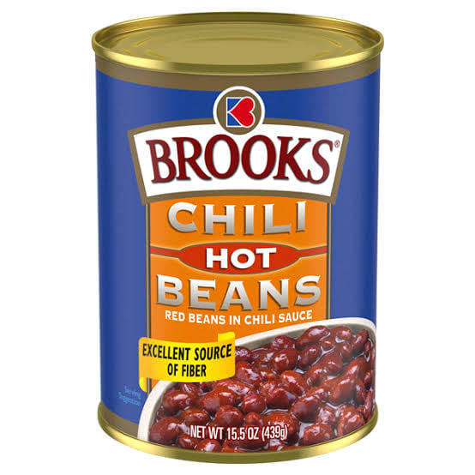
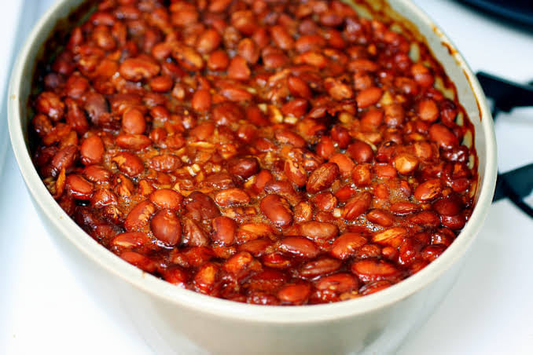
Look at the picture
This are hot beans. Heba uausally have some hot beans.

Slide 9
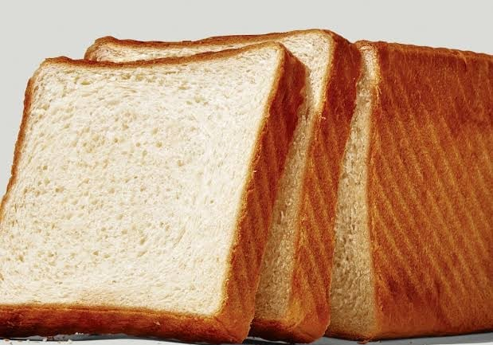
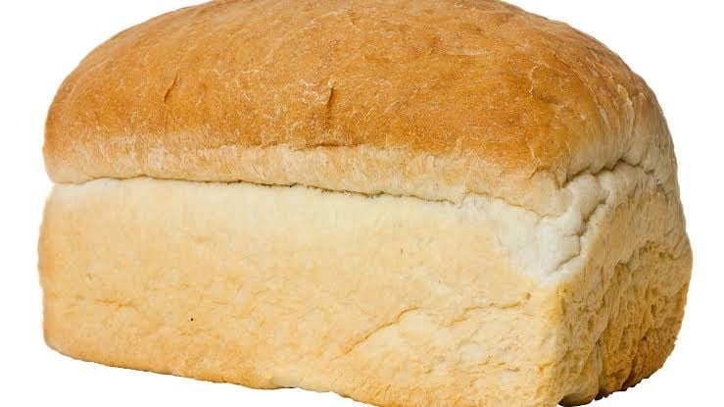
Look at the picture
Bread.
Heba uausally have some bread.

Slide 10
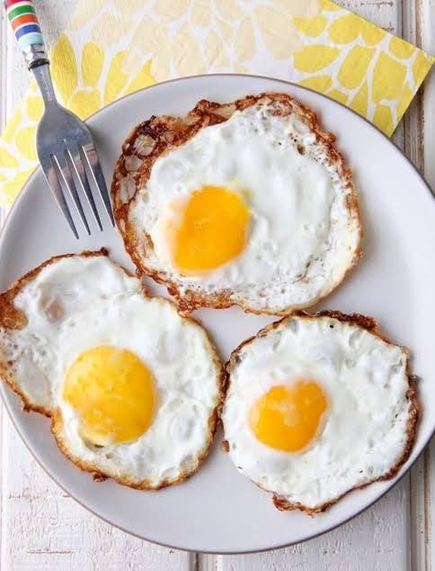
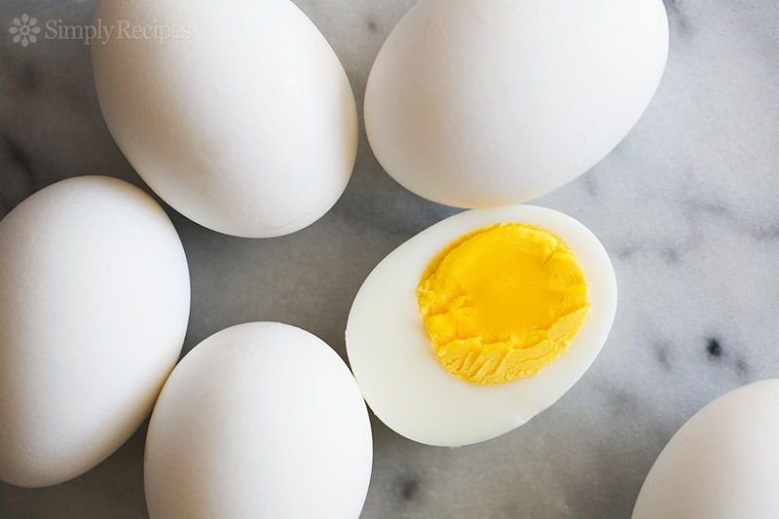
See more--
Egg
Some time Heba have egg.

Slide 11
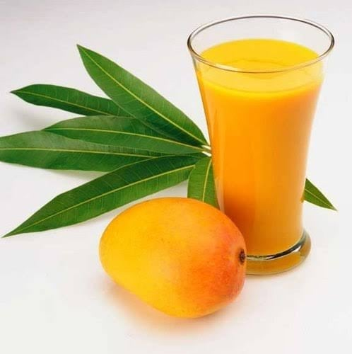
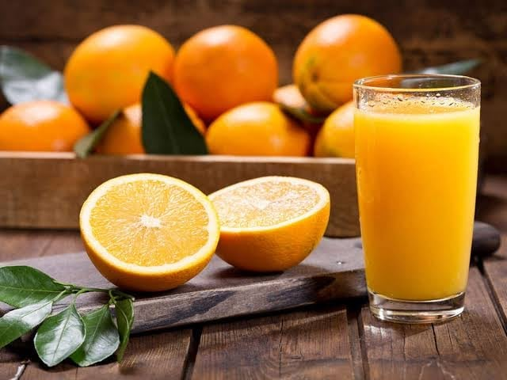
Now we see
Mango juice .
Orange juice .
Mango juice is heba,s fevourite, but she also like Orange juice too.

Slide 12
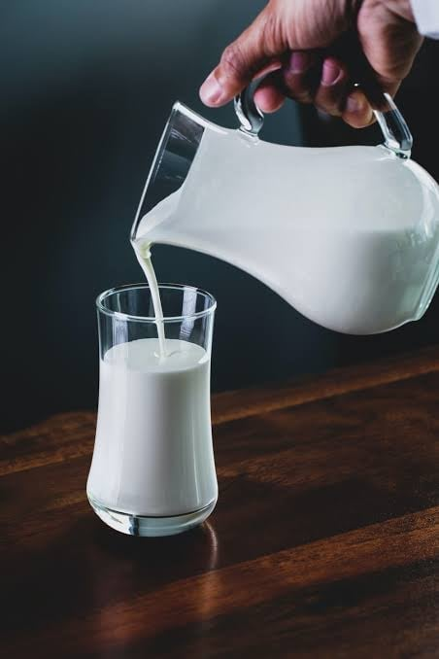
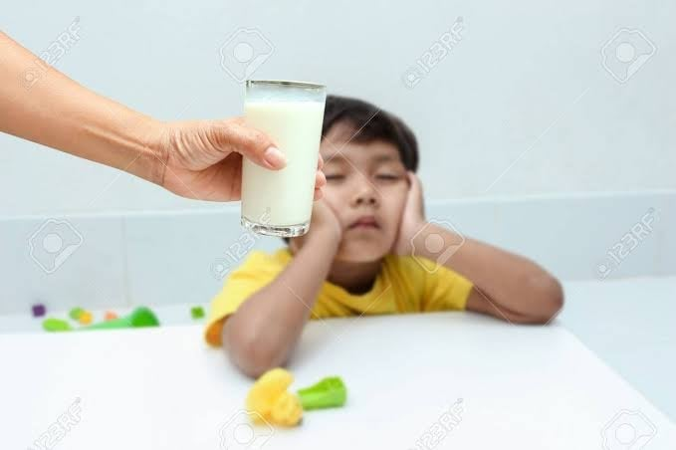
Now look at this.
Milk
Her family do not like a lit of Milk.

Slide 13
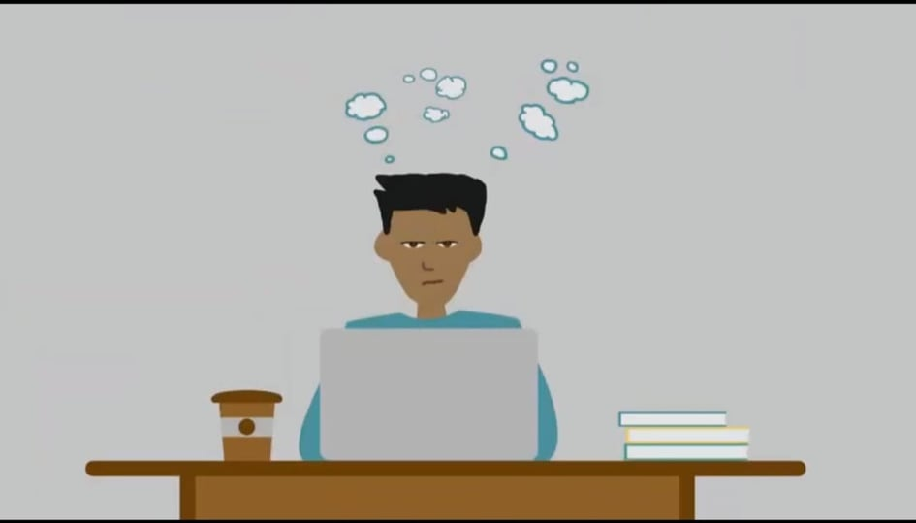
Individul work
Find new words in this todays lesion.
Write the name of food, which Heba usually eat or drink.

Slide 14
Teacher’s loud reading and discuss the lession.
Heba is an Arabian girl.
She get,s up at 5 am.
She usually have hot beans and bread.
heba like Mango juice.
She like Orange juce too.
Her family do not like a lot of Milk.

Slide 15
New words with sentences
Bean- A kinds of seeds.
start– to begin anythings.
Food-we eat food to get energy.
Favourite-to like something very much.

Slide 16
Student’s reading
Open the book at page no: 42

Slide 17
Pair work
6 o’clock
Mango
arabic
breakfast
Heba likes juice.
Heba does not take on weekend.
She takes breakfast at .
Heba is .

Slide 18
Group Work
G-1.When dose Heba take her breakfast?
G-2.Make a list Heba,s breakfast menu.

Slide 19
Evaluation
When do you get up?
What do you eat in your breakfast?
What’s your favourite drink?
When do you take breakfast?

Slide 20
Home work:
You will write a short composition about your favourite food at lest in five sentences.

Slide 21
See you again

