Slide 1
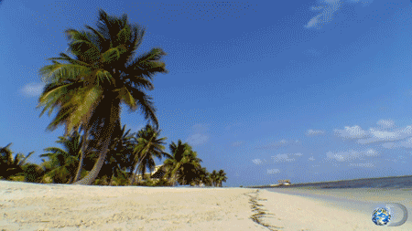
Welcome

Slide 2
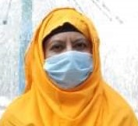
I
N
T
R
O
U
D
U
C
E
Laily Akter
Assistant Teacher
Fulgaon Govt. primary School
Laksam, Comilla.
Unit: 24
Lesson:1
Time:40 minutes

Slide 3
Let’s watch a video.
What do you see in the video?

Slide 4
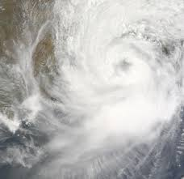
Cyclone Aila

Slide 5
Learning outcomes
Students will be able to:
Listening: 3.4.1:Understand statements made by teachers & students.
Speaking: 6.2.1:Talk about people, objects, events etc.
Reading: 1.5.1:Read words, phrases and sentence in the text with
Proper pronunciation, stress and intonation.
writing: 8.1.1:Make sentences using words & Phrases given in
the textbook.

Slide 6
Word meaning
Rising
Flooded
Blowing
Roof
Away
Repairing
বৃদ্ধি পাওয়া।
বন্যাকবলিত / পানিতে ডুবে যাওয়া।
বহা ( বাতাস বহা )।
ছাদ / ঘরের চালা।
উড়িয়ে নেয়া।
মেরামত করা / পুনরায় তৈরি করা।

Slide 7
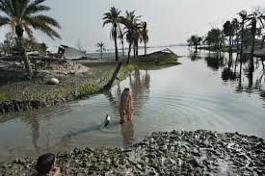
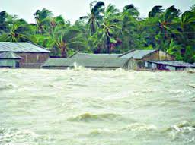
What do you see in the picture ?
The river is rising.

Slide 8
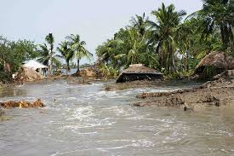
What do you see in the picture ?
The river flooded the field.

Slide 9
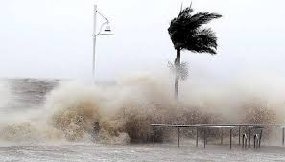
What do you see in the picture ?
The pictures are about ‘Cyclone Aila’

Slide 10
Look at the pictures and think about these alone.
Answer: The river flooded the field.

Slide 11
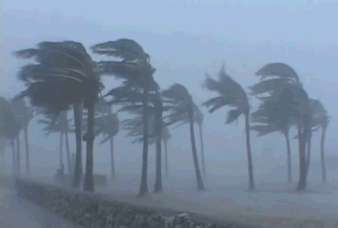
What do you see in the picture ?
The storm starts.

Slide 12
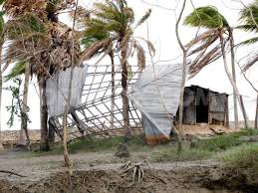
What do you see in the picture ?
The wind is blowing the roof away.

Slide 13
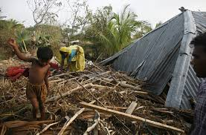
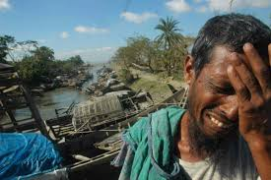
What do you see in the picture ?
The wind is blowing the roof away and the man is so sorrow.

Slide 14
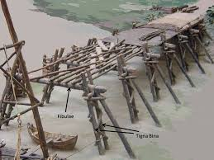
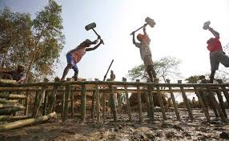
What do you see in the pictures ?
The bridge is damaged by Cyclone.
The workers are repairing the bridge.

Slide 15
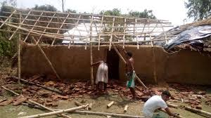
What do you see in the pictures ?
The workers are repairing the huts.

Slide 16
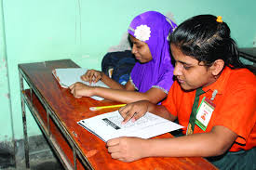
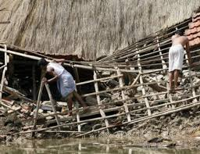
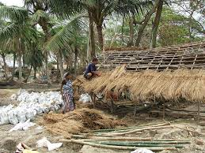
Look at the pictures and think about these pair.
The huts are repairing after Aila.

Slide 17
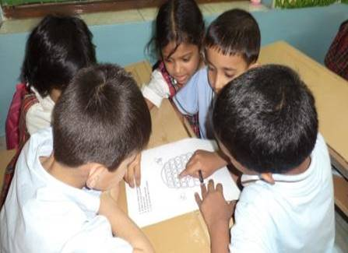
Look at the pictures and discuss in group and write your notebook.
Group- A
Group- B
The wind is blowing the roof away.
The storm starts.
The river is rising.
The workers are reparing the bridge.

Slide 18
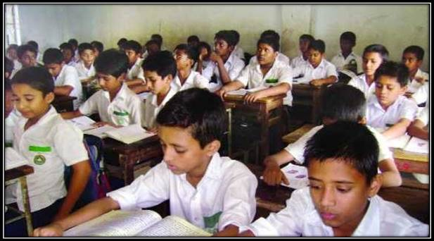
Everybody take your book and open page at 94 .
Read silently.

Slide 19
Evalution
Write the sentences in your notebook and number them in correct
order from 1 to 4.
-------The workers are repairing the huts and fields.
-------The river is rising and the winds are blowing.
-------The storm starts.
-------The wind is blowing the roofs away and the river
is flooding the fields.
4
2
1
3

Slide 20
1. The storm starts.
2. The river is rising and the winds are blowing.
3. The wind is blowing the roofs away and the river
is flooding the fields.
4. The workers are repairing the huts and fields.

Slide 21
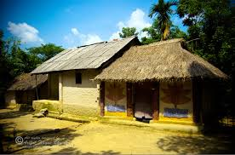
Home Work.
Everybody will read today’s lesson at your home
and write five sentences about “Cyclone Aila”.

Slide 22
Thanks to all. Goodbye.

