Slide 1
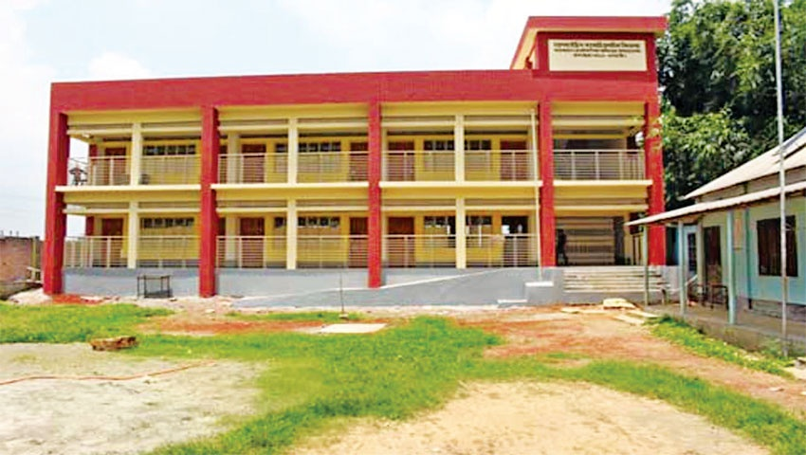
Welcome to our
English class

Slide 2
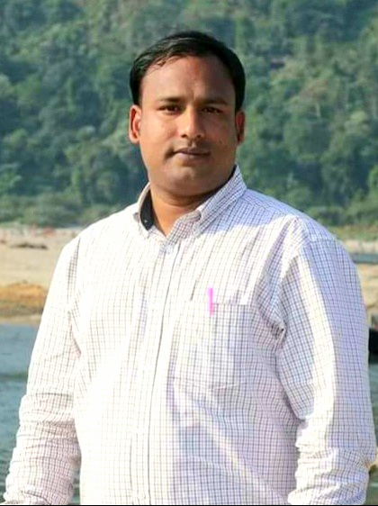
Presented by:
MD.AZIZUR RAHMAN
Assistant Teacher
Kandigoan Govt. Primary School.
Kamalgonj,Moulvibazar .

Slide 3
Class: Five
Subject: English
Unit: 09
Today`s Lesson: Lessons: 1-2

Slide 4
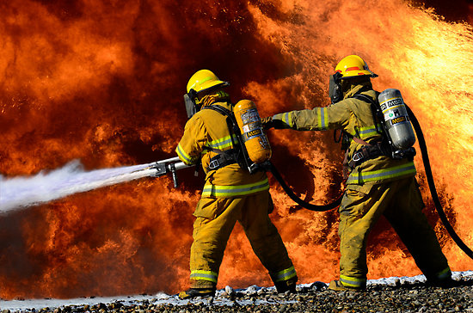
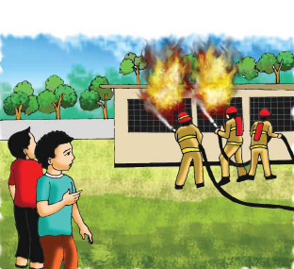
What are you see in the pictures?
There is a fire in a building and the firefighters are trying to put out the fire.

Slide 6
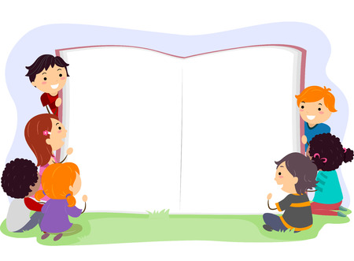
Lesson declaration
Our Today’s lesson
Occupations

Slide 7
Let`s know some new words
Firefighter
Put out
অগ্নিনির্বাপণ কর্মী
নিভানো
a person whose job is to stop fires from burning
to stop a fire

Slide 8
Let`s know some more new words
Panicked
Join
ভীত
যোগদান করা
Suddenly feel frightened
To connect or admit

Slide 9
Let`s know some more new words
Safely
Volunteer
নিরাপদভাবে
স্বেচ্ছাসেবক
Without being injured or harmed.
A person who freely offers to take part in work.

Slide 10
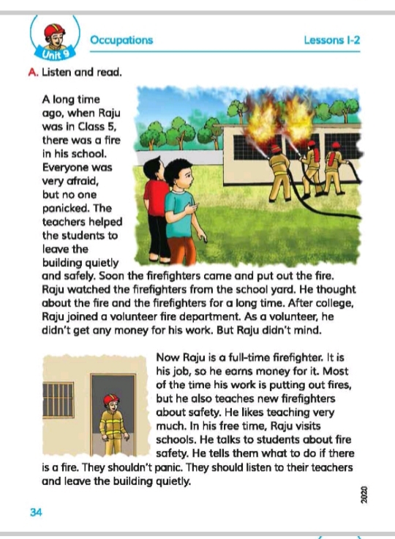
Open your book at page 34

Slide 11
I W
Try to answer the questions
Where did the fire take place ?
Why were the students very afraid?
Who helped the students to leave the building?
Ans: The fire took place in Raju’s school.
Ans: The students were very afraid because there was a fire accident in the school.
Ans: The teachers helped the student’s to leave the building.

Slide 12
Student’s silent reading

Slide 13
Group work
Write ‘True’ for correct statement and
‘False ’ for incorrect statement .
1. Everyone was panicked.
False
2. Raju joined a volunteer fire department after school.
False
3. Now Raju earns money as a full-time firefighter.
True
4. Raju was a student when there was a fire in his school.
True
5. Raju likes teaching very much .
True

Slide 14
Pair work
Fill in the gaps with the best word from box.
Put out
student
yard
students
pleasure
Raju was a--------------- when there was a fire in his school.
Raju watched the firefighters from the school ---------------------.
Raju fills -----------------------for working as a volunteer.
Raju likes to teach the new ------------------------.
5 The fighters came to Raju’s school to----------------- ----- the fire.

Slide 15
Evaluation
Rearrange the words in the appropriate order to make
Meaningful sentences.
1. everyone /very/was/afraid
2.he/to/ talks/fire/safety/students/about
3.raju/volunteer/joined/a/department/fire
4 .shouldn’t/they/panic
Ans : Everyone was very afraid.
Ans:He talks to students about fire safety.
Ans .Raju joined a volunteer fire department.
Ans . They shouldn’t panic.

Slide 16
One day one word
Department
বিভাগ

Slide 17
Home work
Write a short composition
about your favourite occupation.

Slide 18
Thanks to all.
See you in the next class

