Slide 1
Welcome

Slide 2
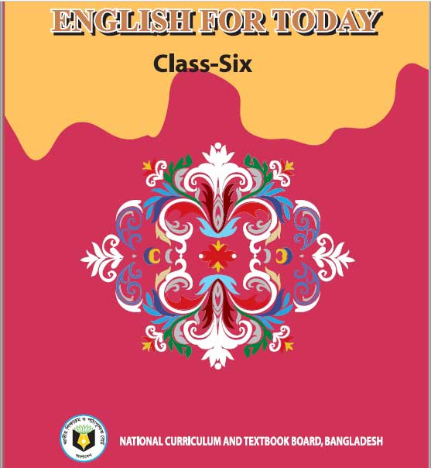
Ujjal Kumar Ghosh
Assistant Teacher (English)
Chuadanga Krishnanagor high school
Panjia,Keshabpur,Jassore

Slide 3
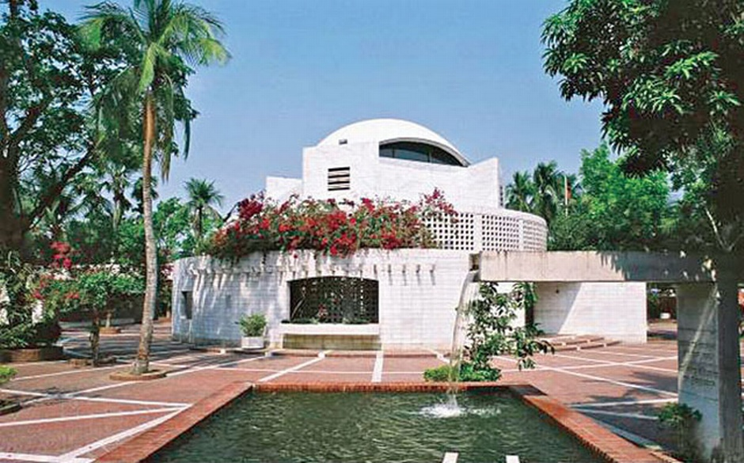
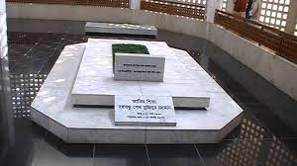
What do you see in the picture?
Yes,We can see a grave.It is the grave of an eminent person.

Slide 4
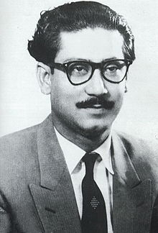
Do you know the man?
Yes , Bangabandhu Sheikh Mujibur Rahman.

Slide 5
Today’s lesson is son of the soil
Lesson -12
English For Today
Class -Six
Page Number 39

Slide 6
Learning outcome
After completing the lesson students will be able to
1.describe picture.
2.answer questions (in oral and written from)after reading a text.
3.participate in group discussions.
4.write short compositions

Slide 7
Independence means freedom, liberty
Bangabandhu Sheikh Mujibur Rahman called for independence.
Autonomy means Swaraj, freedom
Six-point programme drew the roadmap for the independence of Bangladesh under the garb of greater autonomy.
Conspiracy means plot, intrigue, frame-up
On 15 august Bangabandhu Sheikh Mujibur Rahman was assassinated by conspiracy.

Slide 8
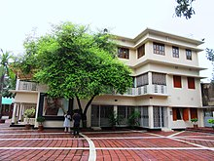
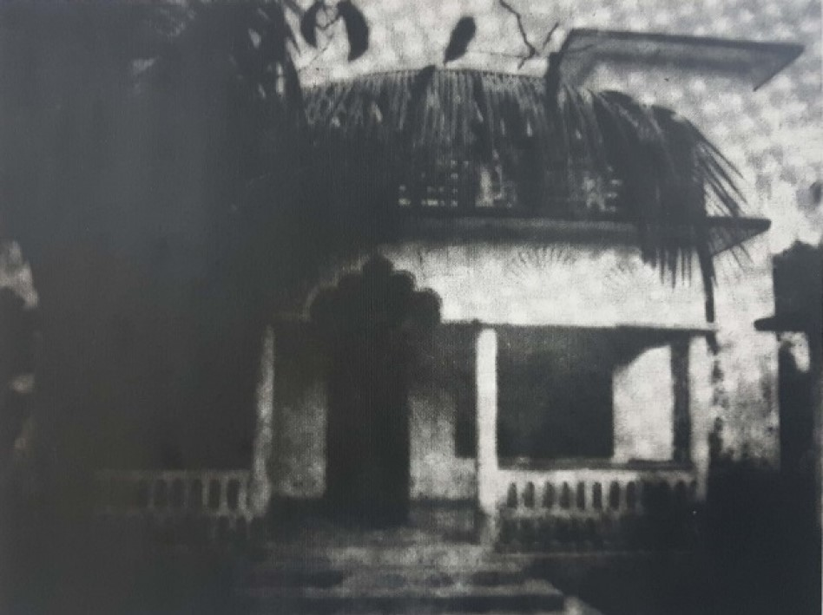
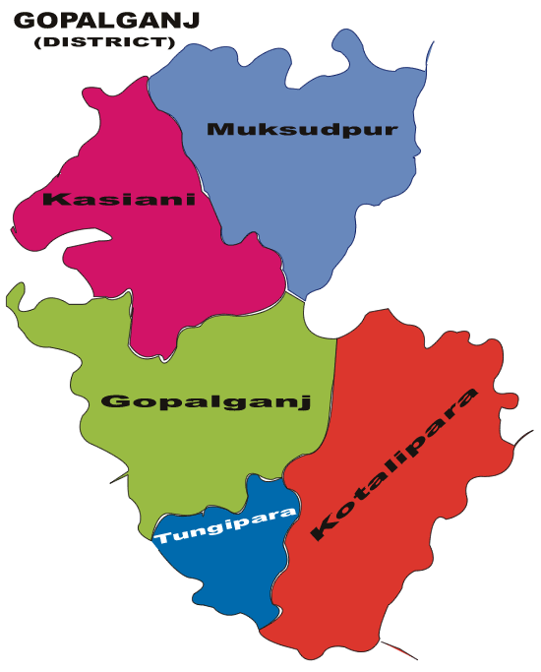
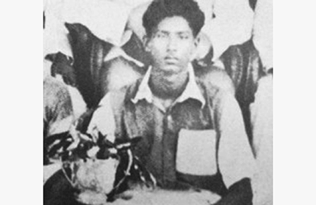

Slide 9
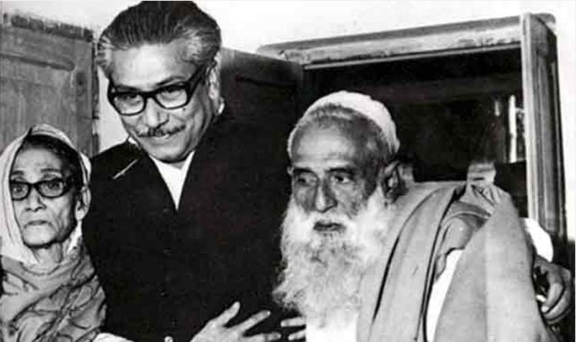

Slide 10
Let's read the text
1920
Sheikh Mujibur Rahman was born in the village of Tungipara under the then Gopalganj Subdivision (now District) of the then Faridpur District on March 17, 1920. His father Sheikh Lutfar Rahman and his mother Sheikh Sayera Khatun had four daughters and two sons. Sheikh Mujibur Rahman was their third child. His parents used to adoringly call him khoka

Slide 11
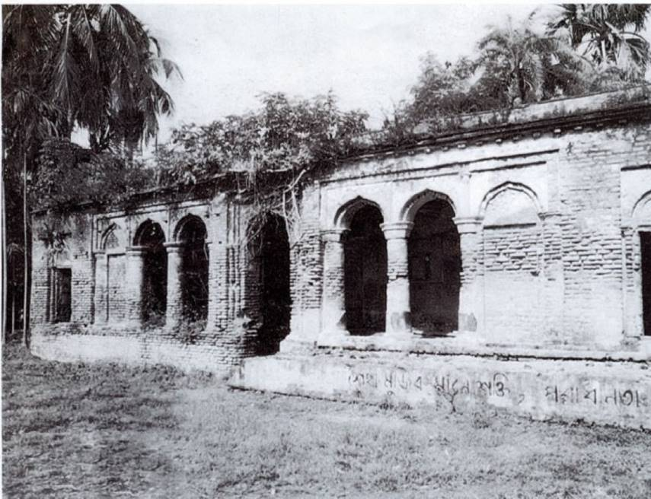

Slide 12
1927
At the age of seven in 1927, Sheikh Mujib began his schooling at Gimadanga Primary School. At nine, he was admitted to class three at Gopalgonj Public School. Subsequently, he was admitted to Gopalgonj Missionary School. Before becoming active in student movements and politics, Sheikh Mujibur Rahman had an affinity toward sports like any other teenager. He possessed a special love for football. A talented football player, Sheikh Mujibur Rahman spent his adolescent years playing in competitive tournaments, where he received awards for his outstanding performances.

Slide 13
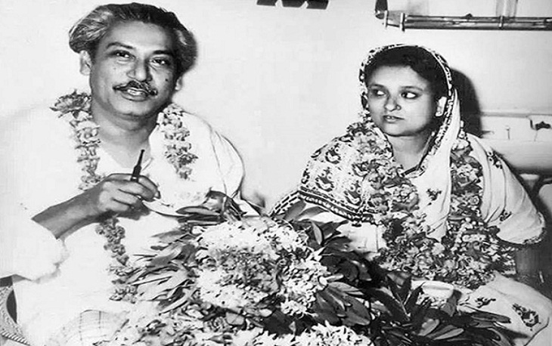
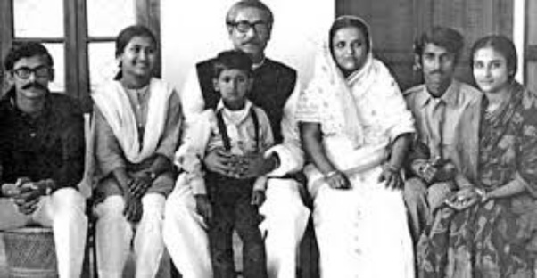

Slide 14
1932/1933
Sheikh Mujibur Rahman married Sheikh Fazilatunnesa (Renu). Together they had two daughters, Sheikh Hasina and Sheikh Rehana, and three sons, Sheikh Kamal, Sheikh Jamal and Sheikh Russel. ​

Slide 15
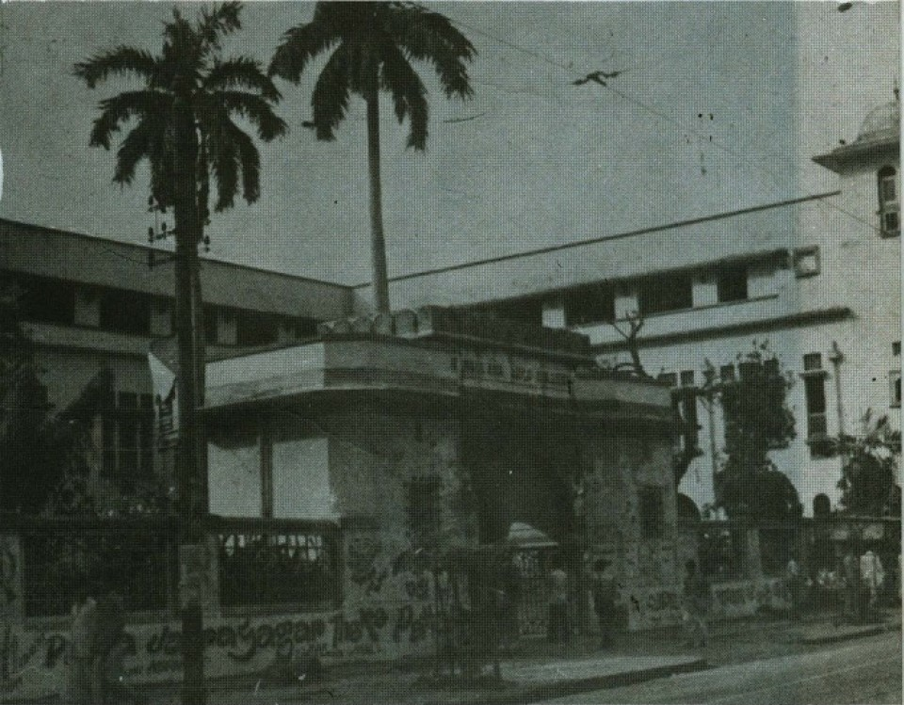
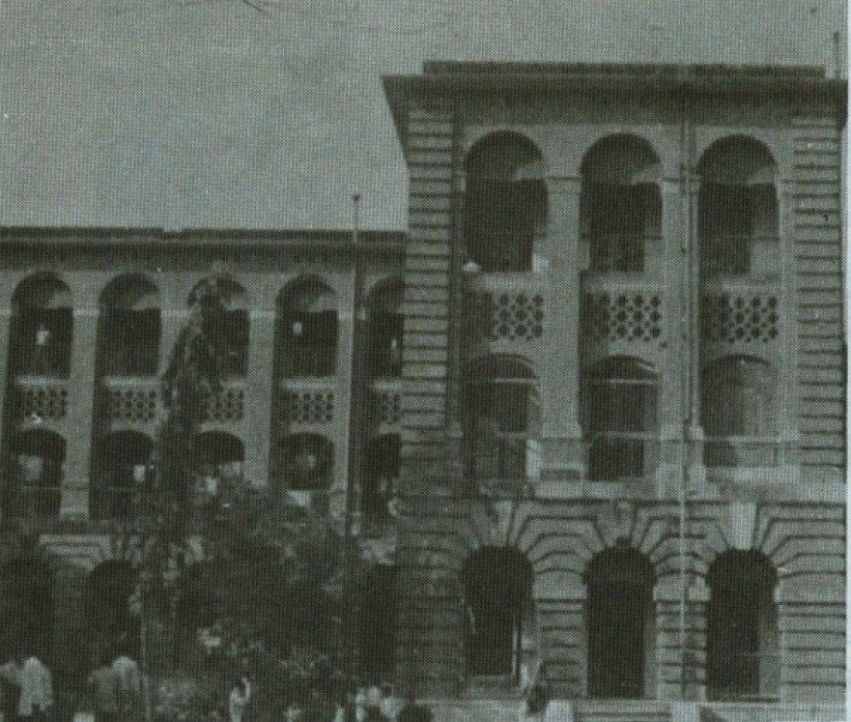
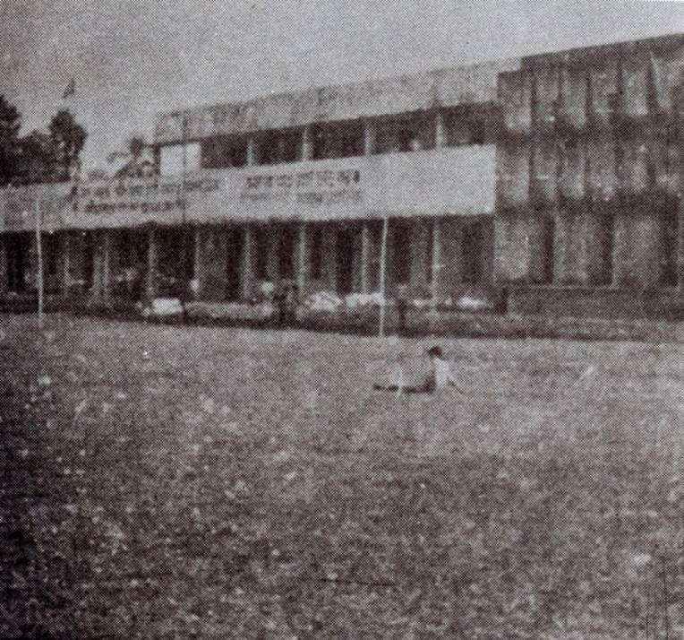

Slide 16
1942
Sheikh Mujibur Rahman passed Matriculation examination from Gopalganj Missionary School. The same year he got himself admitted into the Islamia College (currently Maulana Azad College), Kolkata. From there he completed his graduation in the year 1947. In 1943, Sheikh Mujibur Rahman was elected councillor of All India Muslim League from Bengal. He continued to serve admirably in this position till the partition of India in 1947.

Slide 17
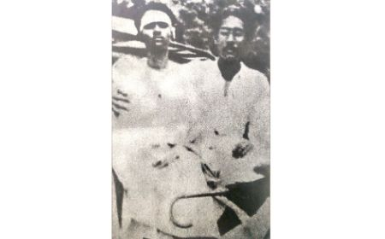
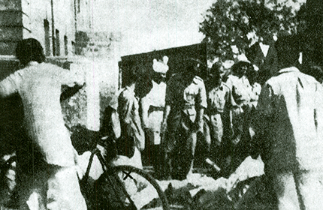
1948
Sheikh Mujibur Rahman took admission in the Department of Law at the University of Dhaka. He founded the East Pakistan Muslim Students’ League, the first opposition student organization in Pakistan on January 4. He rose in spontaneous protest on February 23 when Chief Minister Khawaja Nazimuddin declared in the Constituent Assembly: ‘The people of East Pakistan must accept Urdu as their state language.’

Slide 18
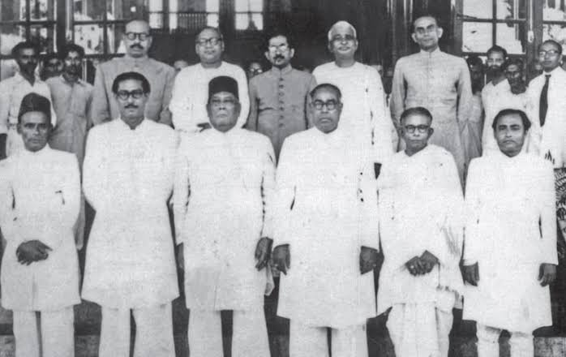

Slide 19
1954
The first elections in East Bengal were held on March 10. The United Front won 223 seats out of 237 Muslim reserved seats. The Awami League alone obtained 143 seats. Sheikh Mujib won the election from the Gopalganj constituency and took oath on May 15 as Minister for Co-operative and Agricultural Development in the new provincial government. The central government arbitrarily dismissed the United Front cabinet on May 30, and as Mujib landed back in Dhaka from Karachi the same day, he was immediately arrested. He was released on December 23.

Slide 20
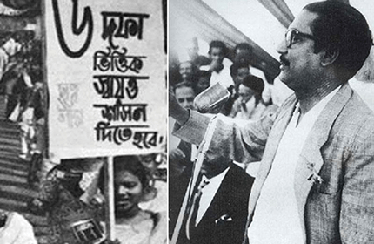
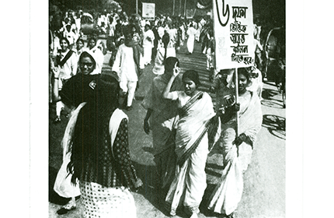
1966
On February 5, 1966, Sheikh Mujibur Rahman presented his historic six-point programme known as the `charter of freedom of the Bengali nation’. It drew the roadmap for the independence of Bangladesh under the garb of greater autonomy.

Slide 21
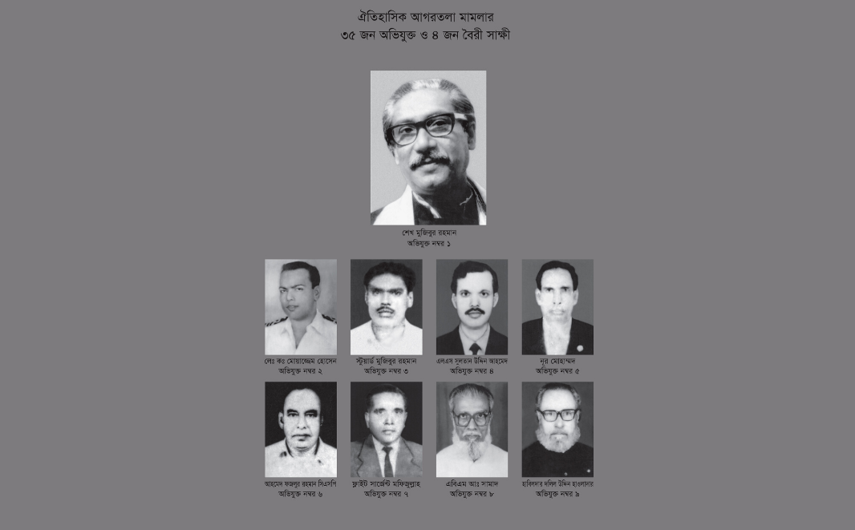
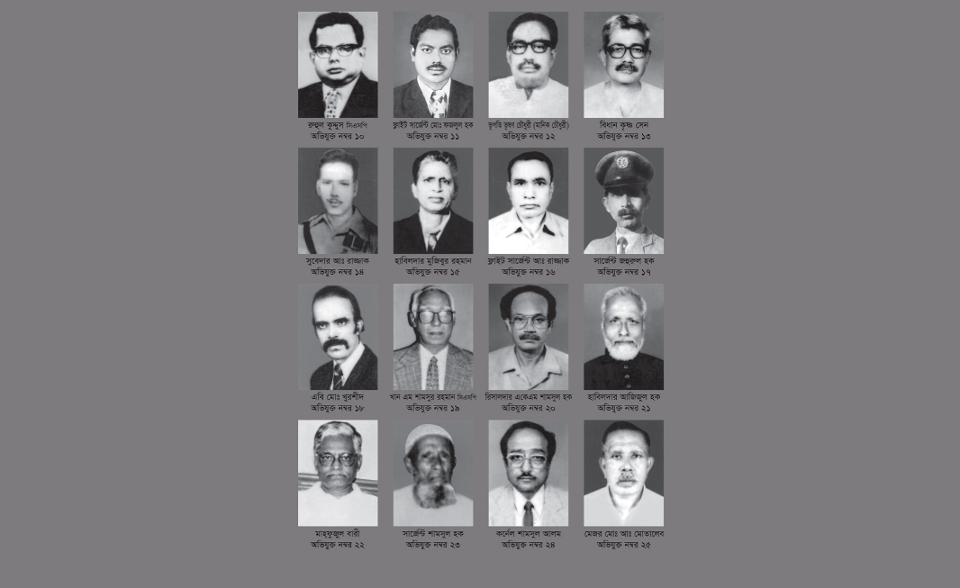
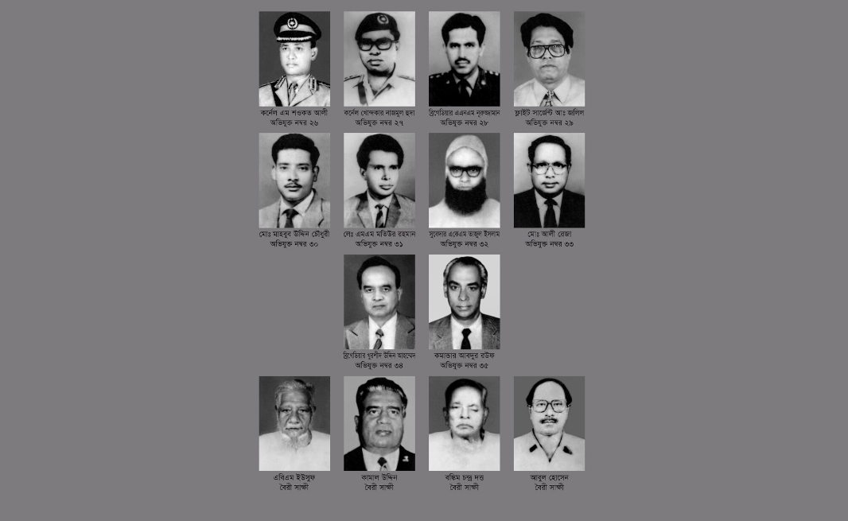

Slide 22
1969
The Agartala Conspiracy Case resulted in a nationwide student movement and mass upsurge demanding the withdrawal of the case and the release of Sheikh Mujibur Rahman. With continued pressure from the public, the Ayub Khan government on February 22 was forced to withdraw the Agartala Conspiracy Case and release Sheikh Mujibur Rahman and others. Afterwards, Sheikh Mujib was awarded with the title 'Bangabandhu' at a reception of millions of students and masses in a mammoth public meeting organized by Central Student Action Committee at the Race Course (now Suhrawardy Udyan) on February 23.

Slide 23
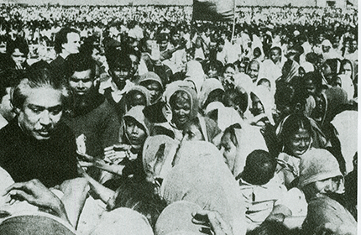
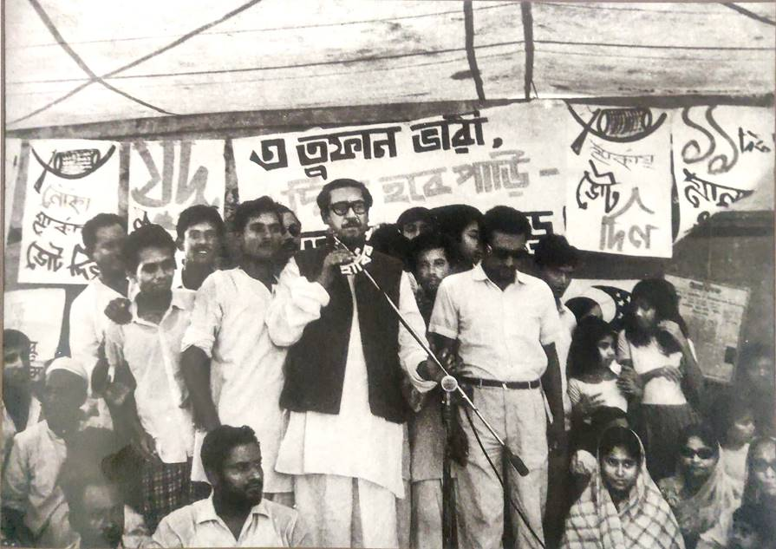
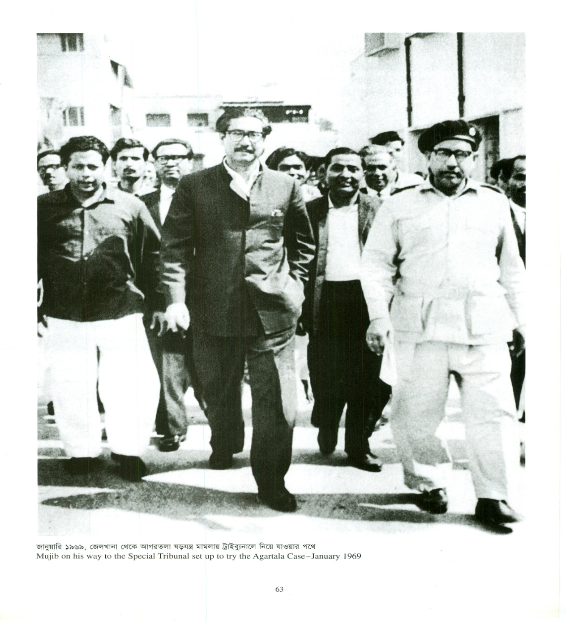
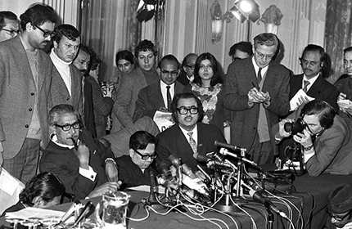

Slide 24
1970
Bangabandhu Sheikh Mujibur Rahman, the Awami League President, urged his countrymen to elect Awami League candidates on the basis of the 6-point demand in the country’s first general elections held on December 7 (National Assembly), and December 17 (Provincial Assembly), barring few seats in the cyclone affected coastal areas in the south. He chose 'boat' as the symbol to represent Awami League and the nation's hope. When a million people died in a catastrophic cyclone in the coastal areas on November 12, Sheikh Mujibur Rahman suspended the election campaign and rushed to the affected areas. Awami League achieved absolute majority in the general elections on December 7, winning 167 (including 7 women reserved seats) out of the 169 seats of the National Assembly in East Pakistan and 298 seats (including 10 women reserved seats) of the 310 seats of the Provincial Assembly of east pakistan.

Slide 25
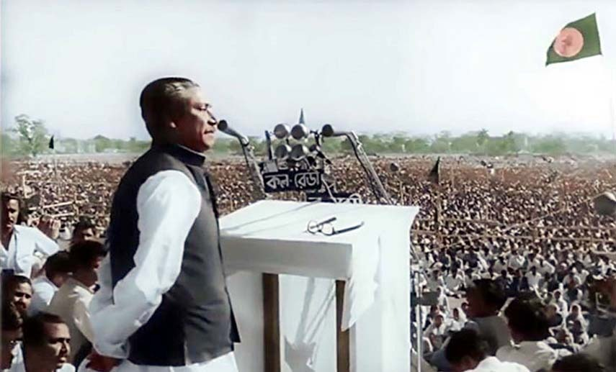
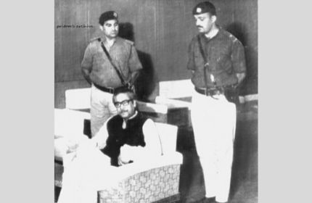

Slide 26
1971
Following general Yahya khan’s postponement of the National Assembly session on March 1, 1971, only two days before the session was due to take place, every section of the Bengalis instantaneously came out onto the streets in massive demonstrations. The Bengalis’ aspirations for freedom reached an indomitable height. From March 1 onward Bangabandhu Sheikh Mujibur Rahman was virtually running East Pakistan as its de-facto head of government. On March 7, in his historic speech before the millions of people at the Racecourse Maidan (Suhrawardy Udyan), Bangabandhu Sheikh Mujibur Rahman called his fellow countrymen to take all out preparations for the war of liberation and independence of Bangladesh.

Slide 27
On the midnight of March 25, the Pakistan army launched its heinous campaign of genocide against the unarmed Bengalis. Sheikh Mujibur Rahman proclaimed the Independence of Bangladesh in the early hours of March 26. Right after the proclamation, he was arrested and taken to a Pakistani prison. On April 10, 1971, the first government of the People’s Republic of Bangladesh was formed, and Bangabandhu Sheikh Mujibur Rahman was elected as President by the constituent assembly.

Slide 28
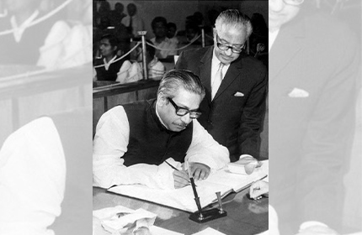
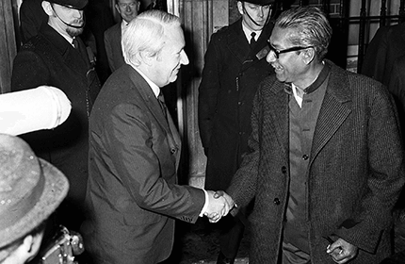
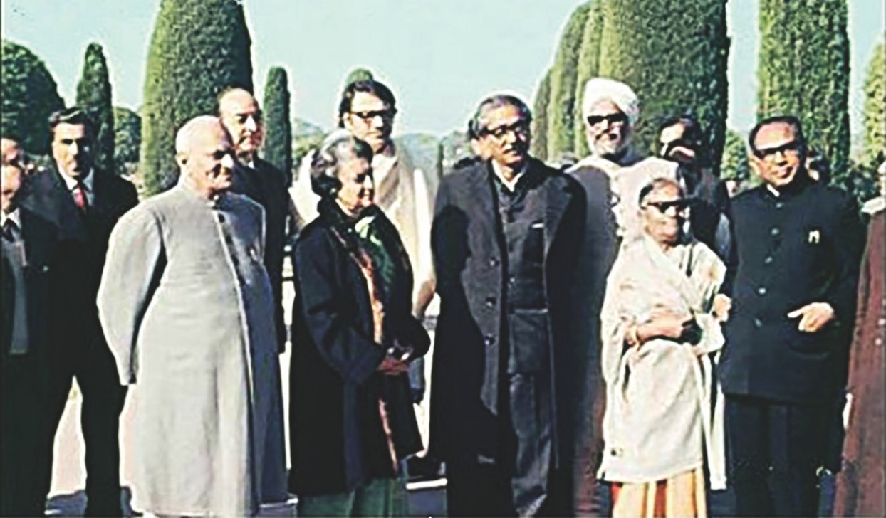
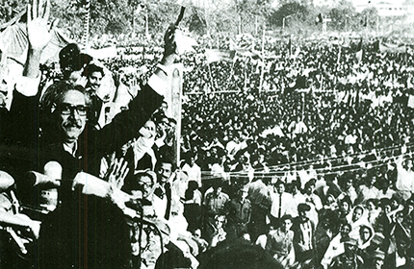

Slide 29
1972
The Government of Pakistan was forced to release Bangabandhu Sheikh Mujibur Rahman on January 8, under immense international pressure. On that very day, Bangabandhu Sheikh Mujibur Rahman traveled to London on his way to Dhaka. There at a crowded press conference in his hotel in London, he spoke to the world press and on January 9, met the British Prime Minister, Edward Heath. Prior to returning to Dhaka, Bangabandhu Sheikh Mujibur Rahman stopped over at Delhi, where the Indian President V. V. Giri and Prime Minister Indira Gandhi along with others welcomed him with grace. When the Father of the Nation reached Dhaka on January 10, millions of jubilant citizens of the newest country in the world welcomed him with open arms.

Slide 30
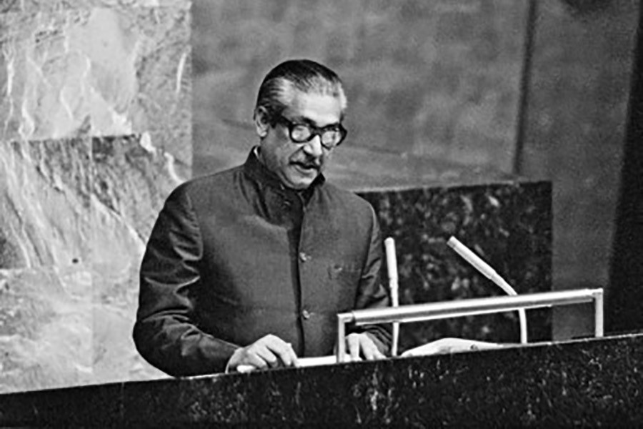
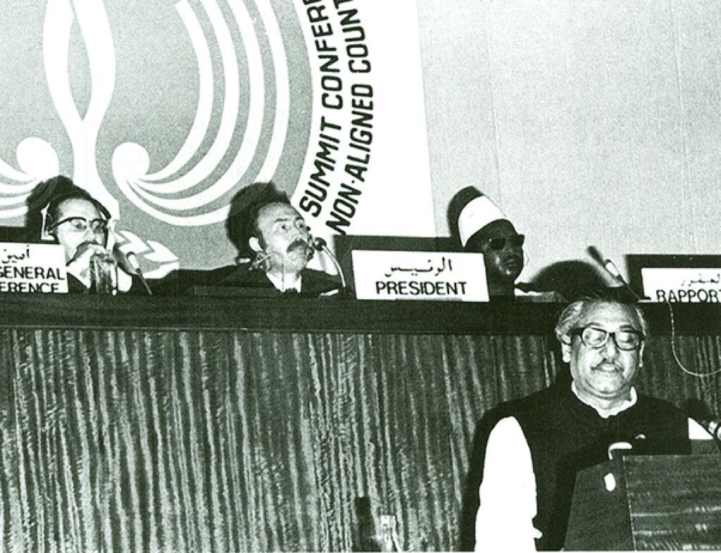

Slide 31
1974
Bangladesh received world recognition by becoming the 136th member of the United Nations on September 17. On September 25, at the 29th General Assembly of the United Nations, Sheikh Mujibur Rahman addressed the world in Bangla, the first ever Bangla speech delivered at the UN.

Slide 32
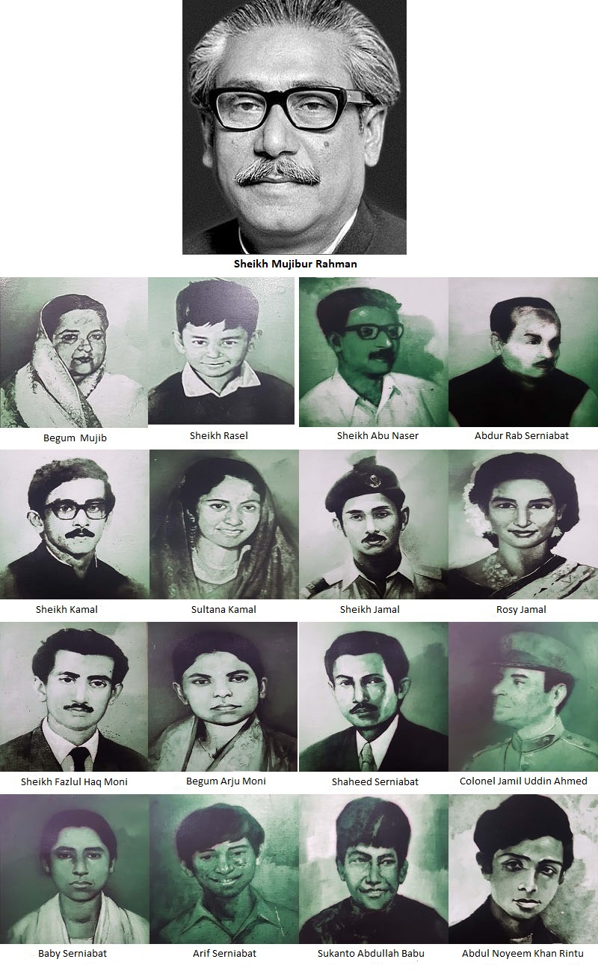

Slide 33
1975
Father of the Nation Bangabandhu Sheikh Mujibur Rahman, the architect of Bangladesh, was assassinated by a handful of army renegades as part of a larger national and international political conspiracy hatched by anti-liberation forces in the pre-dawn hours of August 15. They murdered in cold blood every member of his family except his daughters Sheikh Hasina and Sheikh Rehana, who by fortune alone were abroad at that time. Bangladesh observes August 15 as the National Mourning Day and remembers the noblest and the greatest Bengali who ever lived, through his spirit, ideology, courage and love for the people of his nation.

Slide 34
Pair work
1.Where was Bangabandhu born?
2.In which school did Bangabandhu start reading and writing?
3.Who gave him the title of Bangabandhu?
4.Where and when did Bangabandhu give his speech on March 7?

Slide 35
Group work
Read the multiple choice question . Each question has one correct answer.
1.How was Bangabandhu during his childhood?
a.gentle b. lazy c.lively d.shy
2.What type of activity is brotochari?
a.Playing b.singing c.dancing d.reading
3.Why did mujib follow his house tutor?
a.to help himself b.to help the disable persons
c.to help his school d.to help the unfortunate students
4.When did mujib take the responsibility of helping the poor students alone?
a)after his tutor died b.after his leader died
c.after his father died d.after his friend died
Answer: 1.c) lively 2.c)dancing 3.d)to help the unfortunate students 4.a)after his tutor died

Slide 36
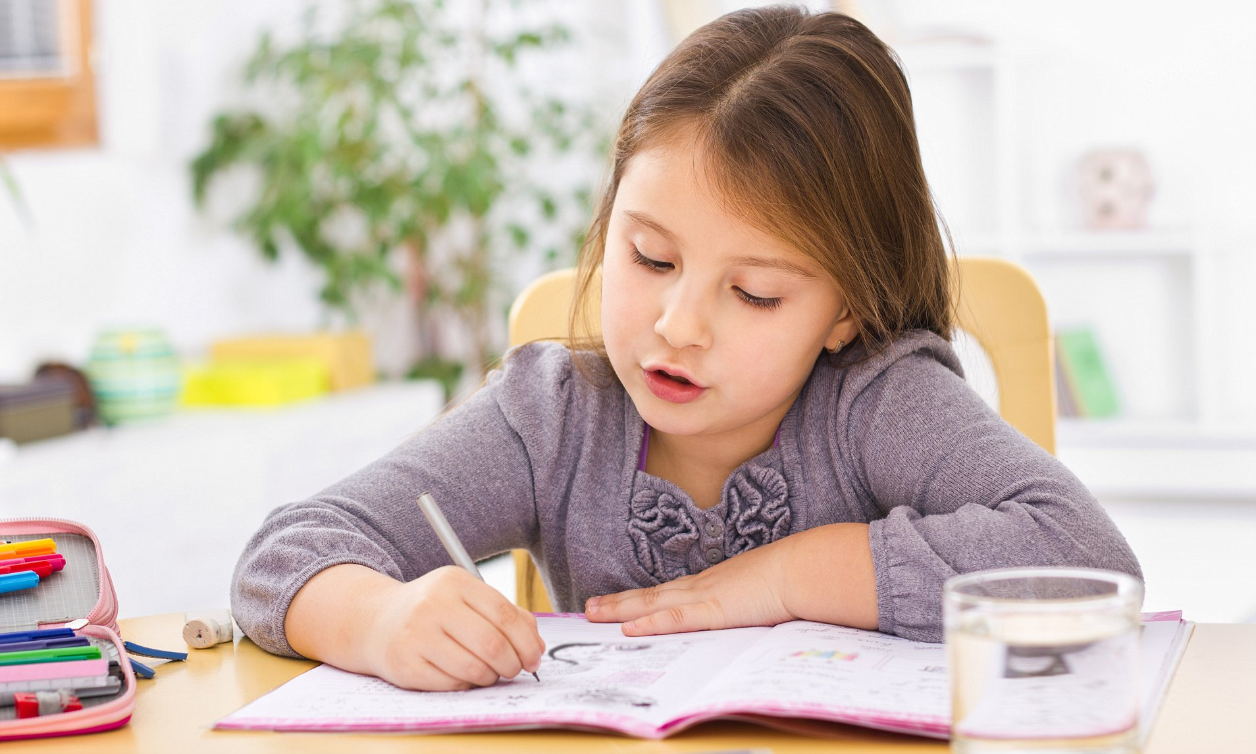
Home work
Write a composition about Bangabandhu Sheikh Mujibur Rahman.

Slide 37
Goodbye

