Slide 1
WELCOME TO MY CLASS

Slide 2
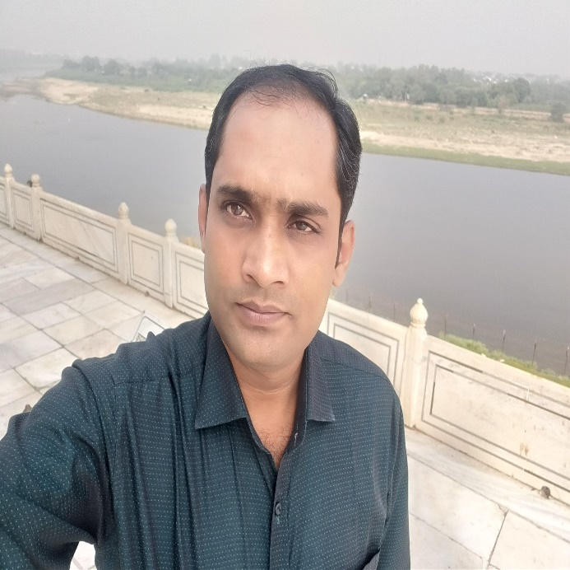
Teachers identity
MD. ABDULLAH AL AHAD REZA
Assistant teacher
Ramchandrapurhat Gov:
Primary School
Sadar, Chapainawabganj

Slide 3
Lessons identity
ENGLISH FOR TODAY
Class-2
Lesson: Alphabet
Unit: 1
Lesson : Aa, Bb and Cc

Slide 4
Learning Outcomes
Students will be able to recognize and say Alphabet(Aa, Bb and Cc)

Slide 5
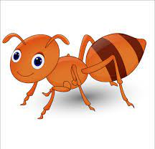
Let’s see some picture
Ant

Slide 6
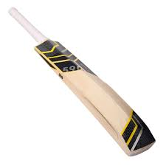
Bat

Slide 7
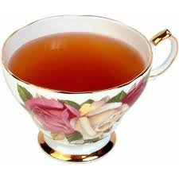
Cup

Slide 8
Ant
Bat
Cup

Slide 9
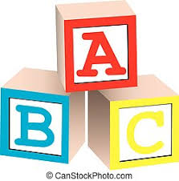
Our todays lesson
Alphabet

Slide 10
A
n
t
A
a
a
n
t
A
a

Slide 11
A for ……… Ant
a for ………ant

Slide 12
B
a
t
B
a
b
t
b
B
b

Slide 13
B for ……… Bat
b for ………bat

Slide 14
C
u
p
C
c
p
c
u
C
c

Slide 15
C for……… Cup
c for………cup

Slide 16
EVALUATION
Match the capital letters with the small letters
(Whole Class Work)
c
b
a
A
C
B

Slide 17
Say the the initial Alphabet after seeing the picture
Aa
Bb
Cc

