Slide 1
WELCOME TO MY CLASS;

Slide 2
Greetings.
Notes:
How are you? Fine Thank you.

Slide 3
Introduction of the teacher.
Mijanur Rahman
Assistant Teacher
Uttar Gopalpur Gov’t primary school
Durgapur, Netrakona
Bangladesh.

Slide 4
Lesson Idendity
Class: 3
Subject: English
Unit:2
Lesson:1-3
Title: Introducing a Teacher.
Part of the lesson: A
Time: 40 minutes
Date: 16. 08. 21

Slide 5
Learning Outcomes:
By the end of the lessons students will be able to---
Listening:
3.1.1-understand simple questions about students, family and
Friends.
3.3.1-understand statements.
Reading:
1.5.1-Read simple sentences with proper pronounciations
and stress.
5.1.3-read texts.

Slide 6
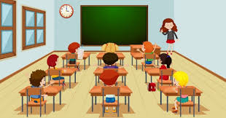
What is this?
This is a classroom.

Slide 7
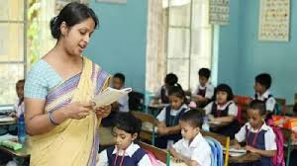
What do you see in the picture?
WCW
Do you know him/her?

Slide 8
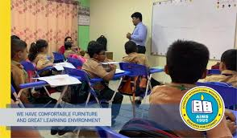
Who teaches in the classroom?

Slide 9
This is Mahbub Alom.

Slide 10
Who is he?
He is an English Teacher.
Can you feel Where does
he work?
He works in a primary school .

Slide 11
Open your book at page number 4 and read the
text silently.

Slide 12
New words:
Year
বৎসর
Old
বয়স
Work
কাজ

Slide 13
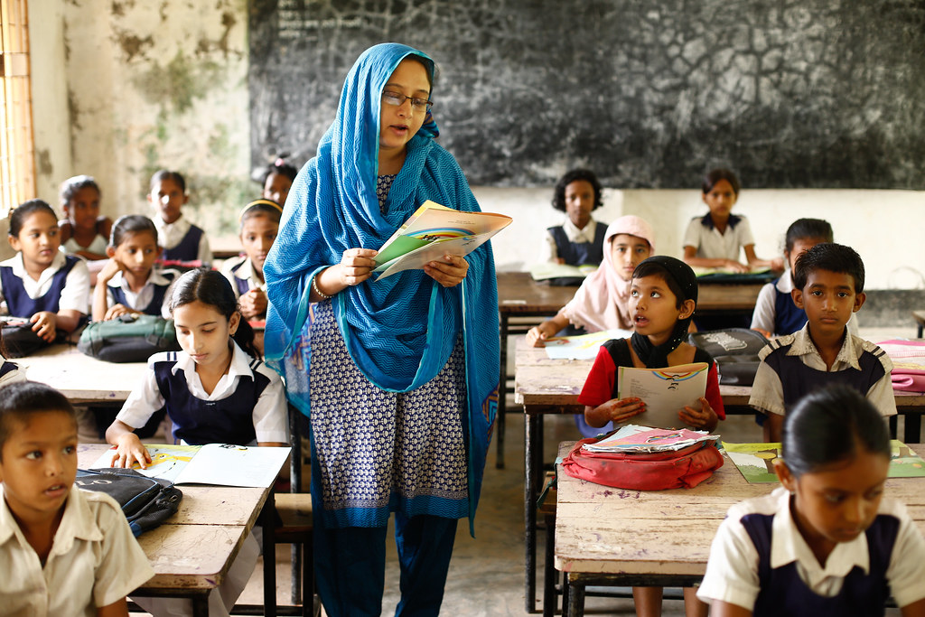
Teacher’s Model Reading:

Slide 14
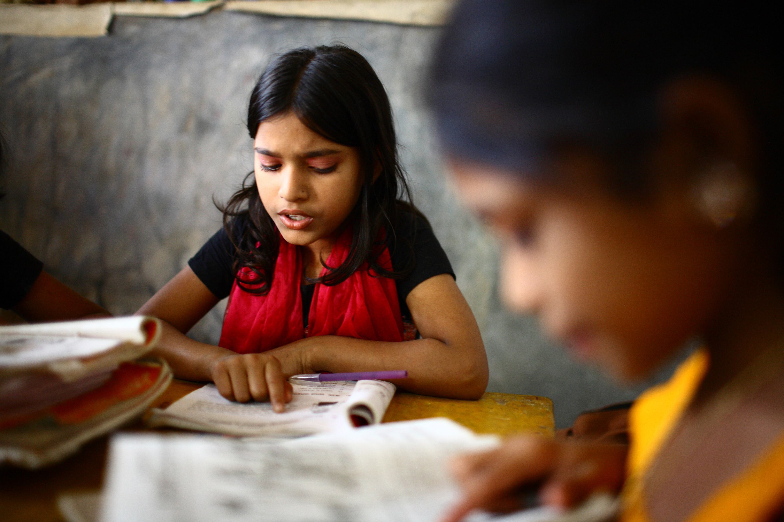
WCW
Student’s Reading:
Read the passage loudly:

Slide 15
Read the passage alone:
IW

Slide 19
Fill in the blanks:
WCW
1. This -------Mahbub Alom.
2. He is-----years old.
3.How---- is he?
4. He is----- English Teacher.
5.He------works in Narail Primary School.

Slide 20
Mahbub Islam
30 years old.
Teaching
Narail Primary School.
Notes:
Pair work.

Slide 21
GW
Write the answer with your group :
Group-1
Group-2
How old is the teacher?
What does he do ?
Where does he work ?
What ‘s the name of your teacher?
Notes:
GW:

Slide 22
Think about your best teacher who teaches
you in the classroom. Now Write a paragraph
about Best Teacher.
What’s the name of your best teacher ?
How old is he/she?
What does he/she?
Why do you follow him/her?

Slide 23
Write a paragraph about yourself:
1.What’s your name?
2.What class do you read in?
3.Where do you study?
Notes:
Evaluation.

Slide 24
Home work:
Write a short paragraph about yourself.

Slide 25
Bye Bye
See you again.

