Slide 1
WELCOME

Slide 2
Presented by:
Abdur Razzaque
Headmaster
Ranihati Govt. primary school
Ranihati , Shibgonj , Chapai nawabgonj .

Slide 3
Subject English
Lesson five
Class Three
Lesson unit- Introducing myself.
Time 40 minutes

Slide 4
Learning outcomes:
1.Students will be able to Read the poe correct pronunciation.
2.Know new words with sentences

Slide 5
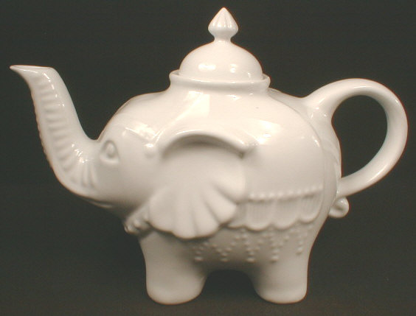
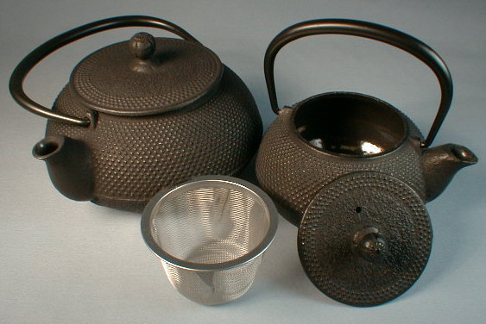
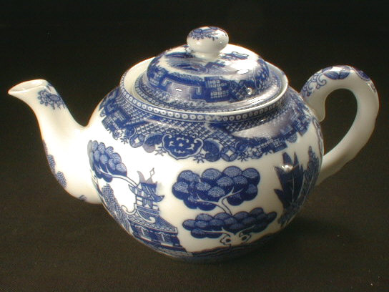
TEA- POT

Slide 6
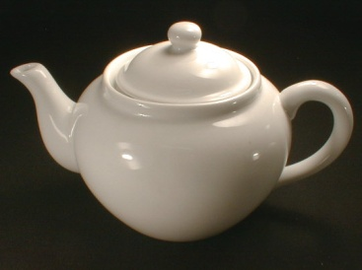
I am a little tea-pot,
Short and stout.
This is my handle,
And this is my spout.

Slide 7
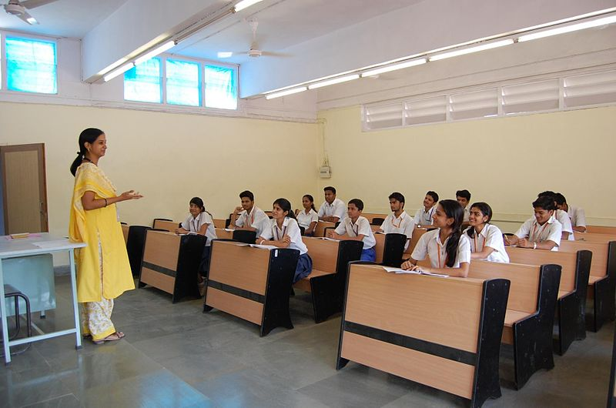
Teacher,s loud reading:

Slide 8
Student,s loud reading:

Slide 9
Task:
Ask student recite the rhyme.

Slide 10
THANK YOU
SEE YOU AGAIN

