Slide 1



Slide 2

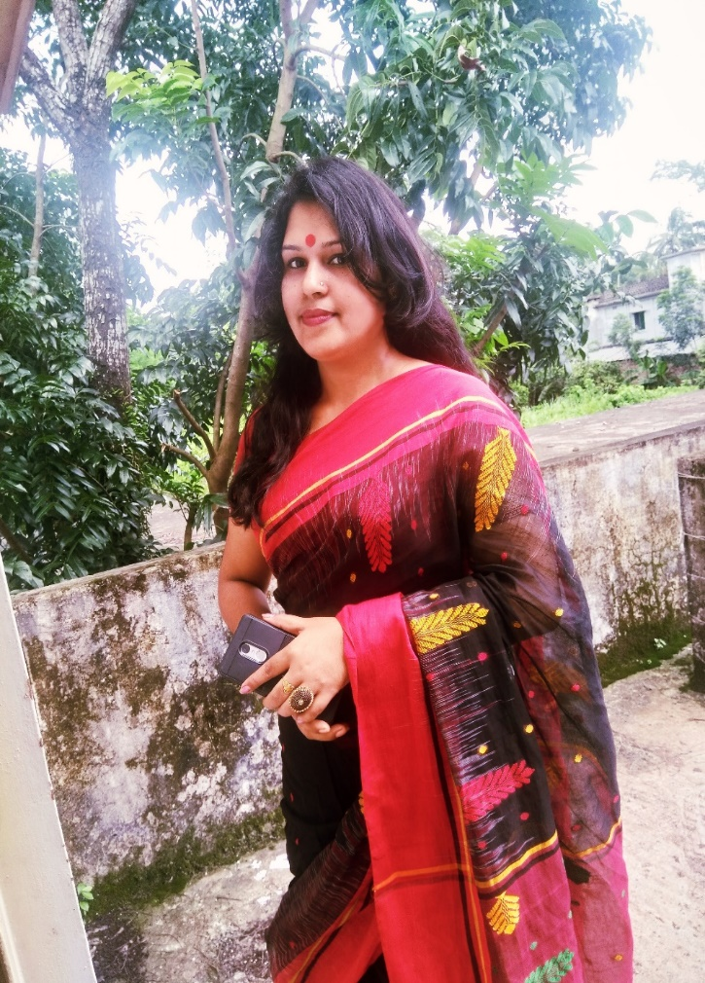
Teacher’s Identity
Lipi Sharma
Assistant teacher
Madhobpur GPS
Chhatak,Sunamganj

Slide 3


Lesson’s Identity:
Subject:English
Class:Four
Unit:16
Lesson:1-2
Topic:Sagar’s week
Time:40 minutes

Slide 4
Learning outcomes
Listening:
1.1.1:- recognize sound differences in the context of words.
1.2.1:- recognize which syllable in a word is stressed.
1.3.1:- recognize which words in a sentence are stressed.
3.2.1:- understand questions about family and friends of students.
3.4.1:- understand statements made by the teacher and student.
Speaking:
1.1.1:- repeat after the teacher and say words, phrases and sentences with proper sounds, stress and intonation.
5.1.1:- tell the time (hours only and mention a. m /p.m.
6.2.1:- talk about people, objects, events, etc.
Reading:
1.4.1 :- read words, phrases and sentences in the text.
1.5.1 :- read words, phrases and sentences in the text with proper pronunciation, stress and intonation.
1.7.1:- read short paragraphs, dialogues and simple letters.
5.1.1:- read silently with understanding paragraphs, stories and other text materials.

Slide 5
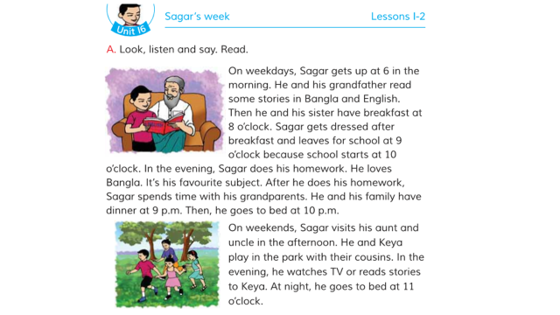
Dear Students, Look at the pictures and say what are they doing ?
Reading
Playing

Slide 6
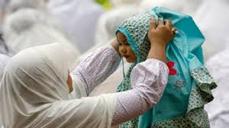
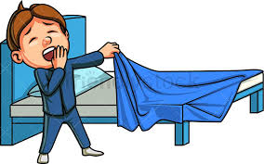
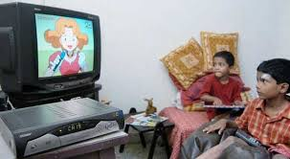
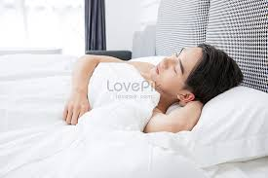
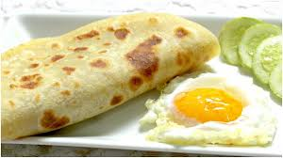
Say what are these pictures about?

Slide 7

Sagar’s week

Slide 8
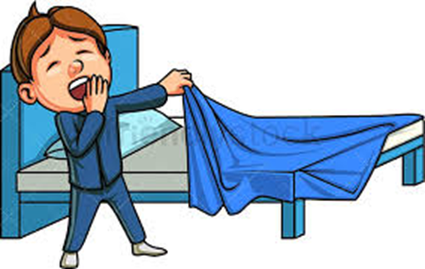
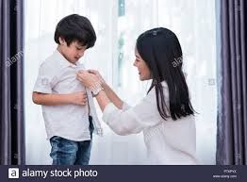
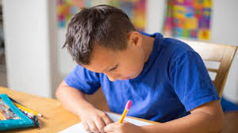

Practice
On weekdays ,Sagar gets up at 6 in the morning.
Sagar gets dressed for school after breakfast.
In the evening Sagar does his homework.
Sagar’s favourite subject is Bangla.

Slide 9
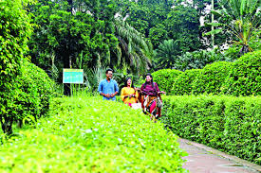
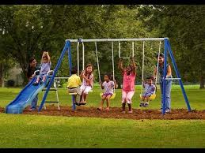


On weekend , sagar visit his aunt and uncle home .
He and keya play in the park .
They watches TV
They go bad at 11 o’clock .

Slide 10
Let’s know some word meaning
Weekend-
end of the week / Friday
সপ্তাহান্ত
Visit -
to go to see someone/ look over
দেখতে যাওয়া
Cousin-
child of uncle or aunt
চাচাতো, মামাতো, খালাতো ভাই – বোন
মনোযোগ দিয়ে দেখা
Watch -
observe

Slide 11

Weekday -
Work day
(কাজের দিন)
Get up -
Wake up
(জেগে ওঠা)
Get dressed-
Put on cloth
(পোশাক পরিধান করা)
Leave -
Go
(যাওয়া)
Beginning
(শুরু)
Start -
Favourite –
Fond of
(প্রিয়)

Slide 12
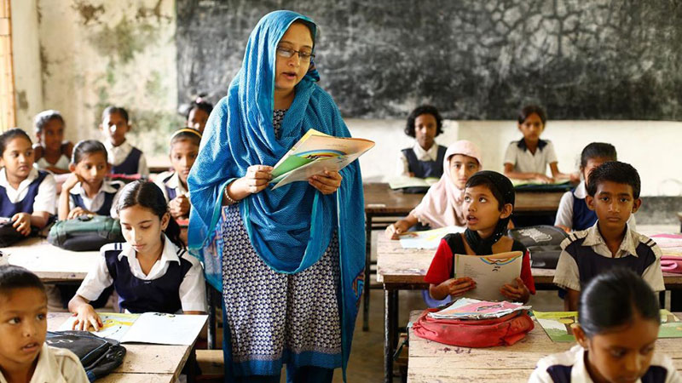
Open your book at page NO-32
Teacher’s loud reading:
The students will repeat after the teacher.

Slide 13
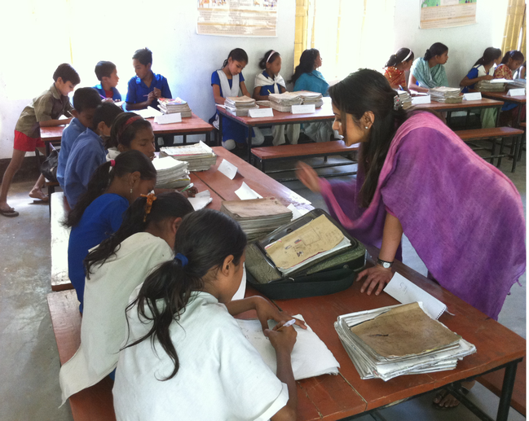
Students silent reading:

Slide 14
Sagar’s activity
6 o’clock -
Gets up
In the morning
8 o’clock -
Has breakfast
9 o’clock-
Leaves for school
10 o’clock -
School starts
In the evening
Does homework & spends time with grandparents .
At night
9 o’clock -
Have dinner with family
10 o’clock-
Goes to bed

Slide 15
Now, make some groups and match the words with their meanings.
Column A | Column B
weekdays | house hold activities
favourite | pass time
homework | Working days
spend | to go to see somethings
visit | fond of

Slide 16
Now ,cheek your groupwork activities:
weekdays
working days
favourite
fond of
homework
house hold activities
spend
pass time
visit
to go to see somethings

Slide 17
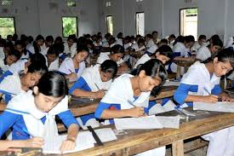
Make pairs and ask and answer the questions. Write the questions on your exercise book.
1. When does Sagar get up?
2. What time does Sagar leave for school?
3. What is Sagar’s favourite subject?
4. Who is Keya?
5.Write three sentences about Sagar’s activities on the weekends.

Slide 18
Now, cheek your answer script:
1.Sagar gets up at 6 in the morning.
2.Sagar leaves for school at 9 o’ clock.
3.Sagar’s favourite subject is Bangla.
4.Keya is Sagar’s little sister.
5.On weekends, Sagar visits his aunt and uncle in the afternoon. He and Keya play in the park.

Slide 19
individual work
Write True / false
Sagar School starts at 9 o’clock .
Sagar Favourite subject is Bangla .
On weekends , he goes to bed at 11 o’ clock .
Sagar visit his aunt and uncle in the morning.
In the evening he watches TV and read stories to keya .

Slide 20
Fill in the blanks
gets up
1. Sagar ……… at six o’clock.
Breakfast
2.He and his sister have ……………….. at eight o’clock.
after
3.He gets dress …….. breakfast.
the evening
4.He does his homework in ………….
Bangla
5.His favourite subject is ……….

Slide 21
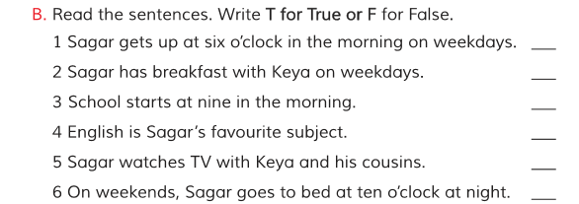
Evaluation
Look your text book activity B & C
T
T
F
F
F
F

Slide 22
Today’s word
Afternoon
The time from noon to evening
(বিকেল)
I play in the afternoon.

Slide 23
Homework:
Write five sentences about your weekly activities.

Slide 24
Home work
Write your activities in the box
activity
Weekdays
Weekends
In the morning
In the Evening

Slide 25

Good bye

