Slide 1
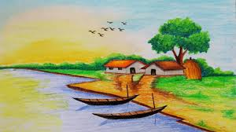
Welcome to Today’s Class

Slide 2
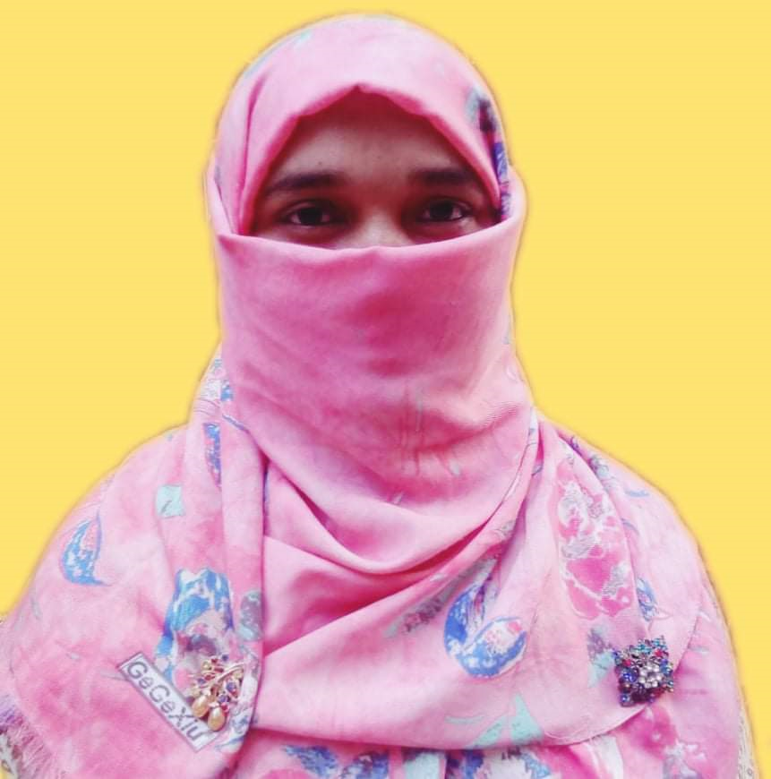
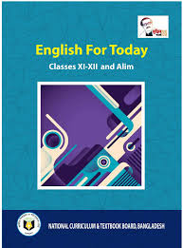
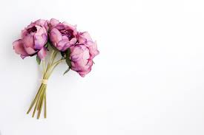
Introduction
Mosammat Nelufa Afrose Bithi
Lecturer in English
Khilbaisa Rahmania Fazil Madrasah
Sadar, Lakshmipur
E-mail:nelufa.afrose@gmail.com
English First Paper
Class-Alim/XI/XII

Slide 3
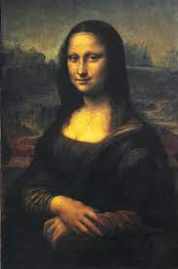
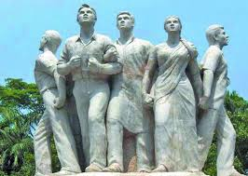
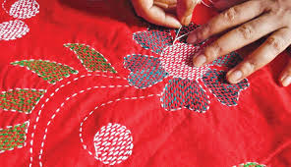
Let’s watch some work of arts-
What are they about?
Painting
Sculpture
How do they look like?
They look Beautiful.
Photograph.
Embroidered quilts.

Slide 4
Can you tell what Parts of speech is ‘Beautiful’?
Beautiful
(Adjective)
Beauty
(Noun)
Now answer the following Question-
What you mean by beauty?

Slide 5
Our today’s topic is-
What is Beauty?
Unit- 5: Art and Music
Lesson-1

Slide 6
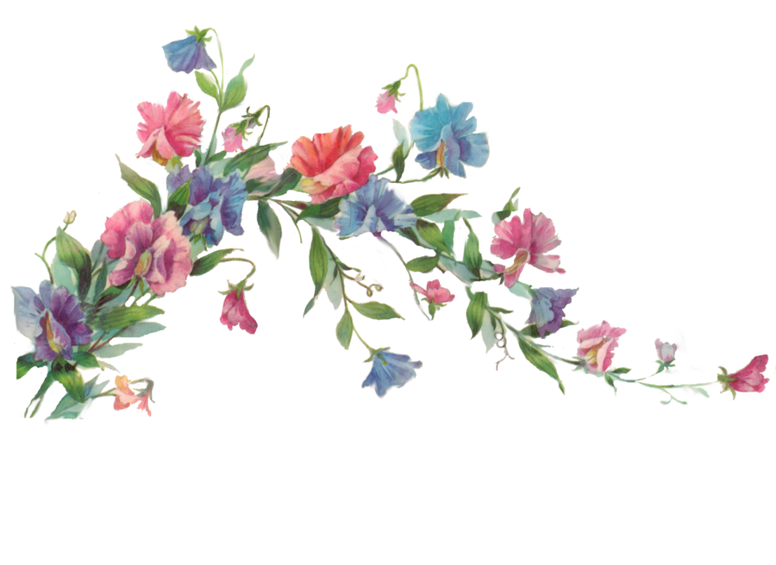
Learning Outcomes
After finishing the lesson, the students will be able to learn-
Learn word meanings.
Find a concept of beauty.
Introduce with poets view about beauty.
Write down summary of text.

Slide 7
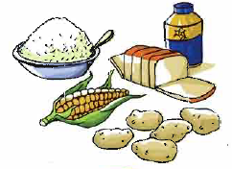
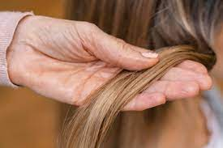
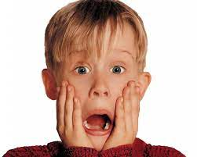
Word meanings.
Ingredient
element.
Tuft
cluster.
Terrible
horrible/dangerous.

Slide 8
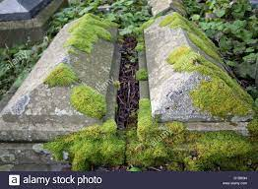
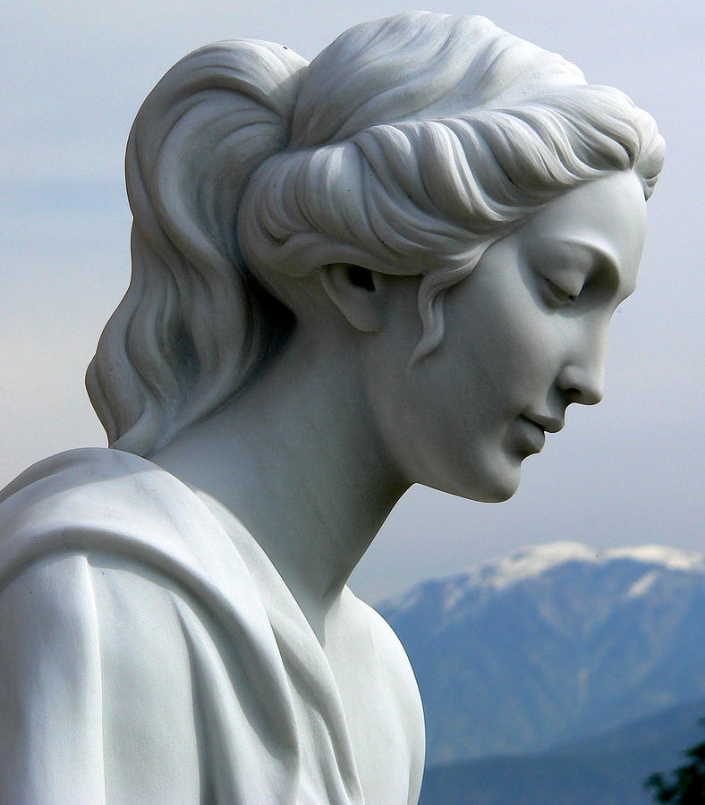
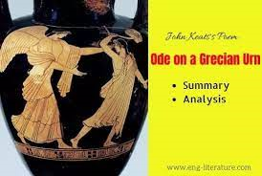
Tomb
monument/grave.
Sculpture
The art of forming solid objects.
Urn
Cinerary.

Slide 9
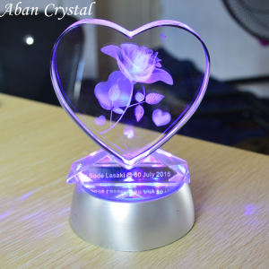
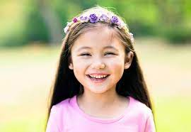
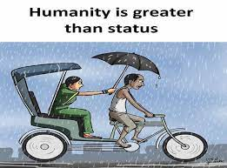
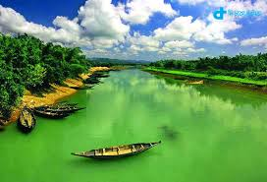
Concept of beauty
Where do we discover beauty?
In Pleasurable objects.
Sight in nature.
In the Laughter of children.
Kindness of the stranger.
So it can be said-
Beauty is easy to appreciate but difficult to define.
If we are asked to define, we run into difficulties.

Slide 10
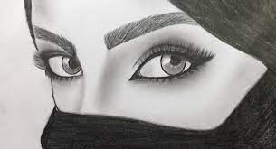
Then a lot of questions arise-
Does beauty have an independent objective identity?
Is it universal?
Is it dependent on our sense perceptions?
Does it lie in the eye of the beholder?

Slide 11
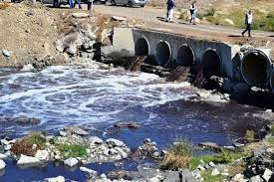
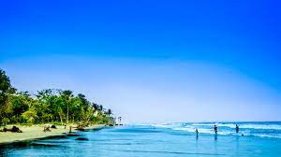
Look -
Ugliness
Beauty
Absence of Beauty.
Beauty manifests itself not only by its presence, but by its absence as well.
When we are repulse by ugliness and desire beauty.

Slide 12
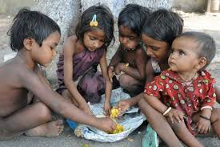
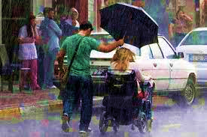
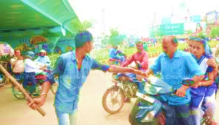
Look carefully-
Beauty is an important part of life, but isn't ugliness a part of life too?
Can art ignore what is not beautiful?
Beauty
Ugliness.
So, we can say that-
Beauty
Ugliness.
Though ugliness is not pleasant, it’s a part of life.
Ugliness has as much a place in our lives as beauty, or may be more-as when there is widespread hunger and injustice in a society.

Slide 13
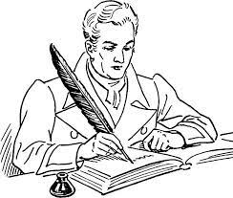
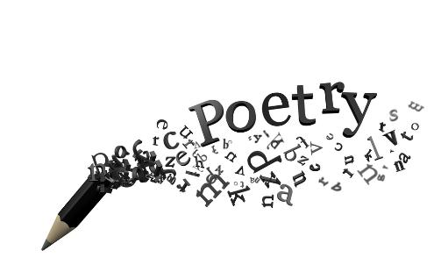
Poets and artists view about beauty
Poets and artists have often tied beauty to truth and justice into their work.
Poetry in every language celebrates beauty and truth.

Slide 14
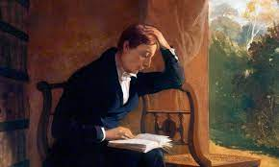
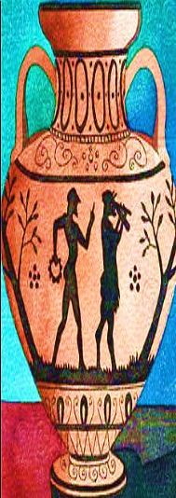
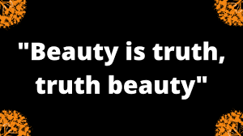
He means that-
What is beautiful forever remains true.
Truth, even if it’s not pleasant, becomes beautiful at higher level.
Truth is a condition of art.
John Keats, a romantic poet.
He wrote in his celebrated “Ode on a Grecian Urn’-
Grecian Urn

Slide 15
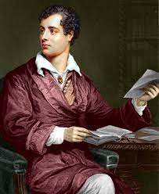
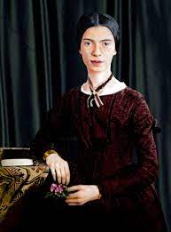
The poems present some enduring ideas about beauty and truth.
The poems are written about; the human scene, love and death.
In your text book, there are two poems of the poets from two different times.
Lord Byron
(1788-1824)
Emily Dickinson
(1830-1886)
An English poet of Romantic tradition.
An American poet of nineteen century’

Slide 16
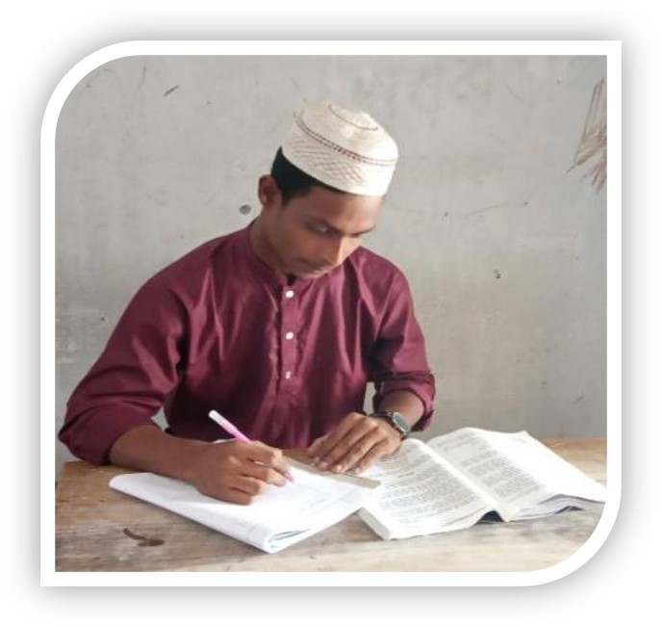
Individual work
Beauty is a complex word”-do you agree? Discuss in your own words.

Slide 17
Read from the textbook.
Open the textbook at page-182
&
Read Silently.

Slide 18
Summary of text.
Man is fond of beauty. We may appreciate it. But it is very difficult to define beauty. The lesson is about art and beauty. Beauty is a concept that we feel a thing that spontaneously pleases us. It depends on our sense of perception. Ugliness has its own beauty also. So, the question arises whether both beauty and ugliness are important parts of arts, or only beauty. The poets and artists infuse both in their works. The associate beauty with truth. They say that all truths are always objects of beauty. Thus the lesson tends to give an aesthetic impression of beauty.

Slide 19
Evaluation
Answer the following question:
1.What is beauty. Explain in brief.
2.Where do we discover beauty?
3. What do the philosophers say about ugliness?
4.What do you think about ugliness comparing to beauty? Write in your own words.
5.What can you realise from ‘Beauty is truth, truth beauty’?

Slide 20
Pair work
Make a flow chart showing the perception
of beauty. One is done for you.
1.
Beauty being easy to appreciate
2
3
4
5
6

Slide 21
Home work
Write the theme of the following text (Not more than 50 words.)(Alim Examination-2017)
Poets and artists have provided an answer by incorporating both into their work. In doing so, they have often tied beauty to truth and justice, so that what is not beautiful assumes a tolerable proportion as something that represents some truth about life. John Keats, the romantic poet, wrote in his celebrated “Ode on a Grecian Urn”. "Beauty is truth, truth beauty, by which he means that, even if it’s not pleasant, becomes beautiful at higher level. Similarly, what is beautiful forever remains true. Another meaning in the context of the Grecian Urn –an art of object is that truth is a condition of art.

Slide 22
Thank you

