Slide 1
2
1
3
5
4

Slide 2
Welcome
To
Nil kamal Osmania High School
Online Class

Slide 3
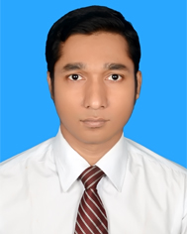
Introduction
Puson Debnath
Assistant Teacher (Business Studies)
Nil kamal Osmania High School
Haimchar, Chandpur
Mobile: 01787748938
E-mail:puson1000@gmail.com

Slide 4
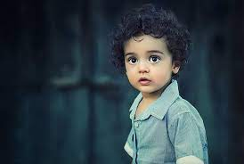
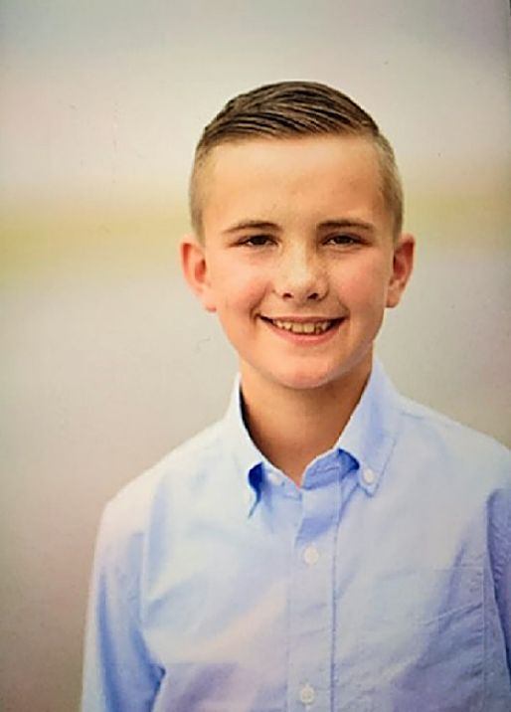
He is a good boy.
He is not a bad boy.
Rakib is an honest boy.
Rakib is not a dishonest boy.
Can you guess what I am going to discuss today?

Slide 5
So, our today’s topic is-
Transformation of Sentences
Affirmative
to
Negative

Slide 6
Learning outcomes
Define Affirmative & Negative
Identify Affirmative & Negative sentences
Change the sentences (Affirmative to Negative )

Slide 7
Rule no 01
None but(person)
Nothing but(things)
Not more than/Not less than(Number/Age)
Only/alone
Replaced by
Affirmative: Only Allah can help us.
Negative: None but Allah can help us.
Affirmative: Only they can do the work.
Negative: None but they can do the work.
Affirmative: He is only four.
Negative: He is not more than four.

Slide 8
Rule no 02
Must
Replaced by
Can not but
Can not help (V+ing)
Affirmative: We must obey our parents.
Negative: We can not but obey our parents.
Affirmative: You must care them.
Negative: You can not help caring them.
Affirmative: You must yield to your fate.
Negative: You can not but yield to your fate.

Slide 9
Rule no 03
Both………and
Not only……but also
Replaced by
Affirmative: Both Hira and Mira were excited.
Negative: Not only Hira but also Mira were excited.
Affirmative: Both Rajib and Sakib were good friends.
Negative: Not only Rajib but also Sakib were good friends.

Slide 10
Rule no 04
No sooner had..(v3)….than
As soon as
Replaced by
Affirmative: As soon as the man saw the police, he ran away.
Negative: No sooner had the man seen the police than he ran away.
Affirmative: As soon as we reached the station the train left.
Negative: No sooner had we reached the station than the train left.
Affirmative: As soon as the rain stopped we came back home.
Negative: No sooner had the rain stopped than we came back.

Slide 11
Rule no 05
Always
Never + opposite word
Replaced by
Affirmative: Rony always attends the class.
Negative: Rony never misses the class.
Affirmative: He was always punctual.
Negative: He was never late.
Affirmative: I always tell truth.
Negative: I never tell lie.

Slide 12
Rule no 06
Every + one
body
mother
All
There is no+
attached word+
but+
rest part
Replaced by
Affirmative: Every mother loves her child.
Negative: There is no mother but loves her child.
Affirmative: Every one hates a terrorist.
Negative: There is no one but hates a terrorist.
Affirmative: Every people hates a lair.
Negative: There is no one but hates a lair.

Slide 13
Rule no 07
As……..as
Not less……than
Replaced by
Affirmative: Shimi is as wise as Rimi.
Negative: Shimi is not less wise than Rimi.
Affirmative: He is as good as you.
Negative: He is not less good than you.

Slide 14
Rule no 08
Too……….to
So ….…….. That +
Sub + can not/could not + verb
Replaced by
Affirmative: He is too weak to walk.
Negative: He is so weak that he can not walk.
Affirmative: He was too tired to do it.
Negative: He was so tired that he could not do it.
Affirmative: The sum was too difficult for me to work out.
Negative: The sum was so difficult for me that I could not work out.

Slide 15
Rule no 09
Many/
Much
Replaced by
Not a few/
A little
Affirmative: I have many friends.
Negative: I have not a few friends.
Affirmative: He belongs much money.
Negative: He does not belong a little money.

Slide 16
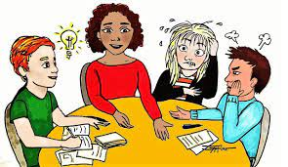
Group work
Change the following sentences into negative……
Allah alone can help us
You must obey the discipline.
Every body wishes to be happy.
He is too weak to go.
I shall always remember you.
Answer
1. None but Allah can help us.
2. You can not but obey the discipline.
3. There is no body but wishes to be happy.
4. He is so weak that he can not go.
5. I shall never forget you.

Slide 17
Change the following sentences into negative……
Only he can play good cricket.
He is only four.
You must care them.
Everyone hates a terrorist.
As soon as he saw the tiger, he ran away.
I always tell truth.
He is as good as you.
He is too weak to walk.
Only the science students can apply for the post.
Robi and Rahat were as strong as Rakib.

