Slide 2
Good morning student

Slide 3
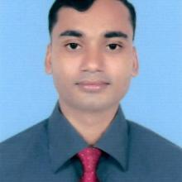
Teacher’s Identity
Ajoy Kanti Deb
Assistant Teacher
Choyciri Bishnupur Government Primary School
Kamalgonj, Moulvibazar.
Mobile No:01716687098

Slide 4
Let’s watch a video

Slide 5
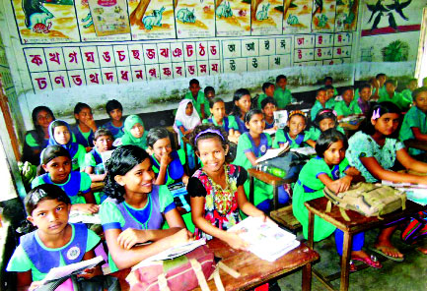
Introduce of the class
Class : Two
Section : A
Total students:
Present students:
Absent students:
Date:21/08/2021

Slide 6
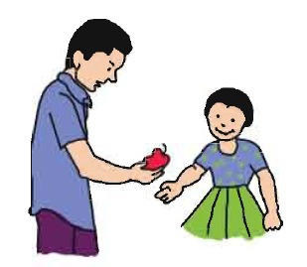
Lesson’s introduction
Class: Two
Subject: English
Unit: 14
Lesson: 4-6 ( Story: Rima and the seed)
Today’s Lesson: ‘A’
Page number:
Time: 40 minutes
29

Slide 7
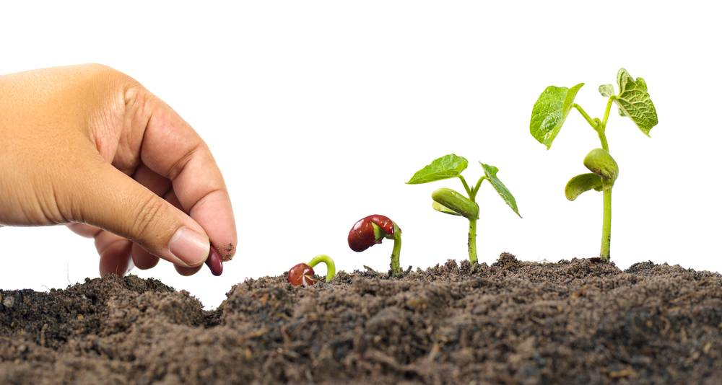
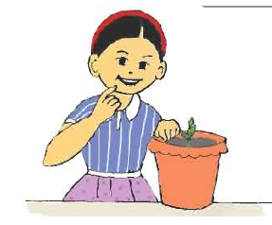
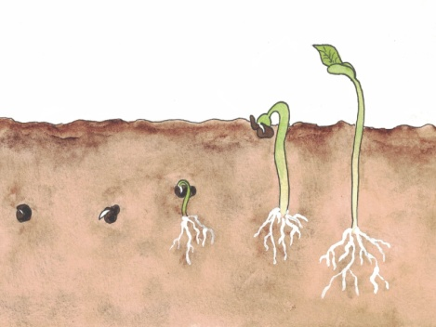
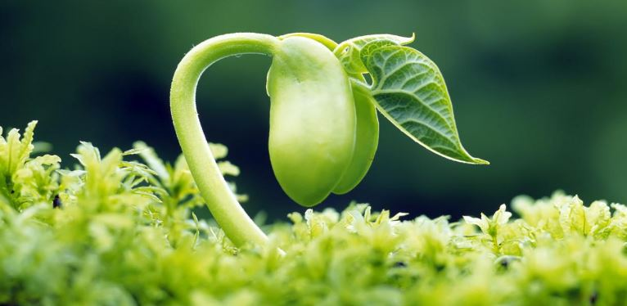
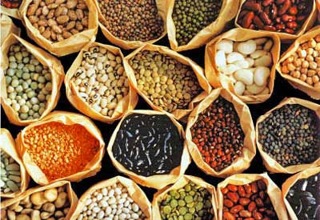
What do you see in this picture?
Rima and the seed

Slide 8
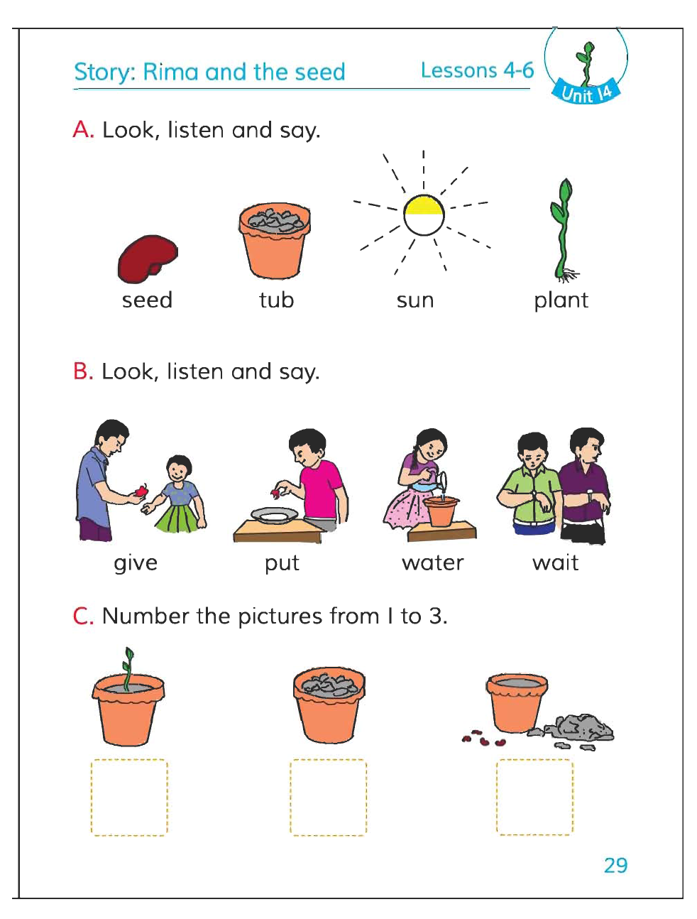
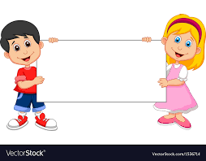
Lesson declaration

Slide 9
Learning outcomes
By the end of the lesson students will be able to-
Listening :
1.1.1 become familiar with English sounds by listening to common English words.
3.1.2 understand simple question and statements about familiar objects.
4.2.1 enjoy simple stories.
Speaking :
1.1.1 repeat after the teacher simple words and phrases with proper sounds and stress.
1.1.2 say simple words and phrases with proper sound and stress.
Reading :
1.3.1 recognize and read the names of objects having the same initial and final sounds
1.4.1 read words and phrases with the help of visual clues and simple sentences.

Slide 10
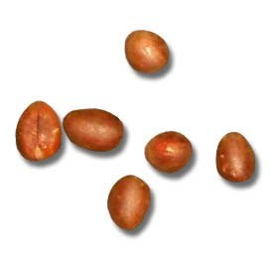
Checking learning
What is this?
seed
tub
sun
plant

Slide 11
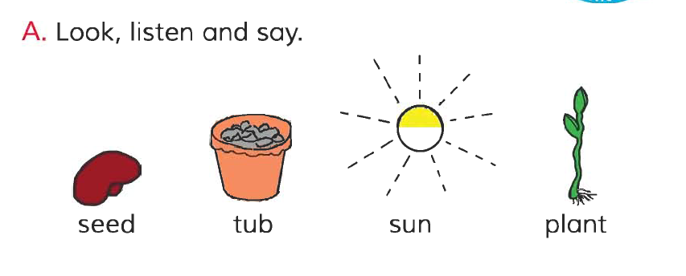
Open at page 29 of your book and look the activity A
Listen carefully and say after it.

Slide 12
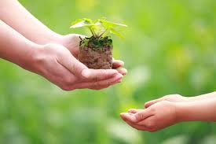
See some pictures and discuss about the pictures in groups
give
put

Slide 13
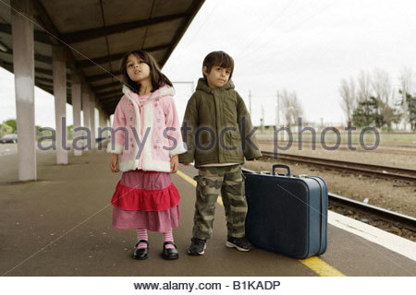
See some pictures and discuss about the pictures in groups
water
wait

Slide 14
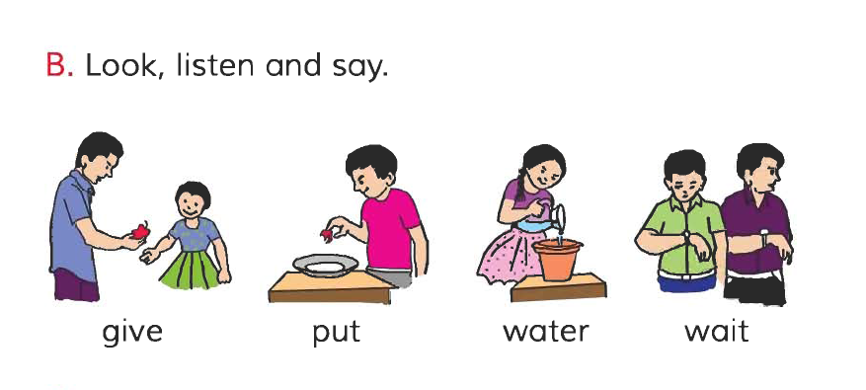
Open at page 29 of your book and look the activity B

Slide 15
Group work
Point and say the pictures name
Group-1:
1
2
Group-2:
1
2
Group-3:
1
2

Slide 16
Evaluation
give
put
water
wait

Slide 17
Home work
Write these Words in your notebook seed, tub, sun, plant.

Slide 18
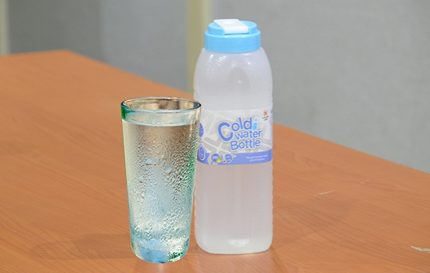
One day one word
Water - পানি

Slide 19
That’s all for today. See you again tomorrow.
Good bye

