Slide 1
Welcome

Slide 2
Identity
Md. Babul Hossain
Assistant Teacher (Mathematics)
Dr. Mohiuddin High School
Madhabpur, Habiganj.
Phone: 01715844786
E-mail: babulbdx@gmail.com
Class: 9-10
Subject: Physics
Chapter: Second
Students: 35
Time: 50 Minute
Date: 11-03-2020

Slide 3
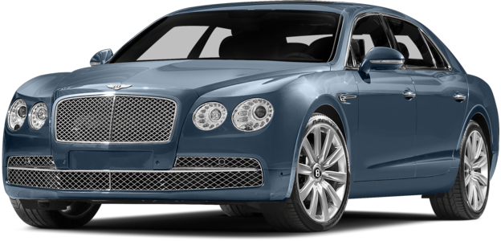
Length of a car is 4.5 m
Physical quantity
Magnitude

Slide 4
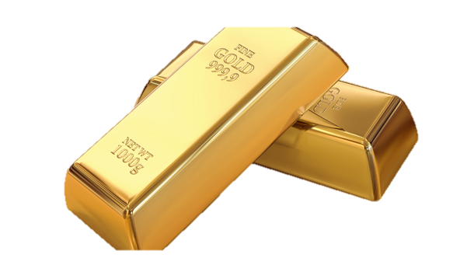
Mass of gold bar is 1 kg
Physical quantity
Magnitude

Slide 5
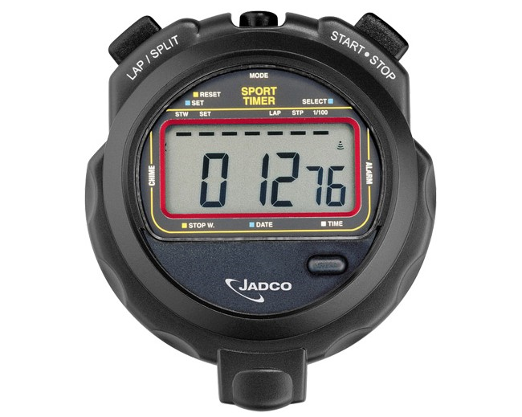
Time is 12.76 s
Physical quantity
Magnitude

Slide 6
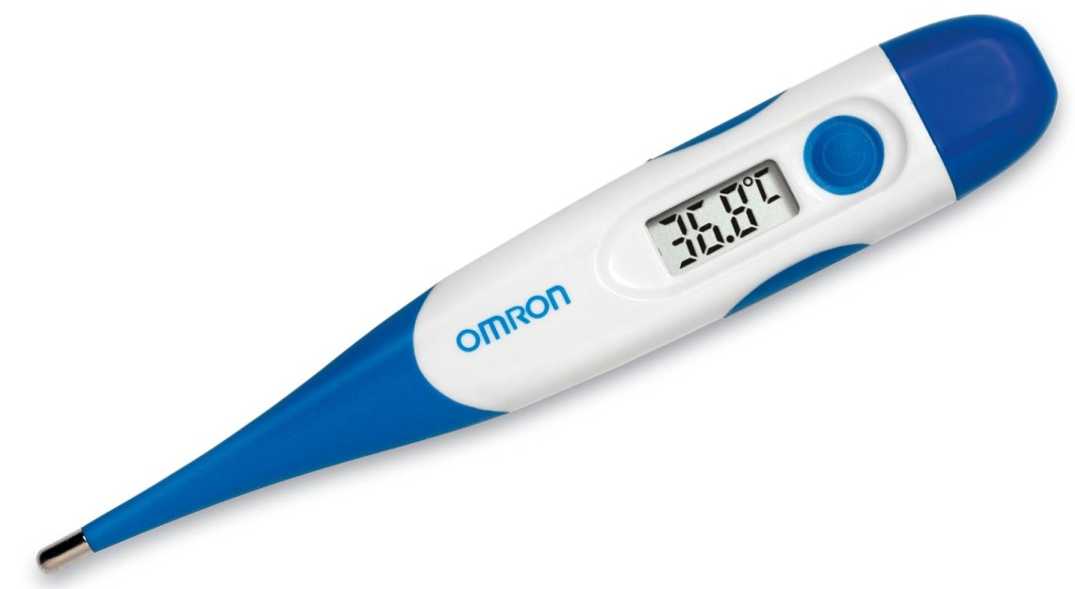
Temperature is 36.8 $°$C
Physical quantity
Magnitude

Slide 7
Scalars and Vectors

Slide 8
Learning Outcomes
After completing the lesson students will be able to…
Tell the definition of scalars and vectors quantities;
Explain the vector quantities by symbols;
Explain equal vector, negative vector, position vector.

Slide 9
Scalars
Scalars are quantities which have magnitude without direction
Examples of scalars
Temperature
Mass
Kinetic energy
Time
Amount
Density
Charge

Slide 10
Vector
A vector is a quantity that has both magnitude (size) and direction.
it is represented by an arrow whereby
the length of the arrow is the magnitude, and
the arrow itself indicates the direction
A
The symbol for a vector is a letter with an arrow over it.

Slide 11
Single Work
What is Scalars Quantities?

Slide 12
Vectors are represented by an arrow
A
- B
A
B
A
θ

Slide 13
A vector is a physical quantity that has
both a magnitude and a direction.
Examples:
Position
Displacement
Velocity
Acceleration
Momentum
Force

Slide 14
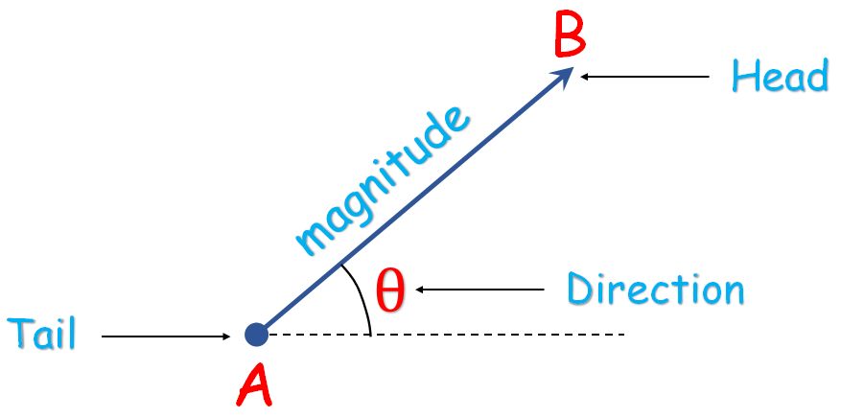
Symbolically it is represented as $\vec{\text{AB}}$

Slide 15
They are also represented by a single capital
letter with an arrow above it.
$$\vec{\text{A}}$$
$$\vec{\text{P}}$$
$$\vec{\text{B}}$$

Slide 16
Some vector quantities are represented by their
respective symbols with an arrow above it.
$$\vec{\text{r}}$$
$$\vec{\text{F}}$$
$$\vec{\text{v}}$$
Position
Velocity
Force

Slide 17
Two parallel vectors are said to be equal vectors,
if they have same magnitude.
$$\vec{\text{P}}$$
$$\vec{\text{A}}$$
$$\vec{\text{B}}$$
$$\vec{\text{Q}}$$
$$\vec{\text{A}}=\vec{\text{B}}$$
$$\vec{\text{P}}=\vec{\text{Q}}$$

Slide 18
Pair Work
Explain the vector quantities by symbols

Slide 19
Some Properties of Vectors
Equality of Two Vectors
Two vectors A and B may be defined to be equal if they have the same magnitude and point in the same directions. i.e. A = B
A
A
B
A
B
B

Slide 20
Negative of a Vector
The negative of vector A is defined as giving the vector sum of zero value when added to A . That is, A + (- A) = 0. The vector A and –A have the same magnitude but are in opposite directions.
A
-A

Slide 21
Collinear Vectors
Two vectors are said to be collinear vectors,
if they act along a same line.
$$\vec{\text{B}}$$
$$\vec{\text{Q}}$$
$$\vec{\text{A}}$$
$$\vec{\text{P}}$$

Slide 22
Group Work
Explain the positions of negative vectors

Slide 23
Evaluation
What is scalar quantities?
What is vector quantities?

Slide 24
Home Work
A runner follows the path shown starting at A and arriving at B ten seconds later
30m
A
What is the distance travelled by the runner?
b) Calculate the average speed of the runner.
c) By using a scale diagram, calculate the runner’s displacement (magnitude and direction).
40m
B

