Slide 1
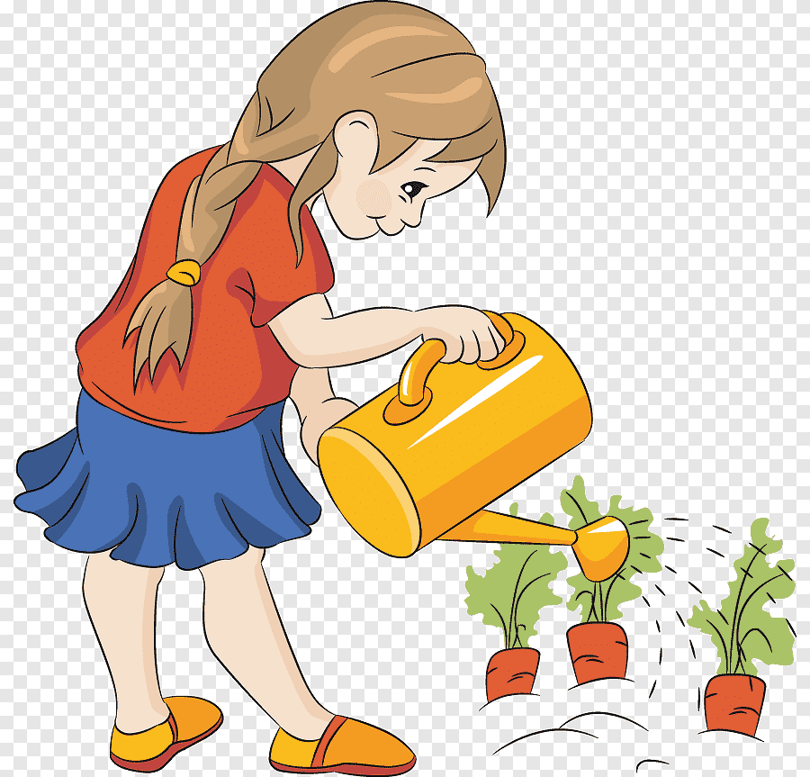

Slide 2
Class Two
Sub: English For Today
Unit:14, Lesson: 1-2. Activity: B
Story: Rima and the seed

Slide 3
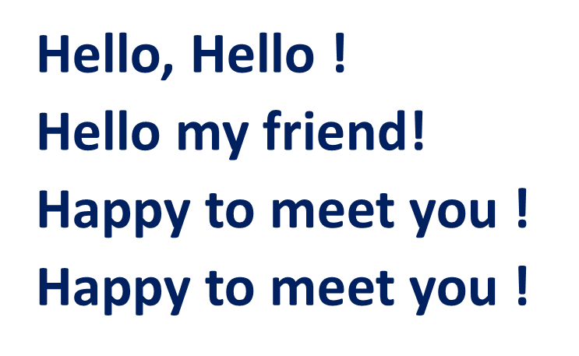
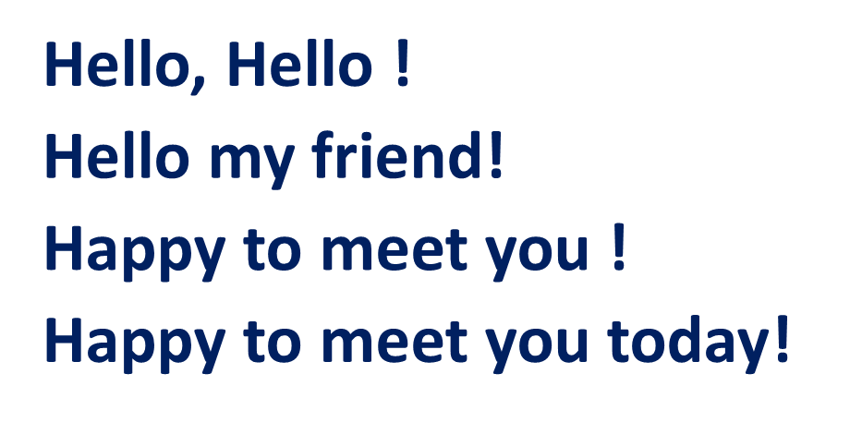
Let us sing a Greeting Song.

Slide 4
Review the previous Lesson
Say the words properly.
seed
tub
sun
plant

Slide 5
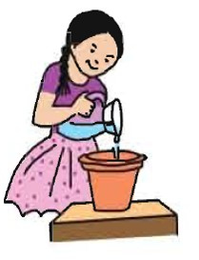
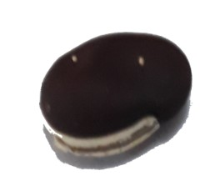
(Activity B)

Slide 7
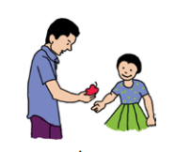
Open your English book at page-29
See the picture and say about it.
Give

Slide 8
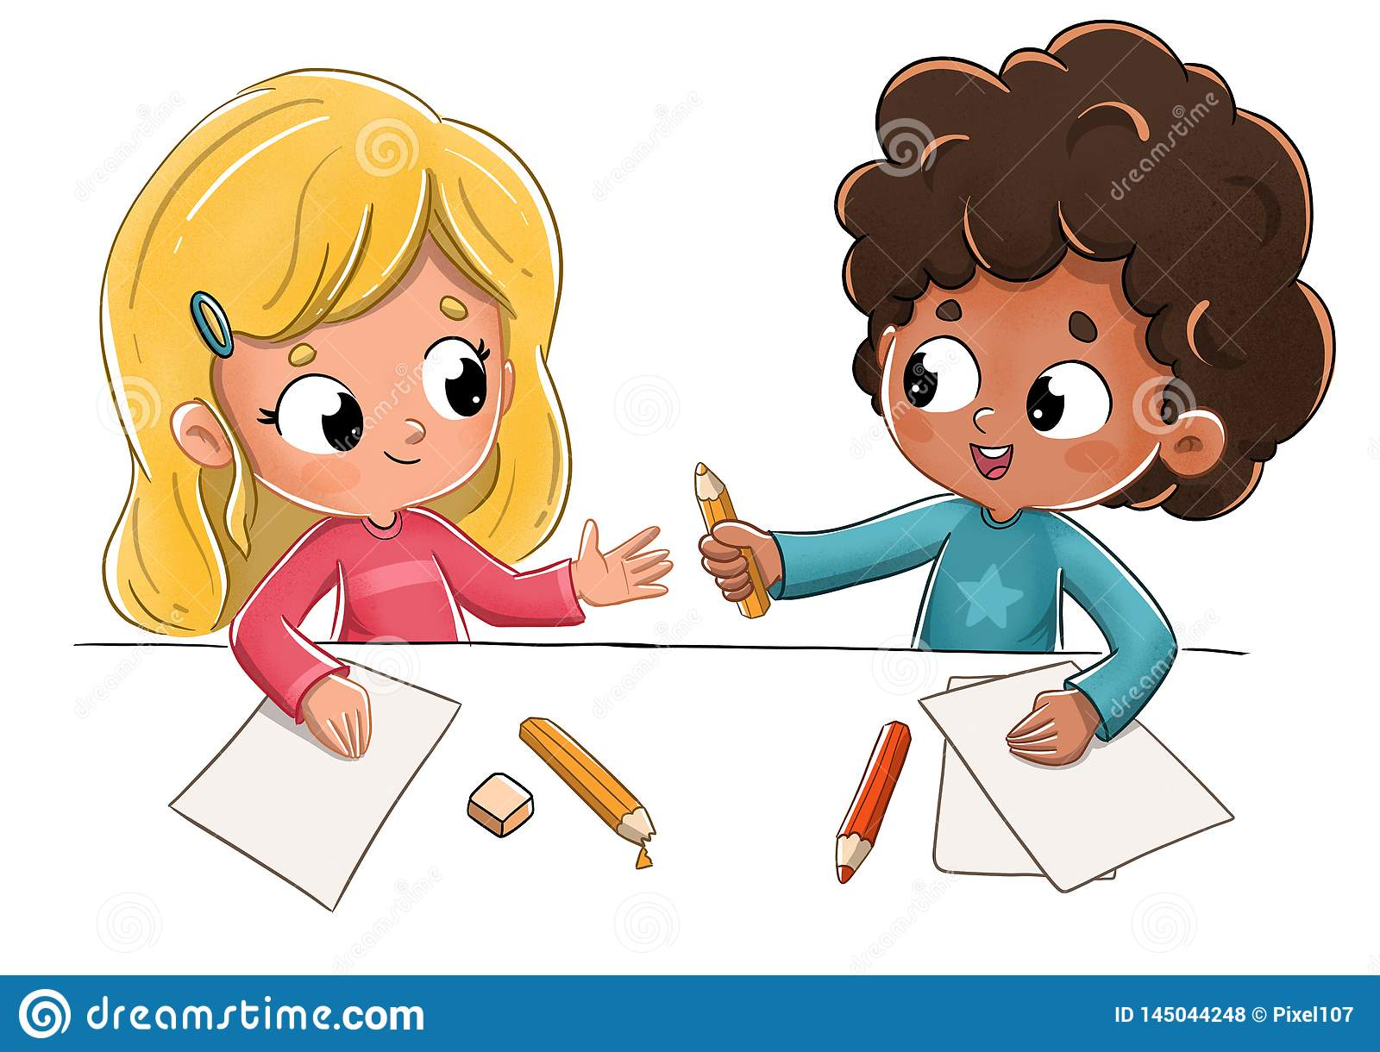
Demonstration
Give me your Pencil
Thank you.

Slide 9
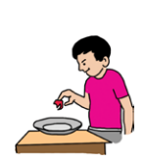
Listen and do with peer
Say about the picture
Put your pencil on the table.
Put

Slide 10
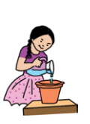
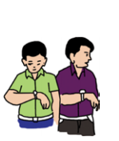
What is this?
Wait
Water

Slide 11
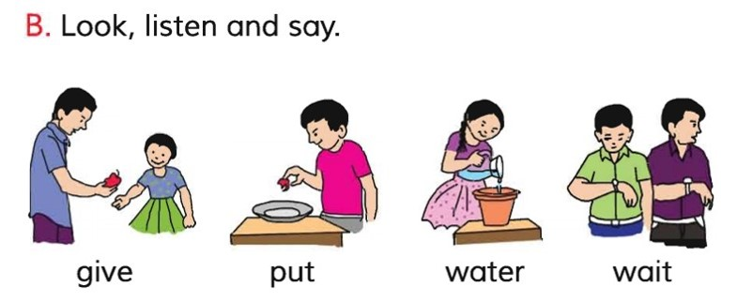
Say the words with the audio

Slide 12
Read the words and repeat after me.
Read the words with peer.
wait
give
water
put

Slide 13
Spell out the words
give
g/i/v/e
put
p/u/t
water
w/a/t/e/r
wait
w/a/i/t

Slide 14
Make the correct word on your exercise book
t/w/a/e/r
water
i/v/e/g
give
t/p/u
put
wait
w/i/a/t

Slide 15
Write down the words of Activity B on your exercise book

Slide 16
