Slide 1
Welcome

Slide 2
Identity
Md. Babul Hossain
Assistant Teacher (Mathematics)
Dr. Mohiuddin High School
Madhabpur, Habiganj.
Phone: 01715844786
E-mail: babulbdx@gmail.com
Class: 9-10
Subject: Higher Mathematics
Chapter: Twelve
Students: 25
Time: 50 Minute
Date: 11-03-2020

Slide 3
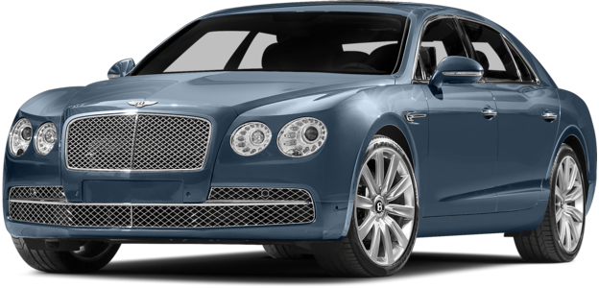
Length of a car is 4.5 m
physical quantity
magnitude

Slide 4
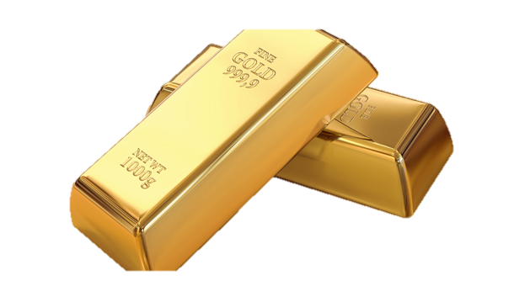
Mass of gold bar is 1 kg
physical quantity
magnitude

Slide 5
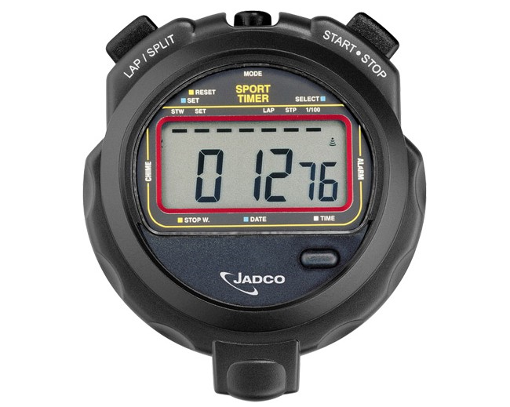
Time is 12.76 s
physical quantity
magnitude

Slide 6
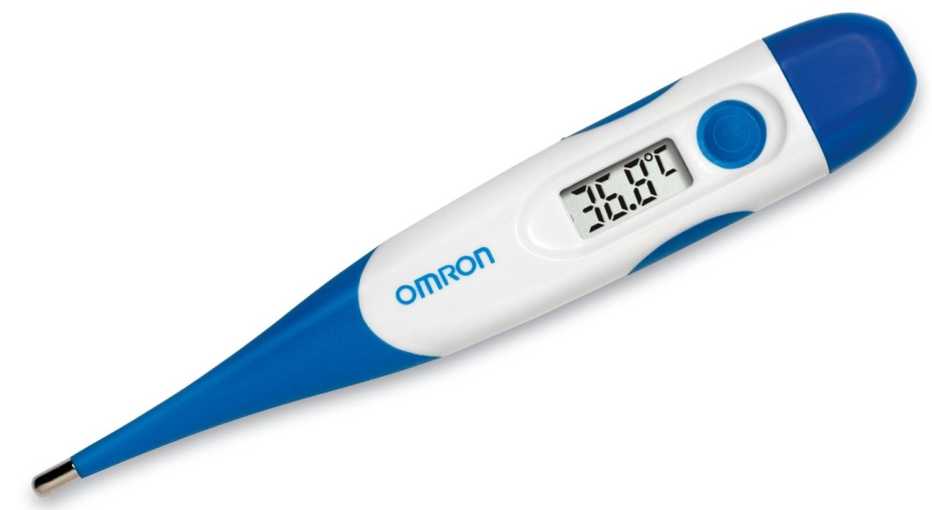
Temperature is 36.8 $°$C
physical quantity
magnitude

Slide 7
PLANAR VECTOR

Slide 8
Learning Outcomes
After completing the lesson students will be able to…
Explain law of vector addition,
Describe Subtraction of vectors,
Explain Scalars Multiplication.

Slide 9
Vector Addition
The addition of two vectors A and B
- will result in a third vector C called the resultant
C = A + B
C
B
A

Slide 10
Associative Law:
(A + B) + C = A + (B + C)
B
B
B + C
C
C
A
A
A + B
A + (B + C)
(A + B) + C

Slide 11
Distributive Law:
m(A + B) = mA + mB
mB
B
m(A + B)
A + B
mA
A

Slide 12
Parallelogram method of addition
A + B
A
B
The magnitude of the resultant depends on the relative directions of the vectors

Slide 13
Single Work
What is vector addition?

Slide 14
Subtraction of vectors
$$\vec{\text{A}}$$
$\vec{\text{A}}$ $\text{+} \vec{\text{B}}$
$$\vec{\text{B}}$$
$$\text{−}\vec{\text{B}}$$
$\vec{\text{A}}$ - $\vec{\text{B}}$
$$\vec{\text{A}}$$
The subtraction of $\vec{\text{B}}$ from vector $\vec{\text{A}}$ is defined as
the addition of vector $\text{−}\vec{\text{B}}$ to vector $\vec{\text{A}}$.
$\vec{\text{A}}$ - $\vec{\text{B}}$ = $\vec{\text{A}}$ + $\text{(}\text{−}\vec{\text{B}}\text{)}$

Slide 15
Vector Subtraction
Equivalent to adding the negative vector
C =
A B
B
C =
A + (-B)
A
-B
A - B

Slide 16
SUBTRACTION OF VECTOR
Similarly orientated vectors can be subtracted the same manner.

Slide 17
Pair Works
Describe the subtraction of vector

Slide 18
Scalar Multiplication
The multiplication of a vector A
by a scalar α
- will result in a vector B
B = α A
- whereby the magnitude is changed
but not the direction
Do flip the direction if α is negative

Slide 19
Multiplying a vector by a scalar
If we multiply a vector $\vec{\text{A}}$ by a scalar s, we get a new vector.
Its magnitude is the product of the magnitude of $\vec{\text{A}}$ and the absolute value of s.
Its direction is the direction of $\vec{\text{A}}$ if s is positive but the opposite direction if s is negative.

Slide 20
Multiplying a vector by a scalar
If s is positive:
$$\vec{\text{A}}$$
$$2\vec{\text{A}}$$
If s is negative:
$$\vec{\text{A}}$$
$$−3\vec{\text{A}}$$

Slide 21
B = α A
If α = 0, therefore B = α A = 0, which is also known as a zero vector
β(αA) = αβA = α(βA)
(β+α)A = αA + βA

Slide 22
Group Work
Explain scalar multiplication

Slide 23
Evaluation
What is vector addition?
What is vector subtraction?
What is scalar multiplication?

Slide 24
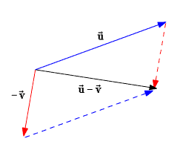
Home Work
Complete the parallelogram and draw the diagonals of the parallelogram from the initial point.

