Slide 1
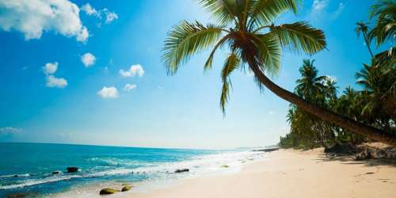
Welcome

Slide 2
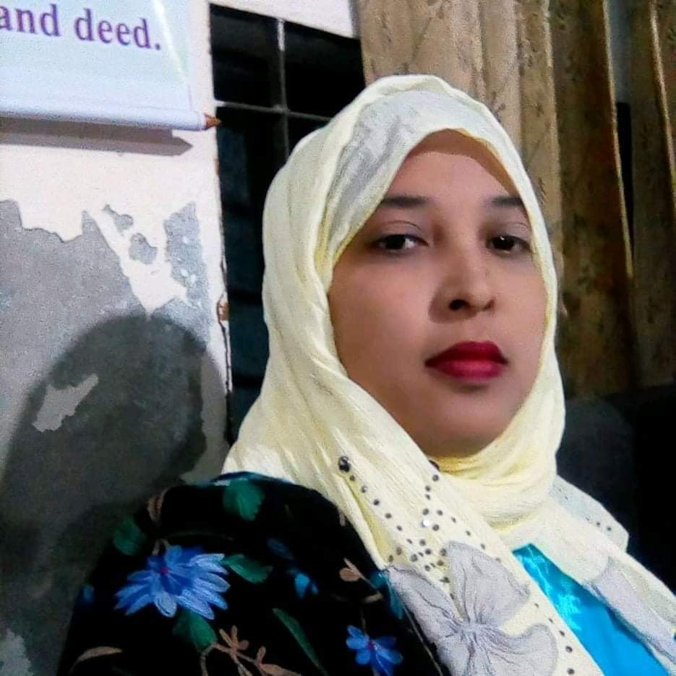
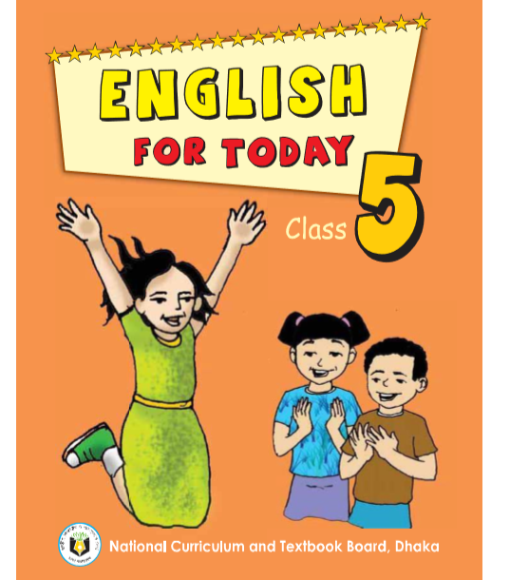
Identity
Class: Five
Sub:English For Today
Lesson title: How far is Saint Martin’s?
Unit:12
Lesson: 1
Time: 35 Minute
Date: 21- 08- 2021
Mst.Forida Yeasmin
Assistant Teacher
Guthoil Model govt.Primary School
Nachoil, Chapainawabgonj
Email:foridapti1982@gmail.com

Slide 3
Review the previous lesson
What is preposition?
Give some examples of preposition?
When does our voice go up and down?

Slide 4
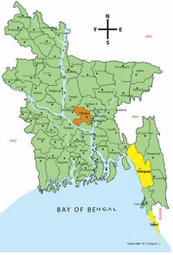
What do you see in the picture?
Map of Bangladesh
Point out the Saint Martin’s Island.

Slide 5
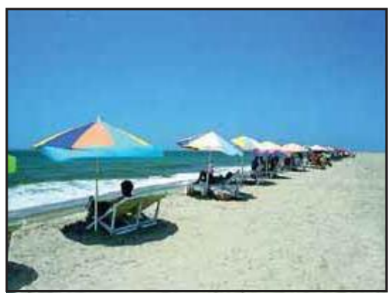
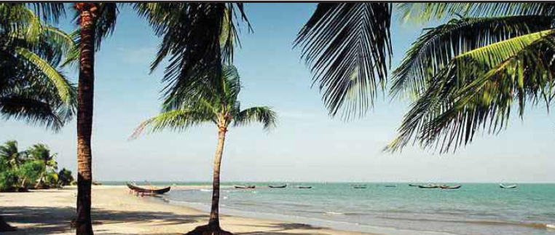
What you can see in the pictures below?
Cox’s Bazar
Saint Martin’s Island

Slide 6
Where Saint Martin’s Island is located?
Saint Martin’s Island is a coral island in the northestern part of the southern most Bay of Bengal in Bangladesh. It is located at the mouth of the Naf River, about 9km south of Teknaf in cox’s Bazar district and 8 km west of the coast of Myanmar.

Slide 7
Lesson Declaration
How far is Saint Martin’s?

Slide 8
Learning outcomes
By the end of the lesson students will be able to
Listening :
1.3.1 recognize which words in a sentence are stressed.
3.4.1 understand statements made by the teacher and student.
Speaking:
1.1.2 Say sentences with proper intonation.
6.2.1 talk about people, objects, events etc.
Reading:
1.7.1 read paragraphs, dialogues stories, letters and other texts.

Slide 9
Dear student’s Listen to the text attentively and say with me.
Andy: Hi, Tamal! Can you help me with something?
Tamal: Sure, Andy!
Andy: What are the main tourist spots in Bangladesh? I know about Cox’s Bazar. I visited there last month.
Tamal: Oh, Cox’s Bazar is the most popular tourist spot.

Slide 10
Andy: And it’s beautiful! I loved the sea and the beach! But I’d like to see some new places to see some new places this time.
Tamal: Right! There are many places to see in our country. You can go to Sreemangal. You can enjoy the beauty of the tea gardens there. From there you can go to Madhabkundu. There are some wonderful waterfalls there. You can also go to Saint Martin’s Island. It’s a special place.

Slide 11
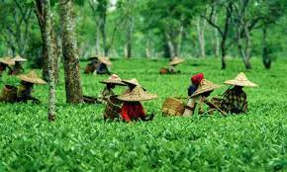
Let’s see some new words
beach
an area of sand near the sea
সমুদ্র সৈকত
The place where tea is grown
Tea garden
চা বাগান

Slide 12
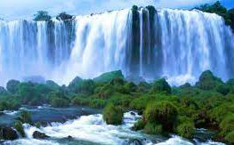
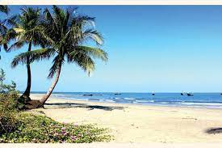
waterfall
place where water falls from a great height
জলপ্রপাত
A piece of land completely surrounded by water
Island
দ্বীপ

Slide 13
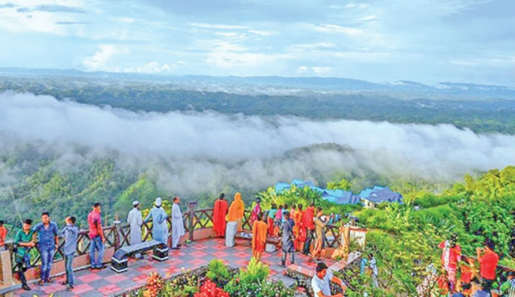
a person who is travelling or visiting a place for pleasure
tourist
পর্যটক
A particular place or point
spot
স্থান

Slide 14
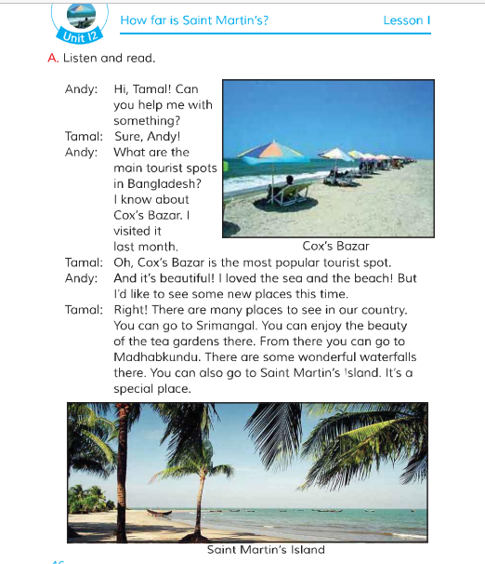
Dear students, make pair and read the text with pair.

Slide 15
Evaluation
Who are in the dialogue?
Who is asking about main tourist spots in Bangladesh?
Who visited Cox’s Bazar last month?
What are the other places to see in our country?

Slide 16
Home work
You will write about different spots in Bangladesh.

Slide 17
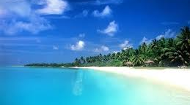
Thank you

