Slide 1
Welcome

Slide 2
Mujibur Rahman
Assistant Teacher
Eklimiah GPS
Biswanath, Sylhet

Slide 3
Introduction of the lesson
Class : Three
Subject : English
Unit :8
Lesson’s title : Numbers

Slide 4
Learning outcomes
1.1.2=Say words,phrases and sentences after the teacher with proper sounds and stress.
2.1.1= Recognize and read cordinal numbers up to 100
2.1.1=write cordinal numbers up to 100 in figures.

Slide 5
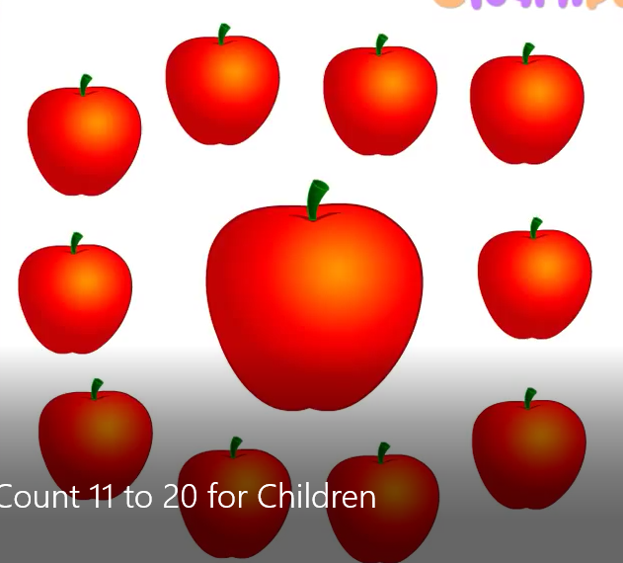
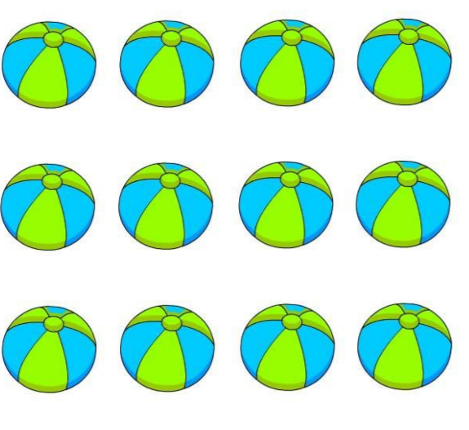
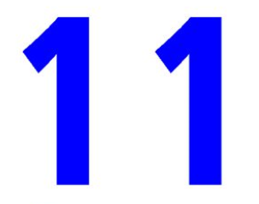

Slide 6
Now, Let’s see a video……..

Slide 7
What have you seen in a video?
Count the Number’s

Slide 9
Activities
Say, count and write the numbers.

Slide 10
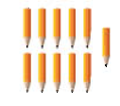

Slide 11
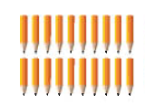

Slide 13
Addition of the text book
Open your English book
Page no: 16
Look , say and count the pictures of the text book.

Slide 14
Individual work
Write the numbers of the flowing picture.

Slide 18
Task
Look at the book .Say and count the numbers of the pictures.
Write the answer of the flowing questions.

Slide 19
Thank you

