Slide 1
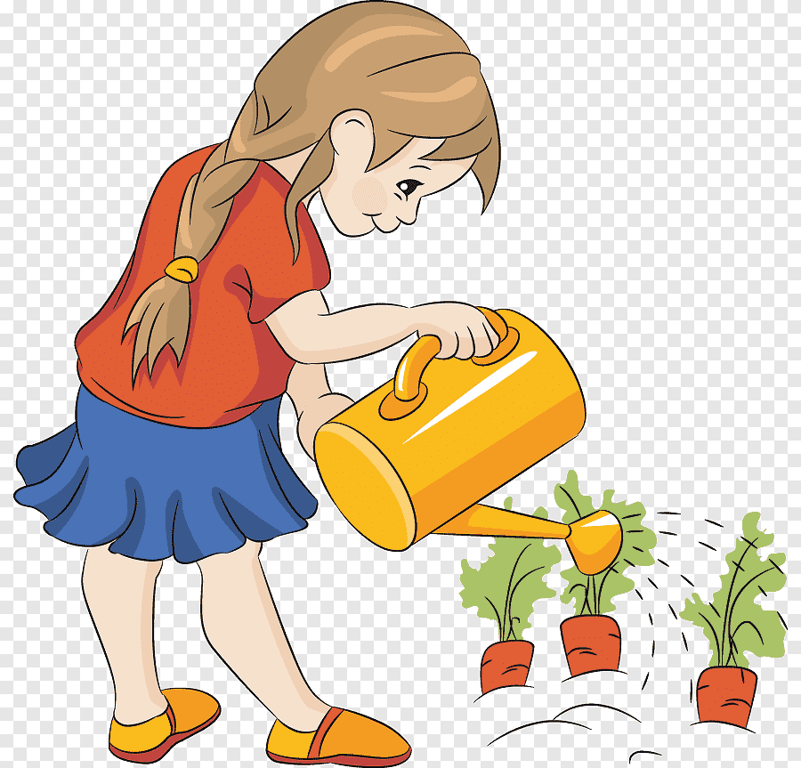

Slide 2
Class Two
Sub: English For Today
Unit:15, Lesson: 1. Activity: A
Story: Rima and the seed

Slide 3
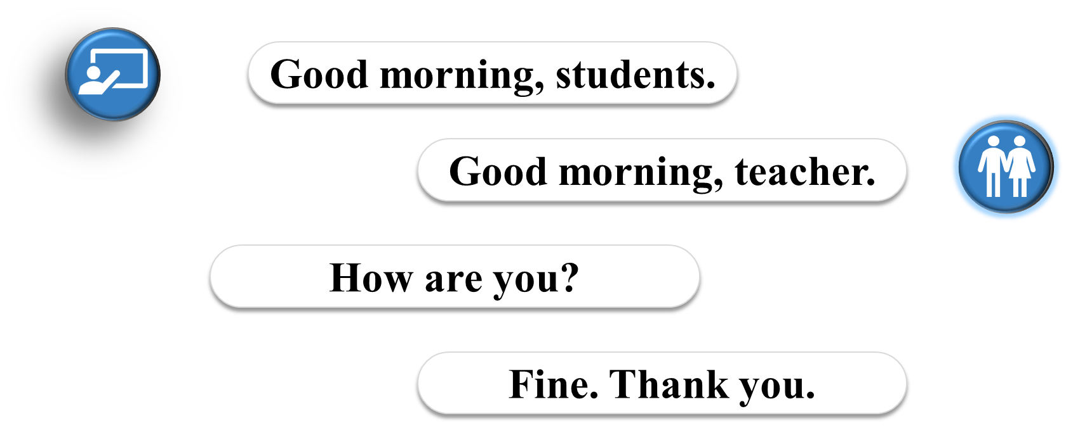
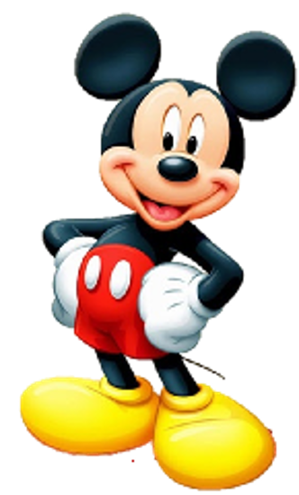

Slide 4
Let us sing a Greeting Song.
I can see left
I can see right
Hello to you!
Hello to you!!
I look at ground
I look at the sky
Fly away little Bird
Goodbye Goodbye..!

Slide 5
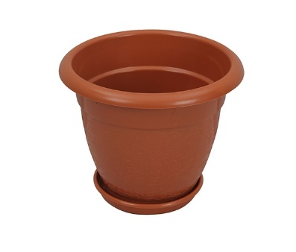
Review the previous Lesson
Look and say about the pictures.
What are these?

Slide 6
Review the previous Lesson
Say the words properly.
seed
tub
plant
put
wait
give
water

Slide 7
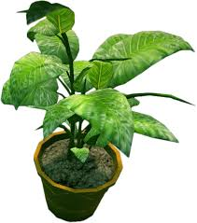
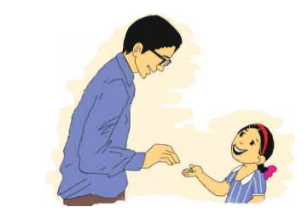
Today’s Lesson is…
Story: Rima and the seed

Slide 8
Learning Outcomes
Listening: 1.1.1 become familiar with English sounds by listening to common English words.
2.1.1 following simple commands and instructions.
3.1.2 understand simple questions and statements about familiar objects.
4.2.1 enjoy simple stories
Speaking: 1.1.1 repeat after the teacher simple words and phrases with proper sounds and stress.
1.1.2 say simple words and phrases with proper sounds and stress.
5.1.1 say the names of the days of the week.
7.1.1 give simple commands and instructions.
Reading: 1.3.1 recognize and read the names of objects having the same initial and final sounds.
1.4.1 read words and phrases with the help of visual clues and simple sentences.
5.1.1 recognize and read the days of the week.

Slide 9
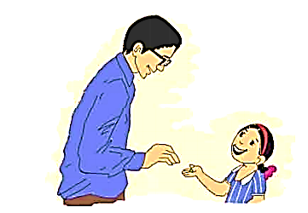
Look at the picture at page 30
On Saturday, Rima’s father gives her a seed.
What does Rima’s father give her ?

Slide 10
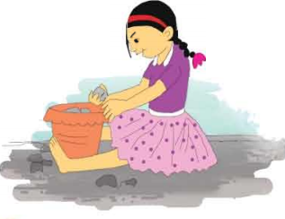
Look at the picture at page 30
On Sunday, Rima puts the seed in a tub.
Where does Rima put her seed?

Slide 11
Ask and Answer
On Saturday, I come to School.
Chain
drill
What do you do on Friday?

Slide 12
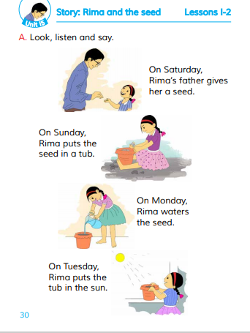
Open your Book at page 30 and
Listen to the Audio

Slide 13
Read the Text with Peer

Slide 14
Say the Answer
What does Rima’s father give her?
On which day Rima’s father gave her the seed?
Where does Rima put her seed?
On which day Rima put the seed on the tub?

Slide 15
Pair work
Fill in the blank on your exercise book.
seed
On Saturday, Rima’s father gives her a -------.
Sunday
tub
On -----------, Rima puts the seed in a ------.

Slide 16
Checking Learning

Slide 17
Home work
Rearrange the letters and make correct words.
t/w/a/e/r
i/v/e/g
t/p/u
w/i/a/t

