Slide 1
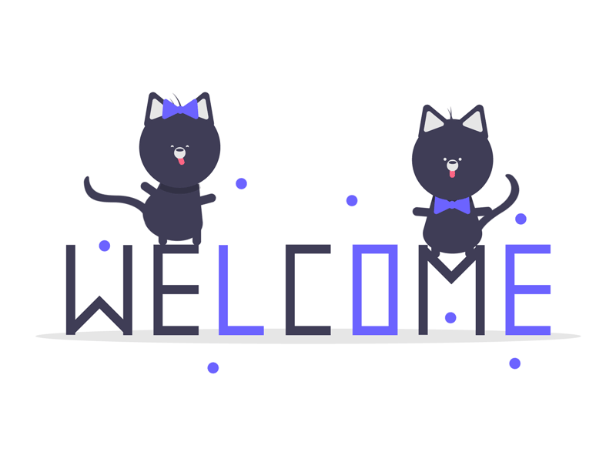

Slide 2
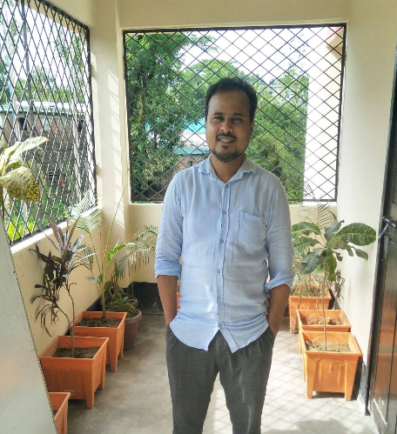
Teacher’s introduction
Md. Rafiqul Hasan
Assistant Teacher
Khonkarkhil Government Primary School, Sadar, Cox's Bazar.
email: rafiquecox1@gmail.com
mobile: 01815 605 444

Slide 3
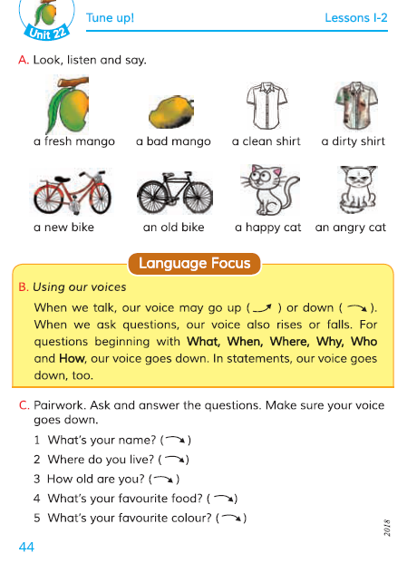
Lesson’s introduction
Class: 4
Sub: English For Today
Unit: 22
Title: Tune up
Part of lesson:
Language Focus
B. Using our voices
C. Pairwork. Ask and answer the questions. Make sure your voice does down.
Page no: 44, Time: 45 Min.

Slide 4
Learning outcomes
Listening:
1.4.1 recognize and use intonation patterns for Wh and Yes / No question, greeting and students
Speaking:
3.1.1 ask and answer Wh questions
Reading:
1.5.1 read words , phrases and sentence in the text with proper pronunciation stress and intonation

Slide 5
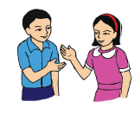
Exchange the greetings
Teacher: Good morning, students.
Students: Good morning, teacher.
Teacher: How are you?
Students: Fine. Thank you.

Slide 6
Let’s watch a video...

Slide 7
Teacher’s reading
B. Using our voices
When we talk, our voice may go up () or down (). When we ask questions, our voice also rises or falls. For questions beginning with What, When, Where, Why, Who and How, our voice goes down. In statements, our voice goes down, too.

Slide 8
Student’s reading
B. Using our voices
When we talk, our voice may go up () or down (). When we ask questions, our voice also rises or falls. For questions beginning with What, When, Where, Why, Who and How, our voice goes down. In statements, our voice goes down, too.

Slide 9
Teacher’s reading
C. Pairwork. Ask and answer the questions. Make sure your voice goes down.
1 What's your name? ()
2 Where do you live? ()
3 How old are you? ()
4 What's your favourite food? ()
5. What's your favourite folour? ()

Slide 10
Student’s reading
C. Pairwork. Ask and answer the questions. Make sure your voice goes down.
1 What's your name? ()
2 Where do you live? ()
3 How old are you? ()
4 What's your favourite food? ()
5. What's your favourite folour? ()

Slide 11
Today's topic
Page no. 44
B. Using our voices
C. Pairwork. Ask and answer the questions. Make sure your voice does down.

Slide 12
Pair work... (for 10 minutes)
1. What's your name? ()
1) My name is Ali.
2. Where do you live? ()
2) I live in Dhaka.
3. How old are you? ()
3) I am 10 years old.
4. What's your favourite food? ()
4) My favourite food is Biryani.
5. What's your favourite folour? ()
5) My favourite folour is white.

Slide 13
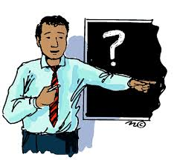
Teacher's observation and support
MD. RAFIQUL HASAN

Slide 14
Evaluation (task)
Open at page 44
N.B:
Teacher will randomly choose the student and ask the questions.
1. What's your name? ()
2. Where do you live? ()
3. How old are you? ()
4. What's your favourite food? ()
5. What's your favourite folour? ()

Slide 15
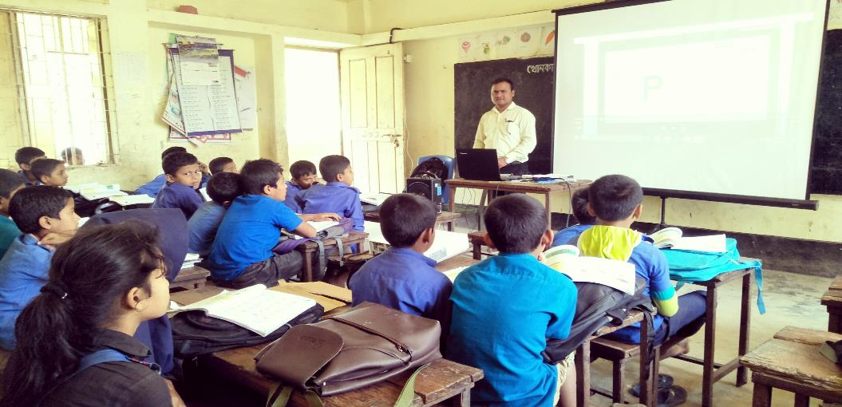
Teacher's support
MD. RAFIQUL HASAN

Slide 16
Summarization on todays lesson
What we have learned today...
Using our voices
Ask and answer the questions.
MD. RAFIQUL HASAN

Slide 17
Page no. 44
Practice activity C at home and write the answer of the question of activity C.
MD. RAFIQUL HASAN

Slide 18
That's all for today
See you tomorrow

