Slide 2
You are welcome

Slide 3
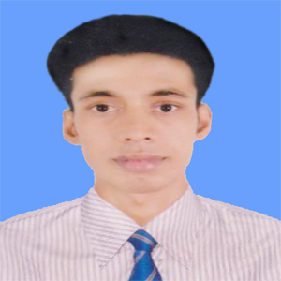
Introduction
Swandip Banerjee
Asst. Teacher (English)
Pallimangal Secondary School, Sonadanga, Khulna.
E-mail: swandipb1@gmail.com
Mobile: 01718503573

Slide 4
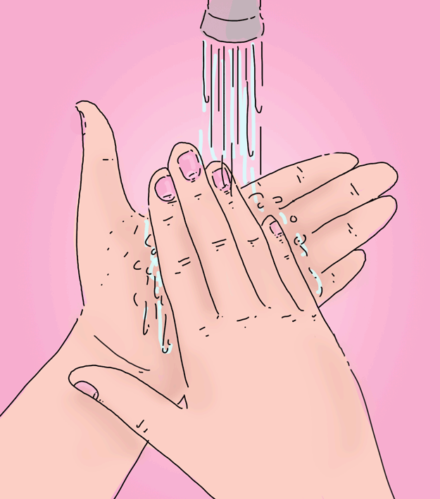
A. Look and talk about the picture. Ask and answer the following questions.
How often do you wash hands?
Why do you wash hands?

Slide 5
Our today’s lesson is…
Health
Unit: Three
Health and hygiene.
Lesson: 01

Slide 6
Learning outcomes
After we have studied this lesson, we will be able to ………
read and understand texts through silent reading.
ask and answer questions.
write the answers to questions.
write paragraphs/compositions.

Slide 7
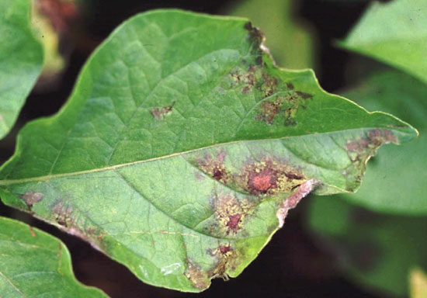
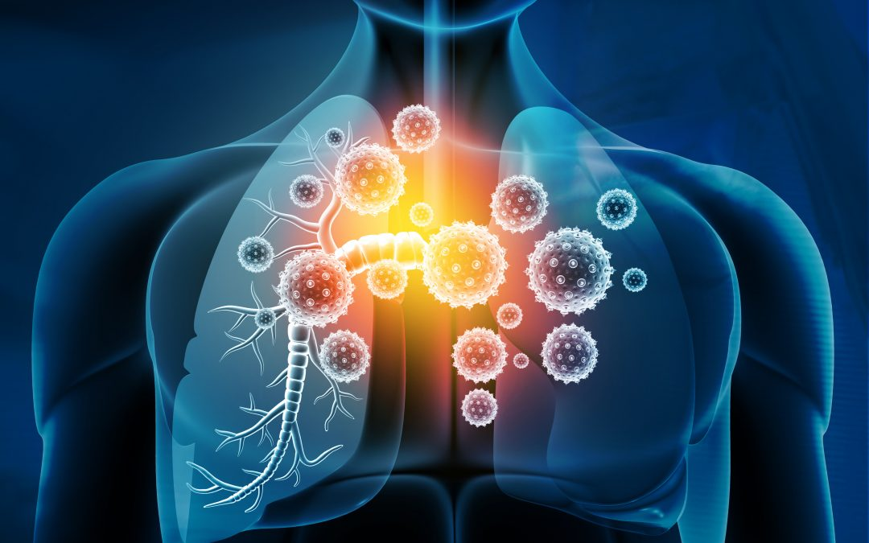
New word
Disease
a disorder of function in a human, animal or plant.
Synonym: malady, disorder

Slide 8
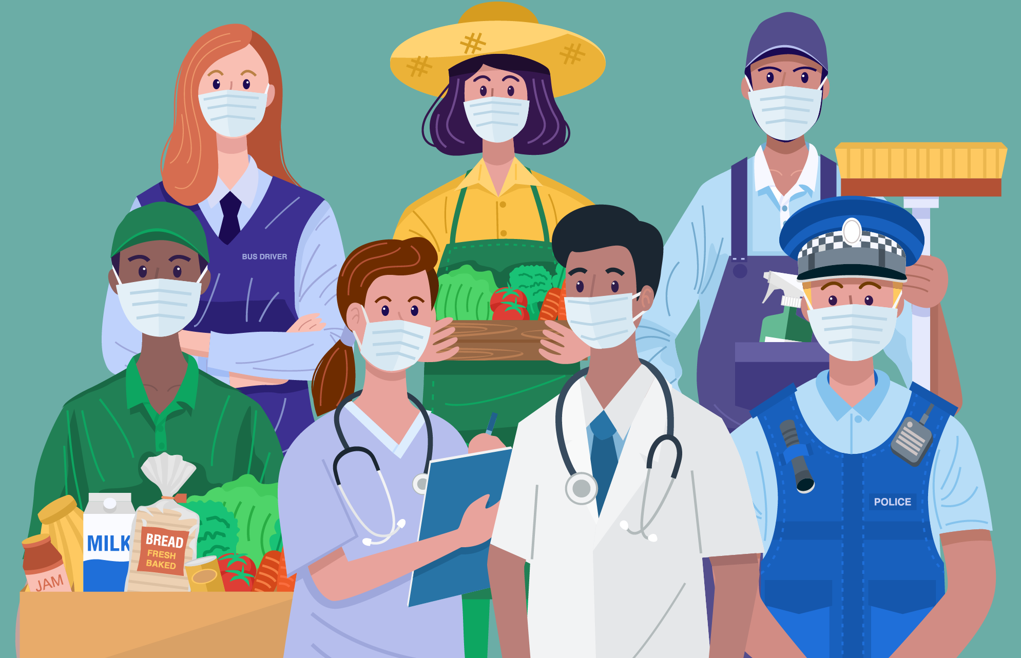
New word
Essential
a thing that is absolutely necessary.
Synonym: necessary or important

Slide 9
New word
Concentrate
focus one’s attention or mental effort on a particular object or activity.
Synonym: condense, solidify

Slide 10
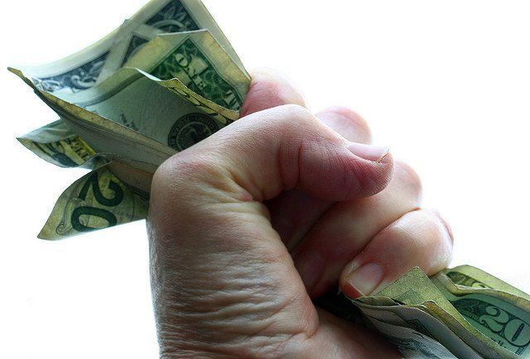
New word
Possession
the state of having, owning or controlling something.
Synonym: occupation, control

Slide 11
B. Read the questions first. Then read the text and answer the questions.
Why is good health essential for us?
Why is physical exercise necessary?
Health is the condition of our body and mind. It may be good or bad. Good health means healthy body free from diseases. It is essential for everyone to lead a happy life. If we are not in good health, we cannot concentrate on any activity in our life.
A proverb goes, ‘Health is Wealth.’ It means health is equally valuable as gold or any other personal possessions. We may have vast wealth and property, but if we are not healthy we cannot enjoy them.

Slide 12
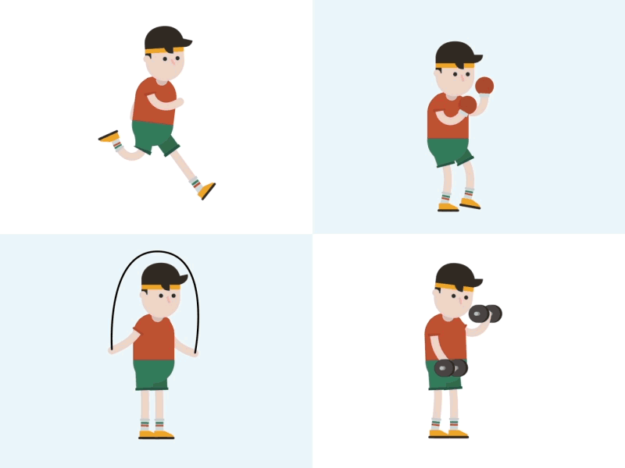
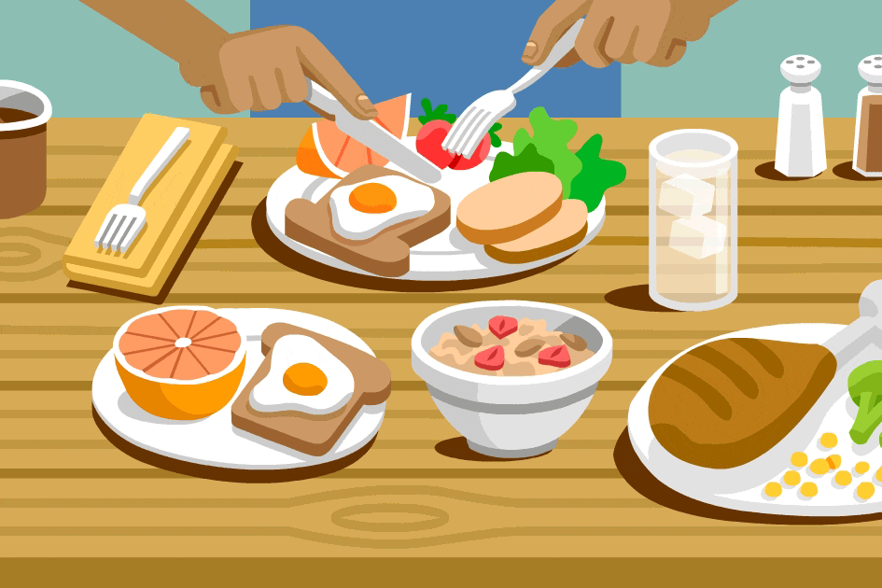
To keep ourselves healthy, we have to do certain things. We have to eat a balanced diet. We must exercise regularly to keep our body fit for work. There is an old saying: ‘Early to bed and early to rise/ Makes a person healthy, wealthy and wise.’
So, we must not keep late hours. We should go to bed early at night and rise early in the morning. Peace of mind is another condition for good health. So, we must not worry over small things of life.

Slide 13
Probable answers to the previous questions.
1. Why is good health essential for us?
Ans: Good health is essential for us to a healthy and happy life.
2. Why is physical exercise necessary?
Ans: Physical exercise is necessary to keep our body fit for work.

Slide 14
C. Read the text in B silently and then choose the best answer .
Health means the condition of –
our body (b) our mind
(c) our body and mind (d) our environment
√
2. A healthy person is one who -
is physically and mentally sound (b) eats good food
(c) has a lot of wealth (d) is overnight
√

Slide 15
C. Read the text in B silently and then choose the best answer .
3. We need to eat –
rich food (b) balanced food
(c) little food (d) lot of food
√
4. The phrase ‘to keep late hours’ means –
to go to bed late (b) to wake up late in the morning
(c) to do things late always (d) to be late for the class
√

Slide 16
Evaluation.
What is health?
What should we do to keep ourselves healthy?
Why is good health necessary?
How can we keep our body fit for work?

Slide 17
Home work.
D. Write a short paragraph about how you can maintain good health within 180-200 words.

