Slide 1
welcome

Slide 2
IDENTITY
MD.Jahangir alam
Assistent Teacher
Vedvedi Govt.Primari School,
Rangamati, sadar.

Slide 3
LESSON IDENTITY
Class:1
Subject: English
Lesson : 1-3
Unit : 4,6, ( 1,2,3 numbers)
Time : 35 mn

Slide 4
Learning outcomes
Students will be able to:
2.1.1 recognize and read cordinal numbers up to 3.

Slide 5
Warm up

Slide 6
What is this?
Mango
How many mango?
1
1 Mango

Slide 7
What is this?
Flower
How many flower?
1
1 Flower

Slide 8
What is this?
Ball
How many Ball?
2
2 Balls

Slide 9
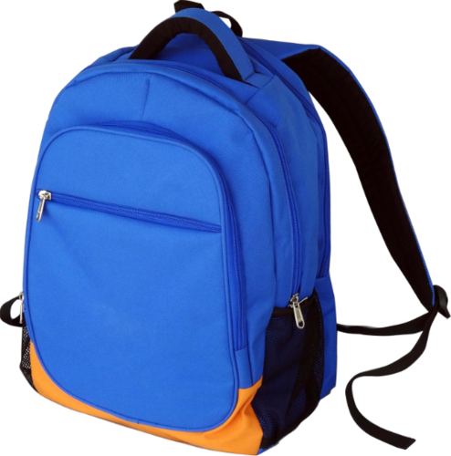
What is this?
How many bag?
Bag
2
2 Bags

Slide 10
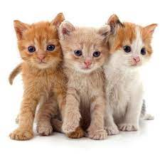
What is this?
How many Cat?
Cat
3 Cats
3

Slide 11
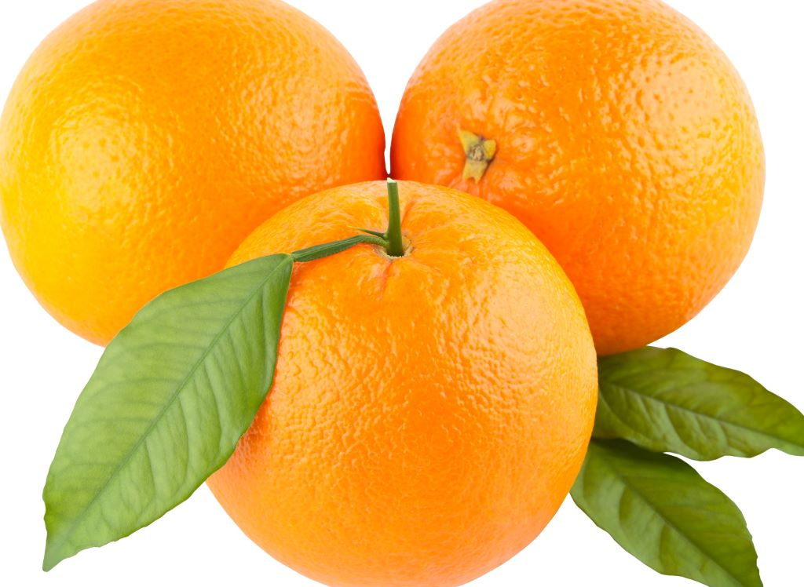
What is this?
Orange
How many Orange?
3
3 Oranges

Slide 12
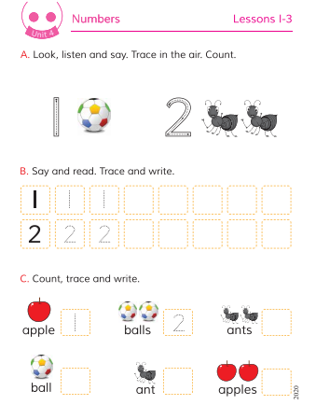
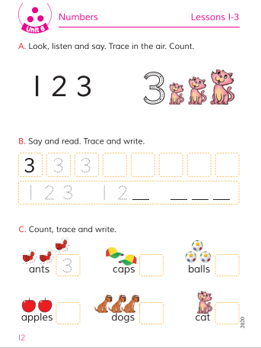
Open your Book at page-08,12.

Slide 13
Lets coutn
1
2
3

Slide 14
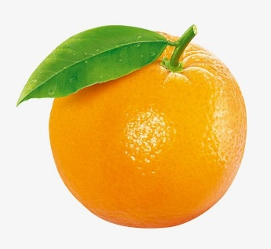
Match the number with the pictures
2
1
3

Slide 15
Say and read. Trace and write.
1
2
3

Slide 16
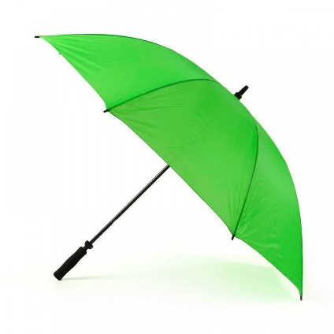
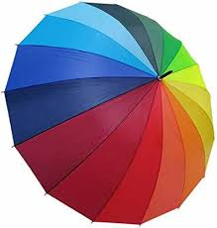
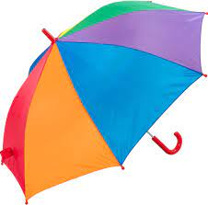
Count how many green umbrella here:
Count how many yellow umbrella here:
Count how many red umbrella here:
1
2
3

Slide 17
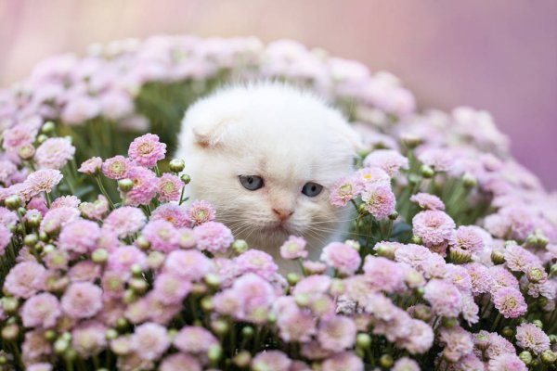
Thanks
All
the
students

