Slide 1
Welcome

Slide 2
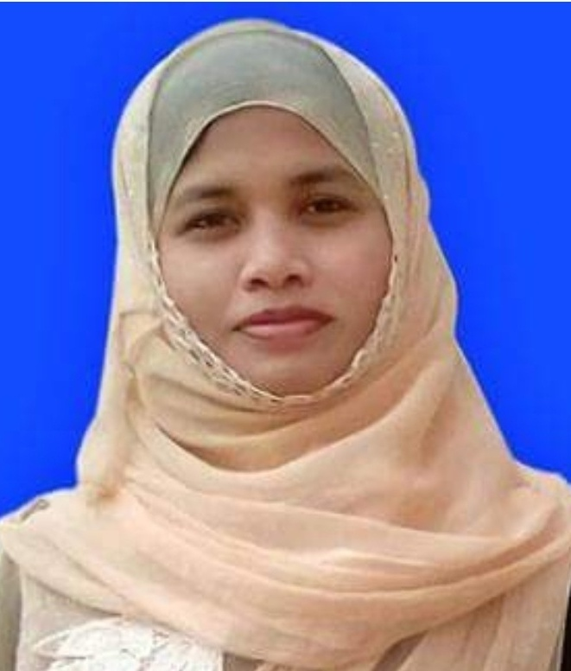
Teacher Introduction
Kuhinur Jannat
Assistant Teacher
Fakirakata Govt. Primary School
Moheshkhali, Cox’sbazar

Slide 3
Lesson Introduction
English For Today
Unit : 2
Lesson : 5-6
Activity : H & I
Title : See you!

Slide 4
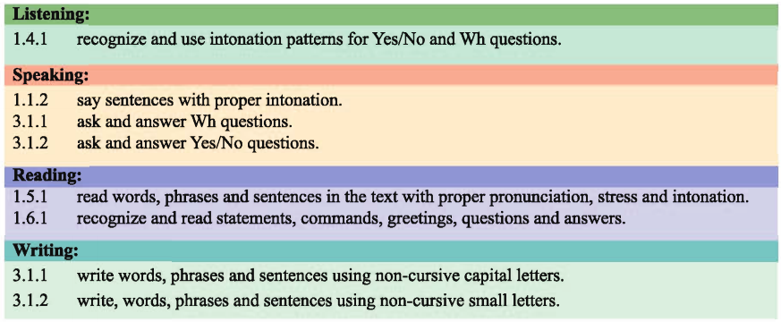
Learning Outcomes : At the end of the lesson students will be able to

Slide 5
Nickname

Slide 6
Full Name : Kuhinur Jannat
1st Part 2nd Part
Nickname : Kuhinur

Slide 7
Practice
With Students Name

Slide 8
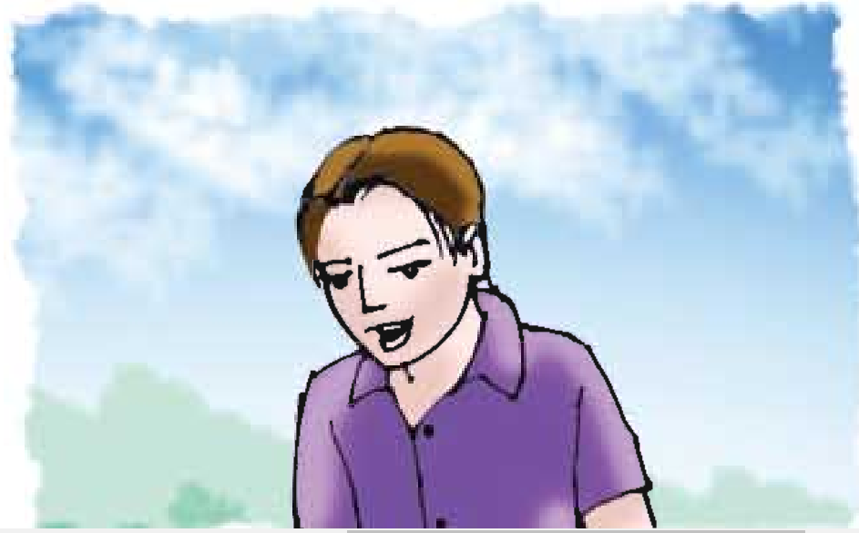
Open your book at page 8 &
look at the picture
Who is he?

Slide 9
Listen to me
What’s your full name?
How do you spell your first name?
What’s your last name again?
Do you have a nickname?
Answer the Questions

Slide 10
What’s your full name? A Yes. It’s Andy.
How do you spell your first name? B Smith.
What’s your last name again? C Andrew Smith.
Do you have a nickname? D A-N-D-R-E-W
Match the line:

Slide 11
Come here any two & match the table:

Slide 12
Play a game with nickname.
( Ball Game)

Slide 13
Group Work
Write your friends information below.

Slide 14
Group Work Presentation

Slide 15
Assessment

Slide 16
What have you learnt from the lesson?
We’ve learnt about full names and nick names.

