Slide 1
WELCOME EVERYBODY

Slide 2
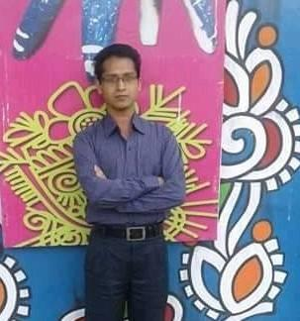
Presented by-
Gobinda Chandra Mondal
Assistant Teacher
Sreenagar No. 1 Model Govt. Primary School
Sreenagar, Munshigonj.
Mobile: 01731663188

Slide 3
Lesson Introduction
Class: Four
Subject: English
Unit: 17
Lesson: 1-2
Time: 40 minutes
Date: 03/08/2021

Slide 4
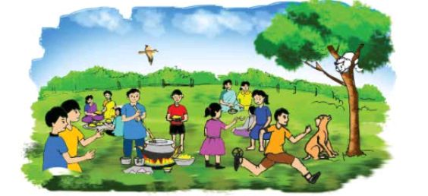
Our Today’s Lesson:
Look at the picture.
Where are they staying?
Write down on your notebook ‘In the park’.
‘‘In the park’’

Slide 5
Learning Outcomes
Speaking:
6.1.1 say what the speaker is doing.
6.1.2 say others are doing.
6.2.1 say what the speaker is doing.
8.1.1 take part in conversations on simple topics (likes/dislikes, hobbies ,holidays, family, friends, etc.)
Reading:
1.4.1 read words, phrases and sentences in the text.
1.5.1 read words, phrases and sentences in the text with proper pronunciation, stress and intonation.
1.7.1 read short paragraphs, dialogues and simple letters.

Slide 6
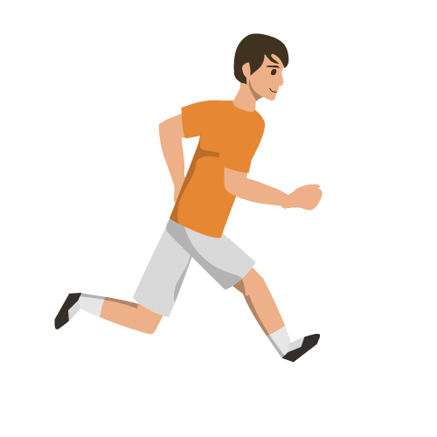
What is the boy doing ?
Look at the picture
The boy is running very fast.

Slide 7
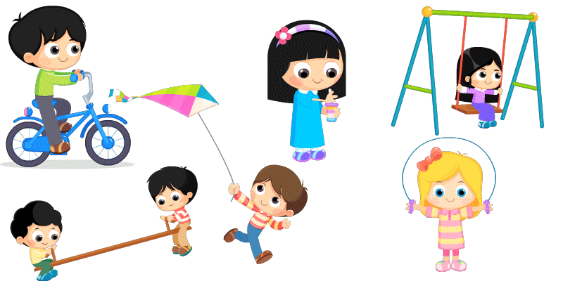
What are the girls doing?
Look at the picture
The girls are playing.

Slide 8
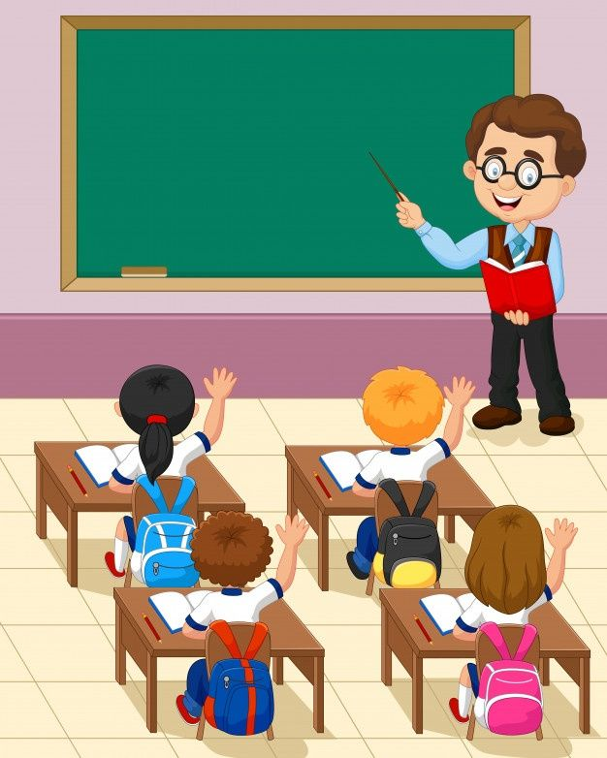
Teacher’s Reading
Open your English book at page 34.
A. Look, listen and say.
Mita: The boy is running very fast.
Salam: The girls are playing! Let’s play with them.

Slide 9
Individual work
Talk about the picture in activity A. Write five sentences with the following verbs. Use the present continuous tense.
eat
cook
sit
look at
fly
stand
Ans:
1. Some children are eating something.
2. A man is cooking.
3. A cat is sitting on the tree.
4. A dog is looking at the cat.
5. There is abird flying in the sky.

Slide 10
Pairwork
See the Answer
Look at the table
Make sentences
I am playing with Mehnaz.
You are playing with Mehnaz.
He/She/It is playing with Mehnaz.
We are playingwith Mehnaz
You are playing with Mehnaz.
They are playing with Mehnaz.
Structure: Subject + am/is/are + verb + ing + object.

Slide 11
Groupwork
Open your book at page 34 and read the text A and act each other in 5 groups.

Slide 12
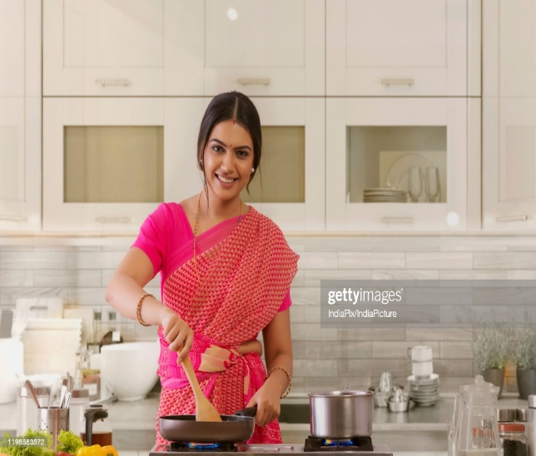
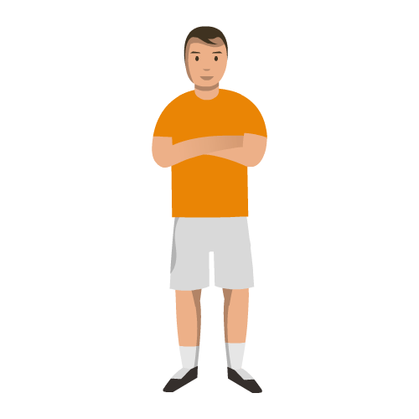
Evaluation
Look at the pictures
1. What is the woman doing?
Ans: The woman is cooking.
2. What is the man doing?
Ans: The man is standing.

Slide 13
One day one word
Date: 05/08/2021
Write down on your note book.
Word Meaning(অর্থ) Antonym Sentence
Fast
Quick(দ্রুত)
Slow
The horse is running fast.

Slide 14
Homework
Write 5 sentences in present continuous.

