Slide 1
Wellcome to my English class

Slide 2
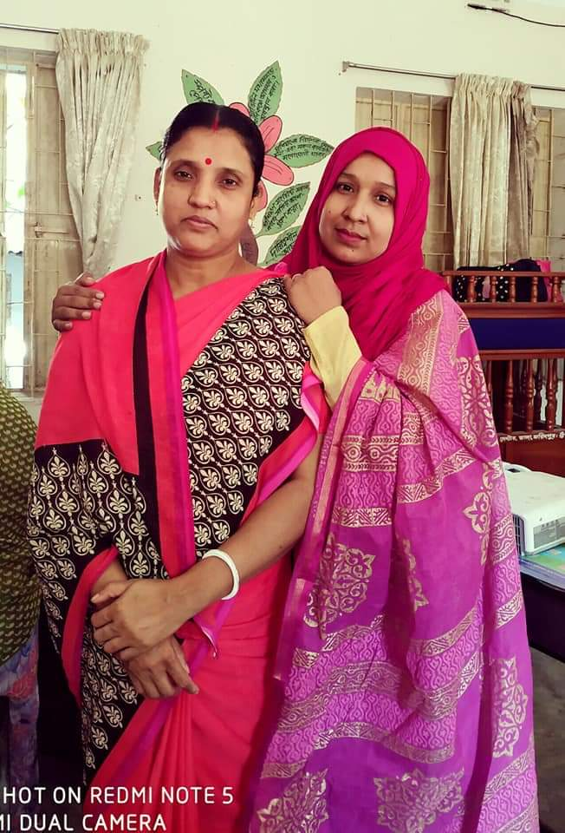
Sharmin Rahman Sweet
Assistant teacher
22no Gharua Govt primary school
Bhanga, Faridpur.

Slide 3
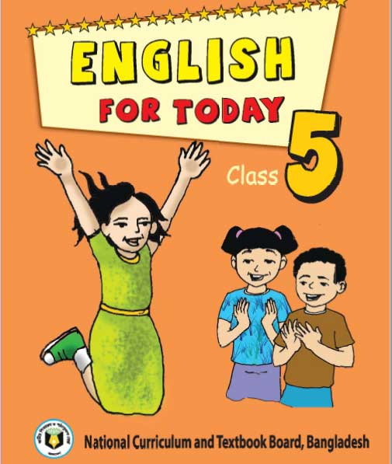
Class :Five
Subject: English
Unit: 05
Lesson: 5-7
context: G, H
Page: 20
date: 22.06.2021

Slide 4
Do you remember the name of the seven days in a week?

Slide 5
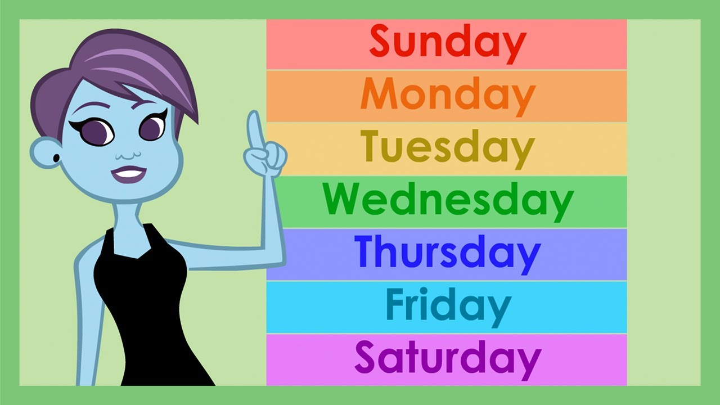

Slide 6
Can you name me the twelve months of the year?

Slide 7
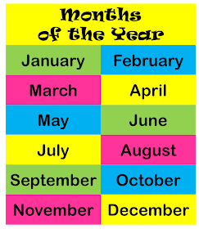

Slide 8
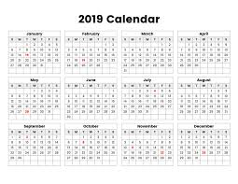
Look at the picture
calendar

Slide 9
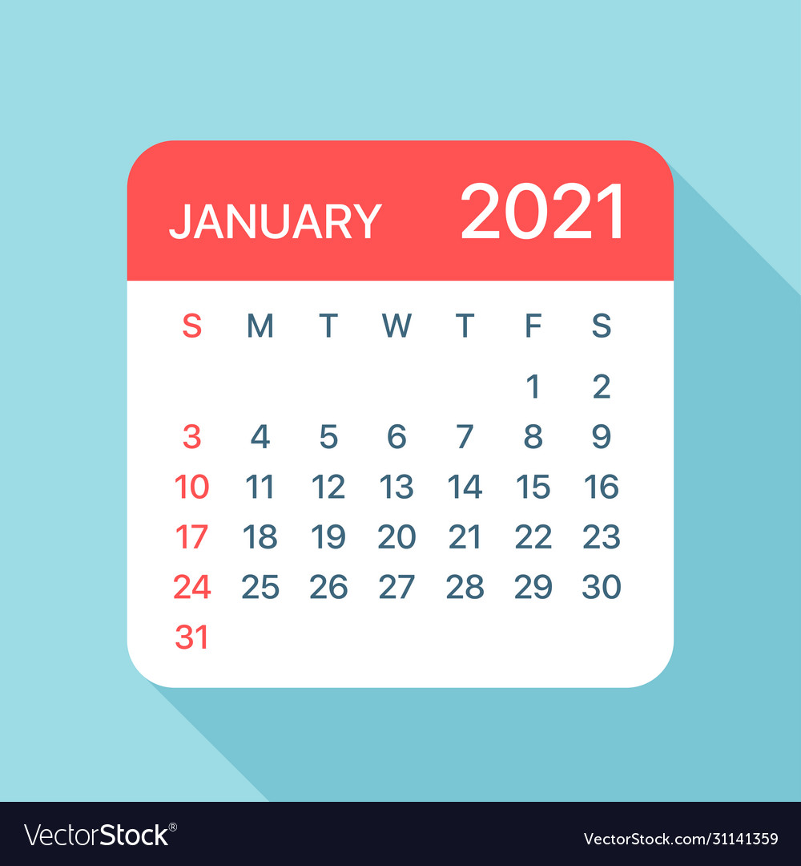
Look at the picture

Slide 10
Today we learn about Days in a calendar

Slide 11
Please open at page 20

Slide 12
New word
Word meaning
Today
The present day
Yesterday
On the day before today
Tomorrow
On the day after today
weekend
Especially regarded as a time for leisure.

Slide 13
Look at the calendar . Answer the following question
1. What day is the 10th of January?
Ans: the 10^{th of} January is Sunday.
2.What is the date of the first Saturday of the month?
Ans: The first Saturday of month is 2nd of January.

Slide 14
Look at the calendar .answer the following question
3. What day is the 20th of January?
Ans: The 20th of January is wednesday.
4. What is the date of the last Friday of month?
Ans:The date of the last Friday of month is 29th of January.

Slide 15
Look at the calendar .answer the following question.
5. How many weekends are there in the month?
Ans:There are 5 weekends in the month.

Slide 16
Evalution
Write the answers of the following questions on your note book.
1. What day is it today? What is todays date?
Ans: Today is Tuesday. Todays date is 22th of june.
2.What day was it yesterday? What was yesterdays date?
Ans: yesterday was Monday. Yesterdays date was 21th june.

Slide 17
3.What day is it tomorrow? What is tomorrows date?
Ans: tomorrow is wednesday. Tomorrows date is 23th june.

Slide 18
Home work
Write the twelve months of the year.

