Slide 1
Welcome

Slide 2
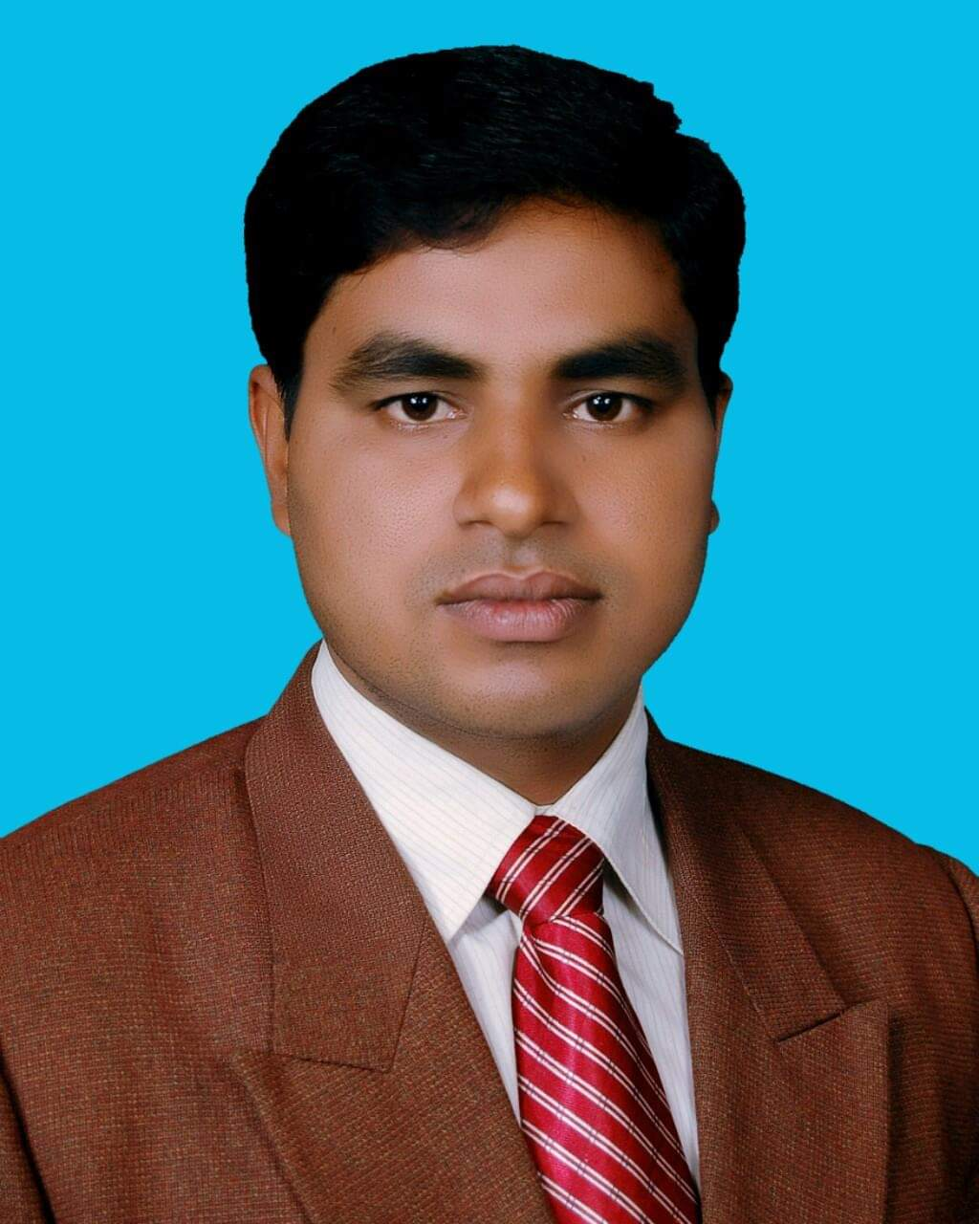
Introduction
Md. Noor –E- Alam Siddiki
Asstt. Teacher
Nageswari Keramatia M.L High School.
Mobile- 01716962418
Email- nooralam.na35@gmail.com
Unit-3, lesson-7

Slide 3
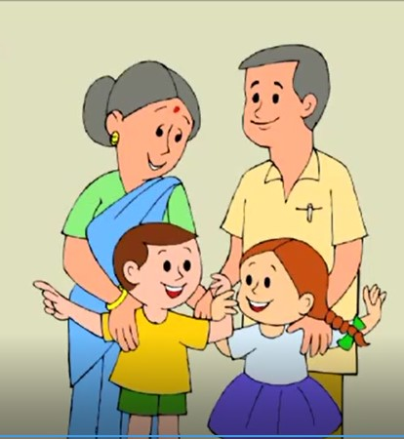
Look at the picture carefully.
How is the family?
It is a healthy and happy family.

Slide 4
Today’s lesson title is…
A healthy and happy family
Unit 3, Lesson 5

Slide 5
Learning outcome
After studied the lesson , we will be able to …
ask and answer questions.
develop listening skill.
identify right or wrong information.
tell meaning of some words

Slide 6
Let’s know some words
nutritious
nutritive, wholesome, healthy, healthful,
beneficial.

Slide 7
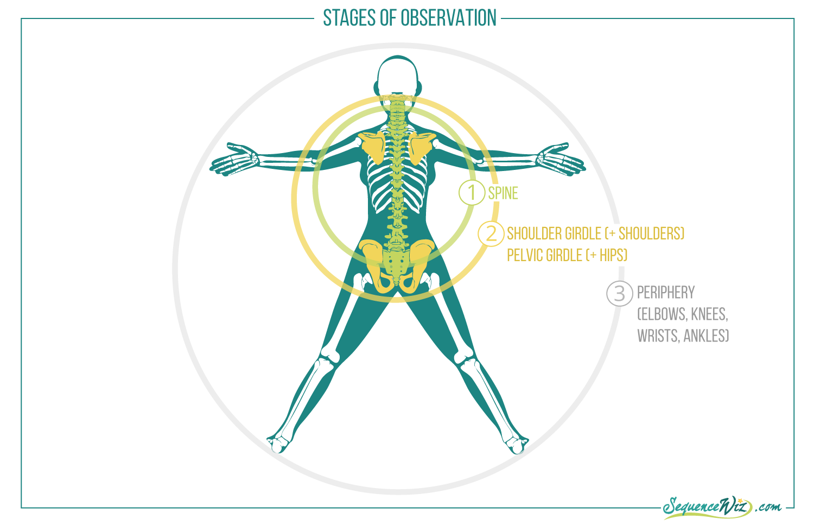
structure
construction, form,
formation, shape,
anatomy, constitution

Slide 8
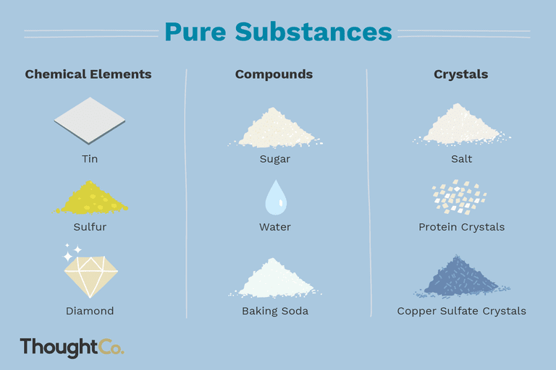
substances
material, matter, stuff,
medium.

Slide 9
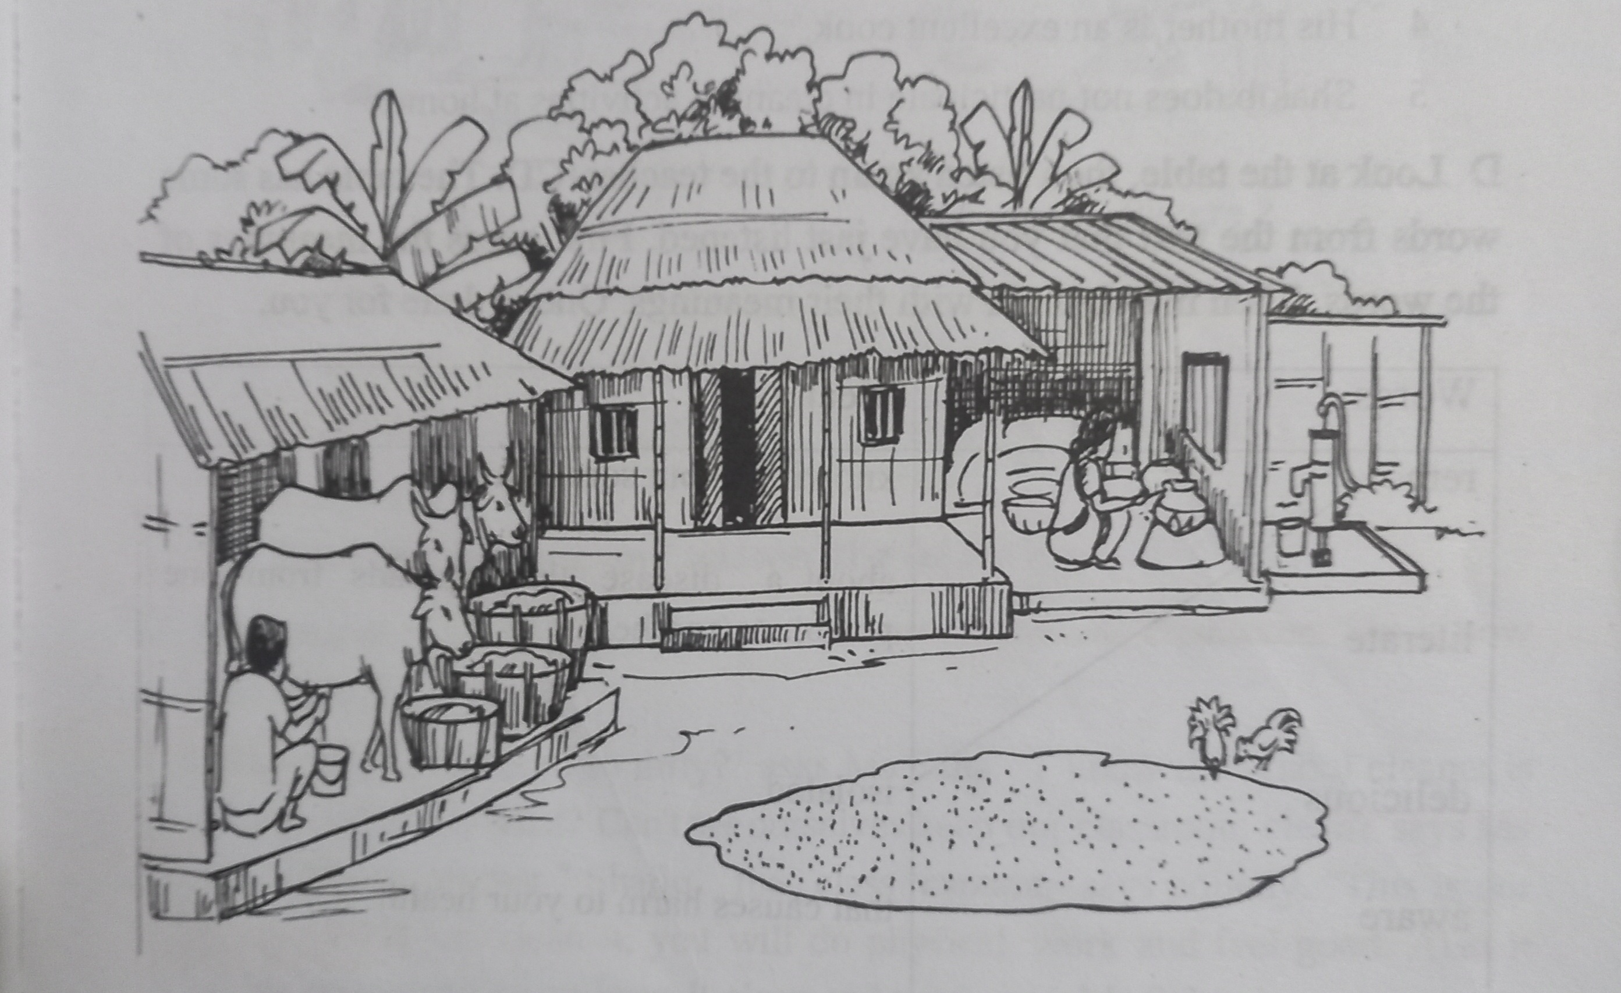
Look at the picture and ask and answer the questions with pair.
1. What do you see in the picture?
2. How do you feel living in such a house?
3. Where can you find these types of house? Why do you think so?

Slide 10
Listen to the audio and answer the following questions individually.
1. How far is Shakib’s house from his school?
2. Why is Shakib’s house is free from mosquitoes?

Slide 11
Individual work
Listen again the audio and write ‘True’ or ‘False’ against each of the following statement.
3. His parents do not know how to read or write.
4. His mother is an excellent cook.
1. Shakib’s family lives in a remote town.
5. Shakib does not participate in cleaning activities at home.
2. He has no brothers or sisters.

Slide 12
Match your answer.
1. Shakib’s family lives in a remote town.
True
False
4. His mother is an excellent cook.
2. He has no brothers or sisters.
True
False
True
False
5. Shakib does not participate in cleaning activities at home.
3. His parents do not know how to read or write.
True
False
True
False

Slide 13
Group work
Look at the table. Then listen to the audio. Then match them with their meaning.

Slide 14
Match your answer
Word
Meaning
Remote
Knowing about something.
About a discuss that spreads from one person to another.
literate
delicious
Isolated.
aware
That causes harm to your health.
harmful
Having a very pleasant taste.
contagious
Able to read and write.

Slide 15
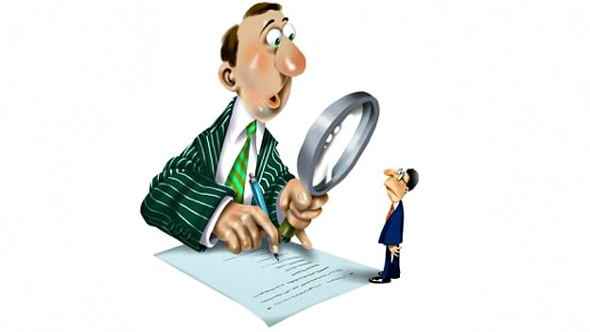
Evaluation
How many members are there in Shakib’s family?

Slide 16
Bye. See you again in next class.

