Slide 1
WELCOME
TO
ALL
Learning outcomes
Watch video
Family pictures
Introduction
Todays topic
Greeting

Slide 2
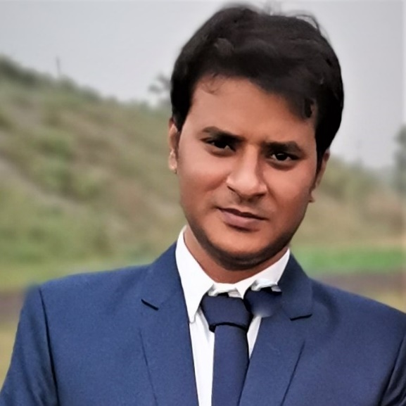
INTRODUCTioN
Learning outcomes
Watch video
Family pictures
Introduction
Todays topic
Greeting
SANJOY KUMAR SARKER
ASSISTANT TEACHER
DHONKURA GOVT. PRIMARY SCHOOL
HOSSAINPUR, KISHOREGANJ.
01717780954
EMAIL: sk03bau@gmail.com
Subject: English. Class: Four. Unit:15, Lesson: 1-3
(Sagar and his family)
Time: 50 Minutes.

Slide 3
GREETINGs
Good morning, students.
Learning outcomes
TEACHER
STUDENTS
Watch video
Family pictures
Introduction
Todays topic
Greeting
Good morning, teacher.
How are you today?
Fine. and you?
Fine, thank you.

Slide 4
Dear students, Let us go to watch a video.
Learning outcomes
Watch video
Family pictures
Introduction
Todays topic
Greeting
Discuss about the video
With the students

Slide 5
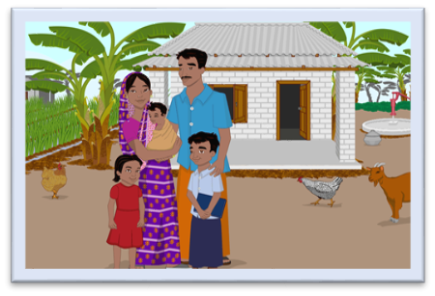
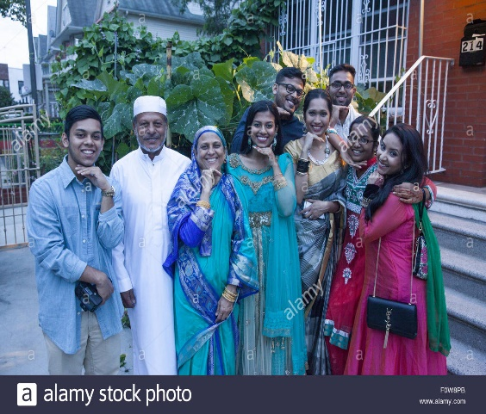
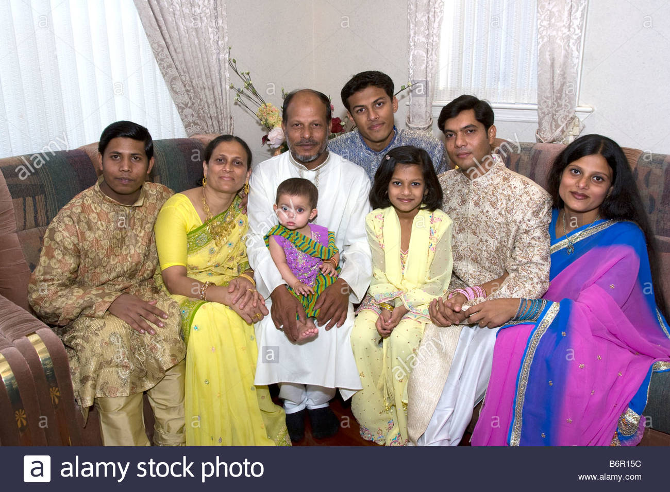
Dear students, Look at the pictures and think alone.
2
Learning outcomes
Watch video
Todays topic
Family pictures
Introduction
Introduction
Greeting
3
4
Students, Right here are some family pictures.

Slide 6
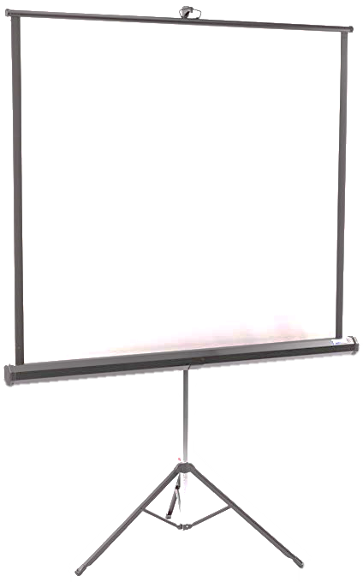
Dear students, Think what will be todays topic
Family
Yes, Todays topic is Sagar And His Family.
Sagar and his family
Learning outcomes
Watch video
Family pictures
Introduction
Greeting

Slide 7
Learning outcomes:
By the end of the lesson students will be able to……
Listening:
1.1.1Recognize sound diffrences in the context of word.
1.2.1 Recognize which syllable in a words is student.
Speaking:
1.1.1 Repeat after the teacher and say words phrases and sentence
with proper sounds.
6.2.1 Take about people object event.
Reading:
1.4.1 Read words phrass and sentence in the text.
1.7.1 Read short paragraph dialogues and simple letters.
Watch video
Family pictures
Introduction
Todays topic
Learning outcomes
Greeting

Slide 8
TEACHER’S READING
Single work
Teacher’s reading
Keyword
Keyword
Keyword
Keyword

Slide 9
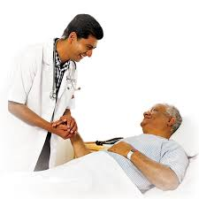
MAIN KEYWORDS OF THE LESSON
DOCTOR
1
Single work
Teacher’s reading
Keyword
Keyword
Keyword
Keyword
Keyword
KEYWORD
A Doctor is a person
who treats the patients.

Slide 10
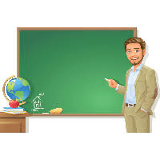
MAIN KEYWORDS OF THE LESSON
TEACHER
2
Single work
Teacher’s reading
Keyword
Keyword
Keyword
Keyword
KEYWORD
A Teacher is a person
Whose work is teaching.

Slide 11
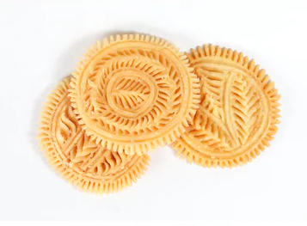
MAIN KEYWORDS OF THE LESSON
PITHA
3
Single work
Teacher’s reading
Keyword
Keyword
Keyword
Keyword
KEYWORD
Pitha is a one kind of food that’s usually makes at home.

Slide 12
MAIN KEYWORDS OF THE LESSON
Single work
DELICIOUS
4
Teacher’s reading
Keyword
Keyword
Keyword
Keyword
KEYWORD
Dlicious food is very pleasant to eat.

Slide 13
Keyword
MAIN KEYWORDS OF THE LESSON
Single work
Wonderful5
Teacher’s reading
Keyword
Keyword
Keyword
KEYWORD
Extremely good

Slide 14
Individual work
Dear Students, Open your book at page no.30 and read the text loudly…
Single work
Teacher’s reading
Keyword
Keyword
Keyword
Keyword

Slide 15
Look at the picture and read the statements.
SAGAR
Statement
Pairwork
Statement
Statement
Statement
Statement
Statement
Sagar is in class 4.
He is nine years old.

Slide 16
Look at the picture and read the statements.
keya
Statement
Pairwork
Statement
Statement
Statement
Statement
Statement
She is a little sister of Sagar. Her name is Keya. She’s only three years old.

Slide 17
Look at the picture and read the statements.
Sagar’s
Father
Statement
Pairwork
Statement
Statement
Statement
Statement
Statement
Sagar’s father is a doctor.

Slide 18
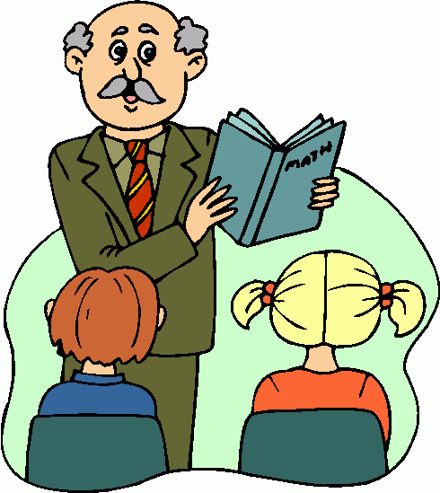
Look at the picture and read the statements.
Sagar’s
Grandfatger
Statement
Pairwork
Statement
Statement
Statement
Statement
Statement
Sagar’s grandfather was a teacher. But he doesn’t work now. His grandfather helps him with his homework.

Slide 19
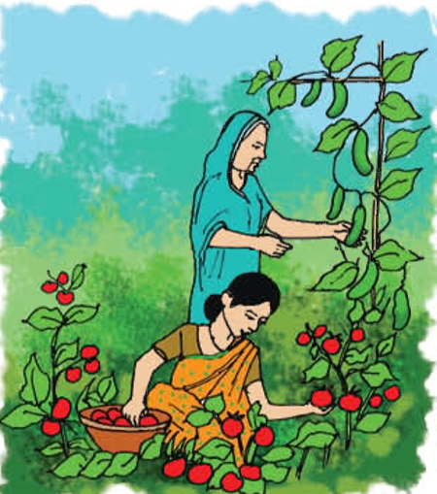
Look at the picture and read the statements.
Statement
Sagar’s Mother
Pairwork
Statement
Statement
Statement
Statement
Statement
Sagar’s mother is a housewife. She has a wonderful garden. She grows the best tomatoes and cucumbers.

Slide 20
Look at the picture and read the statements.
Sagar’s grand mother
Pairwork
Statement
Statement
Statement
Statement
Statement
Statement
Sagar’s grandmother works at home. She makes the best pithas in the world. She helps his mother in the garden.

Slide 21
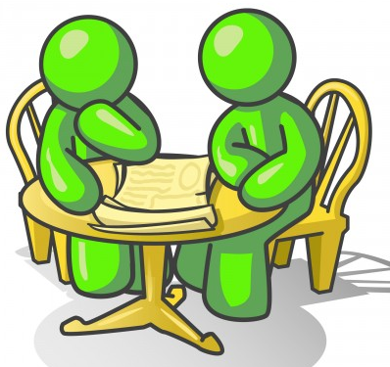
pair work
Dear students, To make conversation to each other about your mother…..
Statement
Statement
Pairwork
Statement
Statement
Statement
Statement

Slide 22
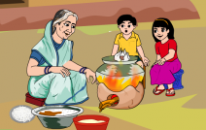
Dear student’s look at the picture and tell me..
what are they doing?
Practice
Bye Bye
Home work
Practice
Thanks
Evaluation
Yes, Saikat grandmother makes
the best pitha’s in the world.

Slide 23
Dear student’s look at the picture and tell me..
what are they doing?
Practice
Bye Bye
Home work
Practice
Thanks
Evaluation
Yes, Saikat mother works in the garden
and his grandmother help him….

Slide 24
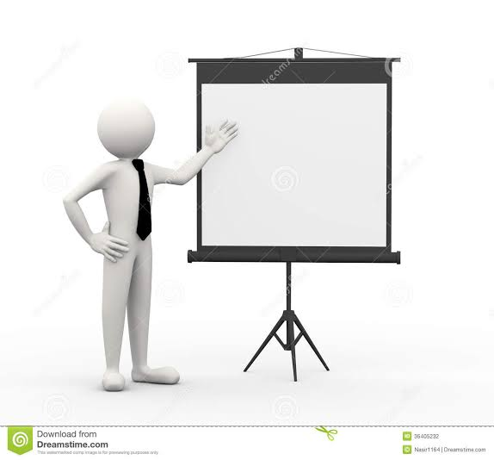
Evaluation
Dear student’s write five sentences about Saikat family.
Practice
Bye Bye
Home work
Practice
Thanks
Evaluation

Slide 25
homework
Practice
Bye Bye
Home work
Practice
Thanks
Evaluation
Dear student’s you will be write five sentences in your khata about your family…..

Slide 26
OK! STUDENTS, NO MORE TODAY
BYE
&
Thank you
Practice
Bye Bye
Home work
Practice
Thanks
Evaluation

Slide 27
THANKS FOR WATCHING
Practice
Bye Bye
Home work
Practice
Thanks
Evaluation

