Slide 1
WELCOME EVERYONE

Slide 2
Presented by:
Md.Shakhawat Hossain
Assistant Teacher
Borogangni Govt.Primary School
Alamdanga,Chuadanga.
shakhawat041086@gmail.com

Slide 3
Lesson Identity
Subject :English
Class:Two
Unit:2
Alphabet
Lesson:4-6
Page:05

Slide 4
Learning outcomes -
Listening
1.1.1 become familiar with English sounds by listening to common English words
Speaking
1.1.1repeat after the teacher words and phrases with proper sound and stress.
1.1.2 say words and phrases with proper sound and stress.
Reading
1.2.1 recognize and read the alphabet both small and capital (non cursive)
1.3.1 recognize and read the name of object having the same initial and final sound
1.4.1 read words and phrases with the visual clues(30 new words) and simple sentences.

Slide 5
Good morning students!
How are you?
I’m fine thank you.

Slide 6
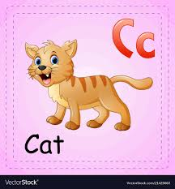
Now look, listen and say

Slide 7
Today’s lesson
Alphabet, f,g,h,i and j

Slide 8
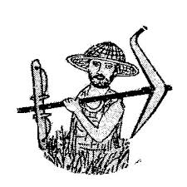
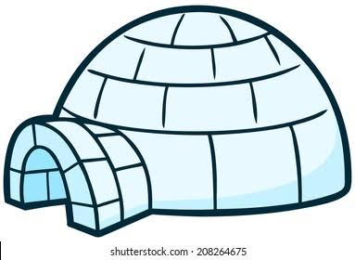
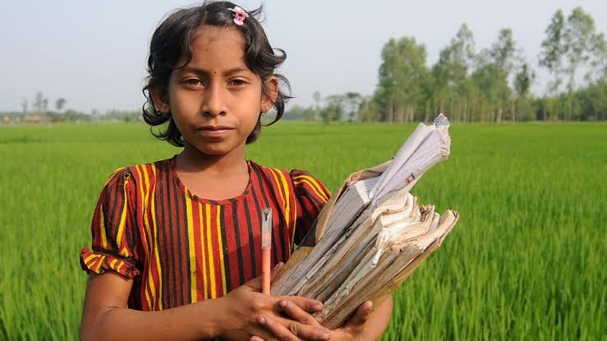
Lets see some pictures and repeat after me
This is an igloo
This is a hut.
This is a jeep
This is a girl
This is a farmer

Slide 9
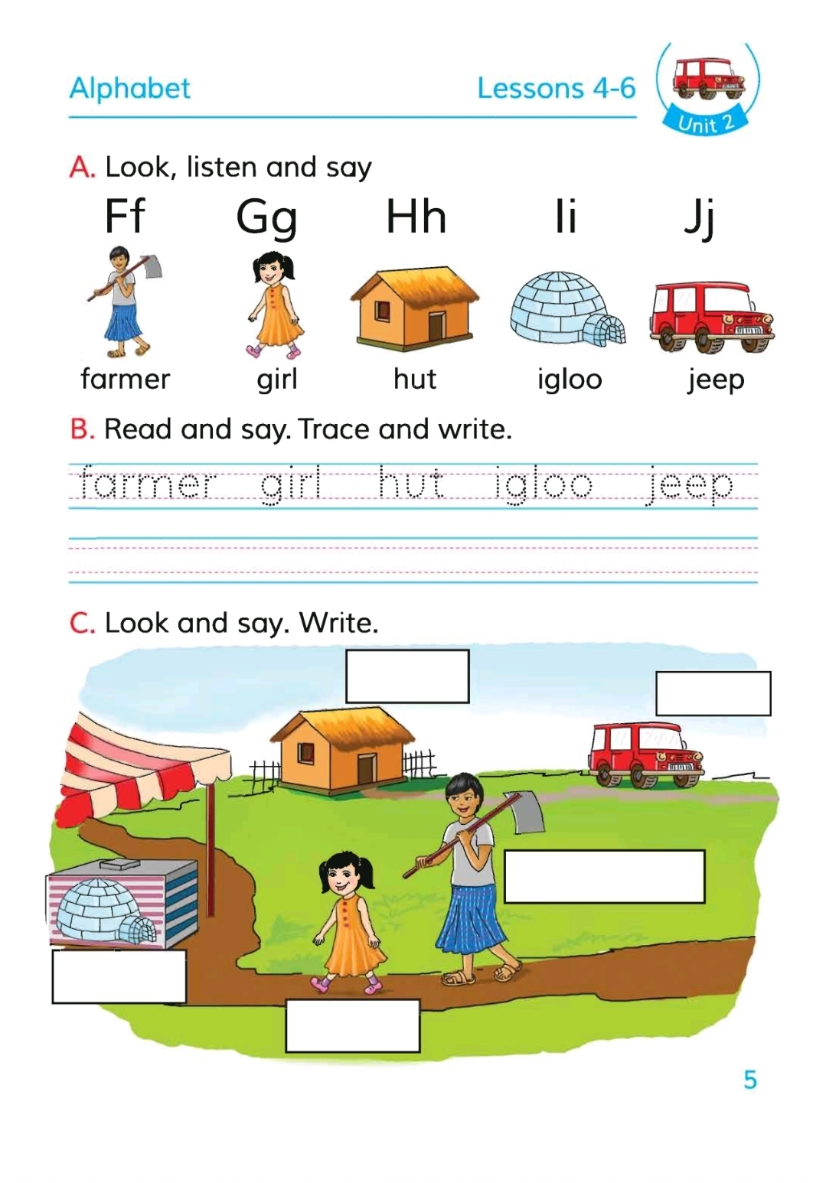
Let’s open at page 05.
Activity A.Look,listen and say.

Slide 10
Now work in pair

Slide 11
Ask your partner what do you see in this picture ?
This is a farmer
This is a hut
This is a girl.
This is an igloo
This is a jeep

Slide 12
Now say some more words related to the alphabet- f,g,h,i and j.

Slide 13
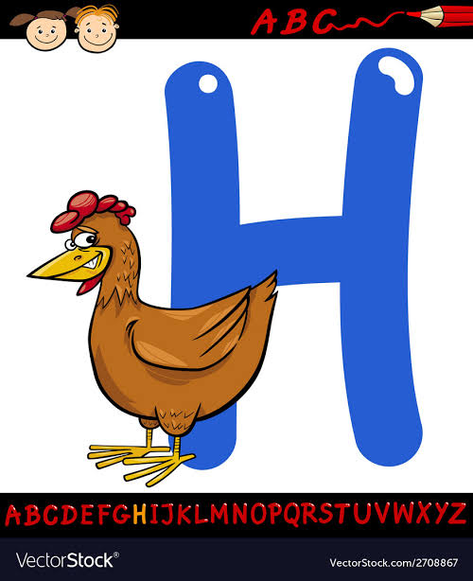
Now look some more pictures (f,g,h,i,and j) and say

Slide 14
Home work
Write one word for each alphabet we learn today.

Slide 15
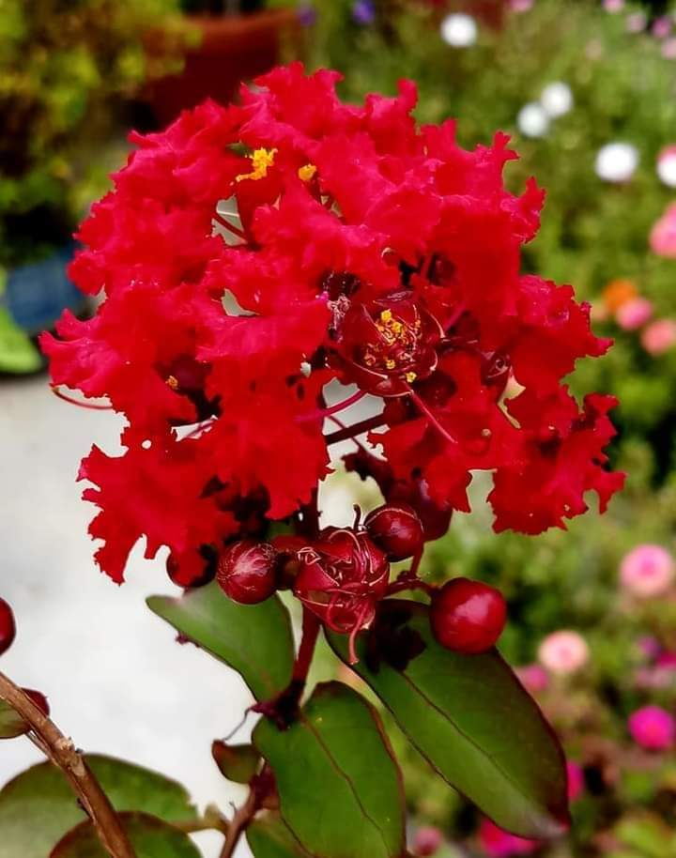
Thank you all

