Slide 1
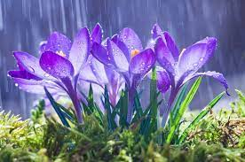
Welcome to this class

Slide 2
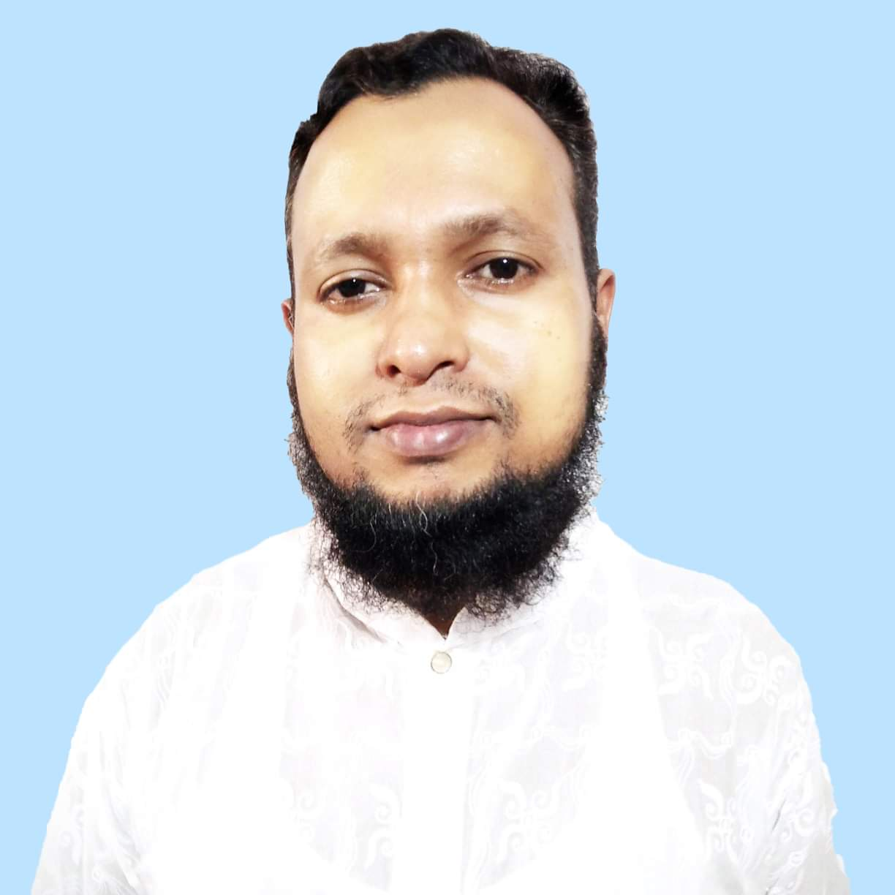
INTRODUCTION
MD. Habibur Rahman
Assistant teacher
Tilsindur Dakhil Madrasah
Barhatta-Netrakona
habib523277@gmail.com
Class: Eight
Sub:English
First-paper

Slide 3
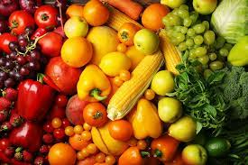
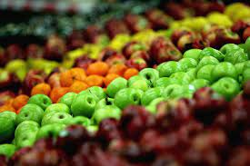
Look at pictures…..

Slide 4
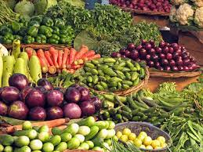
You said the pictures matched any text in your textbook

Slide 5
Today,s topic is….
Good food
Unit..2
Lesson..1

Slide 6
Learning Outcomes
After this lesson the students will be able to-
read and understand text through silent reading
choose the best answers from the alternatives.
ask and answer questions.
Writing paragraph

Slide 7
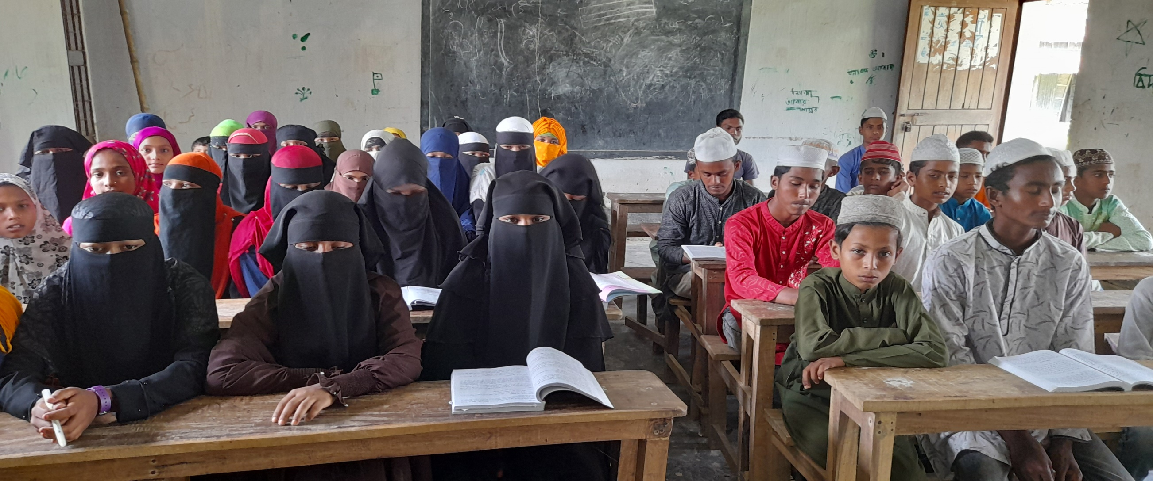
Silent reading…..
Open your book and read the text silently

Slide 8
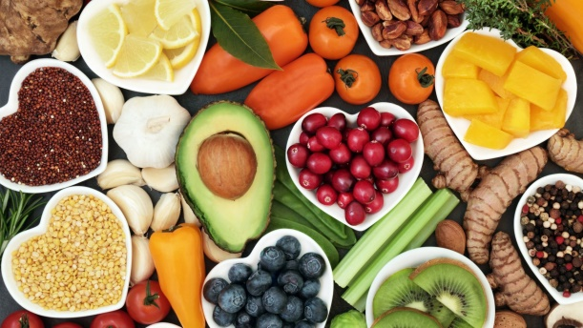
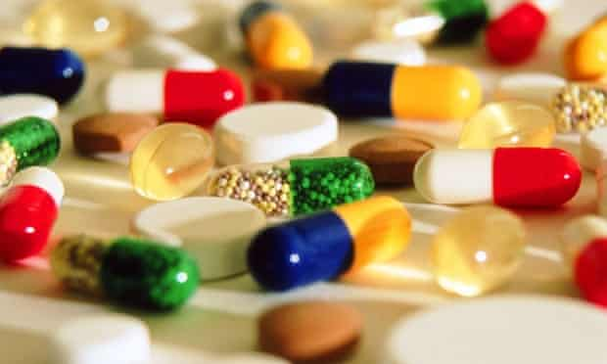
Keywords….
Nutritious
good food
Substances
element

Slide 9
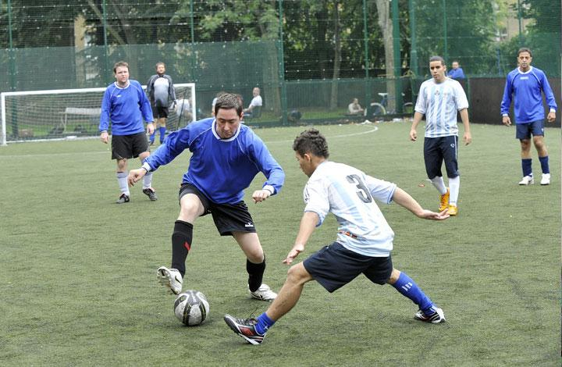
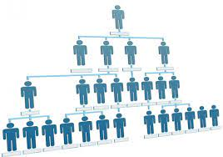
Physical
bodily
build, construction
Structure

Slide 10
Individual work
Ms Rehana is a/an ……teacher.
a) Bangla b) English
c) History d) Arabic
2. Natural substances of food helps………..
a) proper growth b) Good health
c) good foo d) physical structure.
√
√

Slide 11
3. Food is ……….for our body.
a) National b) insignificant
c) Healthy d) essential.
4. To keep good health, we should take………….
a) any kind of food b) food as much as possible
b) a little food d) a balanced diet.
√
√

Slide 12
5. The word “ important” in line 1 of the text
a) simple b) common
c) significant d) ordinary.
6. Our body needs a/an …………..amount of food.
a) huge b) specific
c) scanty d) large.
7. Good food should be ……………..
a)costly b) rich in diet
c) natural d) nutritious.
√
√
√

Slide 13
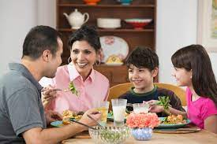
Notice the pictures…
They are talking about good food…

Slide 14
Evaluation…
What is Ms Rehana talking about ?
Why must we have food?
What is nutritious food?
4. How much food does our body need?
5. Does everyone need the same amount of food ? Why ?

Slide 15
Answers…
Ms Rehana is talking about good food.
We must have food because food is very important for our body and we cannot live without it.
Nutritious food is kind of food that contains natural substances that our body needs to grow properly and stay healthy.

Slide 16
4.Our body needs only a certain amount of food.
5.Everyone does not need the same amount of food .It is depends on your growth and physical structure.

Slide 17
Home Work
Write a paragraph about nutritious food

Slide 18
Thanks all

