Slide 1
Welcome
To
You
To
Attend
the
Digital
Class

Slide 2
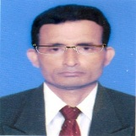
Identity
Manik Chandra Majumder
Senior Teacher
Gazirhat High School
Senbag, Noakhali.
Mobile No: 01717155169
Email: manikmajumder01@gmail.com
Class : Eight-Ten
Subject : English 1st paper
Time : 50 Minutes
Date : 00/00/2021

Slide 3
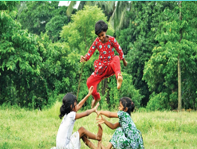
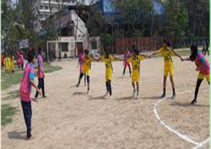
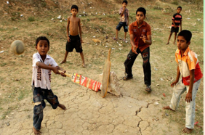
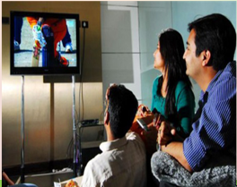
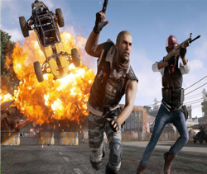
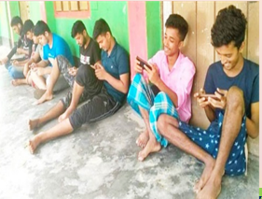
Look at the picture and think about them.
What are the differences between the pictures?
What is your observation on hobbies in the past and
present?

Slide 4
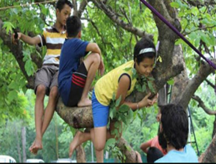
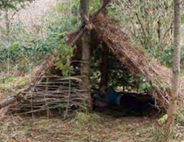
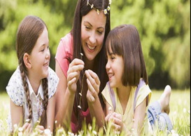
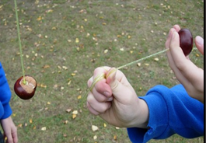
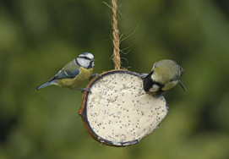
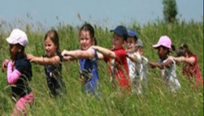
Look at the pictures and guess about our today’s lesson lesson.

Slide 5
Our today’s lesson is………
Change in pastime
Unit-2, Lesson-3

Slide 6
Learning outcomes
After this lesson the students will be able to-
read and understand the text,
ask and answer the questions,
choose the best answer,
Narrate incident,
fill in the blanks .

Slide 7
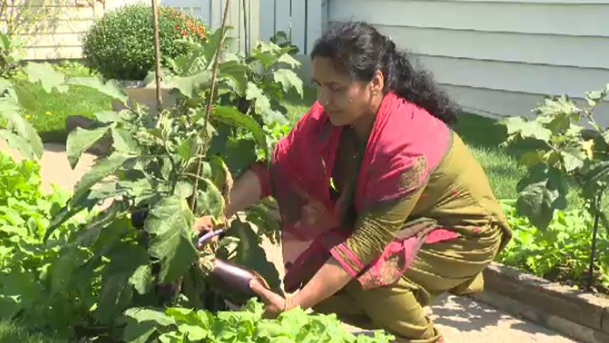
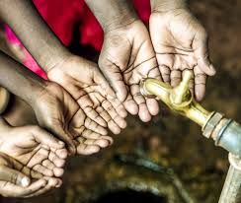
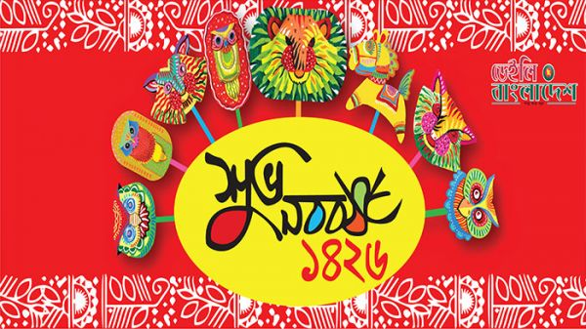
Let's introduce with some new words
Click box
Synonym : Scarcity, Shortfall , Shortage, Deficiency
Discrepancy
Synonym : Ceremonial, Customary, Conventional,
Classical
Synonym : Leisure, Hobby, Amusement,
Entertainment
Synonym : Move up , Go up , Ascend,
Mount
Traditional
Pastime
Climb
Deficit
Sentence: There is deficit of drinking water.
Sentence: Pahela Baishakh is a very traditional festival.
Sentence: Gardening is a very rewarding pastime.

Slide 8
Traditional childhood pastimes of climbing trees and playing Conkers are in decline according to survey by the RSPB (Royal Society for the protection of Birds). It’s a charitable organization registered in England and Wales.
The survey shows that people under 34 recall far fewer such childhood outdoor experiences than their counterparts over 55, according to a survey by RSPB.

Slide 9
People were asked which of the twelve outdoor experiences they could remember during their childhood.

Slide 10
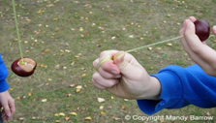
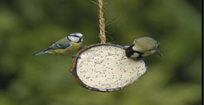
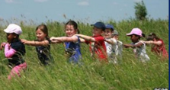
The answer included making dens, daisy chains, climbing trees, playing conkers and feeding birds. Four out of five boys climbed trees and the same numbers of girls made daisy chains.
But the survey showed the numbers declining among the newer generations.

Slide 11
Some 15% more of those aged over 55 had these outdoor experiences in their childhood, compared with those between 15-34 years old.
Some of the 92% of the public agreed that experiences of nature were still important to children , and 82% agreed that schools should play a role in providing them to all children.

Slide 12
The survey has highlighted the positive impact of contact with nature on a child's education, health, wellbeing and social skills. At the same time, there has been a decline in these opportunities, with negative consequences for children, families and society - a condition now known as nature deficit disorder.

Slide 13
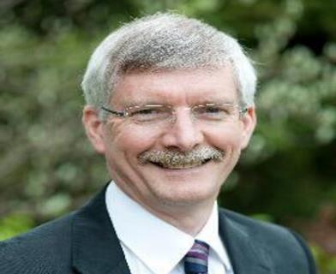
Mike Clarke, chief executive of the RSPB, will meet parliament members on Tuesday to urge the government to join other organizations in providing children with first-hand experiences of the natural environment... “We believe this guidance should include the many positive impacts to children of having contact with nature and learning outside the classroom”.

Slide 14
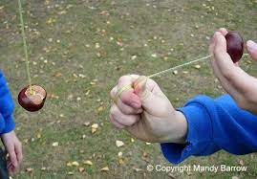
Read the following words and write their meanings as you understand them from the context. If you don’t understand, check the words from a dictionary.
Conkers: Conkers is a traditional children's game in Great Britain. The game is played by two players take turns to hit and strike each other's Conker until one breaks.

Slide 15
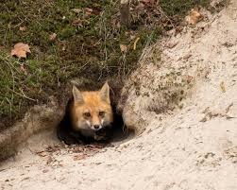
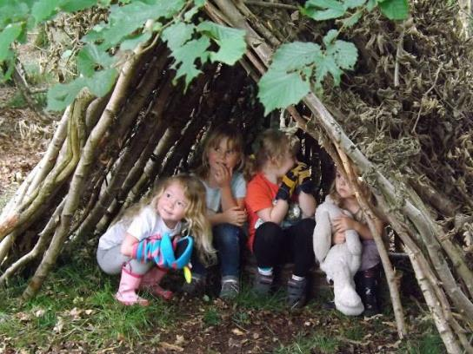
Dens: The hidden home of wild animals.
Dens: A small structure built by children as a place to play.

Slide 16
Decline: A gradual or continuous loss of numbers or value.

Slide 17
Emphasize
Highlight: To emphasize something, especially so that people give it more attention.

Slide 18
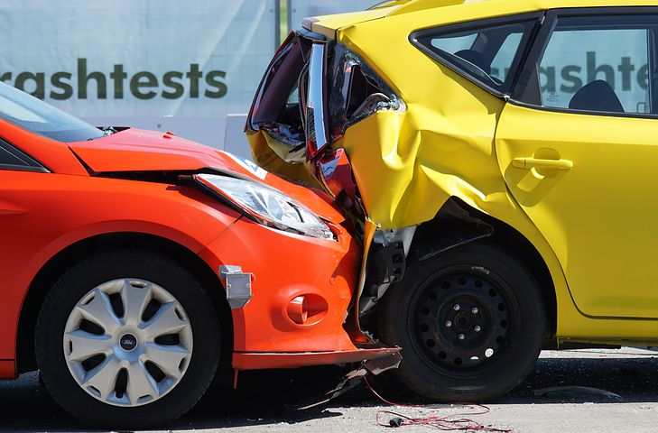
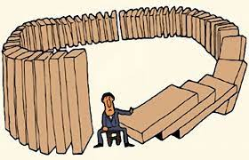
Impact: The powerful effect what something has on somebody or something.
Consequence: A result of effect, typically one that is unwelcome or unpleasant

Slide 19
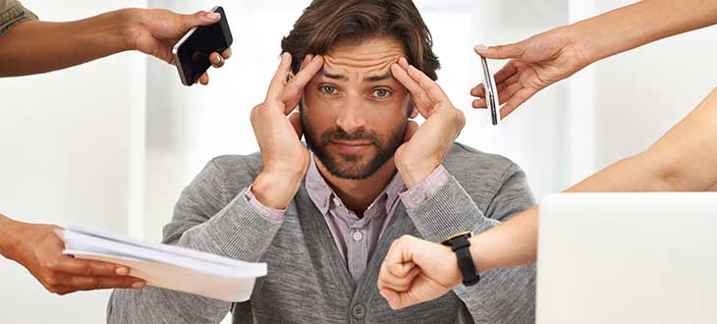
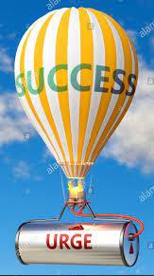
Disorder: A physical or mental condition that is not normal or healthy.
Urge: To demand, request.

Slide 20
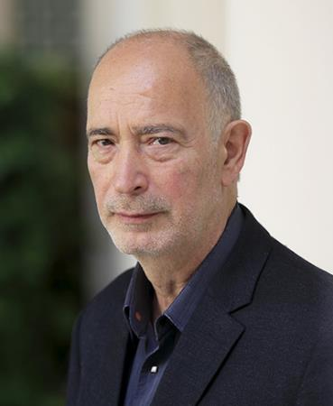
Read the following statement from the text in A and say what the subject of comparison in. Find out the other comparison in the text above.
People under 34 recall fewer such childhood out door experiences than people over 55, according to the survey by Ipsos Mori for RSPB.
Ans: Here the change of pastimes has been compared. The other comparison is that some 15% more of those aged over 55 had these outdoor experiences in their childhood, compared with those between 15-34 years old.

Slide 21
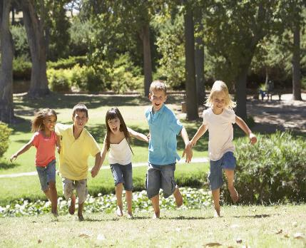
Do you agree that if children have more contacts with nature, they may have a positive impact on them? Make a list of the benefits or harms they may have if taken to nature frequently.
Ans: Nature is the best healer. Children can be benefitted if they are taken to nature frequently, Some of them are listed below:
Nature broadens one’s mind.
It helps one to enjoy natural beauties.
It is the best place to contemplate.
It has positive impact on a child’s education, health, wellbeing and social skills, etc.
I don’t find any big problem if children are taken to nature frequently. But some small problems may rise. Such as:
For some dull students, it may be waste of time.
Wild animals or insects may bite the children.
Running in open nature, they may sometimes hurt themselves.

Slide 22
Choose the best answer
1. The word ‘in decline’ means __.
(i) rising (ii) spoiling (iii) decaying (iv) weakening
2. The word ‘providing’ stands for __.
(i) supplying (ii) bringing (iii) buying (iv) making
3. The word ‘charitable’ refers to __.
(i) educational (ii) recreational (iii) commercial (iv) philanthropic
4. Traditional childhood pastimes are __?
(i) becoming popular (ii) gaining appeal (iii) disappearing (iv) reappearing

Slide 23
5. The word ‘recall’ refers to __.
recast (ii) recap
(iii) discuss (iv) remember
6. What is the closest meaning of the word ‘wellbeing’?
Goodness (ii) Development
(iii) Welfare (iv) Flourishment
7. The word ‘highlight’ means?
To light a lamp (ii) Mention
(iii) Focus (iv) To put the light at a higher place

Slide 24
Fill in the blanks with suitable words
Traditional childhood pastimes are on the (a) .................. The older generation (b) ................... their childhood outdoor (c).....................more than that of the younger (d) ..................... In the past, people like to (e)......................their free time in the midst of (f) ...................... .They would (g) ................... dens, daisy chains, climb trees, play conkers and feed birds. In the past almost all the children had close (h) ....................with nature. Nature played a (i) ................... role in their life. They had much outdoor experiences because of having relation with nature. Nature had positive impact on them. But today children have less connection with nature and they are deprived of natural (j) ................... of the citizens.
decline
recollects
experience
generation
spend
nature
make
connection
vital
experience

Slide 25
Evaluation
Answer the following questions
(i) What do you mean by pastime?
Answer: Pastime means the leisure activities what we do for our recreation but its not our main job.
(ii) Can you tell the name of some pastime activities?
Answer: Gardening, reading books, chatting with friends, travelling, singing, dancing, story writing, gaming, internet browsing etc.

Slide 26
(iii) Who is Mike Clarke?
Answer: Mike Clarke is the chief executive of the RSPB(Royal Society for the Protection of Birds) which is a charitable organisation registered in England and Wales.
(iv) What is the condition of conventional forms of pastime activities?
Answer: The condition of conventional forms of pastime activities are waning gradually.
(v) What is nature’s impact on children’s learning?
Answer: Nature influences on children’s learning by developing their education, health, well-being and social skill.

Slide 27
Home work
Write paragraph on about the differences of modern and traditional pastimes.

Slide 28
Good
Bye
For
Today,
Thank you

