Slide 2
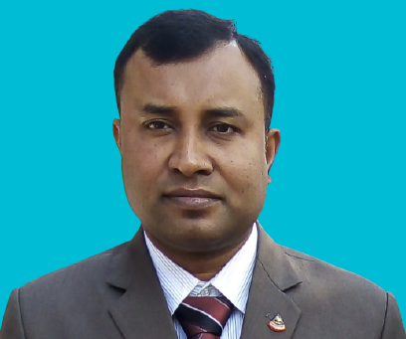
Md. Saifuddin khan
Lecturer in English
Hajee Goyej Uddin Mohila Fajil Madrasah,
Bhangura, pabna.
E-mail: skhan84bd@gmail.com
Mobile: 01710-449379
English for Today
Class nine & ten

Slide 3
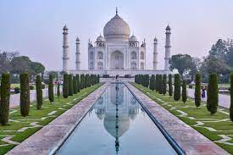
Today our topic is …..
Unit six:
Our Neighbours
Lesson 4 : India : Unity in Diversity

Slide 4
Learning outcomes
After reading the text students will be able to tell ………..
The total land area of India .
The meaning of some new words.
The name of border countries around India.
Some tourist attractions in India .

Slide 5
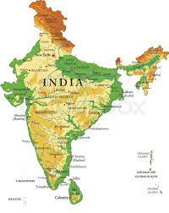
India is the seventh
largest country in the world with an area of 3,287,590 square kilometers.

Slide 6
Single work
Choose the best answer from the alternatives :--
1. Our closest neighbor is …….
(a)China (b) Nepal (c) SriLanka (d) India .
2. India is bordered by ………… to the West.
(a)Pakistan(b) Bhutan (c) German (d) Bangladesh.
3.The Europeans came to India in the ……….
(a)17th century (b)18th century (c) 19th century (d)20th century.
4.Kashmir has described as a ……… on earth.
(a) Paradise (b) jungle(c) hell (d) foot.
5. The people of India use ……. dialects.
(a )400 (b) 845(c) 846 (d) 844.

Slide 7
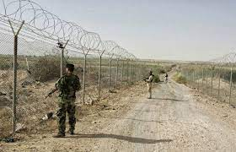
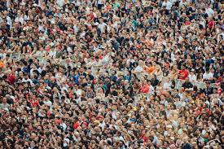
Image
Meaning
Key word
Border
Boundary
spopulous
crowded

Slide 8
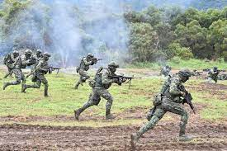
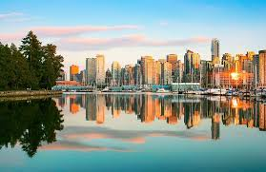
Key word
Image
Meaning
Invasion
Assault
Flourish
Prosper

Slide 9
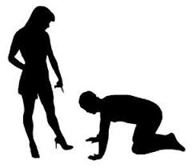
Supremacy
Dominion
Victor
Winner

Slide 10
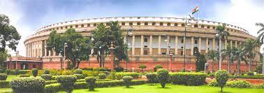
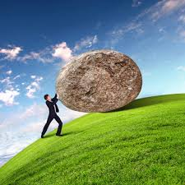
Parliament
Assembly
Struggle
Fight

Slide 11
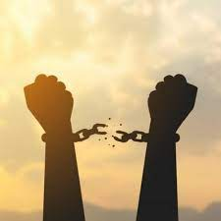
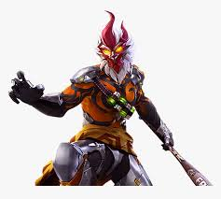
Independence
Freedom
Heroic
Valiant

Slide 12
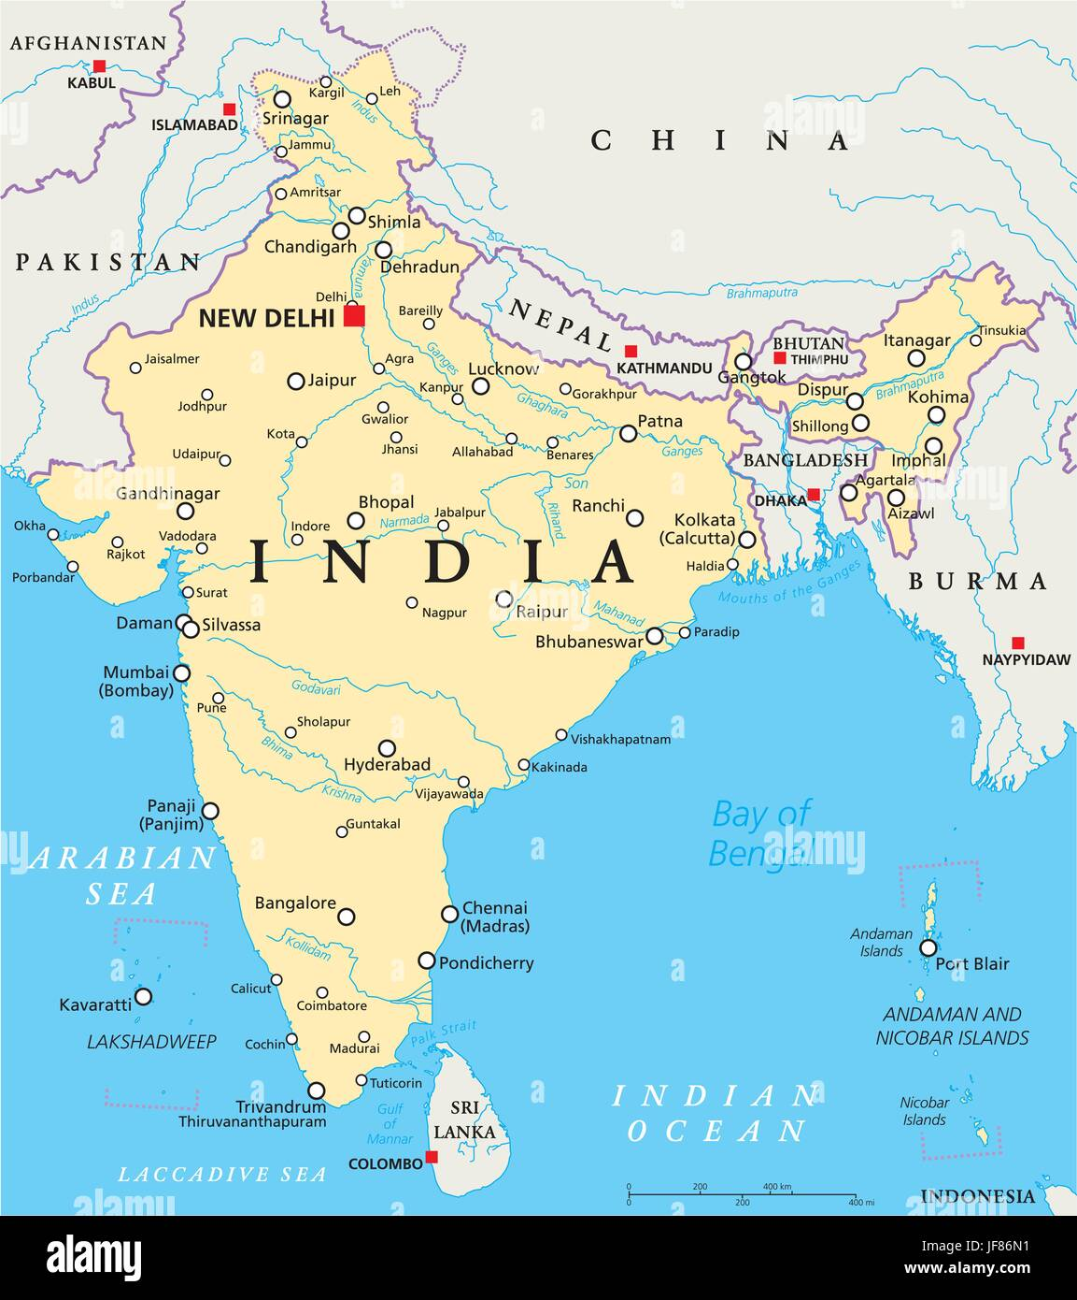
To the North
To the West
Chaina, Nepal & Bhutan
Pakistan
Bangladesh
Myanmar
To the East
Bay of Bengal
On the East
Arabian Sea
On the west
Indian Ocean
On the South

Slide 13
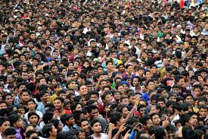
Population

Slide 14
Pair Work
1.What do you know about the population and geographical area of India?

Slide 15
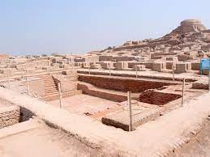
Indus Valley Civilisation

Slide 16
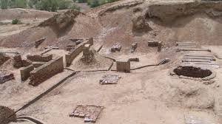
Aryan Civilisation

Slide 17
Group Work
Fill in the gaps with the word from the text.
India is a land of (a)…….. civilisation. The social, economic and cultural diversity of this vast country is the result of by of invasions by (b)…….. Races in the process of history. Indian history (c)……. With the birth of the Indus Valley Civilisation and the (d) …….. Of the Aryans. During this period, Aryan culture (e) ……. in this part of the world.

Slide 18
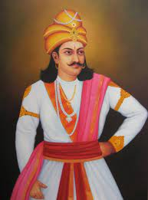
Buddism spread in many parts of Asia under Ashok.
Ashok

Slide 19
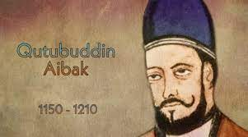
In 1206, Qtubuddin
Aybek founded the Delhi Sultanate.

Slide 20
Evaluation
Match the column A with the Column B
A | B
1.India is the largest 2.It is the seventh largest country 3.The area of India is 4.India got its independence 5.New Delhi is | a) In the world. b) 3,287,590 square kilometers . c) In 1947 . d)The capital . e)Among South Asian Countries.

Slide 21
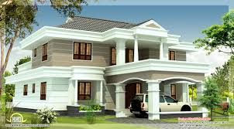
Home Task
Write the summary of the above Passage.

Slide 22
Thank you all.

