Slide 1
WELCOME EVERYONE

Slide 2
Presented by:
Md.Shakhawat Hossain
Assistant Teacher
Borogangni Govt.Primary School
Alamdanga,Chuadanga.
shakhawat041086@gmail.com

Slide 3
Lesson Identity
Subject :English
Class:Two
Unit:2
Numbers
Lesson:1-3
Page:04

Slide 4
Learning outcomes -
Listening
1.1.1 become familiar with English sounds by listening to common English words
Speaking
1.1.1repeat after the teacher words and phrases with proper sound and stress.
1.1.2 say words and phrases with proper sound and stress.
Reading
2.1.1 recognize and read cardinal numbers up to 30.

Slide 5
Good morning students!
How are you?
I’m fine thank you.

Slide 6
Today’s lesson
NUMBERS -1,2,3 AND 4

Slide 7
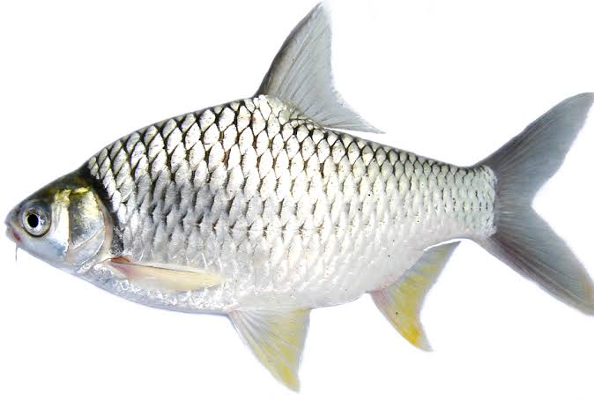
Now look, listen and say
Howm many pen, chalk,duster and fish are there in this picture?
THREE
TWO
TWO
TWO
TWO
THREE
ONE
ONE
THREE
FOUR
FOUR
FOUR
ONE
ONE
THREE
FOUR

Slide 8
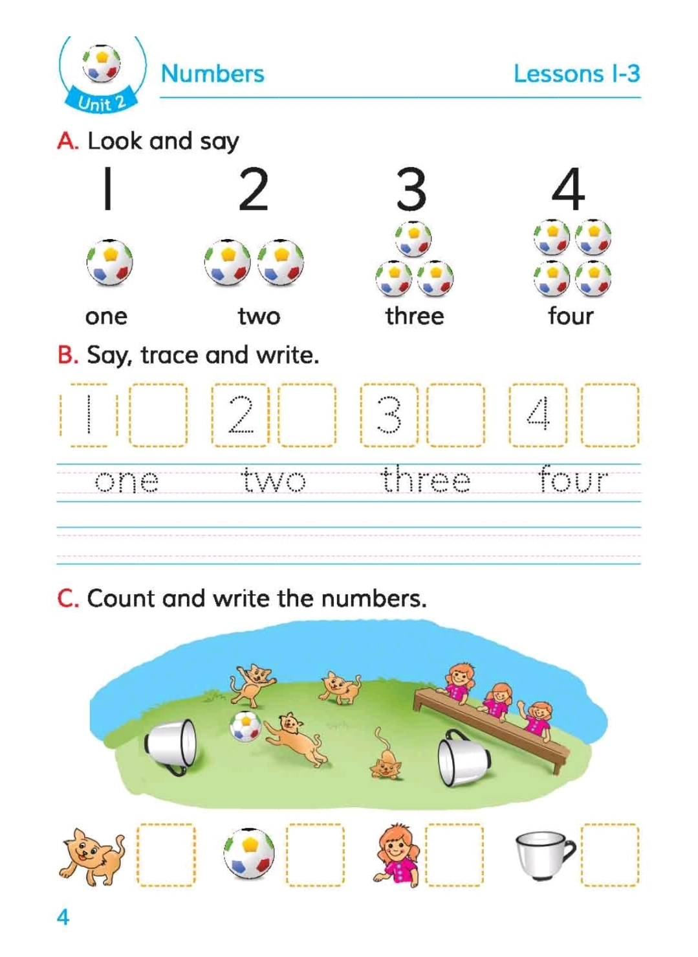
Let’s open at page 04,
A.Look,listen and say.

Slide 9
Now say how may ball is there/How many balls are there?
ONE
TWO
THREE
FOUR

Slide 10
Now look, count and say how many finger is tgere / How many are fingers there?

Slide 11
Home work
Write one page 1,2,3 and 4 in your note book.

Slide 12
Thank you all
That’s all for today.
Goodbye!

