Slide 1
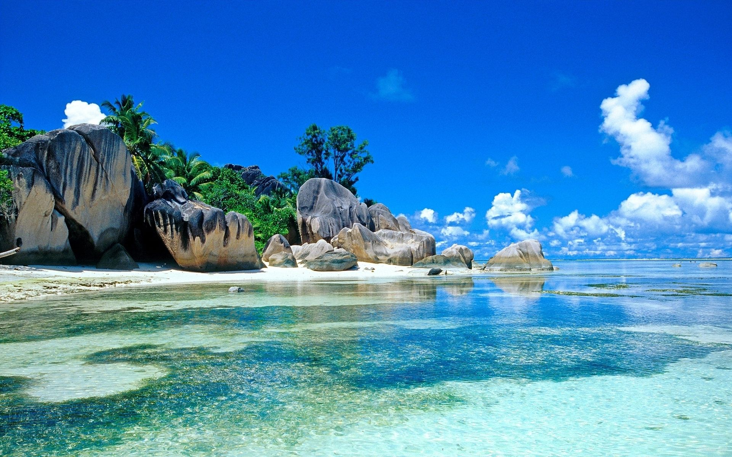
Welcome everybody
Good Morning

Slide 2
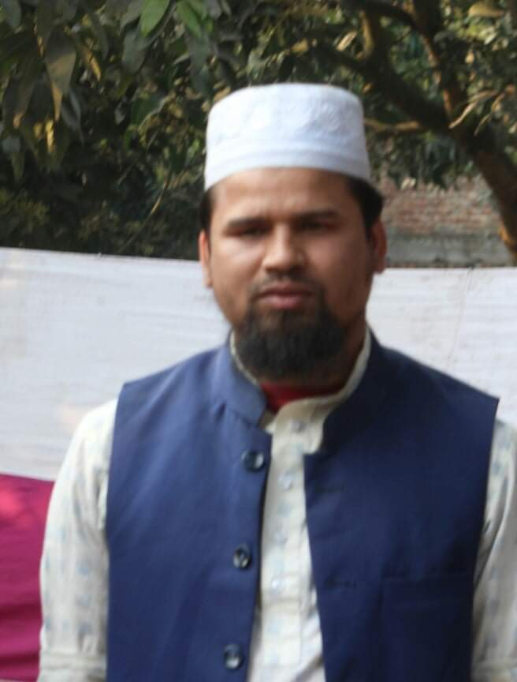
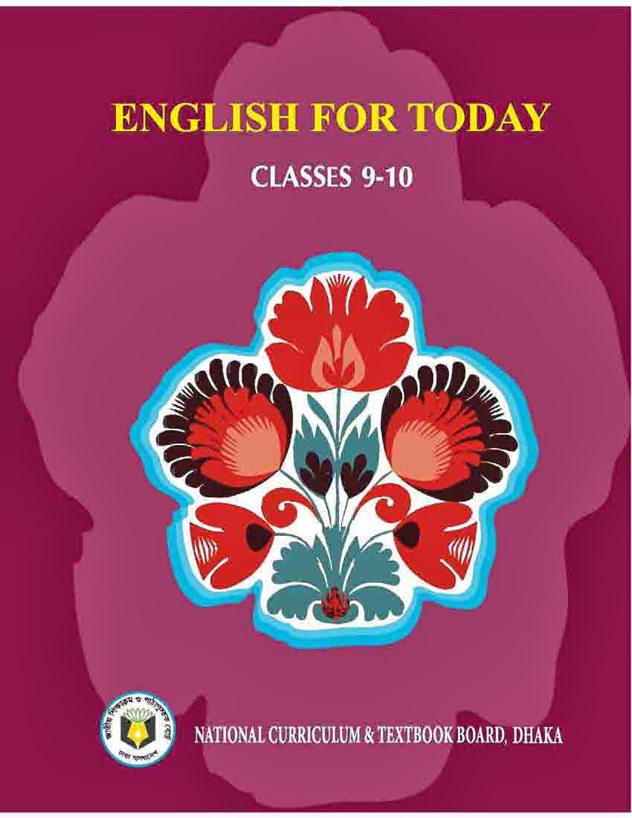
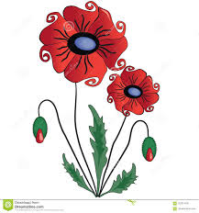
Identity
Md. Farid Uddin
Assistant Teacher (English)
Dupchanchia D.S Fazil Madrasah
English For Today
For Class : 9
Time : 45 Minutes

Slide 3
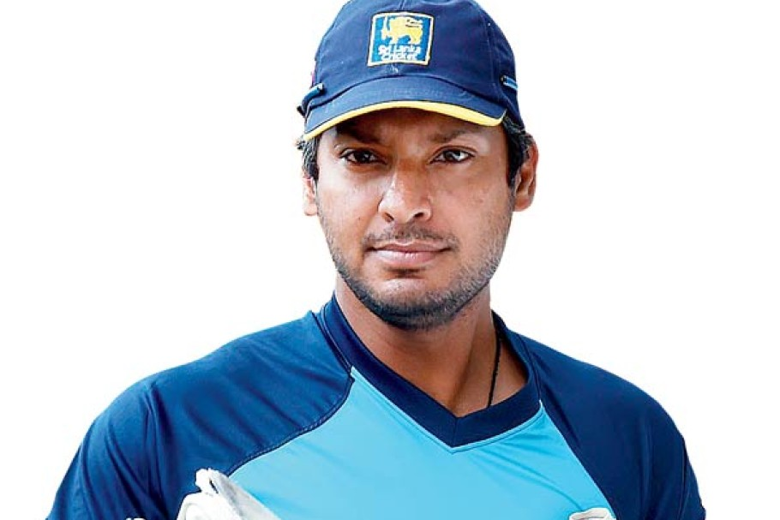
This great cricketer is from a SAARC country. Do you know the country?
Sri Lanka

Slide 5
Our today’s lesson is………
Sri Lanka:
The Pearl of the Indian Ocean
Unit : 6
Lesson : 2

Slide 6
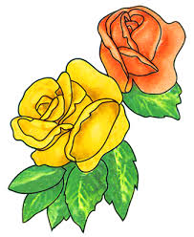
Objectives of the lesson
After the end of the lesson students will be able to
Summarize the context.
Identify a country and its people
Use content related vocabularies
describe the natural beauties of Sri Lanka
ask and answer questions

Slide 7
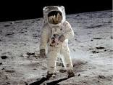
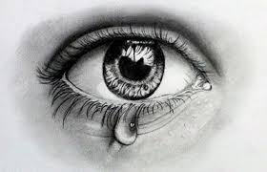
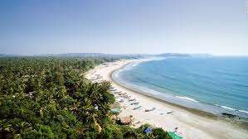
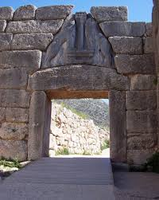
Vocabulary Presentation
Astronaut (n.)
Syn. spaceman
Teardrop (n.)
Syn. droplet
Coastline (n.)
Syn. seashore
Citadel (n.)
Syn. Castle

Slide 8
Silent Reading
Sri Lankan people greet visitors saying ‘Ayubowan’ which means long life
Ayubowan
Notes:
Note for teachers: Please let the students read the text silently from the text book.

Slide 9
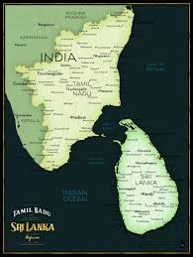
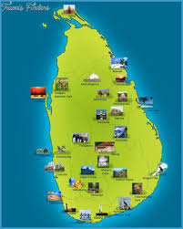
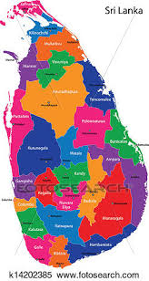
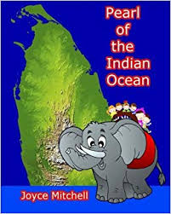
Silent Reading
The other names of Sri Lanka….
Tear drop of India
Serendip
Ceylon
Pearl of the Indian Ocean

Slide 10
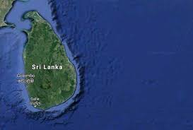
Silent Reading
Sri Lanka is located in the Indian Ocean , just off the south-eastern coast of India. Shaped like a tear drop, the island of Sri Lanka measures about 415 kilometers from north to south, and about 220 kilometers from east to west with a total land area of about 65,600 square kilometers. It has more than 1340 kilometers of coastline.
Sri Lanka is in the south eastern coast of India
Colombo

Slide 11
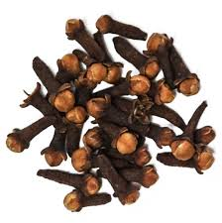
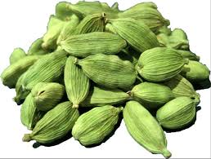
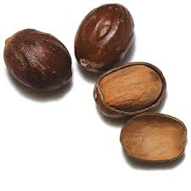
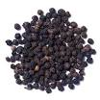
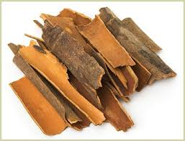
Spices abundantly produced in Sri Lanka
Silent Reading
Cloves
Cardamom
Nutmeg
Pepper
Cinnamon
Notes:
Dear teachers, only the important sentences have been mentioned here from the text.

Slide 12
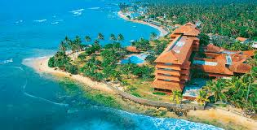
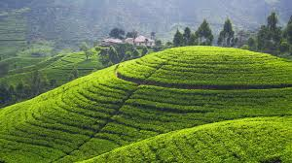
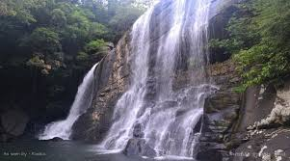
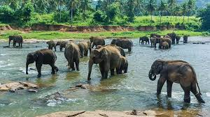
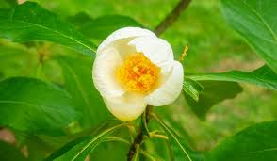
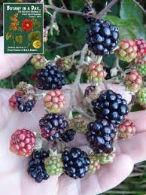
Silent Reading
Besides, the man-made riches, one may find the God-given blessings of nature in Sri Lanka. The island is circled by-------
azure seas
Green hills
Cascading waterfalls
abundant wildlife
Variety of flowers and fruits

Slide 13
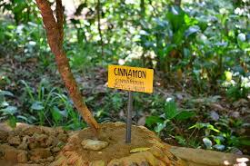
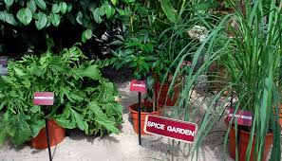
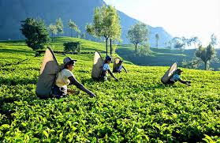
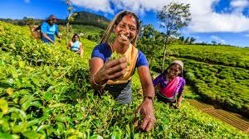
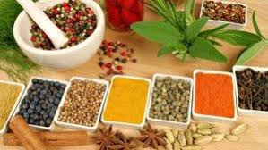
The country abounds with -----
Silent Reading
Coconut groves
Spice gardens
Tea estates
Various spices

Slide 14
Answer the following questions :
1. “Sri Lanka is a multi-religious, multi-racial and multi-lingual country.”- Explain.
2. From your reading the last paragraph of the passage what historical instances do you find regarding Sri Lanka?
Pair Work

Slide 15
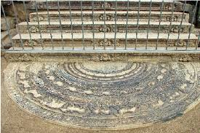
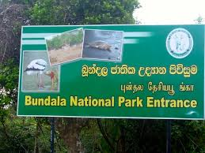
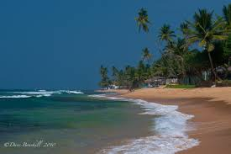
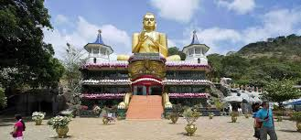
Silent Reading
Some of the best tourists places in Sri Lanka
Anuradhapura
Bundala National Park
Hikkaduawa- Coral reef and sandy beaches
Dambulla

Slide 16
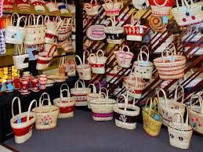
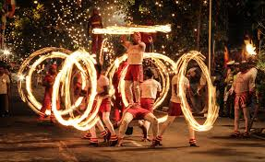
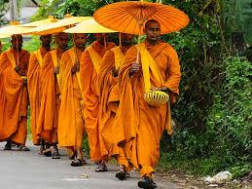
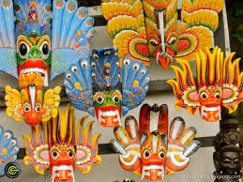
Arts, crafts and culture in Sri Lanka
Silent Reading

Slide 17
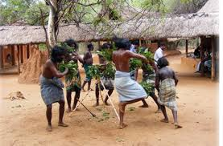
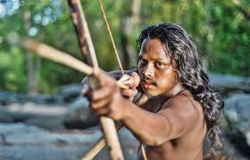
The major four ethnic groups in Sri Lanka are Sinhalese, Sri Lankan Tamils, Indian Tamils, Sri Lankan Moors or Muslims. A fifth group , The Veddhas are the original inhabitants in Sri Lanka.
Silent Reading
Ancient ethnic group The Veddhas

Slide 18
Read the text and fill in each gap with a suitable word based on the information of the text.
Sri Lanka is an (a) country located in the Indian Ocean (b) with resources and fascinating elegance which attract many travelers and mariners. People with different religious (c) live in Sri Lanka with peace. Everyone who visits Sri Lanka becomes (d) with their cordial (e) and gentle beahavor.
Group Work
island
enriched
beliefs
happy
greeting

Slide 19
Evaluation
Choose the correct answer from the alternatives.
i. Which of the following expression describes the natural resources of Sri Lanka?
a) Teardrop of India b) Pearl of the Indian Ocean c) d) Ayubowan
ii. Which of the following expression doesn’t match with Sri Lanka?
Full of natural resources b) Scenic beauty c) d) Racial concord
iii. Which of the following word is the closest meaning of ‘inhabitant’?
a) b) lodge c) native d) tenant
Multi lingual and multi racial
a land locked country
Occupant

Slide 20
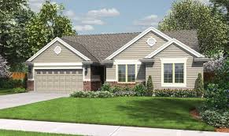
After reading the whole passage what’s your idea about Sri Lanka? Describe in brief.
Home Work

Slide 21
