Slide 1
Hidden Slide

Slide 2

WELCOME
TO MY ENGLISH CLASS

Slide 3
Introduction
MD. ANISUL HAQUE
Assistant Teacher (English)
Jafargonj School & College
Mahanagar, Rangpur
Mobile: 01557125271
Email: anis127299@gmail.com
Notes:
Introduction of the teacher and the class.

Slide 4
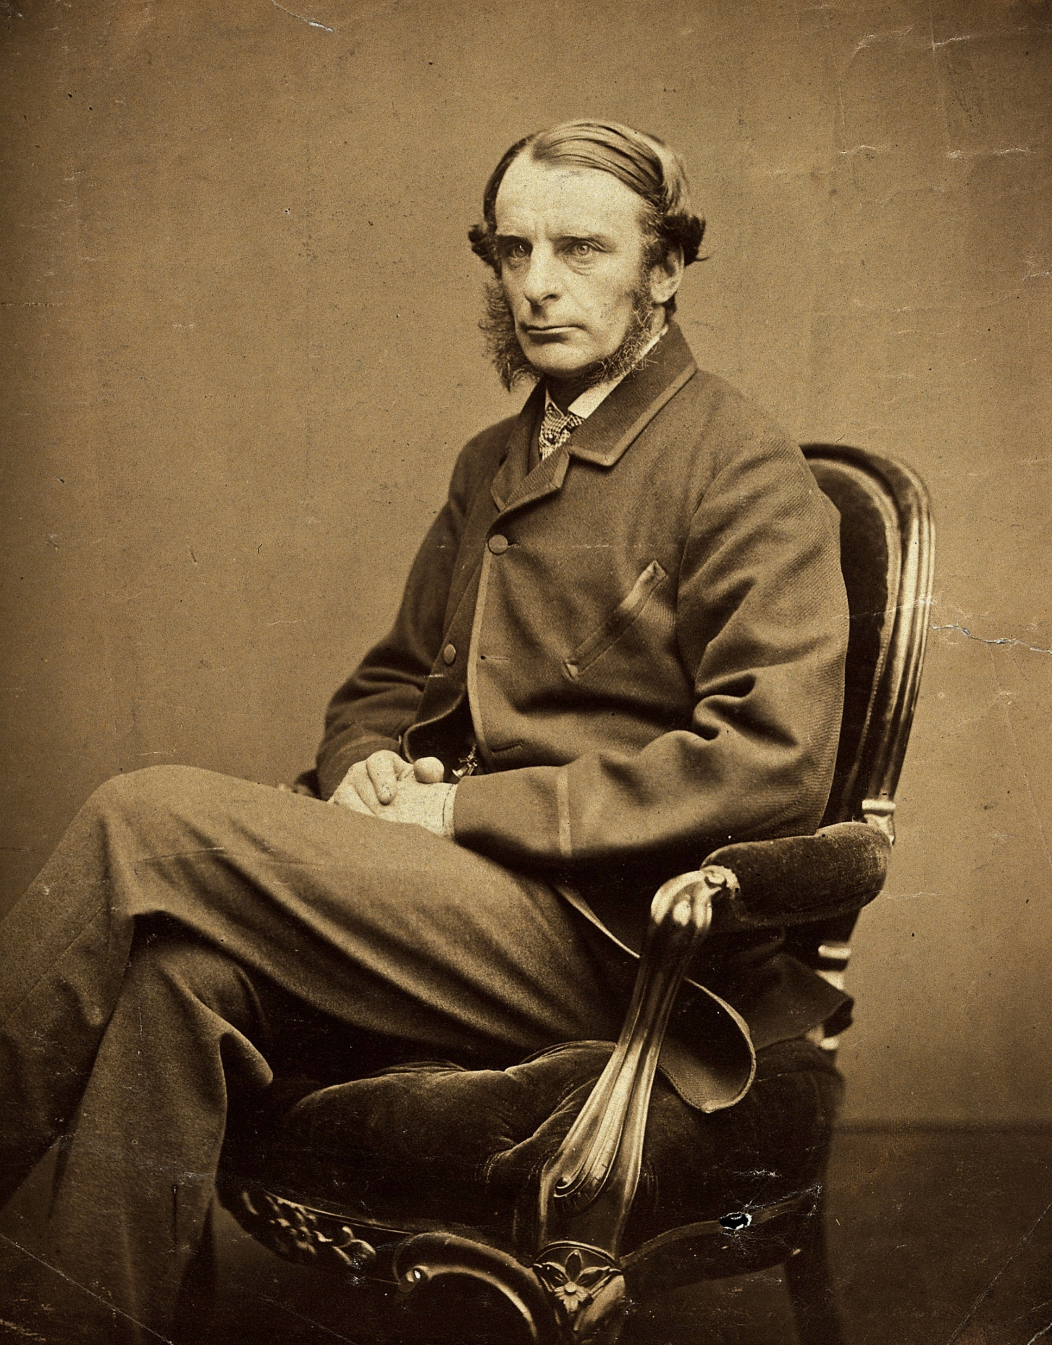
Do you know him?
Charles Kingsley (1819-1875)

Slide 5
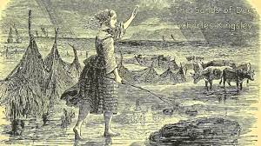
Have you any idea about this picture?

Slide 6
Look another picture and say something about this picture.

Slide 7
Our Todays Lesson is
The Sands of Dee
Unit: 14
Lesson: 03

Slide 8
Learning outcome
By the end of lesson, learners will be able to....
‡ Make minds maps and share ideas, take part in discussion.
‡ Recite the poem in proper way.
‡ Summarize the poem.
‡ Answer the given questions.

Slide 9
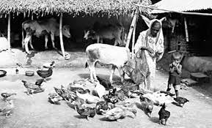
Cattle
domestic
Make Sentence
Mary goes to call the cattle.

Slide 10
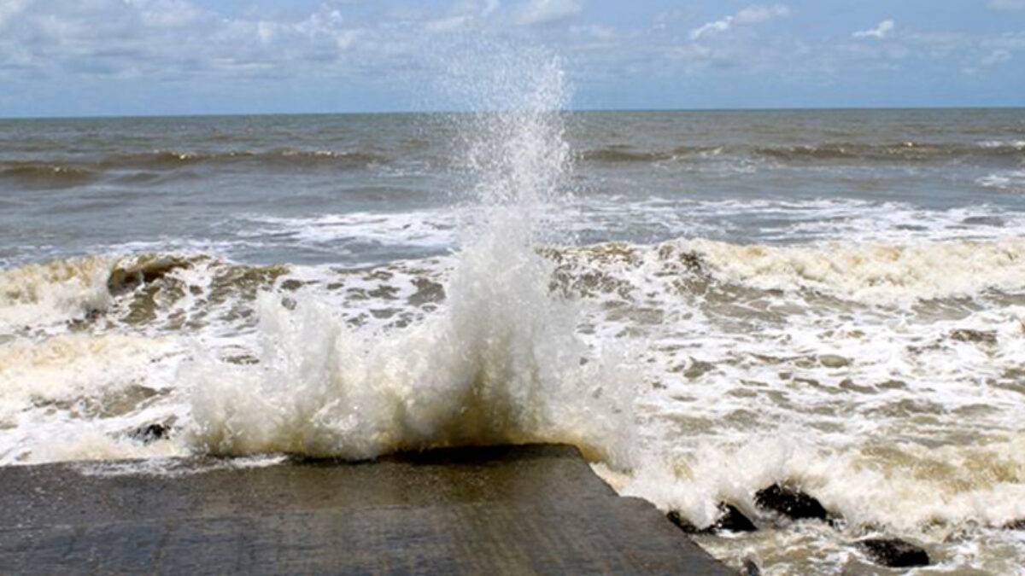
Foam
a mass of small bubbles formed on or in liquid
Make Sentence
You will see the foam in the sea.

Slide 11
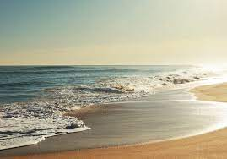
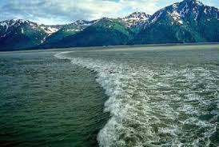
Tide
Rising and falling of the sea water
Make Sentence
He could not control the growing tide of violence.

Slide 12
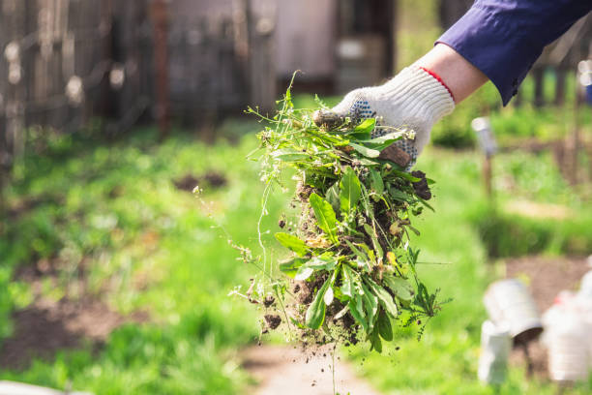
Weed
A plant that is not valued.
Make Sentence
Remove unwanted plants from the garden.

Slide 13
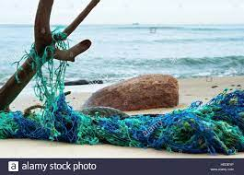
Stake
Pillar/wedge
Make Sentence
The net is with a stake.

Slide 14
A. listen to the poem. Read it aloud in groups.

Slide 15
B. Answer the following questions.
What was the weather like when Mary went to bring the cattle home?
Look at some words, phrases and sentences that have been repeated several times. Explain why the poet has done that.
How has the poet described the sea?
Suppose you were walking on the sea shore with a couple of your friends while Mary was drowning. Describe what you would have done.

Slide 16
HOME WORK
Write the story of Mary in your own words.

Slide 17
May Allah bless you.

