Slide 2
Teacher’s Identity
Identity
A.K.M.SHAHAJAHAN KABIR
HEAD TEACHER
CHANDUAL GOVT. PRIMARY SCHOOL
KALMAKANDA,NETRAKONA.

Slide 3
Lesson Introducing
Unit—8
Lesson—4
Page--17
( How many…………..?)

Slide 4
Let’s enjoy the video.

Slide 5
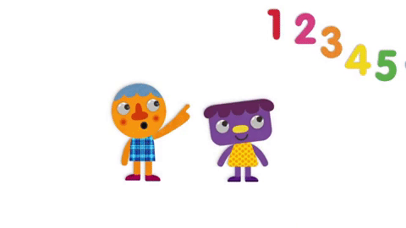
Todays lesson.
Numbers

Slide 6
Learning outcomes
Students will be able to-
Listening: 1.1.1 become familiar with English sounds by listening to command English words.
Speaking: 1.1.1 repeat after the teacher simple words and phrases with proper sounds and stress.
1.1.2 say simple words and phrases with proper sounds and stress.
Reading: 2.1.1 recognize and read cardinal numbers up to 30.

Slide 7
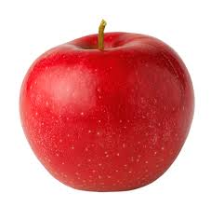
What is this ?
Apples

Slide 8
How Many apples ?
There are 4 apples.

Slide 9
How Many apples ?
Now,There are 3 apples.

Slide 10
How Many apples ?
Now,There are 2 apples.

Slide 11
How Many apple ?
Now,There are 1 apple.

Slide 12
How Many apple ?
Now,There are no apple.

Slide 13
Now, write 1 ,2 , 3, 4 , 5 , 6 , 7 , 8 , 9 , 10

Slide 14
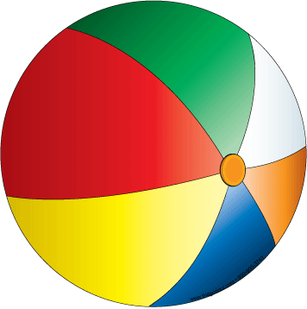
How many balls are there?

Slide 15
What is this?
How many birds are there?

Slide 16
What is this?
How many apples are there?

Slide 17
What is this?
How many flowers are there?

Slide 18
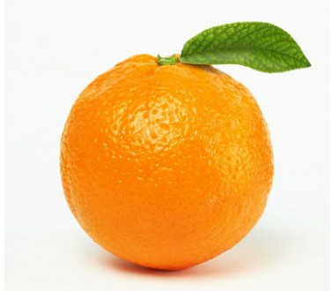
How many oranges are there?
What is this?

Slide 19
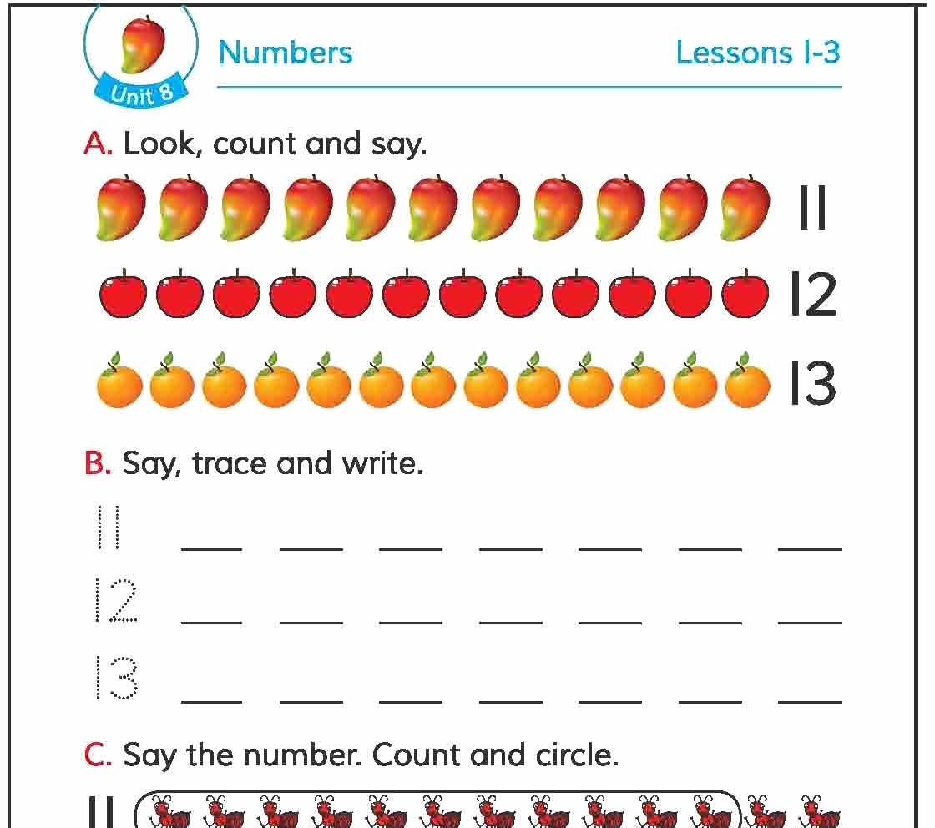
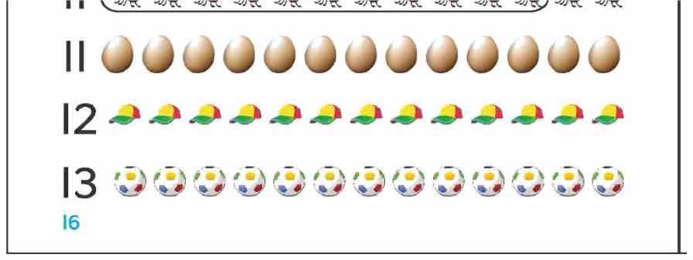
Open your English book at page 16

Slide 20
How many mangoes are there?
How many oranges are there?
How many apples are there?

Slide 21
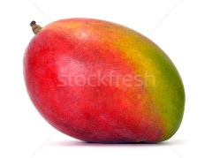
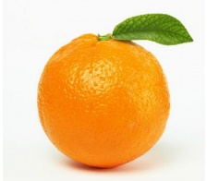
Pair work.
Drag and match the picture.

Slide 22
Evaluation.
count and match the picture.

