Slide 1
Happy New Year 2022
Happy New Year 2022

Slide 2
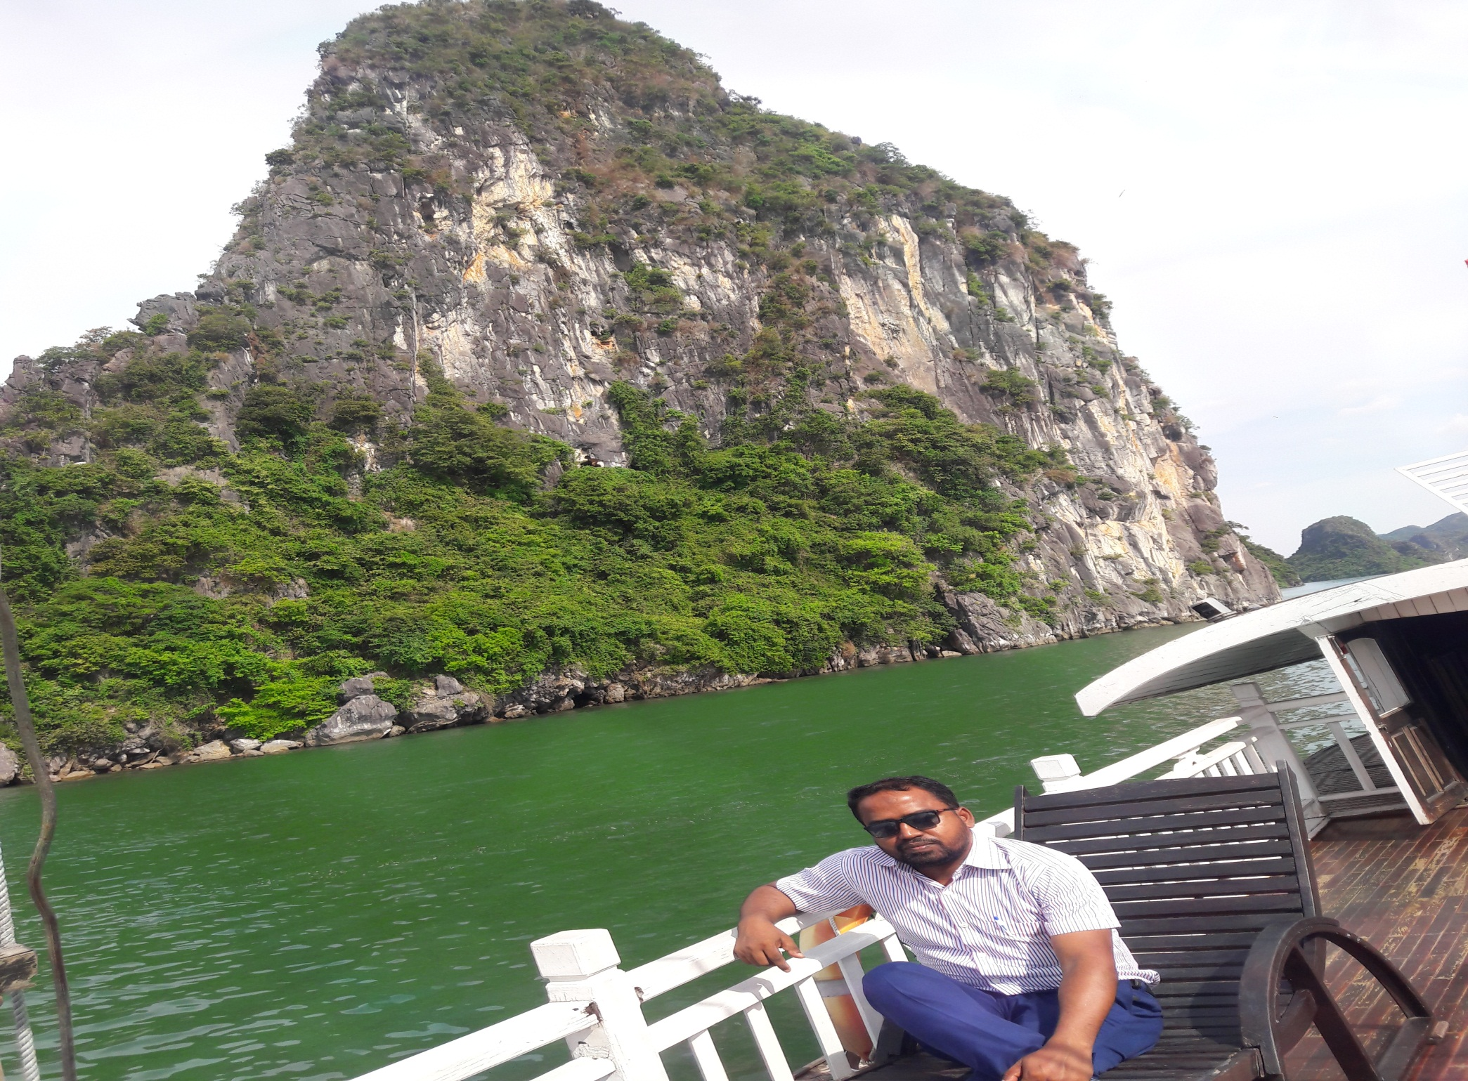
EDUCATOR’S INTRODUCTION
MAHBUBUL ALAM
ASSISTANT TEACHER
HATIRDIA GPS
MONOHARDI , NARSINGDI
01716474455

Slide 3
COLLACATIONS

Slide 4
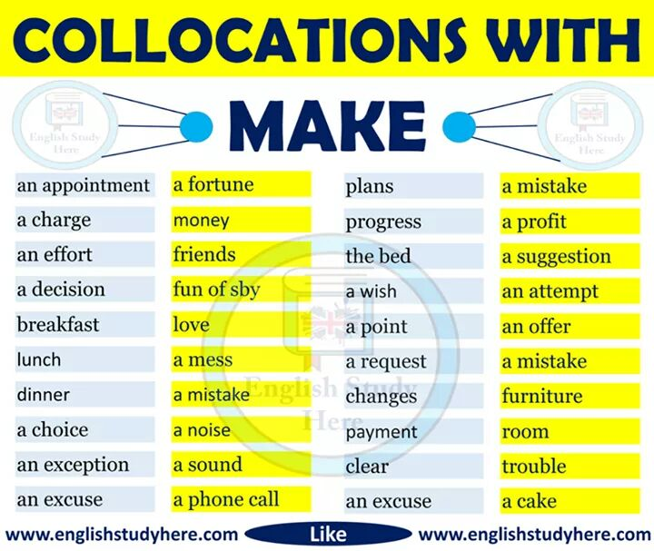
COLLOCATIONS WITH SOME USEFUL WORDS

Slide 10
GOOD BYE

