Slide 1
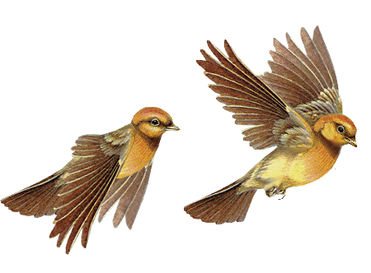

Slide 2
Md.Abdur Razzak
Assistant Teacher (English)
Shatgram Akota High School
Baniachang,Habigang
District Ambassador,Habigang
Mobile Number:01731181479
Class:Eight
Subject: English For Today
Unit:Three
Lesson:Three

Slide 3
Let’s observe some images.
Notes:
No need to click.

Slide 4
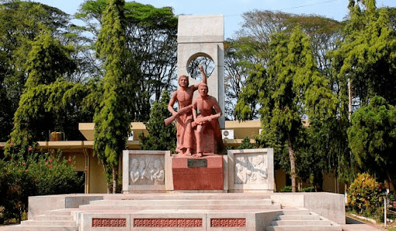
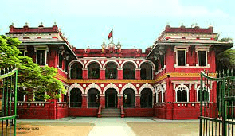
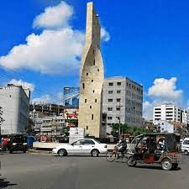
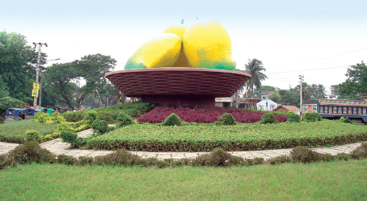
Rajshahi is a peaceful city.

Slide 5
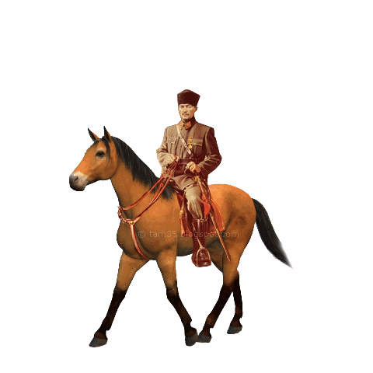
The horse is running.

Slide 6
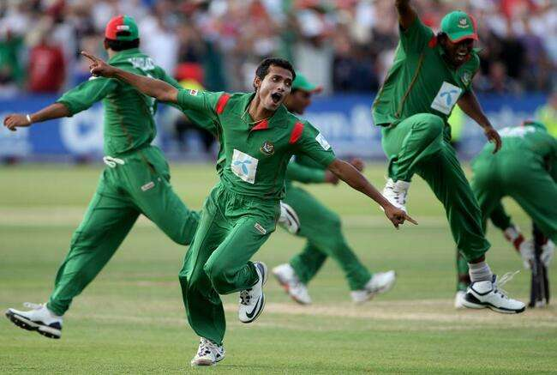
Our team has won the match.
Notes:
An example of a collective noun.

Slide 7
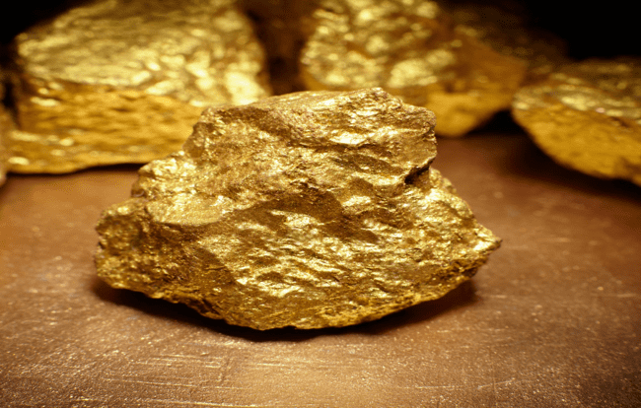
Gold is a precious metal.
Notes:
An example of a material noun.

Slide 8
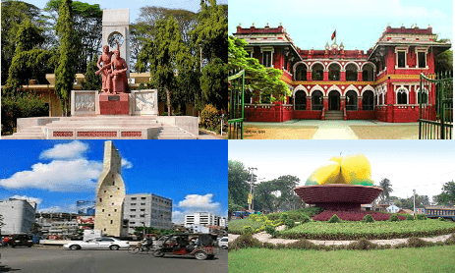
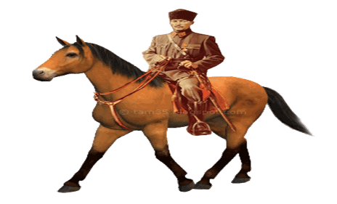
Rajshahi
Horse,rider
team
Gold

Slide 9
Let us see what our today’s lesson is-
What have you observed?
Different kinds of Noun.
Notes:
Four kinds of noun are shown.

Slide 10
Part one

Slide 11
Learning Outcomes
By the end of the lesson,the learners will be able to -
1
define noun.
2
classify noun.
3
identify proper noun.
4
identify common noun.

Slide 12
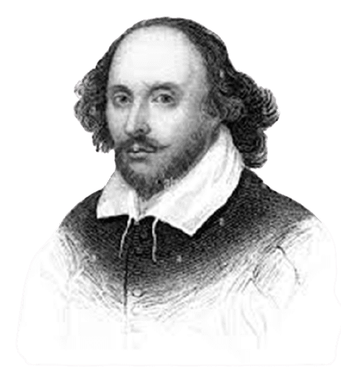
Shakespeare was born in 1564 at Stanford-upon-Avon in England.He was a poet, playwright and actor.He is widely regarded as the greatest writer in English and the world’s prominent dramatist.He enjoys enormous popularity even in the modern age for his plays and poems.
These are all nouns. The noun is a naming word.It may name a person place or thing. There is a bewildering variety of things in the world.So, there is a bewildering number of nouns in a language.

Slide 13
Nouns are classified into five categories----
Proper
Common
Collective
Material
Abstract
Let us discuss nouns in details.
Notes:
Concrete noun is divided into four kinds.

Slide 14
Konal
Specific name of a singer.

Slide 15
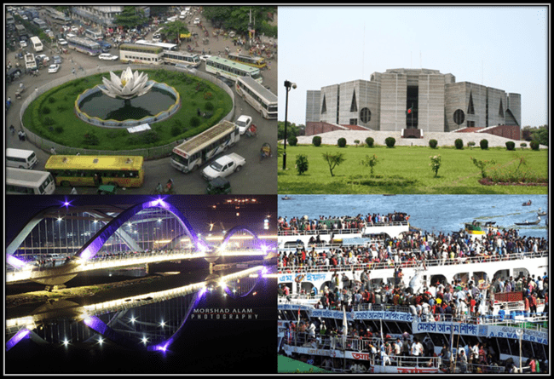
Dhaka
Specific name of a city in Bangladesh.

Slide 16
Rose
Specific name of a flower.

Slide 17
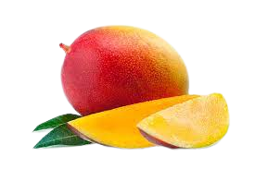
Mango
Specific name of a fruit.

Slide 18
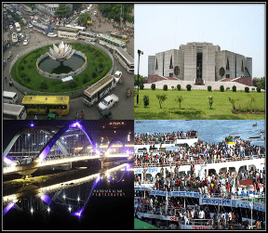
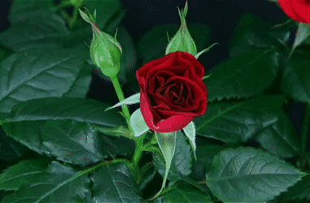
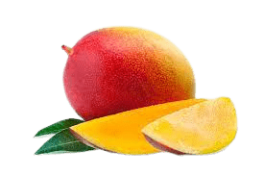
Look at the pictures.
Konal
Dhaka
Rose
Mango
Proper noun is a specific name of a person, place or things.
They are proper noun.

Slide 19
Jakir is a student of class 6.
He lives in Kabirpur.He is a student of Satgram Akota High School.
He reads the holy Quran every day.

Slide 20
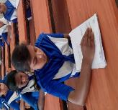
1.What is proper noun?

Slide 22
Student
Common name of all
students in the world.

Slide 23
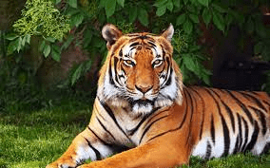
Tiger
Common name of all
tigers in the world

Slide 24
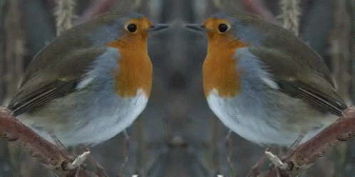
Bird
Common name of all
birds in the world.

Slide 25
Nurse
Student
tiger
bird
A common noun refers to every person,place or thing of the same class or kind.It does not refer to anything in particular.

Slide 26
To get idea clear more -
Common Noun | Proper Noun
Man | Rahim, Karim
Girl | Luna, Tania
City | Dhaka, Khulna
River | Padma, Surma
Notes:
Teacher may discuss it specifically.

Slide 27
1.To make cake, we need eggs, flour, sugar and butter.
2.Rakib reads Gulliver’s Travel last week.
3.Every Tuesday in June ,my team takes part in a charity match.
4.Spelling bee is my favorite show on television.
5.The Shishu Park is a place to visit with friends and parents.

Slide 28
Find out ten common noun from your surroundings and write down on your notebook.

Slide 29
See you again.

