Slide 1
welcome

Slide 2
Nasrin jahan
Assistant teacher
53 no govt Batikamary primary school
Muksudpur , Gopalgonj.

Slide 3
Learning Outcomes
Students will be able to:
1. Understand and enjoy simple stories.
2. Ask and answer wh questions.
3. Read words , phrases and sentences in the text with proper pronunciation, stress and intonation.
4. Write a short composition about their home town .

Slide 4
Class :Five
Subject : English Unit : 10
Time : 50 Minutes

Slide 5
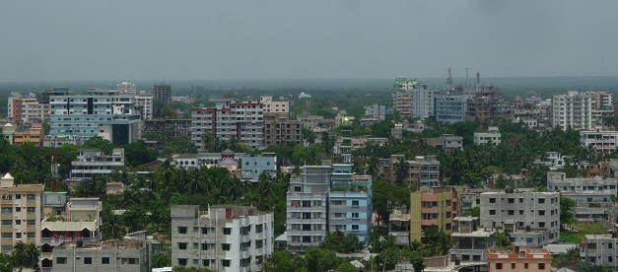
What do you see in the picture?
A Town

Slide 6
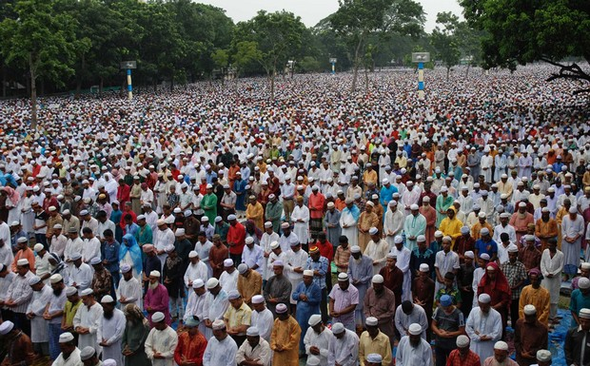
What do you see in the picture?
Solakia Eid Ground

Slide 7
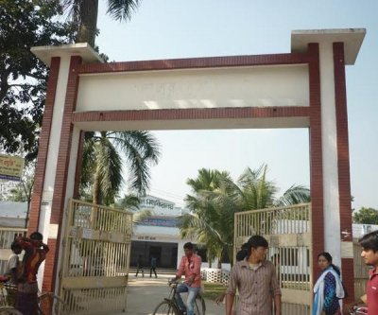
What do you see in the picture?
Govt. Gurudayal College

Slide 8
My home district

Slide 9
New words
Headquarters
সদরদপ্তর
Landlord
জমিদার
Celebrate
উদ্ যাপন করা
Well-known
সুপরিচিত
Fort
দুর্গ
Temple
মন্দির

Slide 10
Now open at page 38.
My home district My home district is Kishoregonj. It is about 145 kilometres from Dhaka. It is a district headquarters. The district has 8 municipalities, 13 upazilas, 108 unions and 1745 villages. The name Kishoregonj comes from the name of an old landlor known as Brojokishore Pramanik or Nandakishore Pramanik. The area of kishorgonj municipality is about 10 square kilometers. The river Narasunda flows throw the town.
Kishorgonj is a small town, but there are many important places in and around it. The largest Eid fairgrounds, called Solakia Eid ground and the well known Government Gurudayal college are in the town. People from many districts come to this place to celebrate Eid. The pagla mosque is also in my home district. Outside the town, you can visit the fort of Isha Khan at Jangal Bari. You can also see the Shah Mohammad Mosque at Egaroshindhur. Near the Fuleshwari river, you can see the Shiva Temple of Chandrabati.

Slide 11
Group Work
Group 1. How far is Kishoreganj from Dhaka?
Group 2.How was the place named ”Kishoreganj”?
Group 3.What is the size of Kishoreganj town?
Group 4.How many upazilas are there under Kishoreganj district?

Slide 12
Home work
Write five sentences on your home town.

Slide 13
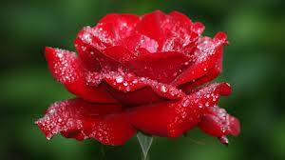
Thank you all. See you again.

