Slide 1
WELCOME

Slide 2
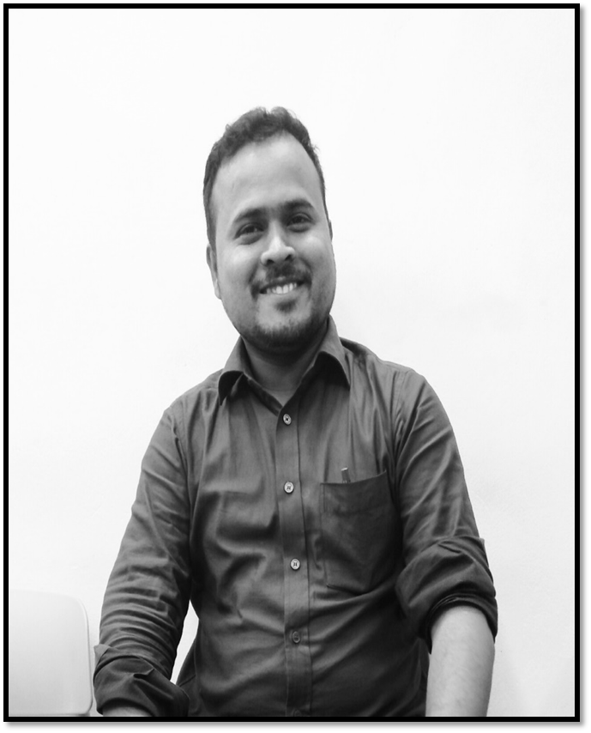
Teacher’s introduction
Md. Rafiqul Hasan
Assistant Teacher
Khonkarkhil Government Primary School
Sadar, Cox's Bazar.
email: rafiquecox1@gmail.com

Slide 3
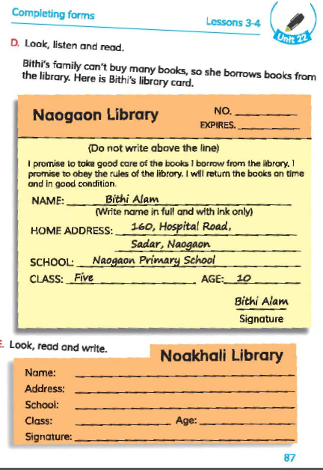
Lesson’s introduction
Class: 5, Sub: English
Unit: 22, Lesson 3-4
Title: Completing Forms
Part of lesson: D & E
Page no: 87, Time: 45 Min.

Slide 4
Learning outcomes
Listening:
3.4.1 understand statements made by the teacher and students.
Reading:
1.5.1 read words, phrases and sentences in the text with proper proper pronunciation, stress and intonation.
1.7.1 read paragraphs, dialogues, stories, letters and other texts.
5.1.4 read silently with understanding personal letters and other texts materials.
Writing:
3.1.1 write words, phrases and sentences using non-cursive capital letters.
6.1.2 use capital letters for proper nouns.
12.1.1 fill in simple forms about oneself and others.

Slide 5
Let's enjoy a video...

Slide 6
Look at the picture
What is this?
It is a form.

Slide 7
Our today’s lesson is
Completing forms
Unit: 22, Lesson: 3-6, Activity: D & E;
Page: 87

Slide 8
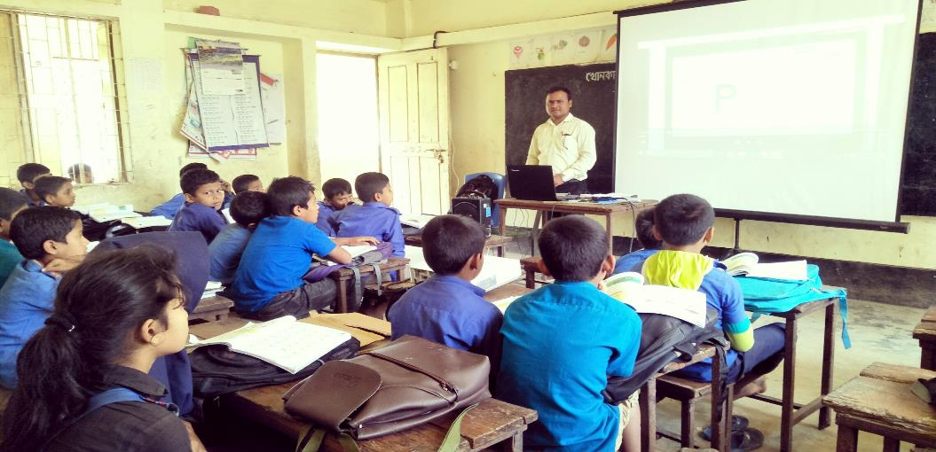
Teacher’s Reading

Slide 9
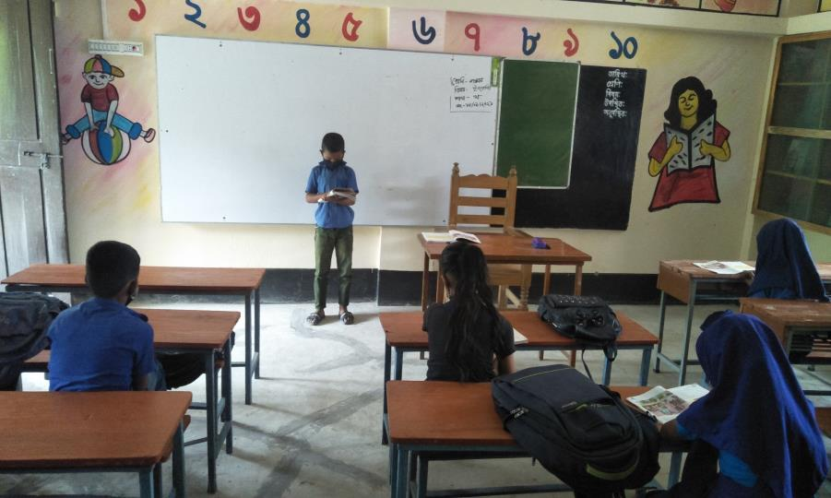
Silent Reading

Slide 10
New Words
Buy is a verb
Buy- ঠিকানা
Buy – purchase / bargain

Slide 11
New Words
Borrow is a verb
Borrow – ধার করা
Borrow - loan

Slide 12
New Words
Promise is a verb
Promise – শপথ করা
Promise - assurance

Slide 13
New Words
Expire is a verb
Expire – শেষ হওয়া
Expire – Become invalid;
to become end of a period

Slide 14
New Words
Signature is a noun
Signature – নাম
Signature – name / autograph / sign

Slide 15
New Words
Return is a verb
Return – ফেরত দেওয়া
Return – arrival / coming back / homecoming

Slide 16
New Words
Address is a noun
Address – ঠিকানা
Address – name of place

Slide 17
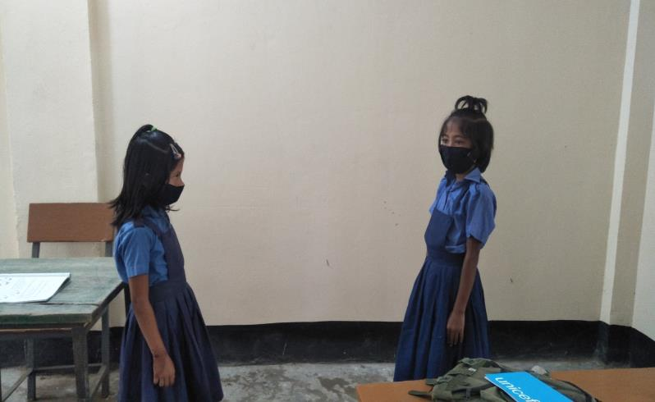
Pair work
Read the text in pair. One will read and other will listen.

Slide 20
Group work

Slide 21
Group work (match your answer)
Karim Khan
College Road, Sadar, Noakhali.
Khonkarkhil Government Primary School.
Five 10
Karim

Slide 22
Evaluation
Complete the form with your own information:
Name: ________________________________
Address: ______________________________
School: _______________________________
Class:________________ Age: ________
Signature: ____________________

Slide 23
Home Work
Completing the form
Cox's Bazar Library
Name: --------------------------------------------------------------
Address: ----------------------------------------------------------
School: -------------------------------------------------------------
Class: --------------------------- Age: -----------------------
Signature: -------------------

Slide 24
That's all for today
See you tomorrow

