Slide 1

Welcome
To day’s class

Slide 2

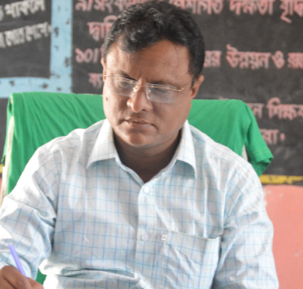
IDENTITY
LESSON
SUBJECT: ENGLISH
CLASS: Three
K.M.ABDUL BARI
Unit: 5
Lesson:4-6(A)
AMOIN GPS
SHERPUR,BOGURA
bari64515@gmail.com
TIME: 35 MIN

Slide 3
Good morning student.
How are you?
Stand up.
Sit down.

Slide 4
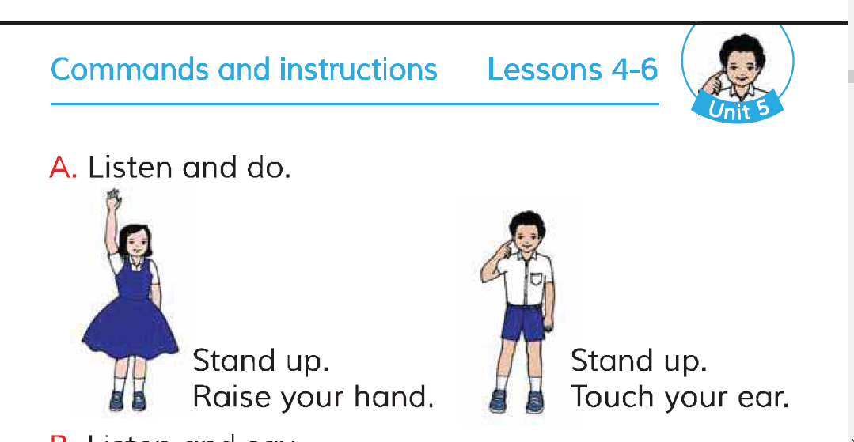
Lesson declaration.
Our today’s lesson…….
Page 11

Slide 5
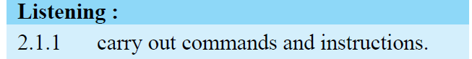
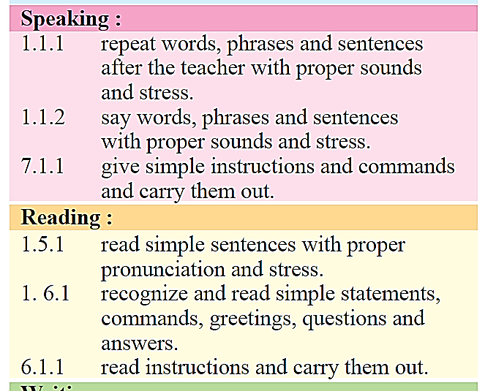
LEARNING OUTCOMES
Student will able to:

Slide 6

Let’s sings and do .

Slide 7
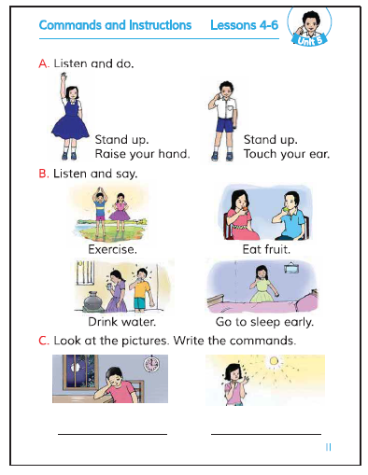
Open your book at page 11.
Look this picture carefully

Slide 8
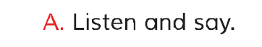

Slide 9
Listen attentively.
Now say with audio.

Slide 10
Listen and do with audio.

Slide 11
Chain drill.
Stand up.
Raise your hand.
Touch your ear.
One will say and others will act.

Slide 12


Evaluation
See this picture and say .

Slide 13
Listen and do.

Slide 14


Thanks for all.

