Slide 1
www
welcome

Slide 2
Identity
Teacher
Fahmida begum
Assistant teacher
Kakura fazil madrasah
Class
Class-ten
Sub-English
Unit-7
Lesson-4

Slide 3
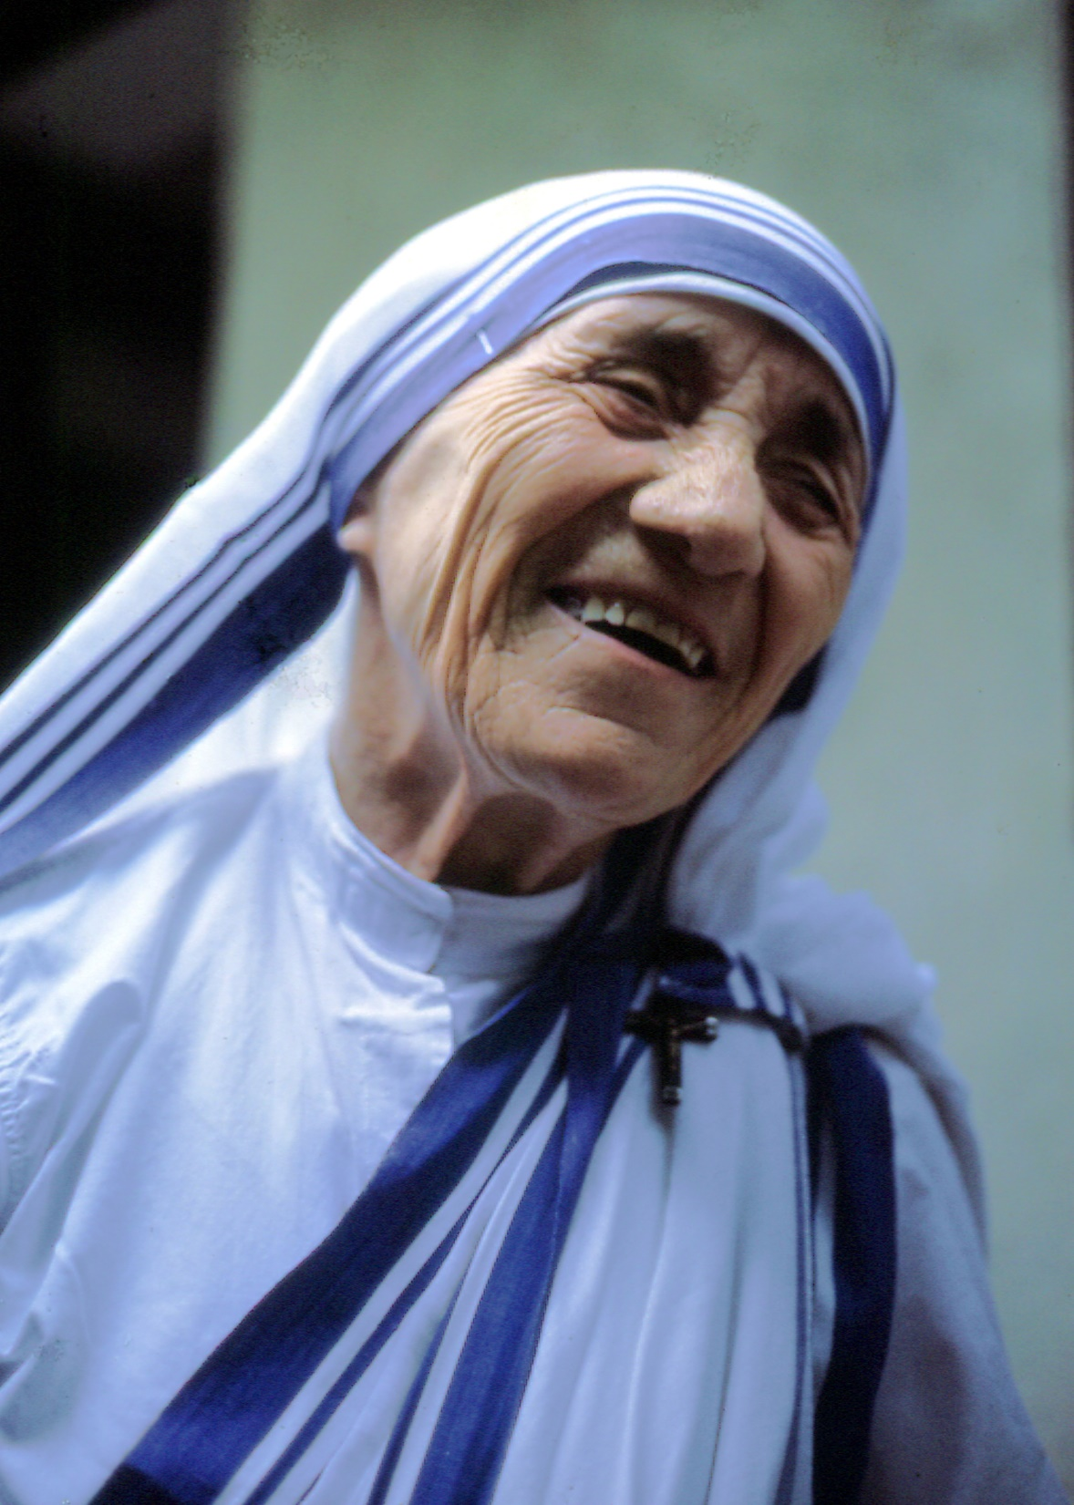

Slide 4
Look at the picture
1,how old is she ?
2, what Is she wearing ?

Slide 5
synonym
antonym
large
small
scattergat
gather

Slide 6
Read the text , anser the questions about it
1where was her fathers home ?

Slide 8
What was nirmol ridoy stand for ?

Slide 9
Home wark
1 what are the things that we have learnt from mother Teresa ?

Slide 10
Thankyou

