Slide 3
Identity
Mahfuja Khatun
Head Teacher
Sujanagor GPS
Pangsha, Rajbari.
Class: Five
Subject: English
Unit: 3 (Saikat’s family )
Lesson: H & I

Slide 4
Learning outcomes
Students will be able to---
Listening:
1.4.1 recognize and use intonation patterns for Yes/No and Wh questions.
Speaking:
1.1.1 say words, phrases and sentences with proper sounds and stress.
1.1.2 ask and answer Wh questions.
Reading:
1.6.1 recognize and read statements, commands, greetings, questions and answers.
5.1.4 read silently with understanding personal letters and other texts materials.

Slide 5
Talk about the picture
This is Saikat’s family

Slide 6
Today’s lesson is
Saikat’s family

Slide 7
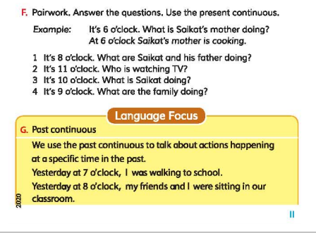
Review of previous lesson

Slide 8
Review of previous lesson
1. It’s 6 o’clock. What is Saikat’s mother doing?
Ans. It’s 6 o’clock Saikat’s mother is cooking.
2. It’s 8 o’clock. What is Saikat and his father doing?
Ans. It’s 8 o’clock. Saikat and his father watching TV.
3. What were you doing at 7 a.m today?
Ans. At 7 o’clock, I was walking to school.
4. What were you doing at 8 p.m yesterday evening?
Ans. Yesterday at 8 o’clock, my friends and I were sitting in our classroom.

Slide 9
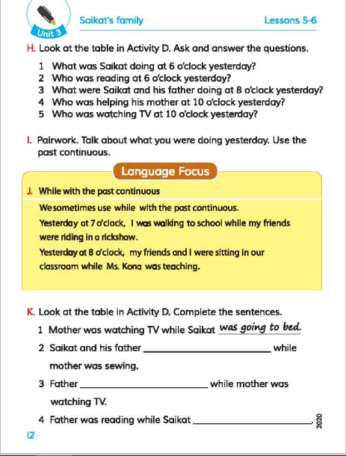
Open your English For Today book at page 12

Slide 10
Teachers loud reading

Slide 11
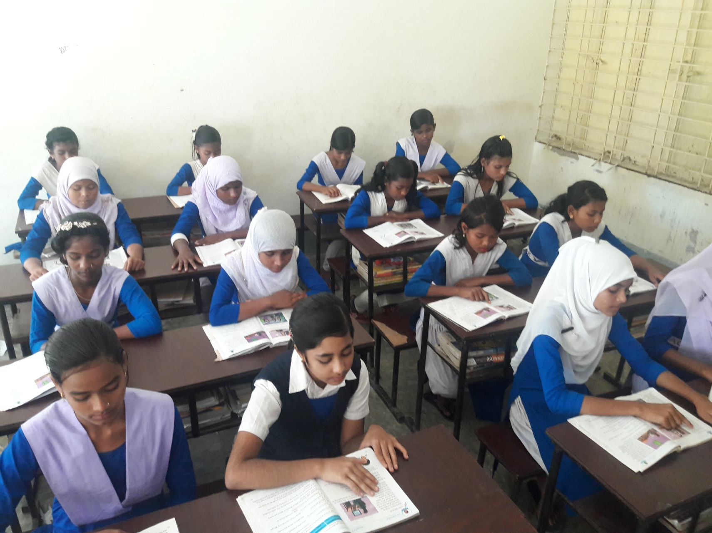
Students silent reading

Slide 12
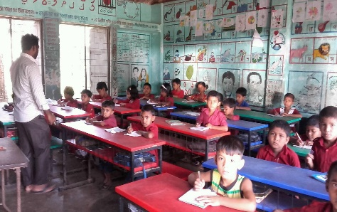
Collaboration by teacher to find answers from activity D.
D. | Name | 6 p.m | 8 p.m | 9 p.m | 10 p.m | 11 p.m
 | Saikat | study | watch TV | Eat dinner | Help mum | Go to bed
 | Mother | cook | sew | Eat dinner | Wash dishes | watch TV
 | Father | read | watch TV | Eat dinner | Help his wife | write
1. What was Saikat doing at 6 o’clock yesterday?
Ans. Yesterday at 6 o’clock Saikat was studying.
2. Who was reading at 6 o’clock yesterday?
Ans. Yesterday at 6 o’clock Saikat was reading.

Slide 13
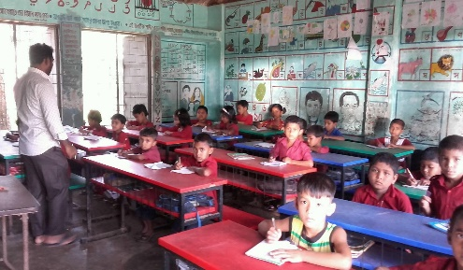
Collaboration by teacher to find answers from activity D.
D. | Name | 6 p.m | 8 p.m | 9 p.m | 10 p.m | 11 p.m
 | Saikat | study | watch TV | Eat dinner | Help mum | Go to bed
 | Mother | cook | sew | Eat dinner | Wash dishes | watch TV
 | Father | read | watch TV | Eat dinner | Help his wife | write
3. What were Saikat and his father doing at 8 o’clock yesterday?
Ans. Yesterday at 8 o’clock Saikat and his father were watching TV.

Slide 14
Collaboration by teacher to find answers from activity D.
D. | Name | 6 p.m | 8 p.m | 9 p.m | 10 p.m | 11 p.m
 | Saikat | study | watch TV | Eat dinner | Help mum | Go to bed
 | Mother | cook | sew | Eat dinner | Wash dishes | watch TV
 | Father | read | watch TV | Eat dinner | Help his wife | write
4. Who was helping his mother at 10 o’clock yesterday?
Ans. Yesterday at 10 o’clock Saikat was helping his mother.
5. Who was watching TV at 10 o’clock yesterday?
Ans. Yesterday at 10 o’clock no one was watching TV .

Slide 15
Group Work
Using past continuous tense make five sentences and answers them.

Slide 16
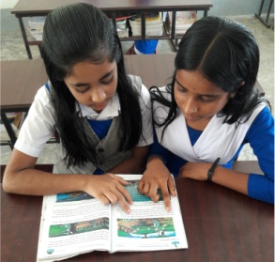
Pair Work
Talk about what you were doing yesterday. Use the past continuous.

Slide 17
Home Work
Make five Wh questions in past continuous tense and answer them.

Slide 18
Thank you

