Slide 2
Identity
Mahfuja Khatun
Head Teacher
Sujanagor GPS
Pangsha, Rajbari.
Class: Five
Subject: English
Unit: 3 (Saikat’s family )
Lesson: J & K

Slide 3
Learning outcomes
Students will be able to---
Listening:
1.3.1 recognize which words in a sentence are stressed.
Speaking:
1.1.1 say words, phrases and sentences with proper sounds and stress.
1.1.2 ask and answer Wh questions.
Reading:
5.1.4 read silently with understanding personal letters and other texts materials.
Writing:
8.1.1 make sentences using words and phrases given in the text book.

Slide 4
Talk about the picture
This is Saikat’s family

Slide 5
Today’s lesson is
Saikat’s family

Slide 6
Review of previous lesson

Slide 7
Open your English For Today book at page 12

Slide 8
Teachers loud reading

Slide 9
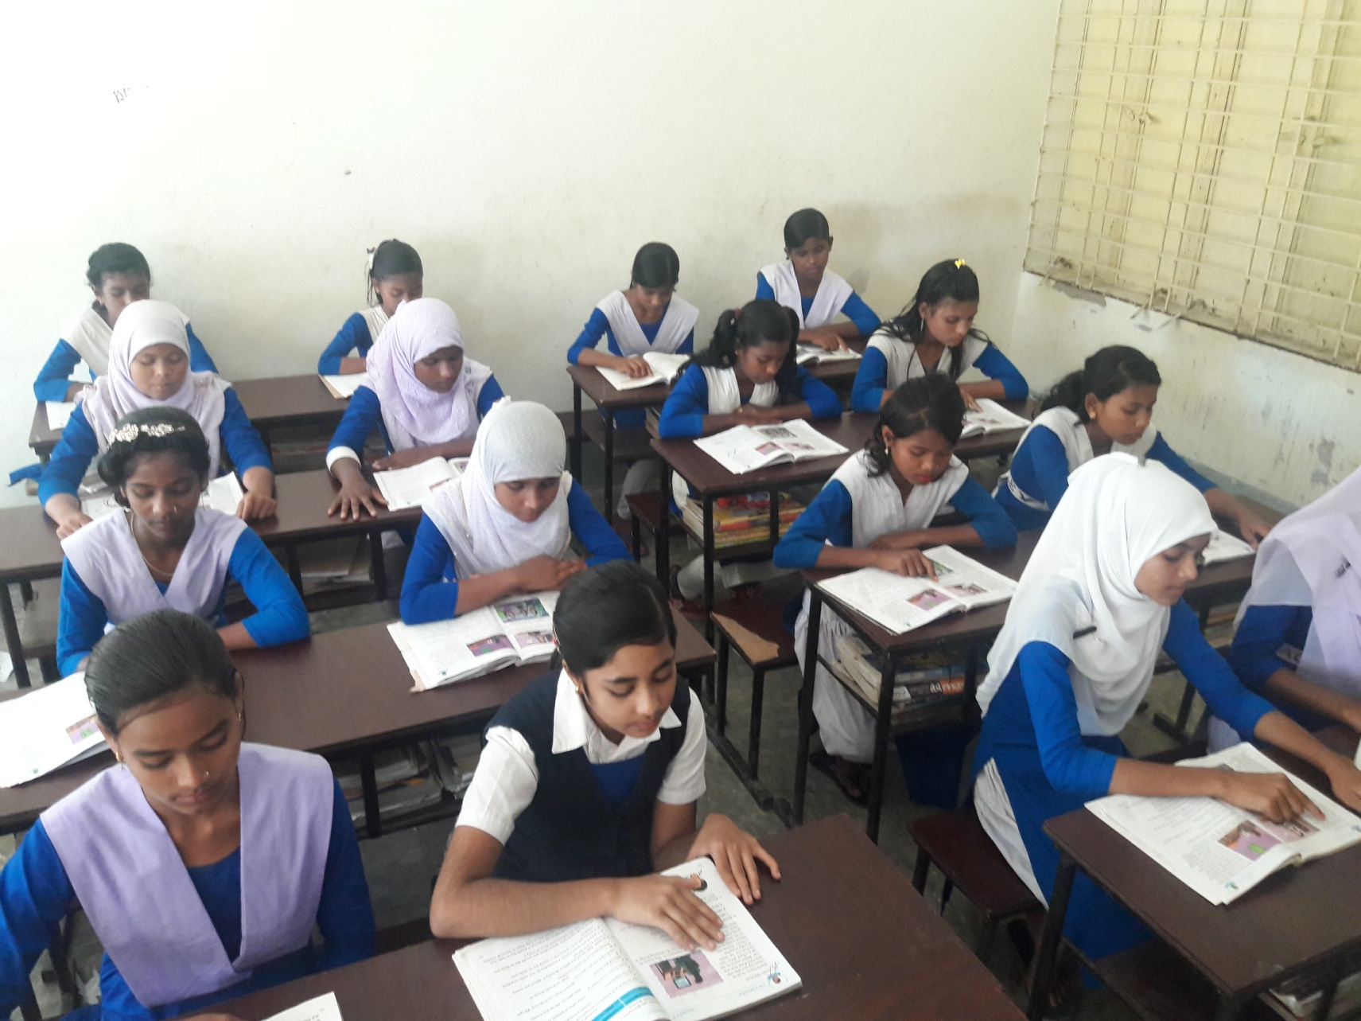
Students silent reading

Slide 10
Language focus
While with the past continuous
We sometimes use while with the past continuous
Yesterday at 7 o’clock I was walking to school while my friends were riding in a rickshaw.
Yesterday at 8 o’clock, my friend and I were sitting in our classroom while Miss Khan was teaching.

Slide 11
Use of while
While is used to indicate that two things are happening at the same time.

Slide 12
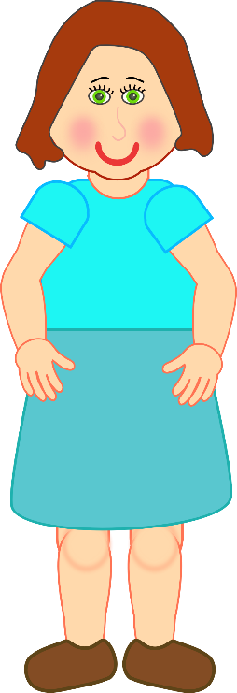
Pair work
Try to say the sentences by looking at the pictures.
Mita
Sabuj
At the same time
Mita was standing while Sabuj was running.

Slide 13
Pair work
Try to say the sentences by looking at the pictures.
Sabuj
Sima
At the same time
Sabuj was running while Sima was reading .

Slide 14
Pair work
Try to say the sentences by looking at the pictures.
Mita
Sima
At the same time
Mita was standing while Sima was reading .

Slide 15
Group work
K. Look at the table in activity D. Complete the sentences.
D. | Name | 6 p.m | 8 p.m | 9 p.m | 10 p.m | 11 p.m
 | Saikat | study | watch TV | Eat dinner | Help mum | Go to bed
 | Mother | cook | sew | Eat dinner | Wash dishes | watch TV
 | Father | read | watch TV | Eat dinner | Help his wife | write
Mother was waching TV while Saikat ……….......................
Saikat and his father…. …………..…………..while mother was sewing .
was going to bed.
were watching TV

Slide 16
Group work
K. Look at the table in activity D. Complete the sentences.
D. | Name | 6 p.m | 8 p.m | 9 p.m | 10 p.m | 11 p.m
 | Saikat | study | watch TV | Eat dinner | Help mum | Go to bed
 | Mother | cook | sew | Eat dinner | Wash dishes | watch TV
 | Father | read | watch TV | Eat dinner | Help his wife | write
3. Father ………................ while mother was waching TV.
4. Father was reading while Saikat ………………….
was writing
was studying.

Slide 17
Home Work
Make five sentences using while with the past continuous.

Slide 18
Thank you

