Slide 1
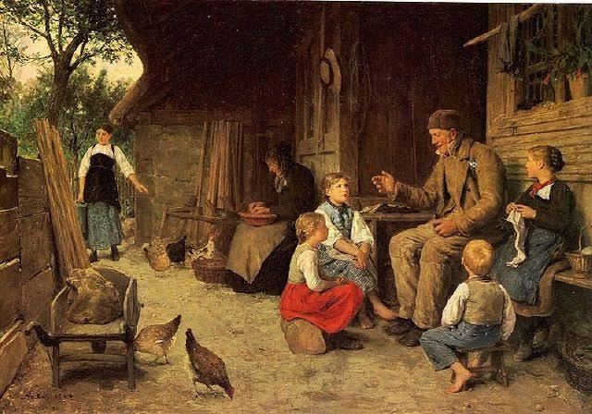
GOOD MORNING

Slide 2
Identity
Md shafiqul islam
Assistant Teacher(English)
Sonatan darussannat dakhil madrasha, kawnia, Rangpur.
Mail:shafiqulislam42347@gmail.com
English 1st Paper
Class: Seven
Unit: Six
Lesson: 8 & 9
Date: 11/02/2021

Slide 3
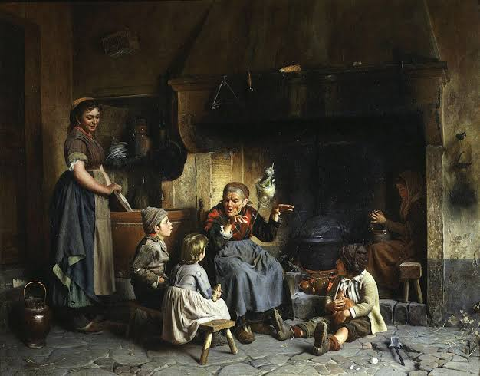
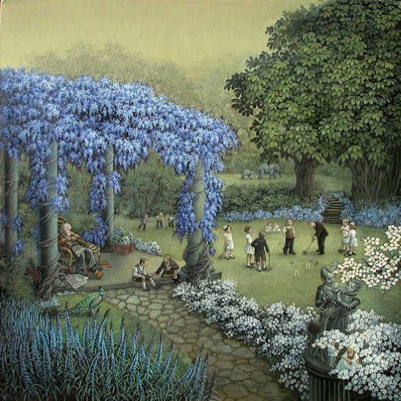
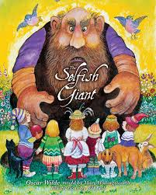
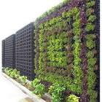
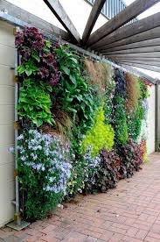
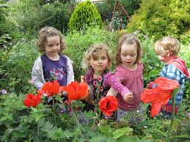
LOOK AT THE PICTURE

Slide 4
Todays Topic is-
The Selfish Giant

Slide 5
Learning Outcome
By the end of the lesson, the students will be able to-
Lesson information.
Word meaning.
Choose the correct answer from the alternative.
Answer the following question.
Fill in each gaps with suitable words from the text.

Slide 6
Word Meaning
Selfish --------------স্বার্থপর
Giant ----------------দানব,দৈত্য
Trespasser ---------অনধিকার প্রবেশকারী
Refused -------------অস্বীকৃতি জানানো
Distant --------------দূরবর্তী
Cry ------------------চিৎকার করা
Allow -----------------অনুমতি দেয়া
Castle -----------------রাজপ্রাসাদ
Crowded -------------জনাকীর্ণ
Blossom --------------ফুল ফোটা
Understand ---------বুঝতে পারা
Lifeless ----------------প্রাণহীন
Hope ------------------আশা করা

Slide 7
Describing Lesson
Shima’s grandfather was telling the story of the Selfish Giant in the family gathering. Grandma refused to go bed.

Slide 8
It was a large lovely garden with soft green grass. Here and there over the grass stood beautiful flowers. Also there were fruit trees around the garden.

Slide 9
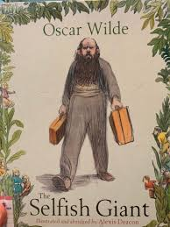
One day the Giant came back. He went to see his friend in a distant land and stayed with him for seven years.

Slide 10
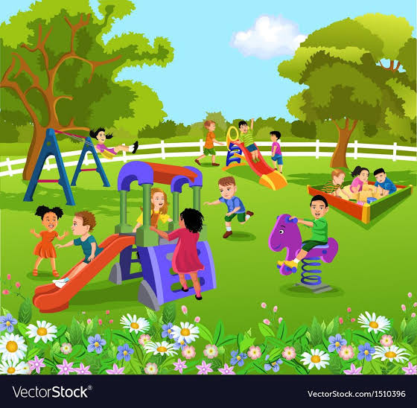
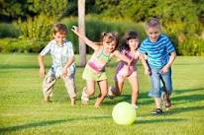
When he arrived, he saw children playing in his garden.

Slide 11
‘’My own garden is my own garden, ‘’ said the Giant. ‘’ Anyone can understand that . And I will allow nobody else to play in it.’’

Slide 12
So he built high wall all around the garden and put up a notice:

Slide 13
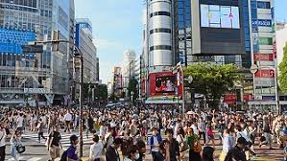
The children had now nowhere to play. There were no garden around and the roads were busy and crowded.

Slide 14
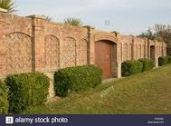
After madrasha they used to go round the high wall and talk about the beautiful garden inside. ‘’ How we were there! ‘’ they said to each other.

Slide 15
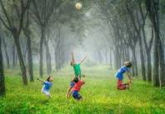
Then came the spring. And all over the country there were flowers and there were birds. Only in the garden of the Giant it was still winter.

Slide 16
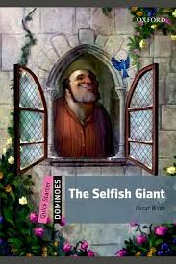
‘’ I cannot understand why the spring is so late in coming , ’’ said the Giant. He was sitting at the window of his castle and looking out at his cold, dry and lifeless garden. I hope there will be a change in the weather.’’

Slide 17
Silent Reading

Slide 18
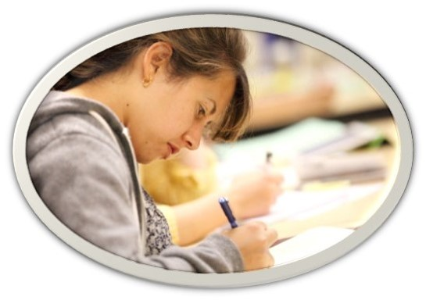
Individual Work
How do you know that the giant is selfish?

Slide 19
Group Work
Choose the correct answer to each question from the alternative:
1. Who was telling the story ?
(a) Mina`s grandfather (b) Rina`s grandfather (c ) Shima`s grandfather
(d) salma’s grandfather
2. Every afternoon the children came back from madrasha and used to go and ------------.
(a) madrasha field (b) school field (c ) collage field (d) giant garden
3. There were only snow and frost and-----------------------.
(a) east wind (b) west wind (c ) north wind (d) south wind
4. Castle means---------------------------.
(a) mansion (b) citadel (c ) fortrees (d) all the options
5. The Giant hoped to find-----------------------------.
(a) a change of friend (b) a change of weather (c ) a change of wealth (d) a change of fortune.

Slide 20
Evaluation
Answer the following question in the text::
1. How were the road?
2. Who say’s my own garden is my own garden?
3. When did the children use to go the garden?
4. What was the condition of the country during the spring?
5. What was the reaction of the Giant in such condition?

Slide 21
Home Work
Read the following text and fill gaps with appropriate words:
From Sunday to Thursday I go to the club at (a)-------------- in the morning. It’s the time for our (b)----------------practice. So I have to get up by (c )-----------------. Usually on Monday afternoon, the team doctor sees all the(d)-----------------------. On Tuesday our coach shows us videos of(e )----------------matches.

Slide 22
THANK YOU ALL STUDENT

